Slide 1
Strategy Implementation: Workforce Utilization and Employment Practices

Slide 2
EFFICIENT UTILIZATION OF HUMAN RESOURCES
Cross-Training
Flexibility in Assigning Work
Work teams
operating on a nonunion basis.

Slide 3
Chaparral, which was established in 1973 as a start-up operation, has great work-force flexibility because it has only two job classifications in its production operations: one dealing with production activities and the other with maintenance. It has obtained flexibility in workforce utilization through extensive cross-training and by operating on a nonunion basis. By paying skill-based or knowledge-based pay, Chaparral has motivated its employees to master a broad range of skills, which enable them to perform wide-ranging activities. Even non-production employees are fully utilized. For example, security guards perform computer data-entry functions, serve as paramedics, and perform safety functions such as checking fire extinguishers. In addition to efficient utilization of human resources, Chaparral has achieved its position as one of the world’s most efficient producers of steel through heavy emphasis on technological innovation and computerization.

Slide 4
Frost, Inc., a small manufacturer in Grand Rapids, Michigan. Frost wanted to diversify its product line and decided that it needed greater flexibility in both its production facilities and its employees and managers. At the time it had machinery and employees who could perform only very limited numbers of functions. Frost replaced outdated machining equipment with robots and numerically controlled machine tools, introduced an automated inventory control system, and automated its office functions. This increase the level of sales per employee from $80,000 to $200,000

Slide 5
Requirements for Effective Teams
there must be a compelling purpose that is served by real teamwork
Effective teams also have members whose skills are complementary
personality characteristics
effective teams share feedback with each other
Teams require substantial training
compatible organizational systems also are required for team effectiveness. Compensation, other rewards, and performance appraisal systems must be adapted to teams with the move from individual to team contributions

Slide 6
Teams go through different phases for best performances: Forming Phase – Deciding which team members will perform individual tasks. Storming Phase – Encountering conflict with each other and working through it. Norming Phase – Establishment of understanding of how things should operate and what conduct is acceptable behavior Performing phase – Team has worked through problems and developed team skills. Managers also need to provide frequent feedback to teams about their performance.

Slide 7
DEALING WITH MPLOYEE SHORTAGES The combination of demographic influences and a robust economy can produce severe labor shortages in many occupations. Upturns and downturns are normal features of the economy, and individual employers may experience skill shortages of qualified managerial and professional personnel at a particular point in time.

Slide 8
Strategic Recruiting
Internet to recruit
More emphasis on higher selectivity and salary
Selection criteria – High skilled professionals or corporate performance
Hiring entry level positions and filling managers through internal recruiting. Special recruiting for minorities and females

Slide 9
Flexible Retirement as a Source of Labor
With an aging population, it seems likely that labor shortages may be partially addressed by extending the number of years that employees work before retirement.
Retraining

Slide 10
Managing Vendors of Outsourced Functions
When such functions are outsourced, the human resource executive or manager’s role changes from super-vision of employees who perform these functions to managers of a vendor relationship. The skills required for managing such relationships are different than those of direct supervision and involve the negotiation of contracts, sensitivity to the more strategic issues such as the importance of avoiding dependency on one vendor, and the need to maintain service levels through a contractual relationship.

Slide 11
Reliability and Validity for selection procedure
A number of requirements must be met before firms can make good selection decisions
Reliability means that the procedure, be it a test or an interview, needs to produce approximately the same result when the procedure is repeated.
Validity means that the procedure predicts what it is supposed to predict.

Slide 12
if a test is used, an applicant’s score from one administration of the test should correlate well with his or her score on the next administration of the test. This form of reliability is called test–retest reliability
Interviews are reliable when there is agreement among the interviewers about an applicant, which means that their ratings are correlated. This form of reliability is called interrater reliability.

Slide 13
predictive validity. With predictive validation, potential selection procedures, such as batteries of tests, are given to job applicants. However, during the validation procedure, selection is based on procedures other than the tests. After sufficient time for those hired to have learned their jobs, their job performance is then correlated with test scores. Tests having a significant and substantial statistical relationship with job performance are said to have predictive validity.

Slide 14
concurrent validity, which has the practical advantage of not requiring a time lag before tests can be used. With concurrent validity, tests are given to current employees and their test scores are compared with their job performance.
content validity is established by having a panel of subject matter experts review the test items in order to determine that the test covers the domain of the subject.

Slide 15
Job Analysis
Job analysis provides the foundation for good selection by identifying the knowledge, skills, abilities, and other requirements (KSAs) necessary to perform the job.
There are two approaches for collecting information for job analysis: 1)interviews of job incumbents and their supervisors 2)task inventory questionnaires.

Slide 16
Interviews
Interviews are a universal feature of selection systems. Recent research has shown that interviews can have substantial validity, particularly when they have more structure and are conducted appropriately

Slide 17
Behavioral Interviews
in a behavioral interview, a candidate might be asked to describe how he or she dealt with a particular situation in the past. For example, an applicant might be asked to describe how he or she dealt with an employer who made a serious mistake. When interviewers ask applicants about past experiences, more predictive information can be obtained than through questions couched in hypothetical situations

Slide 18
Testing
Some of the more common types of tests used for selection include cognitive or mental ability tests, personality tests, work sample or performance tests, and integrity tests.

Slide 19
Cognitive ability tests are commonly used to assess an applicant’s capability to perform a job. Furthermore, they often have fairly high predictive ability.
personality tests also are commonly used for selection purposes. Researchers have established that the “big five” personality dimensions
The big five personality dimensions are extroversion, agreeableness, conscientiousness, emotional stability, and openness to experience.

Slide 20
paper-and-pencil integrity tests have been found to be useful in predicting theft and other undesirable behavior, even though applicants may attempt to fake their response
Performance or work sample tests require job applicants to perform some of the actual tasks required for the job

Slide 21
Assessment Centers
Assessment centers are intensive selection procedures that may last one to two days, in which multiple assessors observe the abilities of applicants in a wide range of settings.
Assessment centers combine several traditional selection procedures, such as interviews and tests, with procedures that simulate managerial work in a job setting.

Slide 22
For example, in-basket exercises are an almost universal feature of assessment centers. In-basket exercises ask applicants to prioritize and describe the actions they would take to deal with the items that would be typically encountered in a manager’s in-basket. Such items might include memos, phone messages, requests from employees, and short internal reports

Slide 23
DEALING WITH EMPLOYEE SURPLUSES
There are several methods by which companies may reduce the likelihood that they will have to lay off employees. These include both short-range and long-range approaches.

Slide 24
Redeployment and Retraining
With the increased rate of technological change and potential for skill obsolescence, retraining may become more important. As a result, many companies provide retraining for managers whose skills have become obsolete.
IBM is an example of a company that provided extensive retraining for employees to be redeployed within the company. However, most companies do not provide retraining for the employees they lay off.

Slide 25
Early Retirement
In dealing with an excess of employees, companies frequently offer early retirement incentives in which employees currently ineligible for retirement receive additional years’ credit and a bonus payment that enhances pension benefits. Major concerns with this practice are the effects on the company’s pool of talent and the impact on early retirees.

Slide 26
Retreat from Employment Security Policies
False hope about employment security needs to be abolished. Layoffs and downsizing is a natural part of organizational structures now days.

Slide 27
Downsizing and Layoffs
Before conducting layoffs, there should be a careful analysis of their effects in the long run, as well as in the short run. For example, if a company conducts layoffs in response to short- term losses, it may find that its long-term survivability is endangered. A short-term problem may only be symptomatic of a larger problem that is not addressed by layoffs, such as lack of adaptability.
in conducting layoffs, companies must be careful not to deplete their knowledge base such that their distinctive competencies are lost

Slide 28
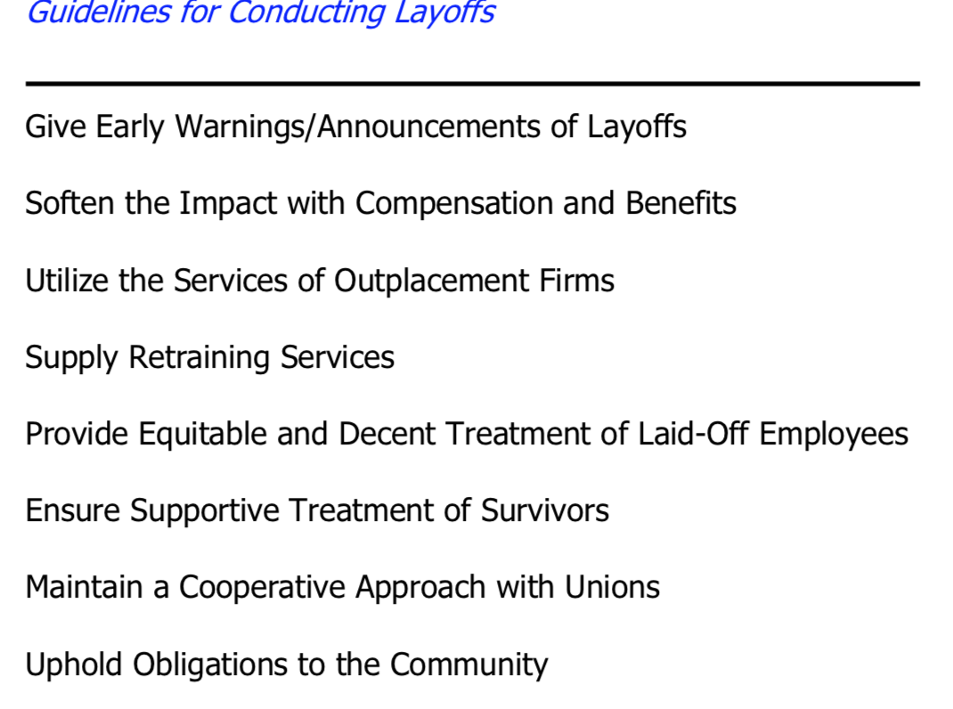

Slide 29
Termination Strategies
As such, terminations may be critical for the implementation of a shift in the strategic direction of an organization. Terminations of managers have been necessary in organizational evolutions in which managers, who can work effectively within an informal structure, cannot adapt to the more formal structure required with growth in size.

Slide 30
Companies should develop approaches toward termination that assure employees that termination will be for just cause and that the performance appraisal, coaching, and counseling systems will have warned them that their performance must improve or that certain behaviors are unacceptable.

Slide 31
Unfortunately, even with an appropriate balance between employment security and the maintenance of performance and behavioral standards, the implementation of such balanced termination strategies often leaves much to be desired.

