Slide 1
Stress Management
Lecture 1

Slide 2
What is stress
Stress has been defined in different ways over the years. Originally, it was conceived of as pressure from the environment, then as strain within the person. The generally accepted definition today is one of interaction between the situation and the individual. It is the psychological and physical state that results when the resources of the individual are not sufficient to cope with the demands and pressures of the situation. Thus, stress is more likely in some situations than others and in some individuals than others. Stress can undermine the achievement of goals, both for individuals and for organisations

Slide 3
Good people management is the starting point for effective prevention of stress. We believe that people work more effectively within a participative management style and are better motivated when work satisfies economic, social and psychological needs. Employers that pay attention to job design and work organisation and equip all managers with people management skills will better support employee engagement and well-being.

Slide 4
Organizations should focus on proactive reduction of common stressors and increasing staff resilience, as well as on helping employees experiencing stress. Where possible, reasonable adjustments should be made to help people stay in work, or make an effective return to work after a period of absence, to make a positive contribution to the organization.

Slide 5
Stress in an employee’s personal life, for example due to financial worries, loss of a loved one or a change in their circumstances, can of course have an effect on performance at work. Many workplace initiatives can help people to manage stress, whatever the cause. Ultimately, building employee resilience and supporting staff experiencing stress can help retain a talented person and enable them to perform at their best in the long-term.

Slide 6
According to the latest Absence management survey, the main causes of stress at work include: excessive workload, non-work-related relationship or family issues, lack of managerial support and management style (for example a bullying or poorly trained line manager), poor working relationships or a large amount of organisation change or restructuring.

Slide 7
Types of stressors
External –
Physical environment ( noise, bright lights, heat, confined spaces)
Social Interaction (Rudeness, Bossiness, Aggressiveness, bullying)
Organizational (rules, regulations, Deadlines)
Major life events ( Birth, death, martial status change, job, promotion)
Daily hassles ( commuting, misplaced keys, mechanical breakdowns)

Slide 8
Internal
Lifestyle choices ( caffeine, lack of sleep, overloaded schedule)
Negative self talk ( pessimistic thinking, self criticism, over analysisng)
Mind traps (Unrealistic expectation, taking things personally, all or nothing thinking, exaggeration, rigid thinking)
Personality traits (perfectionists, workaholics)

Slide 9
Types of stress
Negative stress
Positive stress

Slide 10
Negative Stress
It is a contributory Factor in minor conditions such as headches, digestive problems, skin complaints, insomnia and ulcers.
Excessive prolonged and unrelieved stress can have a harmfull effect on mental physical and spiritual health.

Slide 11
Positive stress
Stress can also have a positive effect spurring motivation and awareness. Providing the stimulation to cope with the challenging situations.
Stress also provides the sense of urgency and alertness needed for survival when confronting threating situations.

Slide 12
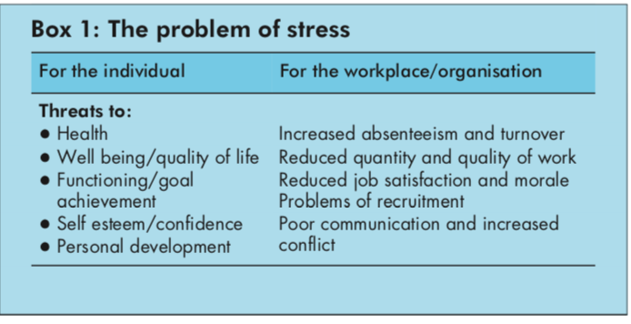

Slide 13
The individual
Everything is different with unique perception of and reaction to events. There is no single level of stress that is optimal for all people Some are more sensitive owing to experiences in childhood, the influence of teachers. Parents and religions etc.

Slide 14
Most of the stress we experience is self generated/ How we perceive life - whether an event makes us feel threatened or stimulated. Encouraged or discouraged, happy or sad depends to a large extent on how we perceive ourselves.

Slide 15
Self generated stress is something of a paradox, because so many people think of external causes when they are upset.
Recognizing that we create most of our own upsets is an important first step towards coping with them.

Slide 16
The Stress Response
In 1930’s Dr Hans Selye and Dr. Walter Canon came up with the Flight or Fight Response.
The Endocrine system –
Stress response controlled by the endocrine system.
Demands on the physical or mental systems of the body results in hormone secretion. (adrenaline. Testosterone)

Slide 17
Endocrine system responses
Increased pupil dilation
Perspiration
Increased heart rate and blood pressure
Rapid breathing
Muscle tenseness
Increased mental alertness

Slide 18
General Adaptation Syndrom
Alarm Response
Adaptation
Exhaustion

Slide 19
Alarm Responses
This is the fight or flight response that prepares the body for immediate action
Alarm reaction”. When confronted with a threat to our safety, our first response is physio-logical arousal: our muscles tense and breathing and heart rate become more rapid. This serves us well when the threat is the proverbial bull in the field rushing towards us. We either fight or flee. Present day threats tend to be more psychological—for example, unjustified verbal attack by a superior at work. It is usually not socially acceptable to act by “fight or flight”, and an alternative means of expressing the resultant emotional and physical energy is required. This falls in the arena of assertive communication.

Slide 20
Adaptation Phase –
If the sources persists. The body prepares for long term protection, secreting hormones to increase blood sugar levels. This phase is common and not necessarily harmful, but must include periods of relaxation and rest to counterbalance the stress response. Fatigue, concentration lapses, irritability and lethargy results as the stress turns negative.
For example, when we first spend time in a house near a railway line, our response to trains hurtling past is to be startled, as described above. Over time, our response dwindles. If this process did not function, we would eventually collapse from physical wear and tear, and mental exhaustion.

Slide 21
Exhaustion
In chronic stress situations, sufferers enter the exhaustion phase: emotional, physical and mental resources suffer heavily, the body experiences ‘adernal exhaustion’ leading to decreased stress tolerance. Progressive mental and physical exhaustion, illness and collapse.

Slide 22
Stress is experienced when either of these mechanisms are not functioning properly or when we find it difficult to switch appropriately from one to another. This forms the basis of individual approaches to stress management

Slide 23
Signs of stress The first signs that indicate employees may be suffering from excessive pressure or stress are changes in behaviour or performance. The kinds of change that may occur are listed below.
Work performance
declining/inconsistent performance
uncharacteristic errors
loss of control over work
loss of motivation/commitment
indecision
lapses in memory
increased time at work
lack of holiday planning/usage

Slide 24
Regression
crying
arguments
undue sensitivity
irritability/moodiness
over-reaction to problems
personality clashes
sulking
immature behaviour

Slide 25
Withdrawal
arriving late to work
leaving early
extended lunches
absenteeism
resigned attitude
reduced social contact
elusiness/evasiveness

Slide 26
Aggressive behaviour
malicious gossip
criticism of others
vandalism
shouting
bullying or harassment
poor employee relations
temper outbursts

Slide 27
Other behaviours
out-of-character behaviour
difficulty relaxing
increased consumption of alcohol
increased smoking
lack of interest in appearance/hygiene
accidents at home or work
reckless driving
unnecessary risk-taking

Slide 28
Physical signs
nervous stumbling speech
sweating
tiredness/lethargy
upset stomach/flatulence
tension headaches
hand tremor
rapid weight gain or loss
constantly feeling cold

Slide 29
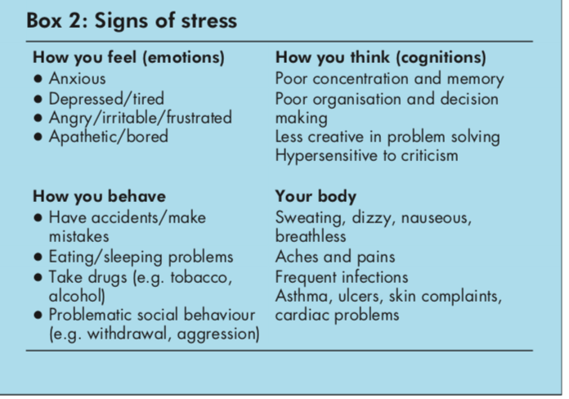

Slide 30
Cost of stress -
80% of all modern diseases have their origins in stress.
In the UK, 40 Million working days per year are lost directly from stress- related illness.
Costs in absenteeism to british industry is estimated at 1.5B pounds per year.

Slide 31
Summary
What is stress
Types of stress
Individuals
Stress origins and the body system
Adaptation system
Symptoms
Costs of stress

