Slide 1
Stress Management
Lecture 2

Slide 2
Work Stress
A dynamic condition in which an individual is confronted with an opportunity, constraint, or demand related to what he or she desires and for which the outcome is perceived to be both uncertain and important

Slide 3
Types of work stress
Challenge Stressor
Stress associated with workload, pressure to complete tasks, and time urgency.
Hindrance Stressors
Stress that keeps you from reaching your goals, such as red tape
Cause greater harm than challenge stressors

Slide 4
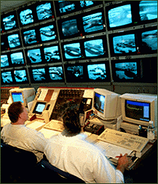
Role-related stressors
Role conflict
interrole conflict
intrarole conflict
person-role conflict
Role ambiguity
uncertain duties, authority
Workload
too much/too little work
Task control
machine pacing
monitoring equipment
no work schedule control
© Photodisc. With permission.

Slide 5
Interpersonal stressors
Conflict with others
Increased emphasis on team work
Sexual harassment
Workplace violence
Workplace bullying

Slide 6
Interpersonal stressor: violence
High risk of workplace violence in the US, but higher in several other countries (eg France, Argentina, Canada)
Workplace violence stress occurs from
trauma of experiencing violence
observing violence to others at work
perceptions of risk of violence at work

Slide 7
Interpersonal stressor: bullying
Offensive, intimidating or humiliating behaviour that degrades, ridicules or insults another person at work
Workplace bullies tend to be people with higher authority
Workplace bullying is reduced through
code of conduct
careful hiring
360 degree feedback
conflict resolution system

Slide 8
Stress and occupations
Accountant
Artist
Auto mechanic
Forester
Hospital manager
Physician (GP)
Psychologist
School principal
Police officer
Tel operator
Prime Minister
Waiter/waitress
Low-stress
occupations
Medium-stress
occupations
High-stress
occupations

Slide 9
Type A / Type B behaviour pattern
Type A behaviour pattern
Type B behaviour pattern
Talks rapidly
Is devoted to work
Is highly competitive
Struggles to perform several tasks
Has a strong sense of time urgency
Is impatient with idleness
Loses temper easily
Interrupts others
Handles details patiently
Is less competitive with others
Contemplates issues carefully
Has a low concern about time limitations
Doesn't feel guilty about relaxing
Has a relaxed approach to life
Works at a steady pace

Slide 10
INDIVIDUAL DIFFERENCES
As explained previously, individuals differ in their risk of experiencing stress and in their vulnerability to the adverse effects of stress. Individuals are more likely to experience stress if they lack material resources (for example, financial security) and psychological resources (for example, coping skills, self esteem), and are more likely to be harmed by this stress if they tend to react emotionally to situations and are highly competitive and pressured (type A behaviour)

Slide 11
The association between pressures and well being and functioning can be thought of as an inverted U, with well being and functioning being low when pressures are either high or very low (for example, in circumstances of unemployment). Different people demonstrate different shapes of this inverted U, showing their different thresholds for responses to stress. A successful strategy for preventing stress within the workplace will ensure that the job fits the person, rather than trying to make people fit jobs that they are not well suited to.

Slide 12
Individual differences in stress
Perceive the situation differently
self-efficacy
locus of control
Different threshold levels of resistance to stressor
store of energy
Use different stress-coping strategies

Slide 13
INTERACTIONS BETWEEN WORK AND HOME STRESS
Increasingly, the demands on the individual in the workplace reach out into the homes and social lives of employees. Long, uncertain or unsocial hours, working away from home, taking work home, high levels of responsibility, job insecurity, and job relocation all may adversely affect family responsibilities and leisure activities. This is likely to undermine a good and relax- ing quality of life outside work, which is an important buffer against the stress caused by work.

Slide 14
In addition, domestic pressures such as childcare responsibilities, financial worries, bereavement, and housing problems may affect a person’s robustness at work. Thus, a vicious cycle is set up in which the stress caused in either area of one’s life, work or home, spills over and makes coping with the other more difficult.

Slide 15
Women are especially likely to experience these sources of stress,7 since they still carry more of the burden of childcare and domestic responsibilities than men. In addition, women are concentrated in lower paid, lower status jobs, may often work shifts in order to accommodate domestic responsibili- ties, and may suffer discrimination and harassment

Slide 16
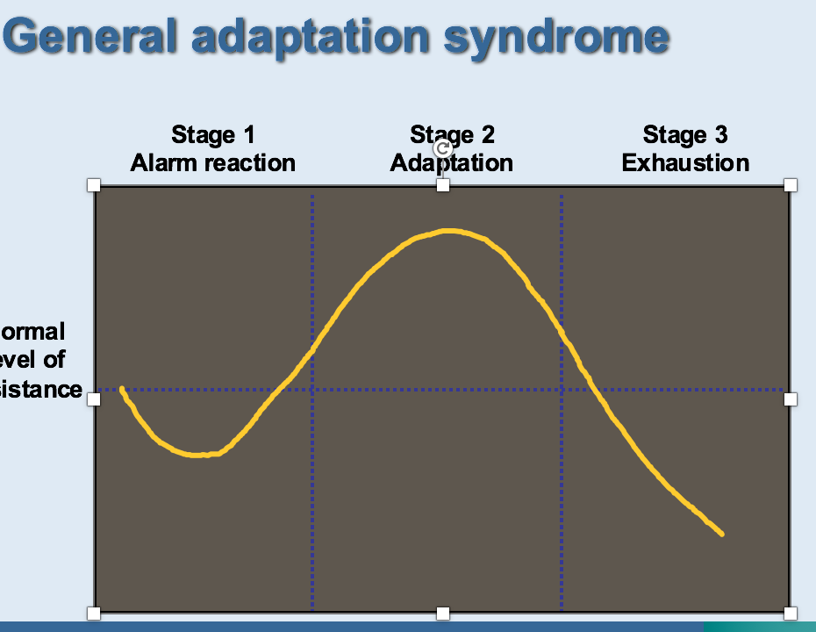

Slide 18
There are two other sources of stress, or buffers against stress: relationships at work, and the organizational culture. Managers who are critical, demanding, unsupportive or bullying create stress, whereas a positive social dimension of work and good team working reduces it.

Slide 19
An organizational culture of unpaid overtime or “presentisms” causes stress. On the other hand, a culture of involving people in decisions, keeping them informed about what is happening in the organization, and providing good amenities and recreation facilities reduce stress. Organizational change, especially when consultation has been inadequate, is a huge source of stress. Such changes include mergers, relocation, restructuring or “downsizing”, individual contracts, and redundancies within the organization

Slide 20
Empirical review
A systematic review of the evidence for work factors associated with psychological ill health and associated absenteeism3 (Michie and Williams 2001, unpublished data) found the key factors to be: long hours worked, work overload and pressure
the effects of these on personal lives
lack of control over work and lack of participation in
decision making
poor social support
unclear management and work role and poor management style.

Slide 24
Explanatory model - Karasek’s model
Three of these factors form part of the influential control- demand model of work related strain. According to this model, work related strain and risks to health are most likely to arise when high job demands are coupled with low decision latitude (that is, low personal control over work and limited opportunities to develop skills).

Slide 25
On the other hand, high job demands with high decision latitude gives the possibility of motivation to learn, active learning, and a sense of accomplishment. Of the two, decision latitude has been found to be more important than demand

