Slide 1
Creating and maintaining High-Performance Organization

Slide 2
Performance Management
Performance management is the process through which managers ensure that employees’ activities and outputs contribute to the organization’s goals.
This process requires knowing what activities and outputs are desired, observing whether they occur, and providing feedback to help employees meet expectations
In the course of providing feedback, managers and employees may identify performance problems and establish ways to resolve those problems
Notes:
Introduction
Like other companies, Microsoft wants to identify employees who are doing a great job and reward them generously. It also wants to help employees recognize when they need to improve. For several years, Microsoft did this with a process in which managers rated their employees every year on a scale from 1 to 5. Employ- ees who got the top rating (a 1 on the scale) were in line for extra pay and company stock; employees who received a 5 knew they had to shape up if they wanted a career with the company. Furthermore, the human resources department estab- lished a curve. Managers were to place most of their employees near the middle of the range, where pay was set to match the local labor market. They also were expected to single out a few employees to rank at the top and bottom of the curve.
Recently, Microsoft’s HR department reconsidered whether this process ad- equately supported the company’s strategic commitment to teamwork and knowl- edge sharing. In interviews with managers and employees, HR managers found that people were in competition with one another to grab the top ratings rather than thinking of their colleagues as part of a team. So Microsoft changed its prac- tices. Now managers rate performance on each employee’s accomplishments, use of coworkers’ input, and contribution to coworkers’ success. No curve establishes a preset distribution for the ratings. Also, managers provide this feedback more
often than the annual reviews, with schedules varying according to the needs of each department. In her announcement of the new methods, the head of human resource management at Microsoft, called this change “an important step in continuing to cre- ate the best possible environment for our world-class talent to take on the toughest challenges and do world-changing work.”1

Slide 3
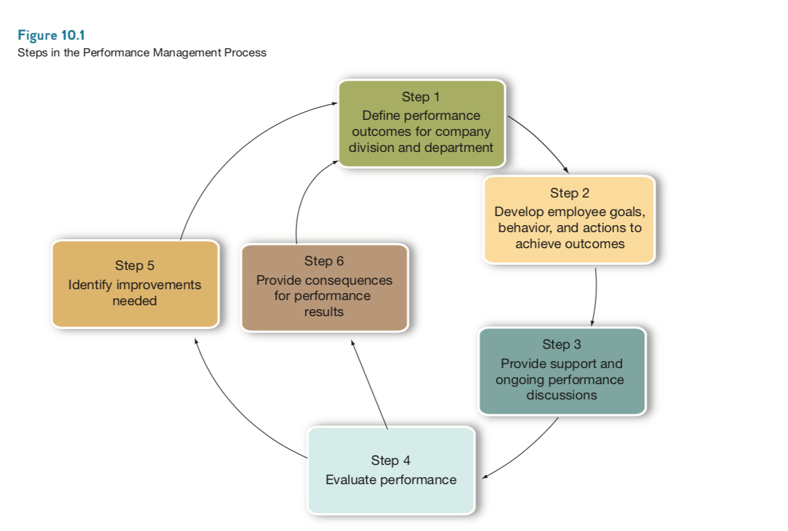
The Process of Performance Management

Slide 4
The first two steps of the process involve identifying what the company is trying to accomplish (its goals or objectives) and developing employee goals and actions to achieve these outcomes.
Typically the outcomes benefit customers, the employee’s peers or team members, and the organization itself. The goals, behaviors, and activities should be measurable and become part of the employee’s job description.

Slide 5
Step three in the process—organizational support—involves providing employees with training, necessary resources and tools, and ongoing feedback between the employee and manager, which focuses on accomplishments as well as issues and challenges that influence performance.
For effective performance management, both the manager and the employee have to value feedback and exchange it on a regular basis—not just once or twice a year. Also, the manager needs to make time to provide ongoing feedback to the employee and learn how to give and receive it.

Slide 6
Step four involves evaluating performance; that is, when the manager and employee discuss and compare targeted goals and supporting behavior with actual results. This step includes the annual formal performance review.

Slide 7
The Final steps of the performance management process involve both the employee and manager identifying what the employee can do to capitalize on performance strengths and address weaknesses.
(step 5) and providing consequences for achieving (or failing to achieve) performance outcomes (such as pay increases, bonuses, or action plans)
(step 6). This includes identifying training needs; adjusting the type or frequency of feedback the manager provides to the employee; clarifying, adjusting, or modifying performance outcomes; and discussing behaviors or activities that need improvement.
Notes:
To be effective, the entire performance management process should be reviewed each year to ensure that what is being measured at the employee level aligns strategi- cally with company, division, and departmental goals and objectives.2

Slide 8
Purposes of Performance Management
Organizations establish performance management systems to meet three broad purposes: strategic, administrative, and developmental
Strategic purpose means effective performance management helps the organization achieve its business objectives. It does this by helping to link employees’ behavior with the organization’s goals.

Slide 9
The administrative purpose of a performance management system refers to the ways in which organizations use the system to provide information for day-to-day decisions about salary, bene ts, and recognition programs.
developmental purpose, meaning that it serves as a basis for developing employees’ knowledge and skills. Even employees who are meeting expectations can become more valuable when they hear and discuss performance feedback. Effective performance feedback makes employees aware of their strengths and of the areas in which they can improve.

Slide 10
Criteria for Effective Performance Management
Fit with strategy—A performance management system should aim at achieving employee behavior and attitudes that support the organization’s strategy, goals, and culture. If a company emphasizes customer service, then its performance management system should define the kinds of behavior that contribute to good customer service.

Slide 11
validity is the extent to which a measurement tool actually measures what it is intended to measure. In the case of performance appraisal, validity refers to whether the appraisal measures all the relevant aspects of performance and omits irrelevant aspects of performance

Slide 12
Reliability—With regard to a performance measure, reliability describes the consistency of the results that the performance measure will deliver. Interrater reliability is consistency of results when more than one person measures performance

Slide 13
Acceptability—Whether or not a measure is valid and reliable, it must meet the practical standard of being acceptable to the people who use it. For example, the people who use a performance measure must believe that it is not too time consuming. Likewise, if employees believe the measure is unfair, they will not use the feedback as a basis for improving their performance.

Slide 14
Specific feedback—A performance measure should specially tell employees what is expected of them and how they can meet those expectations. Being specific helps performance management meet the goals of supporting strategy and developing employees. If a measure does not specify what an employee must do to help the organization achieve its goals, it does not support the strategy.

Slide 15
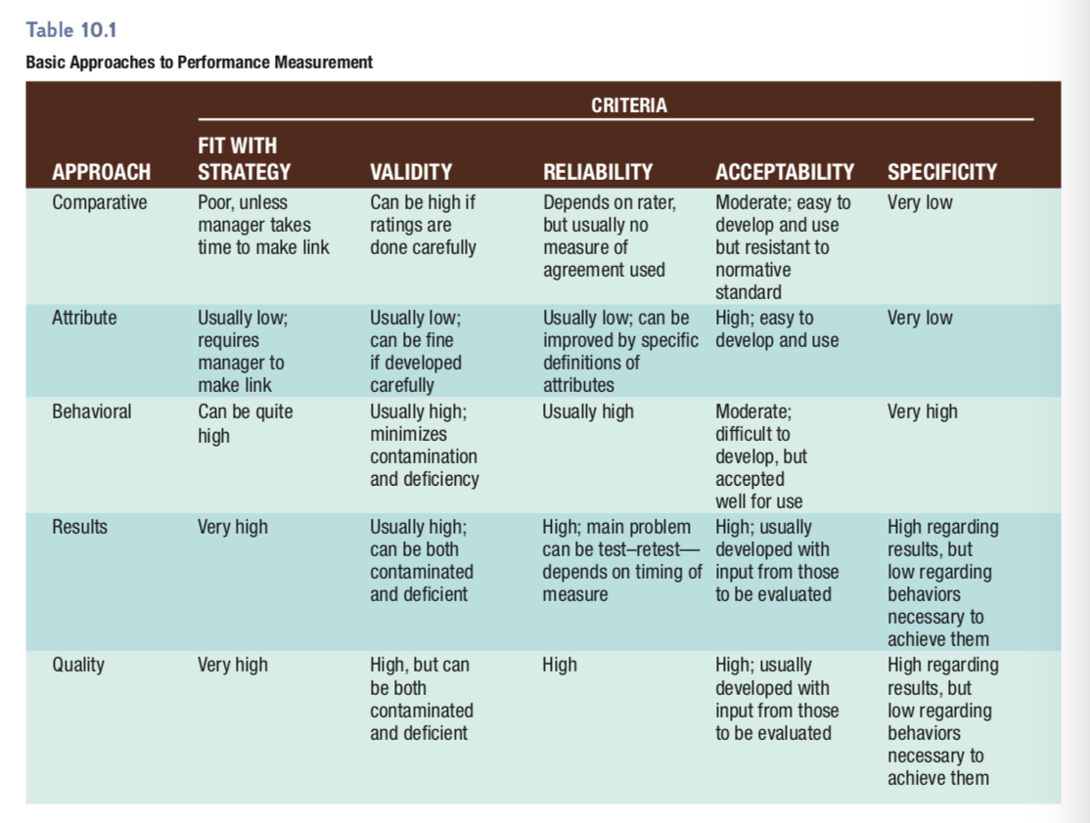
Methods for Measuring Performance

Slide 16
Simple ranking requires managers to rank employees in their group from the highest performer to the poorest performer. In a variation of this approach, alternation ranking, the manager works from a list of employees.
First, the manager decides which employee is best and crosses that person’s name off the list. From the remaining names, the manager selects the worst employee and crosses off that name. The process continues with the manager selecting the second best, second worst, third best, and so on, until all the employees have been ranked.
The major downside of ranking involves validity

Slide 17
forced-distribution method. This type of performance measurement assigns a certain percentage of employees to each category in a set of categories. For example, the organization might establish the following percentages and categories:
Exceptional—5%
Exceeds standards—25%
Meets standards—55%
Room for improvement—10%
Not acceptable—5%

Slide 18
paired-comparison method. This approach involves comparing each employee with each other employee to establish rankings. Suppose a manager has several employees, Allen, Barbara, Caitlin, David, and Edgar.
The manager compares Allen’s performance to Barbara’s and assigns one point to whichever employee is the higher performer. Then the manager compares Allen’s performance to Caitlin’s, then to David’s, and nally to Edgar’s.
The manager repeats this process with Barbara, comparing her performance to Caitlin’s, David’s, and Edgar’s. When the man- ager has compared every pair of employees, the manager counts the number of points for each employee.
The employee with the most points is considered the top-ranked employee. Clearly, this method is time consuming if a group has more than a handful of employees.

Slide 19
Rating Individuals
Instead of focusing on arranging a group of employees from best to worst, performance measurement can look at each employee’s performance relative to a uniform set of standards.
Done in previous chapters.
Graphic rating scale, BARS, MBO, etc.

Slide 20
Errors in Performance Measurement
Types of Rating Errors
People often tend to give a higher evaluation to people they consider similar to themselves. Most of us think of ourselves as effective, so if others are like us, they must be effective, too.
If the rater compares an individual, not against an objective standard, but against other employees, contrast errors occur. A competent performer who works with exceptional people may be rated lower than competent simply because of the contrast.

Slide 21
Raters make distributional errors when they tend to use only one part of a rating scale. The error is called leniency when the reviewer rates everyone near the top, strictness when the rater favors lower rankings, and central tendency when the rater puts everyone near the middle of the scale. Distributional errors make it difficult to compare employees rated by the same person.
Raters often let their opinion of one quality color their opinion of others. For ex- ample, someone who speaks well might be seen as helpful or talented in other areas simply because of the overall good impression created by this one quality. Or some- one who is occasionally tardy might be seen as lacking in motivation.

Slide 22
When the bias is in a favorable direction, this is called the halo error. When it involves negative ratings, it is called the horns error. Halo error can mistakenly tell employees they don’t need to improve in any area, while horns error can cause employees to feel frustrated and defensive.

Slide 23
Ways to Reduce Errors v
Raters can be trained how to avoid rating errors.30 Prospective raters watch videos whose scripts or storylines are designed to lead them to make specific rating errors. After rating the employees in the videos, raters discuss their rating decisions and how such errors affected their rating decisions. Training programs offer tips for avoiding the errors in the future.
Another training method for raters focuses on the complex nature of employee per- formance.31 Raters learn to look at many aspects of performance that deserve their attention. Actual examples of performance are studied

Slide 24
Political Behavior in Performance Appraisals
Appraisal politics are most likely to occur when raters are ac- countable to the employee being rated, the goals of rating are not compatible with one another, performance appraisal is directly linked to highly desirable rewards, top executives tolerate or ignore distorted ratings, and senior employees tell newcomers company “folklore” that includes stories about distorted ratings.

Slide 25
calibration meeting, a gathering at which managers discuss employee performance ratings and provide evidence supporting their ratings with the goal of eliminating the in uence of rating errors. As they discuss ratings and the ways they arrive at ratings, managers may identify undervalued employees, notice whether they are much harsher or more lenient than other managers, and help each other focus on how well ratings are associated with relevant performance outcome

Slide 26
Giving Performance Feedback
Once the manager and others have measured an employee’s performance, this in- formation must be given to the employee. Only after the employee has received feedback can he or she begin to plan how to correct any shortcomings. Although the feedback stage of performance management is essential, it is uncomfortable to managers and employees.

Slide 27
Scheduling Performance Feedback
Performance feedback should be a regular, expected management activity
Preparing for a Feedback Session
Managers should be well prepared for each formal feedback session. The manager should create the right context for the meeting. The location should be neutral.

Slide 28
Conducting the Feedback Session
During the feedback session, managers can take any of three approaches. In the “tell- and-sell” approach, managers tell the employees their ratings and then justify those rat- ings. In the “tell-and-listen” approach, managers tell employees their ratings and then let the employees explain their side of the story. In the “problem-solving” approach, managers and employees work together to solve performance problems in an atmo- sphere of respect and encouragement

Slide 29
Finding Solutions to Performance Problems
When performance evaluation indicates that an employee’s performance is below stan- dard, the feedback process should launch an effort to correct the problem. Even when the employee is meeting current standards, the feedback session may identify areas in which the employee can improve in order to contribute more to the organization in a current or future job

Slide 30
Lack of ability—When a motivated employee lacks knowledge, skills, or abili- ties in some area, the manager may offer coaching, training, and more detailed feedback. Sometimes it is appropriate to restructure the job so the employee can handle it.
Lack of motivation—Managers with an unmotivated employee can explore ways to demonstrate that the employee is being treated fairly and rewarded adequately. The solution may be as simple as more positive feedback (praise). Employees may need a referral for counseling or help with stress management.

Slide 31
Lack of both—Performance may improve if the manager directs the employee’s at- tention to the signi cance of the problem by withholding rewards or providing spe- ci c feedback. If the employee does not respond, the manager may have to demote or terminate the employee.

Slide 32
Legal and Ethical Issues in Performance Management
Because performance measures play a central role in decisions about pay, promotions, and discipline, employment-related lawsuits often challenge an organization’s perfor- mance management system. Lawsuits related to performance management usually in- volve charges of discrimination or unjust dismissal.
Notes:
Discrimination claims often allege that the performance management system discriminated against employees on the basis of their race or sex. Many perfor- mance measures are subjective, and measurement errors, such as those described earlier in the chapter, can easily occur. The Supreme Court has held that the selec- tion guidelines in the federal government’s Uniform Guidelines on Employee Selection Procedures also apply to performance measurement

Slide 33
To protect against both kinds of lawsuits, it is important to have a legally de- fensible performance management system.40 Such a system would be based on valid job analyses, as described in Chapter 4, with the requirements for job success clearly communicated to employees. Performance measurement should evaluate behaviors or results rather than traits.

Slide 34
The organization should use multiple rat- ers (including self-appraisals) and train raters in how to use the system. The or- ganization should provide for a review of all performance ratings by upper-level managers and set up a system for employees to appeal when they believe they were evaluated unfairly. Along with feedback, the system should include a process for coaching or training employees to help them improve, rather than simply dismiss- ing poor performers.

Slide 35
Electronic Monitoring and Employee Privacy
Computer technology now supports many performance management systems. Orga- nizations often store records of employees’ performance ratings, disciplinary actions, and work-rule violations in electronic databases.
Many companies use computers to monitor productivity and other performance measures electronically.
A company called E22 Alloy has developed a service that collects data about employees’ activities on their computers, smartphones, and other devices and stores the data in the “cloud”
Employees can visit the service to review the data collected about themselves and delete any data they believe to be inaccurate or irrelevant

Slide 36
Although electronic monitoring can improve productivity, it also generates pri- vacy concerns. Critics point out that an employer should not monitor employees when it has no reason to believe anything is wrong
They complain that monitoring systems threaten to make the workplace an electronic sweatshop in which employ- ees are treated as robots, robbing them of dignity. Some note that employees’ per- formances should be measured by accomplishments, not just time spent at a desks or workbenches.

Slide 37
When monitoring is necessary, managers should communicate the reasons for using it. Monitoring may be used more positively to gather information for coaching employees and helping them develop their skills.
Finally, organizations must protect the privacy of performance measurements, as they must do with other employee records.

Slide 38
Compensation to improve performance
Incentive-Based Compensation : incentives can include commissions based on sales, individual sales goals.
Profit Sharing
Team-Based Compensation

Slide 39
Diversity to improve performance
Diversity
Research on the creativity of groups has found that ethnic diversity is positively related with cre-ativity. Correspondingly, it has been asserted that the heightened creativity produced by a more diverse workforce can have a positive impact on the firm’s performance if properly managed

Slide 40
Employment practie to increase performance
Countercyclical Hiring : practice of hiring key employees during economic downturns. firms can obtain bargains in key personnel that may be needed to implement a strategy that will produce substantial returns after the recovery.

Slide 41
Downsizing and its impact on performance
downsizing firms did not obtain significantly greater returns than the average for firms in their industries. However, firms that pursued a combined approach of coupling downsizing with a restructuring of their assets (plant and equipment) had substantially higher returns on assets two years later than those that only downsized.

Slide 42
Employment Security
Employment security practices help to preserve the firm’s investments in its human resources. They also provide the stability needed to unleash the innovativeness of employees for the benefit of the firm. It has been asserted that employees who are more secure in their jobs are more likely to use their knowledge to increase the firm’s productivity

Slide 43
Human Resource Outsourcing
Cost reductions and greater efficiencies are often cited as benefits of outsourcing.
However, practitioners are quick to point out that when outsourcing is adopted solely for cost reduction, the result is often disappointing.
Sustainable competitive advantage appears to result from outsourcing when it allows human resource departments to focus on value-added activities and when outsourcing helps to support the strategic direction of the firm

Slide 44
Industrial Relations
Positive Labor Relations :
The manner in which firms handle relations with their unions and the workers they represent can have a number of effects. Such labor relations practices can affect the productivity of the workforce and financial performance
Unions also can have a positive impact on productivity under certain labor market conditions

Slide 45
Strikes
After relatively long strikes (11 to 29 days), shareholder returns tended to increase. Conversely, after short strikes (1 to 10 days), the firms’ financial performance tended to decline, and after extremely long strikes (30 days or more), shareholder returns tended to decline dramatically. These results provide evidence of the conventional wisdom that companies win longer strikes (11 to 29 days) and that unions win short strikes (1 to 10 days)
It seems reasonable to conclude that failure to invest in good labor relations practices has negative financial consequences for firms.

Slide 46
Internal Labor Market
promotion from within is significantly related to perceptual measures of organizational performance.

Slide 47
SYSTEMS OF HIGH-PERFORMANCE HUMAN RESOURCE PRACTICES
Information sharing
Use of formal job analysis
Promotion from within
Use of attitude surveys of the workforce
Use of quality of work life programs
Profit sharing or gain sharing
Employee training
Employee access to grievance procedures
Use of selection tests

Slide 48
The second system of motivation practices was made up of the following:
Compensation based on performance appraisals
Use of formal performance appraisals
Merit-based promotions
Hiring selectivity

