Slide 1
Managing Change
Organization Development

Slide 2
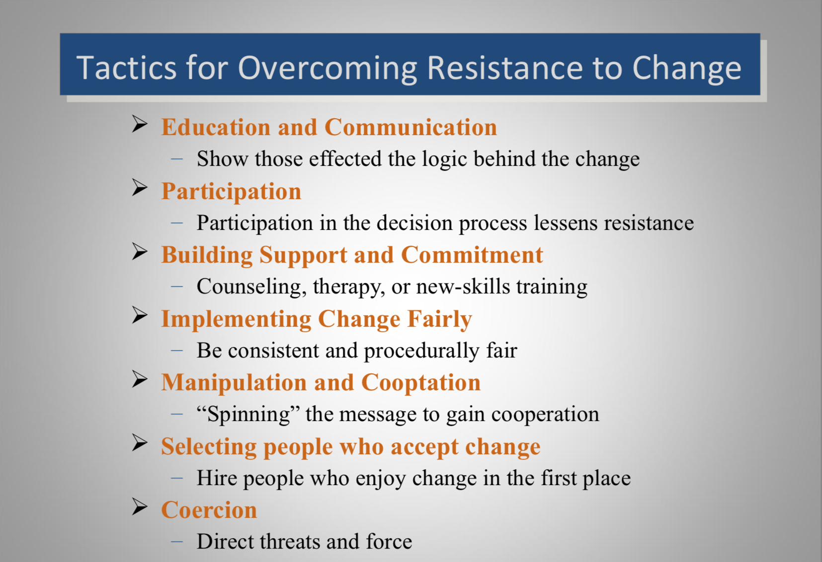

Slide 3
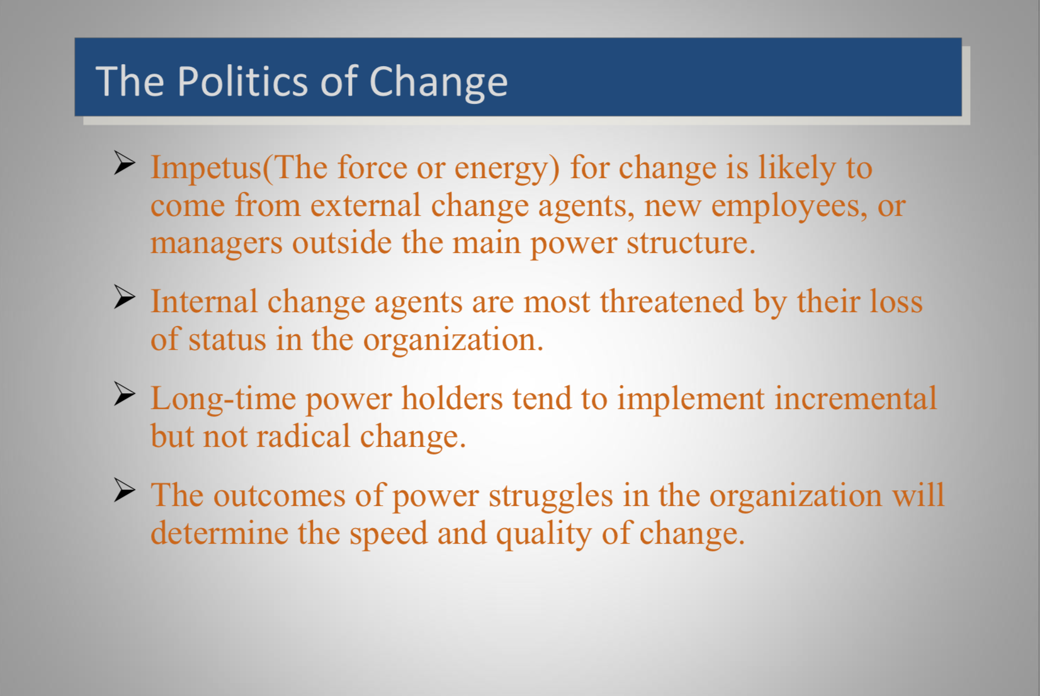

Slide 4
Lewin's 3-Stage Model of Change: Unfreezing, Changing & Refreezing
If you have a large cube of ice but realize that what you want is a cone of ice, what do you do? First you must melt the ice to make it amenable to change (unfreeze). Then you must mold the iced water into the shape you want (change). Finally, you must solidify the new shape (refreeze).

Slide 5


Slide 6
By looking at change as a process with distinct stages, you can prepare yourself for what is coming and make a plan to manage the transition – looking before you leap, so to speak. All too often, people go into change blindly, causing much unnecessary turmoil and chaos.
To begin any successful change process, you must first start by understanding why the change must take place. As Lewin put it, "Motivation for change must be generated before change can occur.

Slide 7
Unfreeze
This first stage of change involves preparing the organization to accept that change is necessary, which involves breaking down the existing status quo before you can build up a new way of operating.
Key to this is developing a compelling message showing why the existing way of doing things cannot continue. This is easiest to frame when you can point to declining sales figures, poor financial results, worrying customer satisfaction surveys, or suchlike. These show that things have to change in a way that everyone can understand.

Slide 8
To prepare the organization successfully, you need to start at its core – you need to challenge the beliefs, values, attitudes, and behaviors that currently define it. Using the analogy of a building, you must examine and be prepared to change the existing foundations as they might not support add-on storeys. Unless this is done, the whole building may risk collapse.

Slide 9
By forcing the organization to re-examine its core, you effectively create a (controlled) crisis, which in turn can build a strong motivation to seek out a new equilibrium. Without this motivation, you won't get the buy-in and participation necessary to effect any meaningful change.

Slide 10
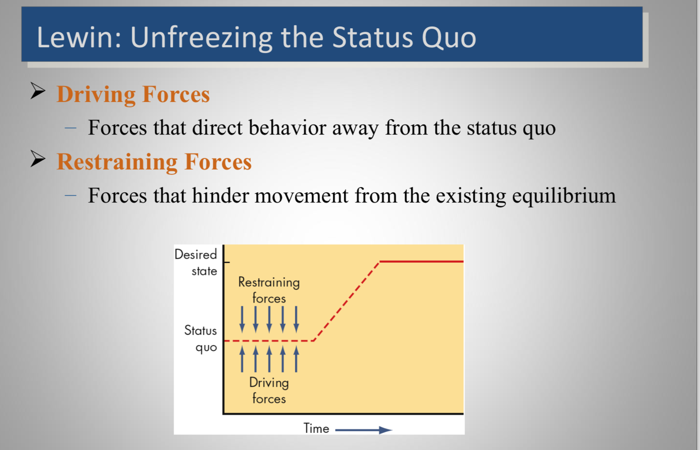

Slide 11
Change
After the uncertainty created in the unfreeze stage, the change stage is where people begin to resolve their uncertainty and look for new ways to do things. People start to believe and act in ways that support the new direction.
The transition from unfreeze to change does not happen overnight: People take time to embrace the new direction and participate proactively in the change.

Slide 12
In order to accept the change and contribute to making it successful, people need to understand how it will benefit them. Not everyone will fall in line just because the change is necessary and will benefit the company. This is a common assumption and a pitfall that should be avoided.

Slide 13
Time and communication are the two keys to the changes occurring successfully. People need time to understand the changes, and they also need to feel highly connected to the organization throughout the transition period. When you are managing change, this can require a great deal of time and effort, and hands-on management is usually the best approach.

Slide 14
Refreeze
When the changes are taking shape and people have embraced the new ways of working, the organization is ready to refreeze. The outward signs of the refreeze are a stable organization chart, consistent job descriptions, and so on
The refreeze stage also needs to help people and the organization internalize or institutionalize the changes.

Slide 15
This means making sure that the changes are used all the time, and that they are incorporated into everyday business. With a new sense of stability, employees feel confident and comfortable with the new ways of working.

Slide 16
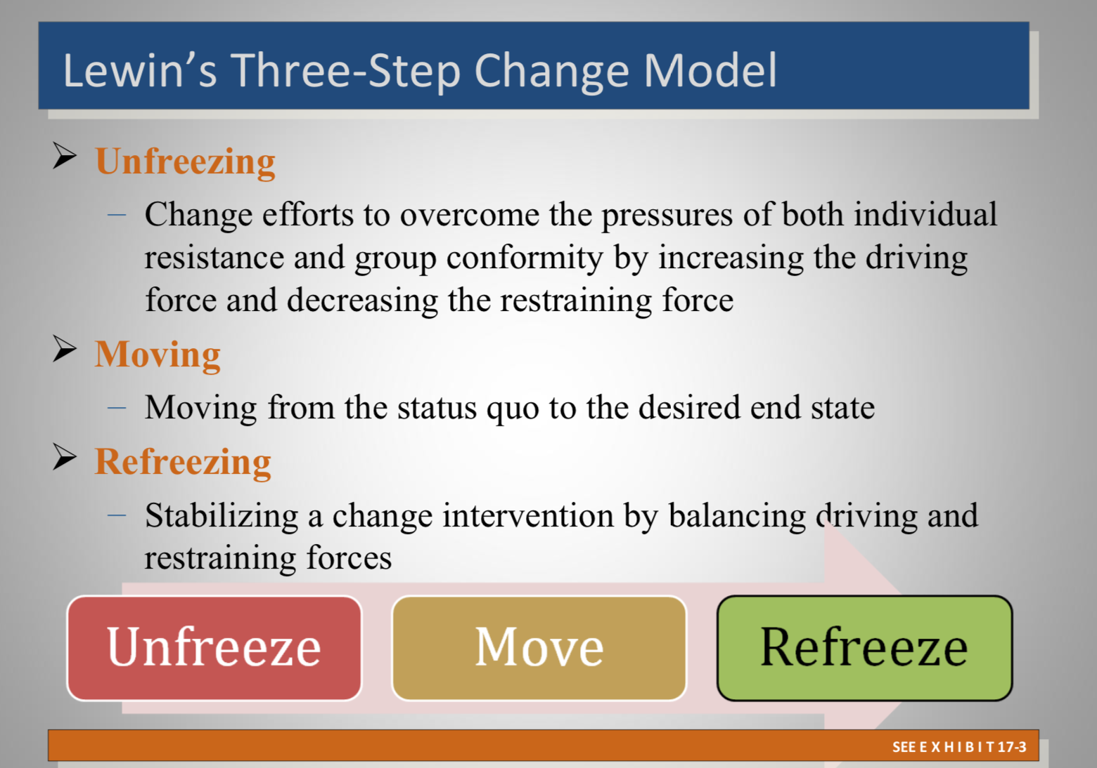

Slide 17
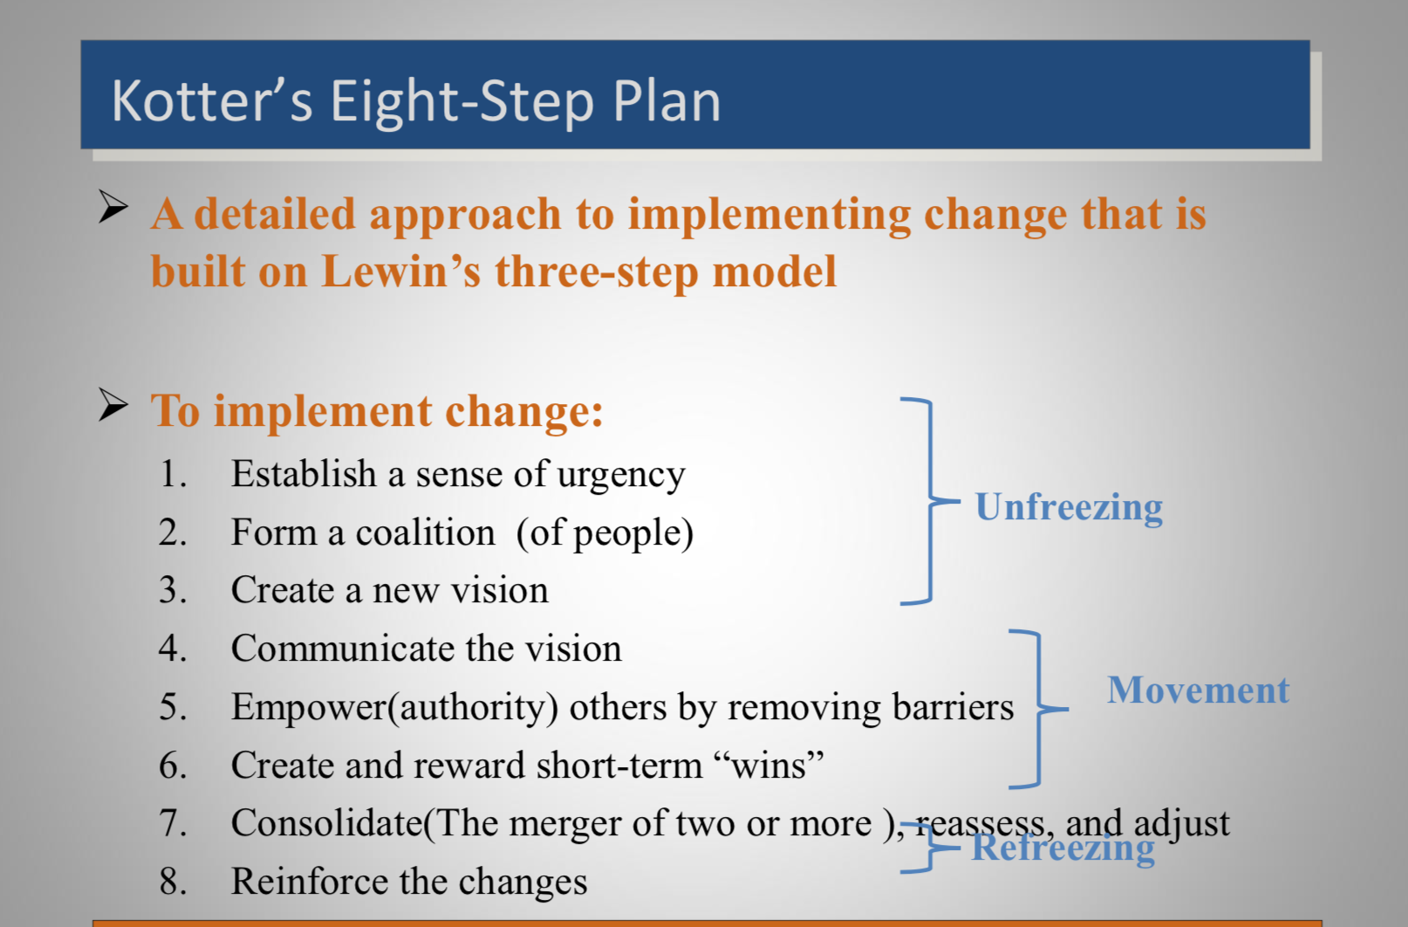

Slide 18
Step 1: Create Urgency
For change to happen, it helps if the whole company really wants it. Develop a sense of urgency around the need for change. This may help you spark the initial motivation to get things moving.

Slide 19
Step 2: Form a Powerful Coalition
Convince people that change is necessary. This often takes strong leadership and visible support from key people within your organization. Managing change isn't enough – you have to lead it.
You can find effective change leaders throughout your organization – they don't necessarily follow the traditional company hierarchy. To lead change, you need to bring together a coalition, or team, of influential people whose power comes from a variety of sources, including job title, status, expertise, and political importance.
Once formed, your "change coalition" needs to work as a team, continuing to build urgency and momentum around the need for change.

Slide 20
Step 3: Create a Vision for Change
When you first start thinking about change, there will probably be many great ideas and solutions floating around. Link these concepts to an overall vision that people can grasp easily and remember.
A clear vision can help everyone understand why you're asking them to do something. When people see for themselves what you're trying to achieve, then the directives they're given tend to make more sense.

Slide 21
Step 4: Communicate the Vision
What you do with your vision after you create it will determine your success. Your message will probably have strong competition from other day-to-day communications within the company, so you need to communicate it frequently and powerfully, and embed it within everything that you do.
Don't just call special meetings to communicate your vision. Instead, talk about it every chance you get. Use the vision daily to make decisions and solve problems. When you keep it fresh on everyone's minds, they'll remember it and respond to it.

Slide 22
Step 5: Remove Obstacles
Put in place the structure for change, and continually check for barriers to it. Removing obstacles can empower the people you need to execute your vision, and it can help the change move forward.
Recognize and reward people for making change happen.
Identify people who are resisting the change, and help them see what's needed.
Take action to quickly remove barriers (human or otherwise).

Slide 23
Step 6: Create Short-Term Wins
Nothing motivates more than success. Give your company a taste of victory early in the change process. Within a short time frame (this could be a month or a year, depending on the type of change), you'll want to have some "quick wins" that your staff can see. Without this, critics and negative thinkers might hurt your progress.

Slide 24
Create short-term targets – not just one long-term goal. You want each smaller target to be achievable, with little room for failure. Your change team may have to work very hard to come up with these targets, but each "win" that you produce can further motivate the entire staff.

Slide 25
Step 7: Build on the Change
Kotter argues that many change projects fail because victory is declared too early. Real change runs deep. Quick wins are only the beginning of what needs to be done to achieve long-term change.
Launching one new product using a new system is great. But if you can launch 10 products, that means the new system is working. To reach that 10th success, you need to keep looking for improvements.

Slide 26
After every win, analyze what went right, and what needs improving.
Set goals to continue building on the momentum you've achieved.
Keep ideas fresh by bringing in new change agents and leaders for your change coalition.

Slide 27
Step 8: Anchor the Changes in Corporate Culture
Finally, to make any change stick, it should become part of the core of your organization. Your corporate culture often determines what gets done, so the values behind your vision must show in day-to-day work.
Make continuous efforts to ensure that the change is seen in every aspect of your organization. This will help give that change a solid place in your organization's culture.
It's also important that your company's leaders continue to support the change. This includes existing staff and new leaders who are brought in. If you lose the support of these people, you might end up back where you started.

Slide 28
Action Research
Action Research is the foundation stone of Organsation Development practice, it is what underpins the theory and practice of the discipline in the organisation. The theory is based on what Lewin advised, “no action without research, no research without action.”

Slide 29
Action Research is a four step continuous process; Diagnosis, Planning, Action and Evaluation
Action Research Theory provides the bridge between knowledge building and data gathering with effective action
It empowers employees and enables the organisation to sustain the change by providing data not only of how to make the changes required today but also on the change process itself
Action refers to the OD interventions that are implemented to develop the organisation
All organisational stakeholders are involved in the collaborative process of creating and executing the planned changes.

Slide 30
Applying Action Research Theory in an OD intervention
Involve the people affected by the change so that they become co-investigators into the reasons for change, and participate in analysing the current reality
Let individuals discuss the future they need to move toward
Work to increase the amount and quality of inquiry between people so that they can learn from each other and gather a rich mix of data

Slide 31
Secure a commitment to give some decision making power to the people involved in collecting the data so that real change can be achieved
Set up a temporary diagnostic team by using those key individuals who have to support the implementation of change.
Provide space for individuals to reflect on the insights they have gained

Slide 32
Plan the direction of change/OD intervention in collaboration with all stakeholders
Implement decisions that employees and leaders make democratically
Provide a learning zone where individuals and groups can self organise for change.

Slide 33
