Slide 1
Entrepreneurship and small business
Lecture Five
Oeshwik Ahmed, Faculty of HRM, Northern University

Slide 2

Text book- Small business Management by Megginson and Byrd

Slide 3
Planning, Organizing, and Managing a Small Business
6
Chapter
Importance Of Planning
Strategic, Operational, & Financial Planning
Need & Purpose Of A Business Plan

Slide 4
Planning
The Process Of Setting Objectives And Determining Actions To Achieve Those Objectives.
McGraw-Hill/Irwin
© 2006 The McGraw-Hill Companies, Inc. All rights reserved.

Slide 5

Criteria For Planning
Be Prepared
Be Patient
Know When To Get Help
Form Support System
Know Power Of Vertical Integration
Never Rest On Laurels
Keith Brofsky/Getty Images

Slide 6
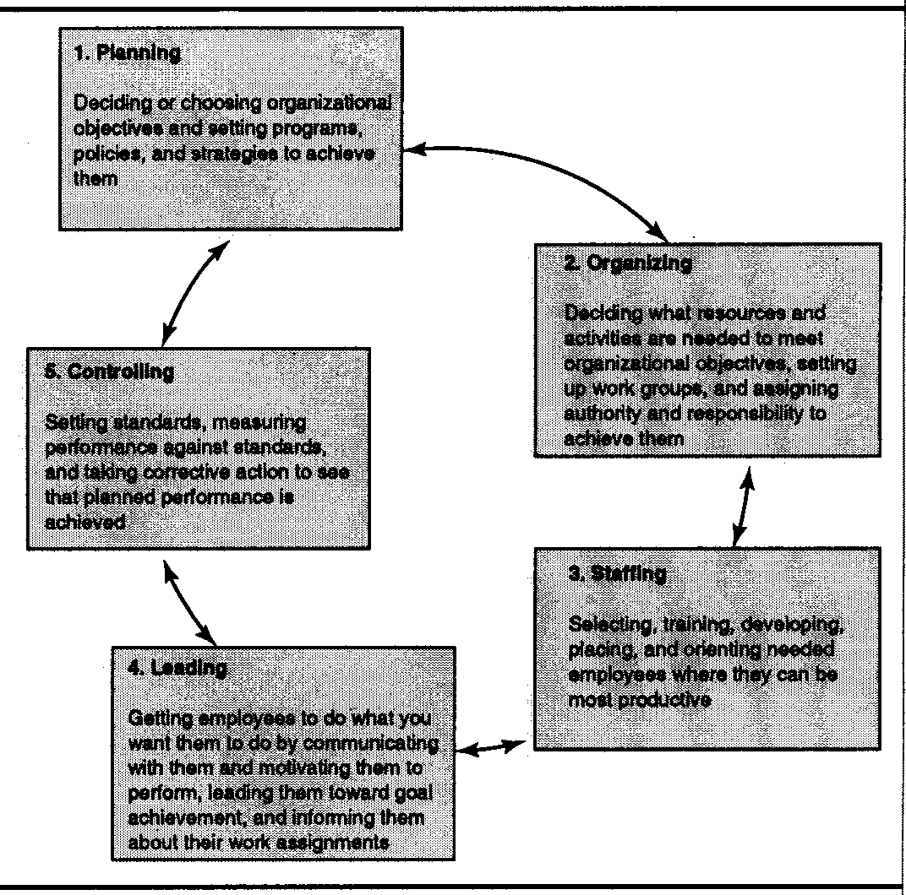
Planning & Other
Managerial Functions

Slide 7

Planning
Provides Internally:
Course Of Action
Bases For Change
Means To Delegate
Javier Pierini/Getty Images

Slide 8

Planning
Provides Externally:
Interest From Investors/Lenders
Guide Owner/Managers In Operations
Give Direction/Motivation To Employees
Attracts Customers & Prospective Employees
Ryan McVay/Getty Images

Slide 9

Reasons To
Neglect Planning
Day-To-Day Activities Get In Way
Fear Of What It Might Reveal
Lack Of Planning Knowledge
Feeling Future Cannot Be Planned For
Requires:
  Original Thinking
  Time
To Difficult
Jason Reed/Getty Images

Slide 10

Types Of Planning
Strategic- Before Starting Business
Business Plan to Attract:
  Investors
  Financiers
  Prospective Employees
Operational- Continuous Before & After Business Starts
Jim Arbogast/Getty Images

Slide 11
Strategic Planning
Comprehensive Long-Term Direction To Help Business Accomplish Its Mission.

Slide 12

Parts Of Strategic Plan
Mission: Long-Term Direction
Objectives: Short-Term Ends
Strategies: Means To Achieve Objectives For
  Total Firm
  Functional Area

Slide 13

Areas For
Strategic Planning
Business Selection
Determining Mission
Deciding On Start, Buy, Franchise
Choosing Product/Service
Identifying Target Market
Picking Legal Structure
Shaping Financial Needs
Selecting Location
Ryan McVay/Getty Images

Slide 14
SWOT Analysis
Strengths | Weaknesses
1) 2) 3) 4) | 1) 2) 3) 4)
Opportunities | Threats
1) 2) 3) 4) | 1) 2) 3) 4)

Slide 15
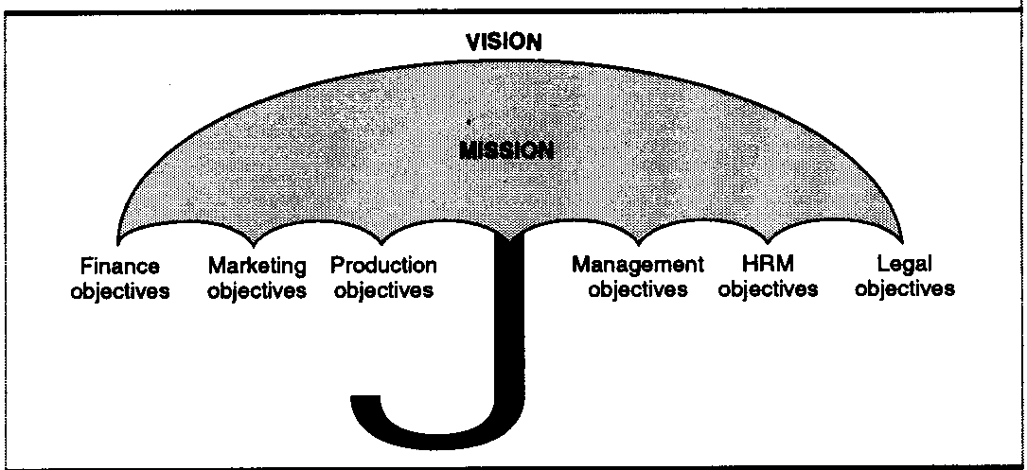
Strategic Umbrella

Slide 16
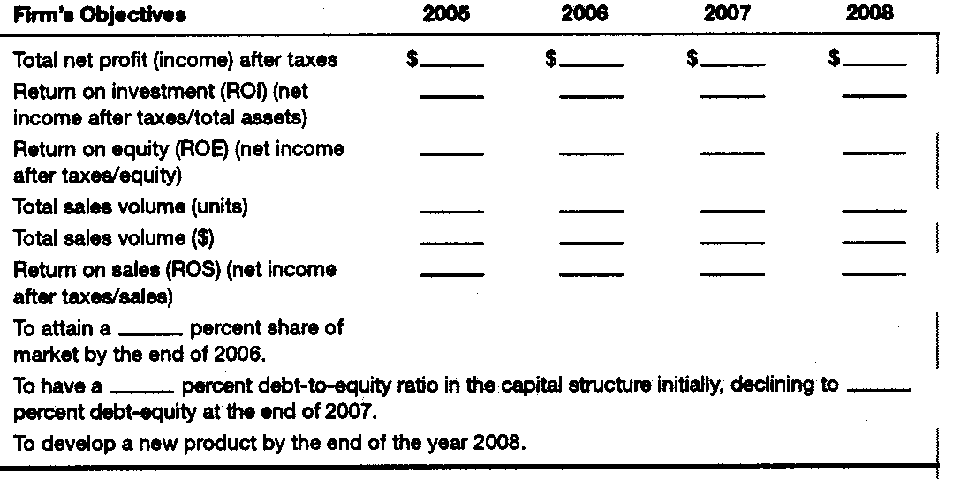
Setting Objectives

Slide 17

External Environment
Legal & Political Factors
Economy
Changing Demographics
Clients
Foreign Competition

Slide 18



Internal Resources
(Competitive Edge)
Human
Physical
Financial
Royalty-Free/CORBIS

Slide 19
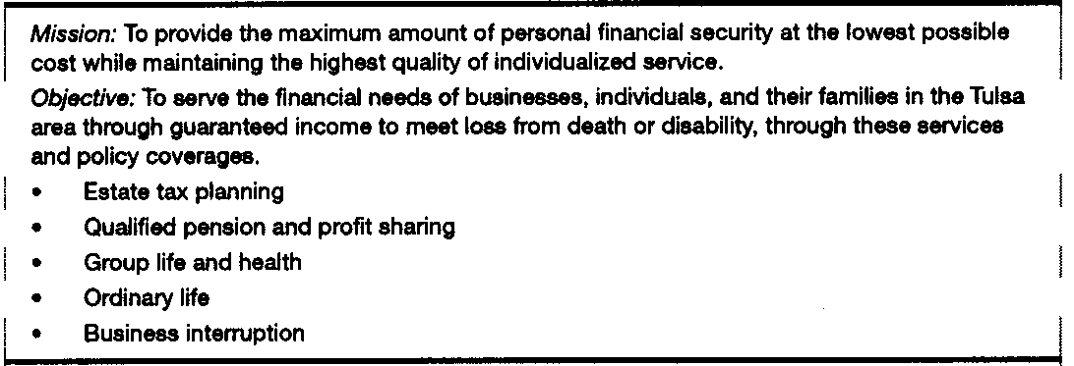
Mission/Strategy
John Smith, General Agent

Slide 20
Operational Planning
Sets Policies, Procedures, And Standards For Achieving Objectives.

Slide 21

Parts Of Operational Plan
Polices: Guides For Consistent Action
Methods & Procedures: Manner Of Operating
Budgets & Standards: Measures Of Control For Activities
Jules Frazier/Getty Images

Slide 22
Areas Of
Operational Planning
Choosing Location
Planning Facilities
Developing Sources Of Supply
Planning HR Needs
Setting Up Legal Structure
Determining Approach To Market
Establishing Record System
Setting Up Schedule

Slide 23

Financial Planning
Estimating Income/Expense
Estimating Initial Investment
Locating Sources Of Funds
Royalty-Free/CORBIS

Slide 24
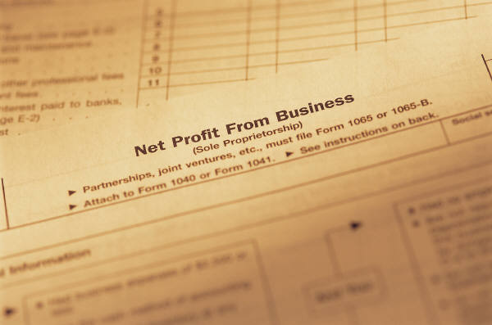

Income And Expenses
Net Profit
Expenses
  Variable
  Fixed

Slide 25
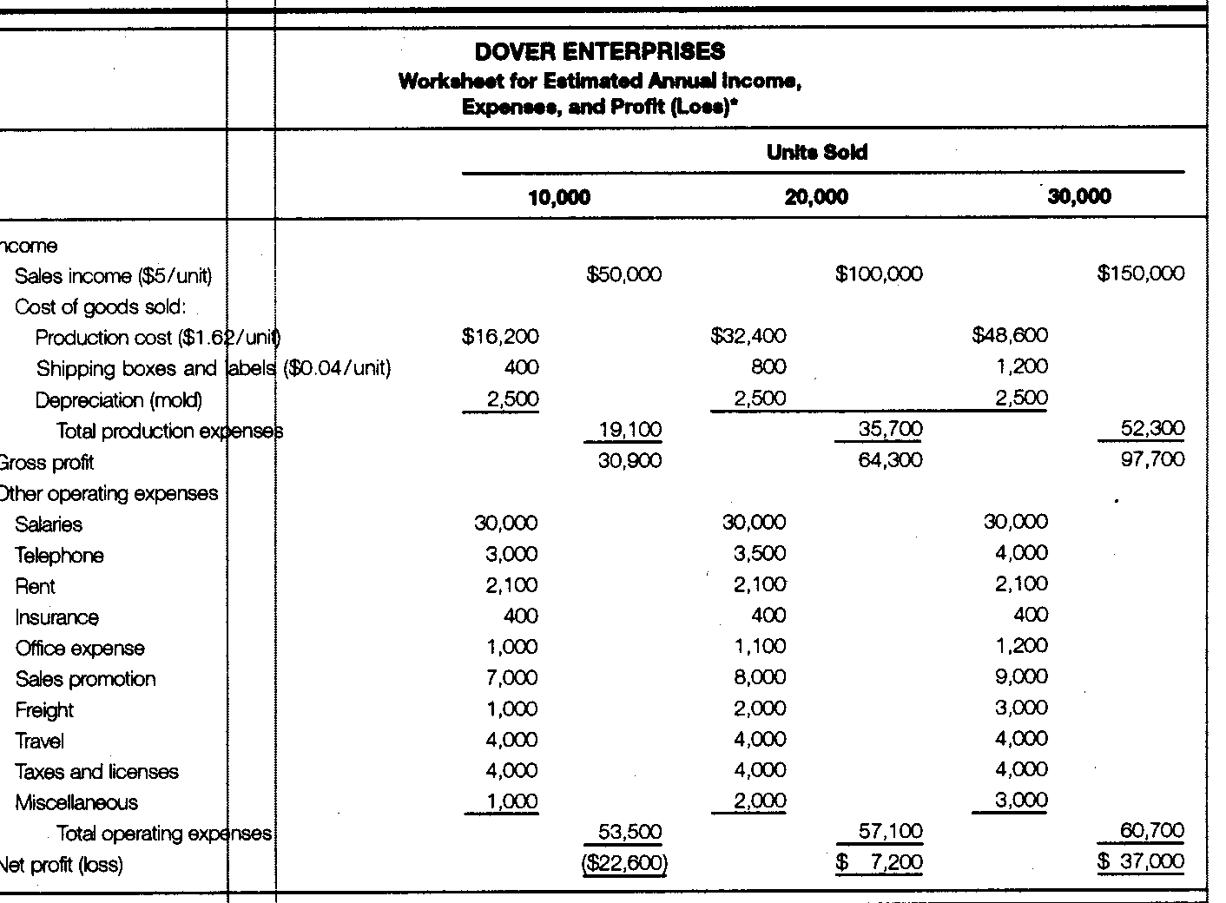
Estimating Annual Income/Expense/Net Profit

Slide 26

Sources Of Funds
Your Own Funds
Funds From Others
  Equity Investors
  Lenders

Slide 27

Purposes Of
Business Plan
Keeps On Target
Keeps Creativity Focused
Concentrates Power On Goal
Patagonik Works/Getty Images

Slide 28

Plan Should Include
Proposed Product
Expected Market
Industry Strengths & Weaknesses
Marketing Policies
Operations/Production Methods
Financial Aspects
C Squared Studios/Getty Images

Slide 29

Preparing Business Plan
Business Current Status
Where Would Business Like To Be- Objective
What Will It Take To Get Business To Objective- Strategy
Owner Should Prepare
Create Action Steps
Monica Lau/Getty Images

Slide 30
Components Of
Business Plan
Cover Sheet
Executive Summary
Table Of Contents
History
Description Of Business
Definition Of Market
Description Of Products & Services
Management Structure
Objectives & Goals
Financial Data
Appendixes

Slide 31
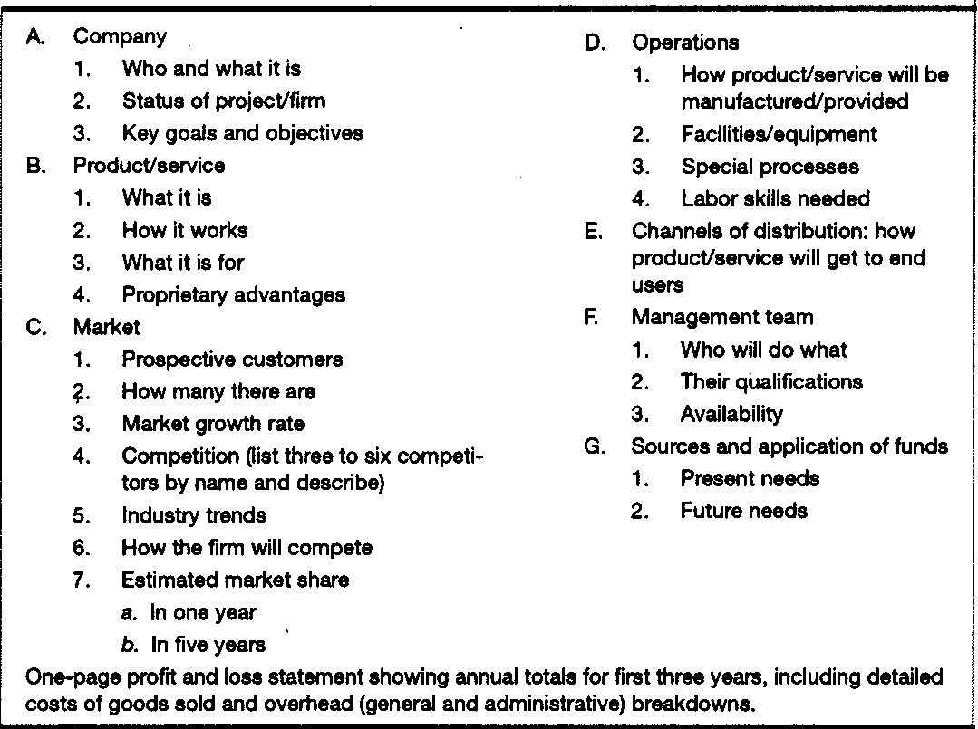
Outline Of
Executive Summary

Slide 32

Writing The Plan
Be Honest
Use The Third Person
Use Transitional Words
Avoid Redundancies
Use Short, Simple Words
Use Visuals

Slide 33

Preparation For Presentation
Adequacy Of Research & Development
Validity Of Research
Understanding Of Business
Financial Projections
Priority Of Objectives
Ability To “Make It Happen”

