Slide 1
Entrepreneurship and small business
Lecture Four
Oeshwik Ahmed, Faculty of HRM, Northern University

Slide 2

Text book- Small business Management by Megginson and Byrd

Slide 3

Becoming The Owner Of A Small Business
5
Chapter
Steps/Procedures For Going Into Business
Identify Your Niche’
Start Or Buy
Franchising

Slide 4
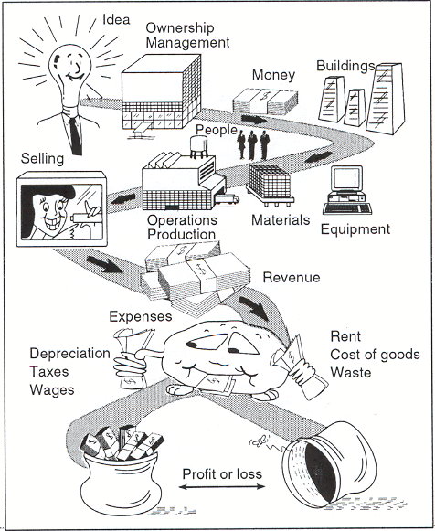
Business
Formation & Operation
McGraw-Hill/Irwin
© 2006 The McGraw-Hill Companies, Inc. All rights reserved.

Slide 5
Steps To Going
Into Business
Identify Need
Study Market
Start, Buy Existing Or Franchise
Set Mission, Objectives, Strategies
Make Operational Plans
Make Financial Plans
Develop Business Plan
Implement Plan

Slide 6

Finding Your Niche
Search For Good/Service To Sell
Niche Marketing- Finding
  Small
  Profitable

Slide 7

Searching For
Product/Service
Newspaper
  Business For Sale
  Products For Sale
Hobbies/Recreation
Talk To People
Observe/Study & Luck
PhotoLink/Getty Images

Slide 8
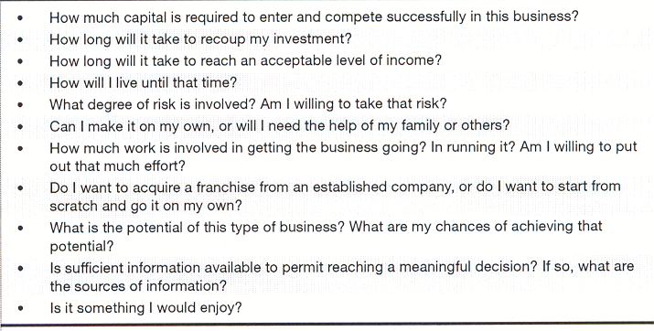
Questions To Ask

Slide 9

Government Sources
Of Advice/Help
Small Business Administration- http://www.sba.gov
Service Corps Of Retired Executives
State Economic Development Agencies
U.S. Department Of Commerce- Office Of International Trade

Slide 10

Other Sources
Of Advice/Help
Directory of Trade Associations in the U.S.
Local Colleges
Public Libraries
Chambers Of Commerce
Royalty-Free/CORBIS

Slide 11
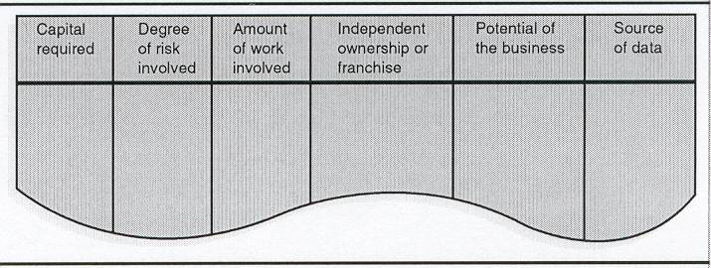
Business
Selection Checklist

Slide 12

Study Market
Market Research = Potential
Location/Segment Being Satisfied?
Select 1 Market Segment Or 1 Product
Limited Resources = Limited Options

Slide 13
Estimating Market Size
Industry Size?
Where Is Market?
How Large Is Market?
Identify Target Market & It Size?
Size & Distribution Of Population?
Sales = Growing, Stable, Declining?
Competitors = Successful?
Industry Technology?
Your Share?

Slide 14
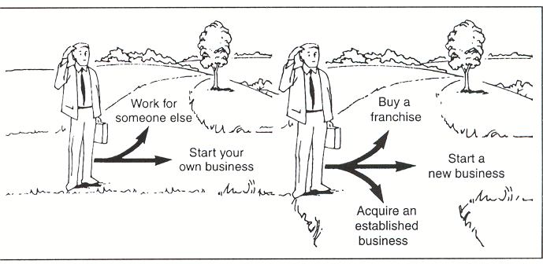
Start, Buy, Or Franchise?

Slide 15

Reasons To Start A
Business = Owner’s Freedom
Define Nature
Physical Facilities
Inventory
Select/Develop Personnel
Technology, etc.
Competitive Environment
Doug Menuez/Getty Images

Slide 16

Reasons To Not
Start A Business
Right Business?
Assemble Resources
Established Product Line
Production Problems
Market & Distribution
Systems & Controls
Start-Up vs. Existing vs. Franchise
Amos Morgan/Getty Images

Slide 17

Reasons For
Buying Existing Business
Experienced Employees
Existing Facilities
Existing Product & Market
Desirable Location
Bank Credit Relationships
Revenues, Profits, & Goodwill
C Squared Studios/Getty Images

Slide 18

Reasons For Not
Buying Existing Business
Facilities = Old/Obsolete
Poor Employees
A/R Past Due/Uncollectible
Bad Location
Poor Financial Condition/Relations
Inventory = Poor/Obsolete
Royalty-Free/CORBIS

Slide 19
Questions Before Buying
Why For Sale?
Present Owner Intentions?
Changing Environment?
Facilities Suitable- Present/Future?
Operating Efficiently?
Financial Condition?
Investment?
Return On Investment?
Price Right?
Managerial Ability?

Slide 20

Reasons For
Buying Franchise
Successful/Proven Operation & Image
Experience Guidance
Many To Chose From
Combines Your Talent & Desires

Slide 21

Franchise Questions?
How Much Help?
Franchise Help = Cover Costs?
Professional Advice
  Legal
  Accounting
Source/Cost Of Supplies
PhotoLink/Getty Images

Slide 22
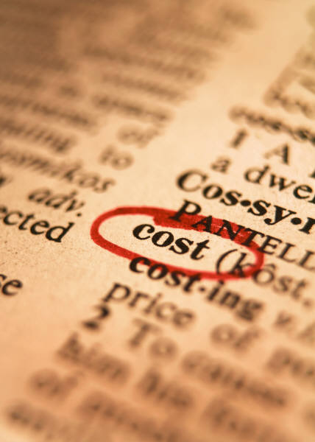
Reasons For Not
Buying Franchise
Cost
  Initial Investment
  Royalties
New?
Owner Fit?
Independence
“White Elephant”?

Slide 23
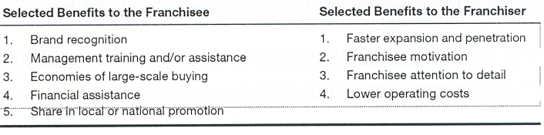
Franchising Benefits
Franchisee & Franchiser

Slide 24

Franchising Opportunities
2,552 Franchises
75 Countries
International Franchise Association - http://www.franchise.org
Jason Reed/Getty Images

Slide 25

Franchising
Franchise Agreement
Franchiser
Franchisee
Royalty-Free/CORBIS

Slide 26

Franchisor
Startup Assistance
Proven System
Standardized Accounting
Some Financial Assistance
Purchase/Construction
Training
Advertising Program
Customer Service Standards
Changing Market Opportunities
Quantity Discounts

Slide 27
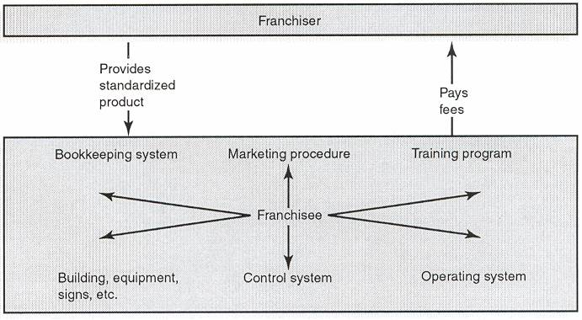
Product/Trademark Franchise

Slide 28
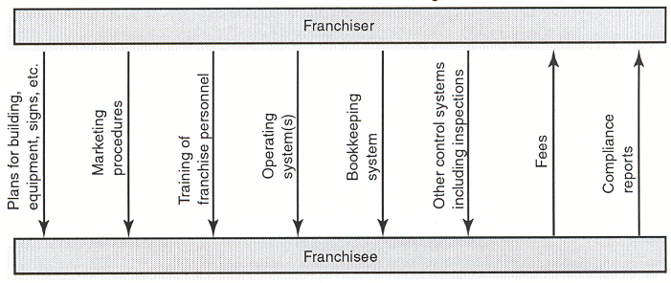
Business Format Franchise

Slide 29

Franchise Popularity
Already Identified Need, Product Created, Marketing
Failure Rate Lower
Established Systems
PhotoLink/Getty Images

Slide 30

Future Of Franchising
Growth Areas
  Restaurants
  Motels
  Convenience Stores
  Technology
  Auto Parts
Two-Income Families
Global

Slide 31
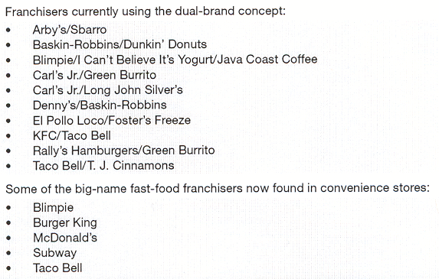

Franchises Teaming Up

Slide 32
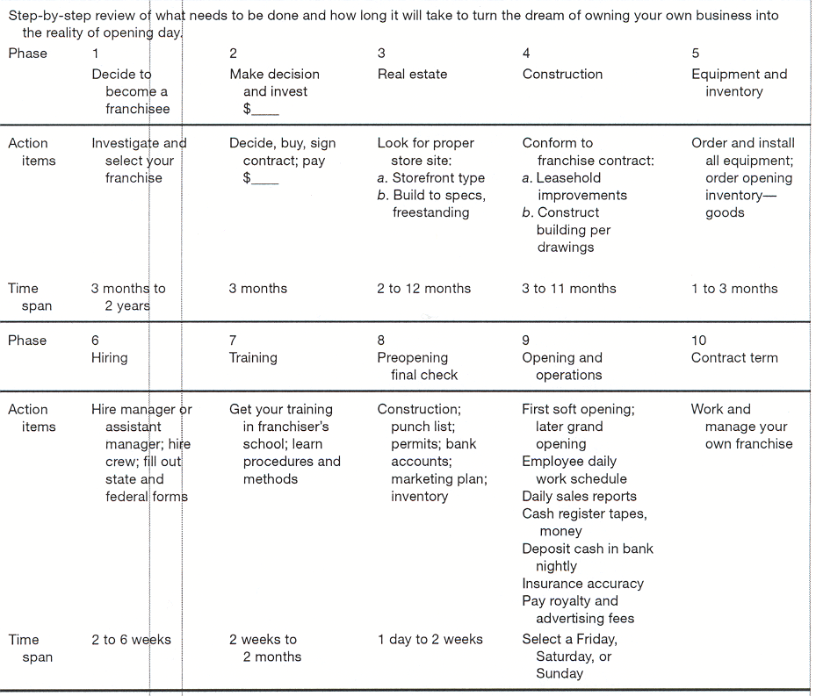
Checklist For
Franchise Investment

