Slide 1
Entrepreneurship and small business
Lecture Three
Oeshwik Ahmed, Faculty of HRM, Northern University

Slide 2
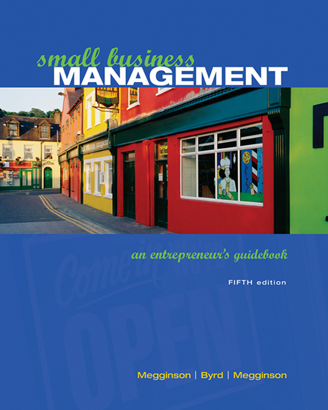
Text book- Small business Management by Megginson and Byrd

Slide 3
Forms Of Ownership
Of Small Business
3
Chapter
Primary Legal Forms
Advantages & Disadvantages Of Each Form
Other Legal Forms

Slide 4

Right Legal Form:
Business Factors To Consider
Future Size
Nature
Desired Control
Legal Vulnerability
Tax Implications
Expected Profit (Loss)
Re-investment
Personal Cash Needs
PhotoLink/Getty Images
McGraw-Hill/Irwin
© 2006 The McGraw-Hill Companies, Inc. All rights reserved.

Slide 5
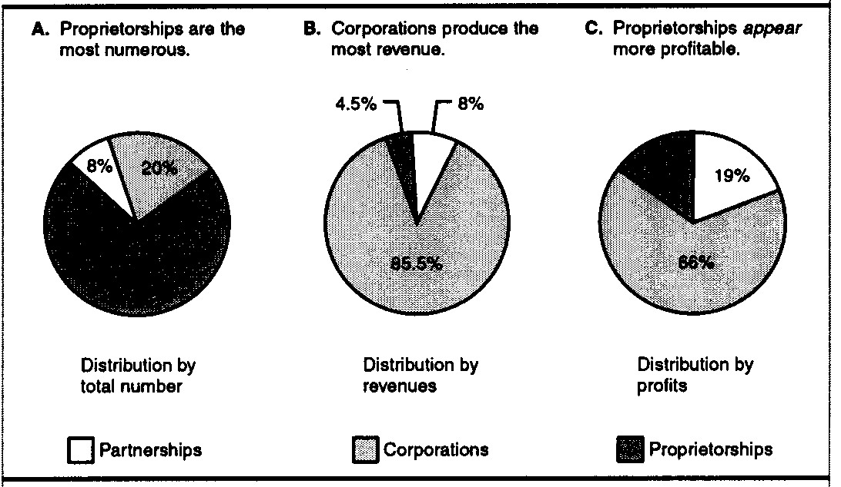
Relative Positions
Of Legal Forms

Slide 6
Legal Form By Industry

Slide 7
Legal Form
By Industry’s Receipts

Slide 8
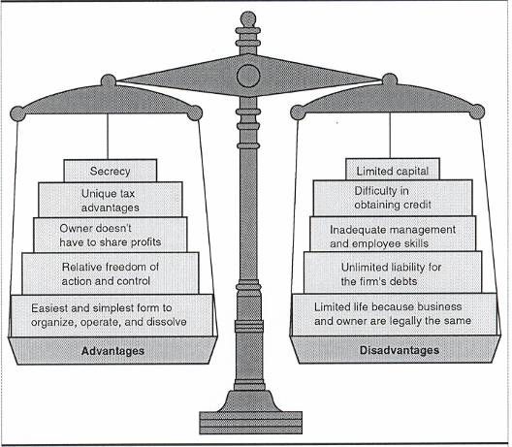
Advantages/Disadvantages
Of Proprietorship
Insert Figure 3.2

Slide 9
Partial List Of Federal
Tax Forms: Sole Proprietorship
Form 1040: Individual Income Tax Return
Schedule C: Business Profit(Loss)
Schedule SE: Self-Employment Tax
Form 1040ES: Estimated Tax For Individuals
Form 4562: Depreciation & Amortization
Form 8829: Expenses For Business Use Of Your Home
Forms 941, W-2, W-3: Employment Tax Forms

Slide 10
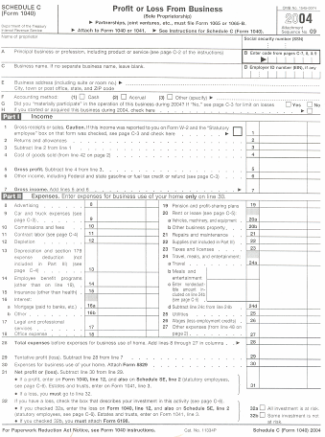
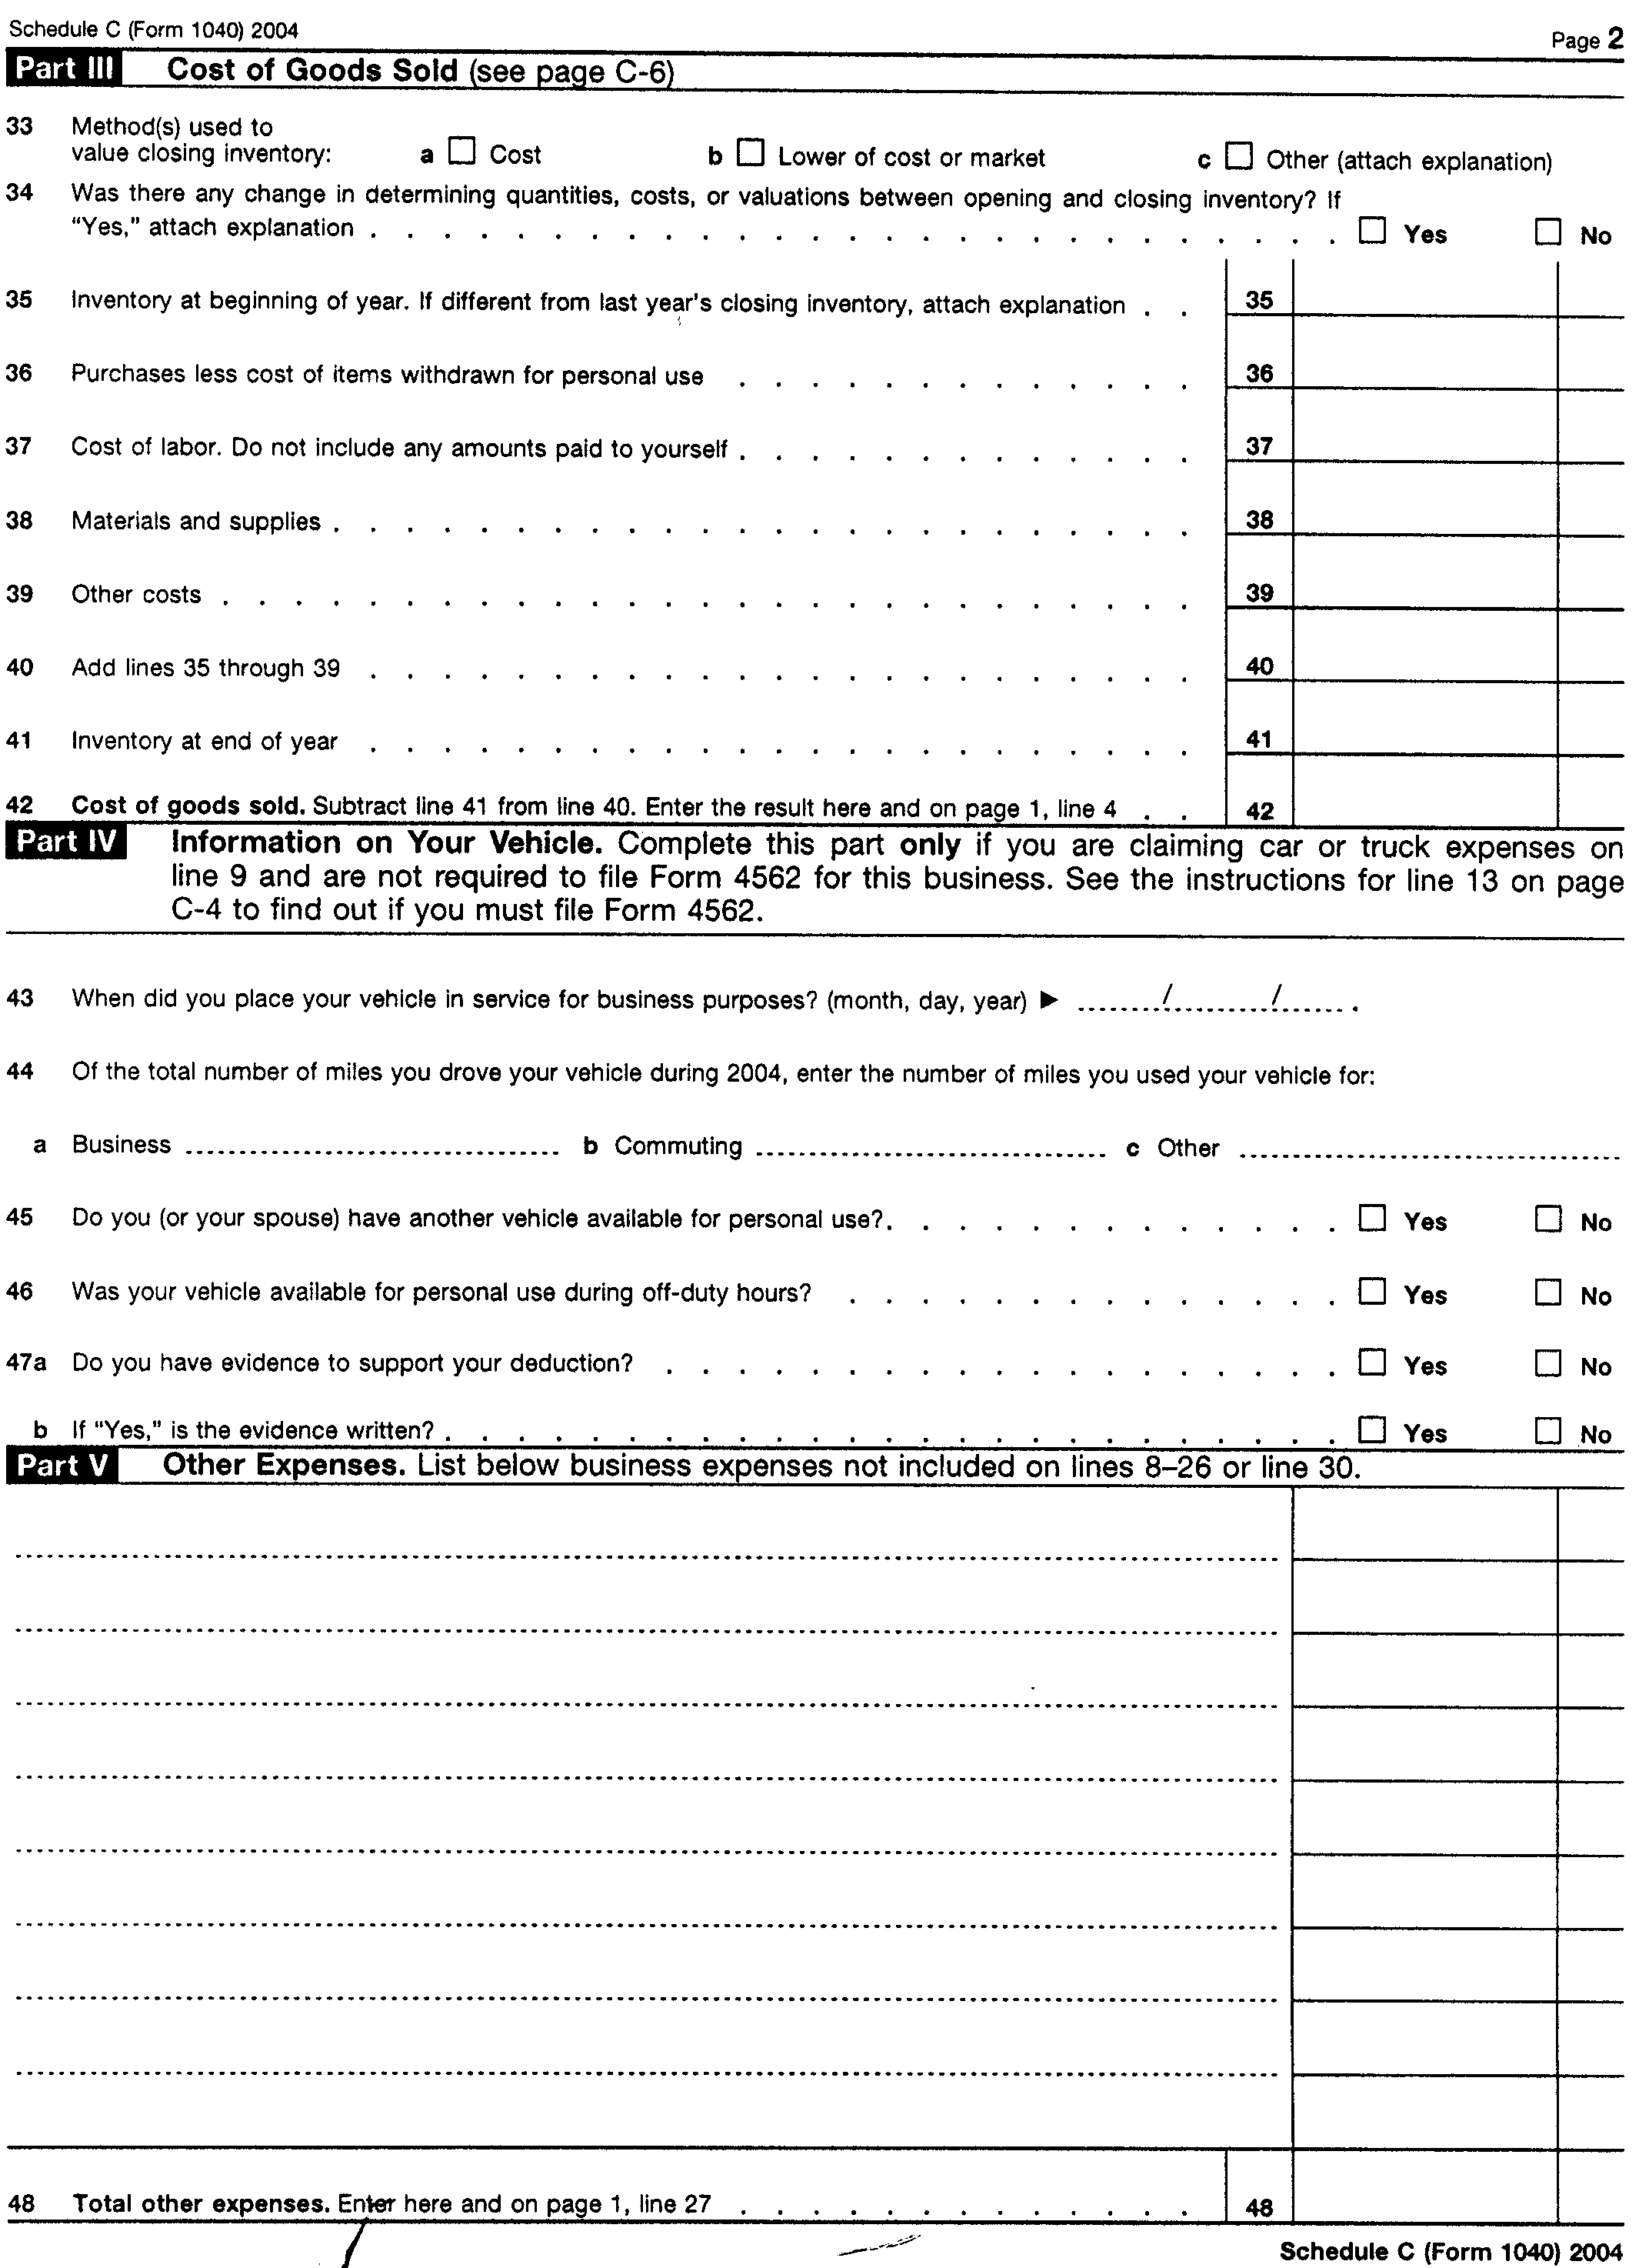
Schedule C
Front
Back

Slide 11
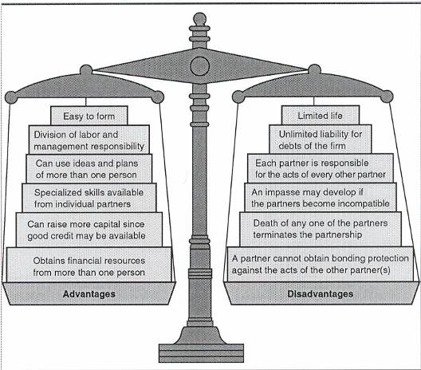
Advantages/Disadvantages
Of Partnership

Slide 12

General Partnership Operations
Uniform Partnership Act
Partners Responsible For Other Partners’ Actions
Liability:
  Personal Property At Risk
  All Debts Of Firm
Resolve Disputes Among Partners(?)
S. Wanke/PhotoLink/Getty Images

Slide 13
Types Of Partnerships
General
Partner
General
Partner
Partners Liable For Each Others’ Actions
General
Partner
General
Partner
Manage With Unlimited Liability
Limited
Partner
Limited
Partner
Limited
Partner
Liability = Capital Contribution

Slide 14

Partnership:
Legal/Tax Documents
Articles of Co-Partnership
Tax Forms
  Form 1065 K-1: Partner’s Share Of Income, Credit, Deductions
  Form 4562: Depreciation
  Form 1040: Individual Income Tax Return
  Schedule E: Supplemental Income & Loss
  Schedule SE: Self-Employment Tax
  Form 1040-ES: Estimated Tax For Individual

Slide 15
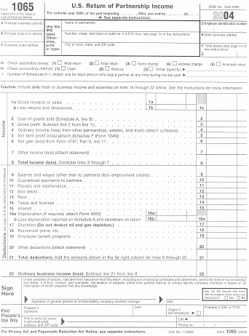
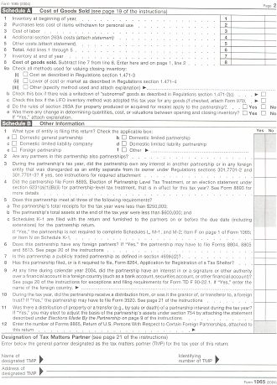
Form 1065 K-1 (Pages 1 & 2)
Front
Back

Slide 16
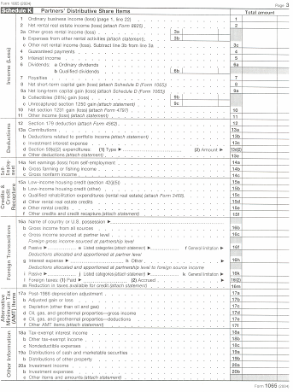
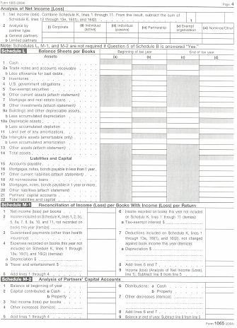
Form 1065 K-1 (Pages 3 & 4)
Front
Back

Slide 17
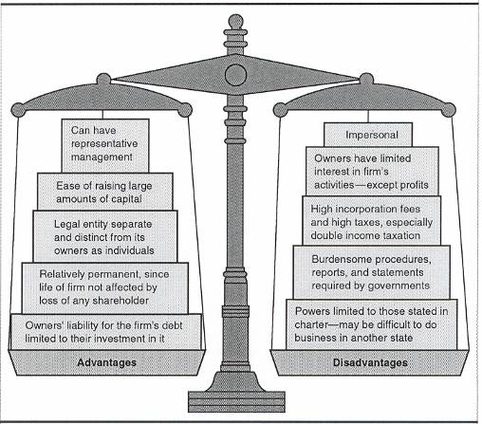
Advantages/Disadvantages
Of Corporation

Slide 18
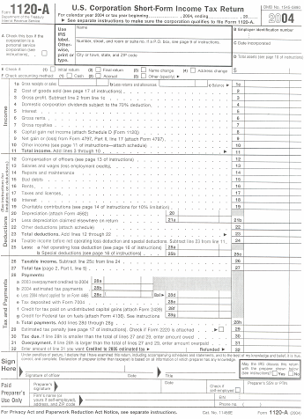
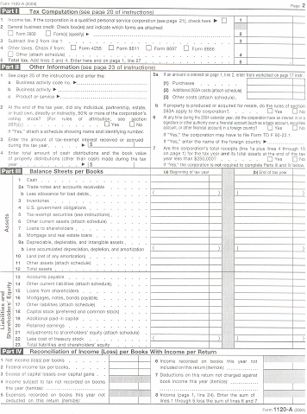
Form 1120A
Front
Back

Slide 19
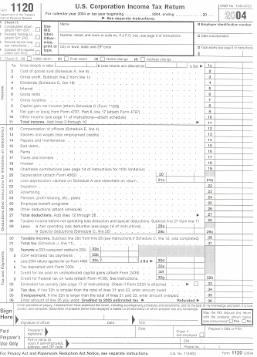
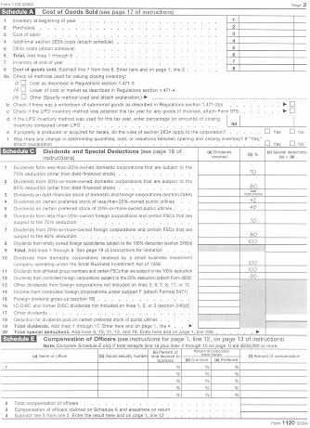
Form 1120 (Pages 1 & 2)
Front
Back

Slide 20
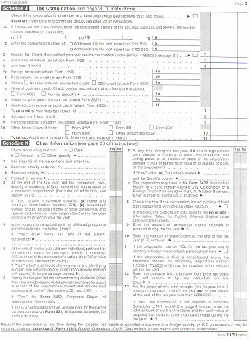
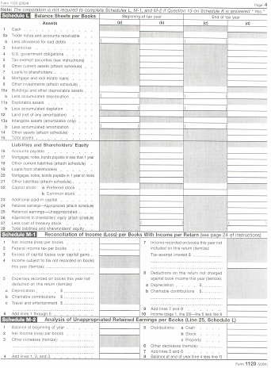
Form 1120 (Page 3 & 4)
Front
Back

Slide 21

Formation Of Corporation
Articles Of Incorporation- Filed With State
Corporate Charter- Comes From State
Buy-Sell Agreement- Include In Articles Of Incorporation

Slide 22
Corporate Governance
Stockholders
Elects
Board Of Directors
Appoints
Corporate Officers

Slide 23

S Corporation
Royalty-Free/CORBIS
Exempt From Multiple Taxation
Less Than 75 Stockholders
One Class Of Stock
No Corporations/Partnerships Can Be Stockholders
Stockholders= U.S. Citizens Or Permanent Residents
Early 1990s Lost Appeal Because Of Tax Law Change
TAXES

Slide 24
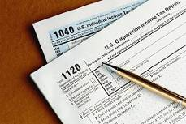
Partial List Of Federal
Tax Forms: S Corporation
Form 1120S: Income Tax Return For S Corporation
Form 1120S K-1: Shareholder’share Of Income, Credit, Deductions
Form 4625: Depreciation
Forms 941, W-2, W-3: Employment Tax Forms
Form 1040: Individual Income Tax Return
Schedule E: Supplemental Income(Loss)
Schedule SE: Self-Employment Tax
From 1040ES: Estimated Tax For Individuals
Other Forms
Royalty-Free/CORBIS

Slide 25
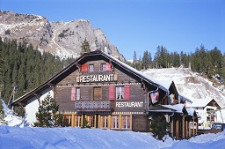
Limited Liability Companies
Since 1977
Benefits:
  Limited Liability
  Taxed As Partnership
Similar To S Corporation
Owners = Members
Lifespan- Determined At Organization
Emma Lee/Life File/Getty Images

Slide 26

Other Legal
Forms Of Ownership
Limited Liability Partnership
  Protects Individual Partners
  Not Recognized By Every State
Family Limited Liability Partnership
  Partners Related
  Agriculture/Family Farms
Professional Service Corporation
  Provides Licensed Professional Services
  Doctors, Lawyers, & Accountants
F. Schussler/PhotoLink/Getty Images

Slide 27

Other Legal
Forms Of Ownership (cont’d)
Nonprofit Corporations
  Civic, Charitable, Educational, Religious
  Tax Exempt
Cooperative
  Independent Producers
  Buys/Sells For Clients
Joint Venture
Fractional Ownership
Royalty-Free/CORBIS

Slide 28
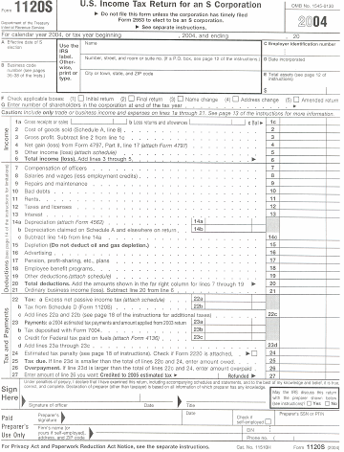
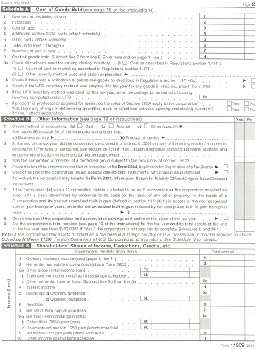
Form 1120S (Page 1 & 2)
Front
Back

Slide 29
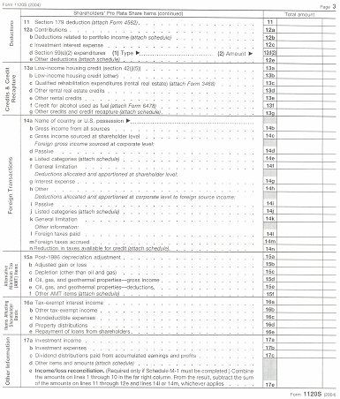
Form 1120S (Page 3)

Slide 30
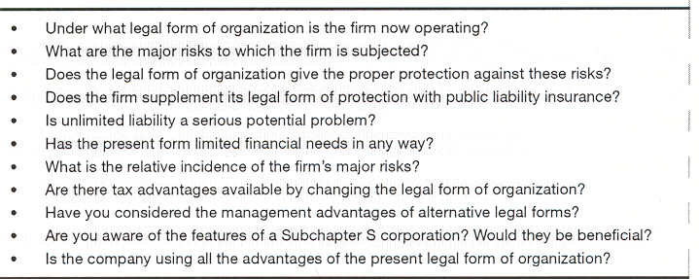
Checklist For
Legal Form Evaluation

