Slide 1
Entrepreneurship and small business Lecture two
Oeshwik Ahmed, Faculty of HRM, Northern University

Slide 2
Text book- Small business Management by Megginson and Byrd

Slide 3
Family-Owned Business
2
Chapter
Organizing/Operating Family-Owned Business
Family Relationships & Business
Preparing For Succession & The Next Generation
Tax/Estate Planning

Slide 4
Family & Business
Written Mission Statement
Include Children In Decisions
Family Discussions
McGraw-Hill/Irwin
© 2006 The McGraw-Hill Companies, Inc. All rights reserved.

Slide 5
Family Mission Statement
Start From Trust/Openness
Unanimous Agreement On Values & Vision
Copies To All
Avoid:
Rushing Family
Favoring An Agenda
Forgetting Purpose
Photodisc

Slide 6
Trends In Family Business
Royalty-Free/CORBIS
Kids Start Business & Get Capital From Parents
Parent Given Executive Position
Spouses Working Together- Service Businesses With Technology
Needs Clear Chain Of Command

Slide 7
Tips For Spousal Ownership
Monica Lau/Getty Images

Slide 8
Daughters Considering Succession To Family Business
Express Interest
Outside Experience
Learn From Seniors
Be Sensitive
Get Involved
Meet Women
Define Yourself
Develop A Vision
Royalty-Free/CORBIS

Slide 9
Successful Family Interaction
Founder = Head
Some Family In High Positions
Incur “Sense Of Ownership”
Deal With Incompetents
Compensate
Recognize Limitations

Slide 10
Steps In Divorce
Business Appraisal
Negotiate Buyout
Decide What To Do With Stock
Seek Tax Professionals

Slide 11
Family Culture & Business
Large Families
Stay-At-Home Mom
Develop Hobbies As Business
Working Moms Establish Business
Economy More Difficult
Need Additional Income
Large Business No Longer Family-Friendly
Keith Brofsky/Getty Images

Slide 12
Family Resources
Borrow Capital
Sell Stock
Selling Personal Assets
Other
PhotoLink/Getty Images

Slide 13
Next Generation Preparation
Start Part/Full-Time Job
Start Entry/Higher-Level Position In Business
Outside Experience
Rotate Jobs
Earn Promotions
Teaching/Training
Leave Work At Work
If Prepared, Give Responsibility

Slide 14
Succession Planning
Plan Early & Carefully
Groom Successor
http://www.businesslaw.gov
Doug Menuez/Getty Images

Slide 15
Succession Problems
Treat All Children Fairly
Nonfamily Employees?
Family Concerns:
Communication
Conflict
Estate Taxes
More Than 1 Child Succession

Slide 16
Succession Planning Obstacles: Founder
Financial Security
Sudden Free Time
Self-Esteem
Founder Fair To Successor(s)
Successor Ready?
Jealousy/ Rivalry To Successor
Effect On Spouse
Founder’s Fiduciary Responsibility To Nonfamily Employees
Friends Continue To Work
Fear Of Death
Reluctance To Release Power
Coaching Skills?
Source: Family Business Experts, www.familybusinessexperts.com

Slide 17
Succession Planning Obstacles: Family
Spouse’s Role In Business
Reluctance To Discuss Future Beyond Parents’ Life
Fairness vs. Favoritism
Fear Of Parents’ Death
Jack Hollingsworth/Getty Images
Source: Family Business Experts, www.familybusinessexperts.com

Slide 18
Succession Planning Obstacles: Employees
Personal Relationship With Founder
Differentiating Amongst Key Managers
Reluctance To Establish Formal Controls
Fear Of Change
Royalty-Free/CORBIS
Source: Family Business Experts, www.familybusinessexperts.com

Slide 19
Succession Planning Obstacles: Outsiders
Customers & Suppliers
Dependence On Founder
Trust/Confidence In Potential Successor
Royalty-Free/CORBIS
Source: Family Business Experts, www.familybusinessexperts.com

Slide 20
Causes Of Succession Family Leader:
Sudden Departure
Dies
Becomes Incapacitated
Planned Departure
Leaves Company
Retires
Royalty-Free/CORBIS \

Slide 21
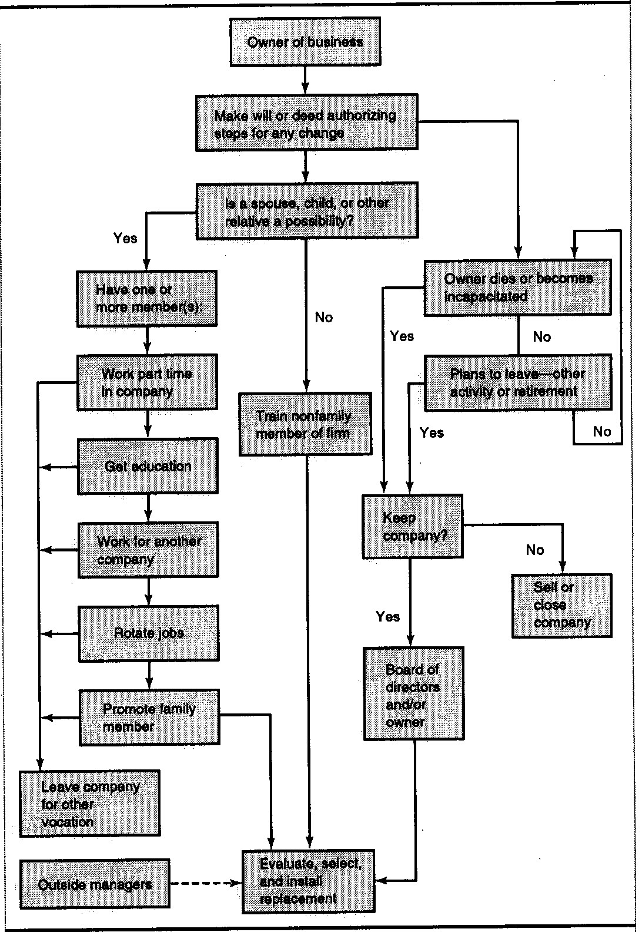
Family Leader: Replacement Options

Slide 22
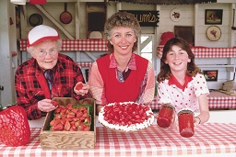
Selling To Family Members- Advantages
Stays In Family
Source Of Family Employment
Stature Maintained
Owner = Relax
Pleasure Of Success
Strengthen Family

Slide 23
Selling To Outsiders- Advantages
Assured Income
Lack Of Worry
Consult?
Release Tension
Relief Of Responsibility

Slide 24
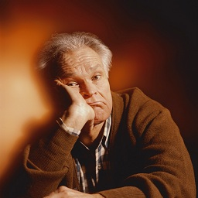
Selling To Outsiders- Disadvantages
Loss Of Family ID
Loss = Sadness
Greg Kuchik/Getty Images

Slide 25
Ease The Transition For Owner
Broaden Focus
Devote Time To:
Hobbies
Other Groups
Gradually Turn Over Control
Doug Menuez/Getty Images

Slide 26
Estate Planning Issues
Minimize Taxes
Retain Control
Maintain Business Flexibility
Steven Cole/Getty Images

Slide 27
Inc. 500 CEOs’ Net Worth
Source: Inc. Magazine, “Compensation”, November 2004.

Slide 28
INC. 500 CEOs’ Take-Home Pay
Source: Inc. Magazine, “Compensation”, November 2004.

Slide 29
Financial Planning
Tax - Annual Conferences With Tax Accountant
Estate – Transfer Of Assets At Death
Perpetuation
Liquidity
Business Standpoint
Reduce Cash Strain
Maintain Beneficiaries’ Interest
Smooth Transition
Keith Brofsky/Getty Images

Slide 30
Estate Planning Techniques
Gifts
Stock Sales
Living Trusts
Family Limited Partnerships
Minimize Cost
Retain Control
Buy/Sell Agreement
PhotoLink/Getty Images

Slide 31
Business Valuation
Comparables
Earnings Capitalization
Book Value

