Slide 1
CHAPTER 2
Trends in Human Resource Management
Oeshwik Ahmed, Faculty of HRM, Northern University

Slide 2
fundamentals of
Human Resource Management 4th edition by R.A. Noe, J.R. Hollenbeck, B. Gerhart, and P.M. Wright
CHAPTER 2
Trends in Human Resource Management
Notes:
This chapter describes major trends that are affecting human resource management.
2

Slide 3
What Do I Need to Know?
Describe trends in the labor force composition and how they affect human resource management.
Summarize areas in which human resource management can support the goal of creating a high-performance work system.
Define employee empowerment and explain its role in the modern organization.
Notes:
After reading and discussing this chapter, you should be able to:

Slide 4
What Do I Need to Know? (continued)
Identify ways HR professionals can support organizational strategies for quality, growth, and efficiency.
Summarize ways in which HRM can support organizations expanding internationally.
Discuss how technological developments are affecting human resource management.
Notes:
After reading and discussing this chapter, you should be able to:

Slide 5
What Do I Need to Know? (continued)
Explain how the nature of the employment relationship is changing.
Discuss how the need for flexibility affects human resource management.
Notes:
After reading and discussing this chapter, you should be able to:
More than ever, organizations today must be able to respond creatively to uncertainty and change.

Slide 6
The Labor Force
Internal Labor Force
External Labor Market
An organization’s workers
  Its employees
  The people who have contracts to work at the organization
The internal labor force has been drawn from the external labor market.
Individuals who are actively seeking employment.
The number and kinds of people in the external labor market determine the kinds of human resources available to an organization.
Notes:
The term labor force is the general way to refer to all the people willing and able to work.
For an organization, the labor force consists of;
Internal Labor Force
External Labor Market
HR professionals need to be aware of trends in the composition of the external labor market because these trends affect the organization’s options for creating a well-skilled, motivated internal labor force.

Slide 7
Change in the Labor Force
An Aging Workforce
A Diverse Workforce
Skill Deficiencies of the Workforce
Notes:
Human resource professionals need to be aware of trends in the composition of the external labor market, because these trends affect the organization’s options for creating a well-skilled, motivated internal labor force.
The key trends are:
An aging workforce
A diverse workforce
Skill deficiencies of the workforce

Slide 8
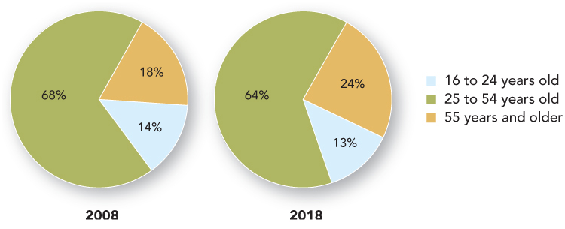
Figure 2.1: Age Distribution of U.S Labor Force, 2008 and 2018
Notes:
The Bureau of Labor Statistics (BLS) has projected that from 2008 to 2018, the total U.S. civilian labor force will grow from 154 million to 167 million workers.
Figure 2.1 highlights the changes to the labor force
Some of the expected change involves the distribution of workers by age.
From 2008 to 2018, the fastest-growing age group is expected to be workers 55 and older.
The 25- to 44-year-old group will increase its numbers slightly, so its share of the total workforce will fall.
And young workers between the ages of 16 and 24 will actually be fewer in number.

Slide 9
HRM Implications of the Aging Workforce
HR professionals will spend much of their time on concerns related to retirement planning, retraining older workers, and motivating workers whose careers have reached a plateau.
Organizations will struggle with ways to control the rising costs of health care and other benefits.
Many of tomorrow’s managers will supervise employees much older than themselves.
Organizations will have to find ways to attract, retain, and prepare the youth labor force.
Notes:
There are several practical implications of the aging workforce.
HR professionals will spend much of their time on concerns related to retirement planning, retraining older workers, and motivating workers whose careers have reached a plateau.
Organizations will struggle with ways to control the rising costs of health care and other benefits.
Many of tomorrow’s managers will supervise employees much older than themselves.
Organizations will have to find ways to attract, retain, and prepare the youth labor force.

Slide 10

As more and more of the workforce reaches retirement age, some companies have set up mentoring programs between older and younger workers so that knowledge is not lost but passed on.
Notes:
Ask the students: “How does the company benefit from these mentoring programs?”

Slide 11
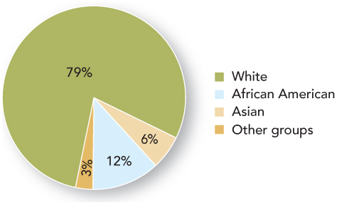
Figure 2.2: Projected Racial/Ethnic Makeup of the U.S. Workforce, 2018
Notes:
Another kind of change affecting the U.S. labor force is that it is growing more diverse in racial, ethnic, and gender terms.
As Figure 2.2 shows, the 2018 workforce is expected to be 79 percent white, 12 percent black, and 9 percent Asian and other groups.
The fastest growing category is expected to be Asian and “other groups” because of immigration and birthrates above the national average.
In addition to these racial categories, the ethnic category of Hispanics is growing equally fast, and the Hispanic share of the U.S. labor force is expected to reach 18 percent of the total in 2018.
More women are in the paid labor force than in the past, and the labor force participation rate for men has been slowly declining. By 2018, the share of women in the labor force is expected to reach about 47 percent.

Slide 12
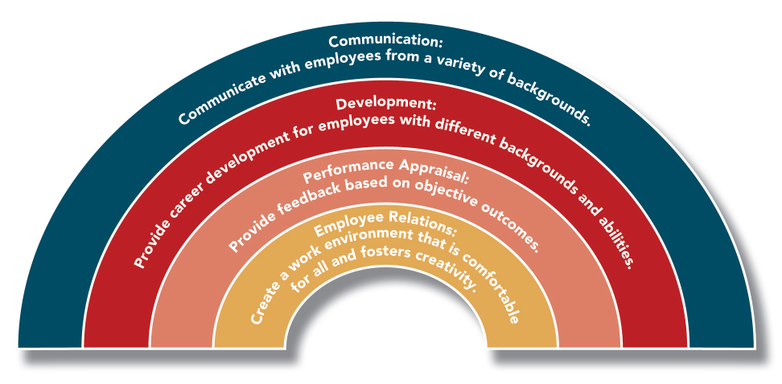
Figure 2.3: HRM Practices That Support Diversity Management
Notes:
Throughout the text and subsequent presentations, the authors will show how diversity affects HRM practices.
For example, from a staffing perspective, it is important to ensure that tests used to select employees are not unfairly biased against minority groups.
From the perspective of work design, employees need flexible schedules that allow them to meet non-work needs.
In terms of training, it is clear that employees must be made aware of the damage that stereotypes can do.
With regard to compensation, organizations are providing benefits such as elder care and day care as a way to accommodate the needs of a diverse workforce.
Successfully managing diversity is also critical for companies that compete in international markets.

Slide 13
Skill Deficiencies in Workforce
A = True B = False
Use of computers to do routine tasks has changed the kinds of skills needed by employees.
A college degree is not as important as it once was.
U.S. production jobs require intelligence and skills as much as strength.
Notes:
Use of computers to do routine tasks has changed the kinds of skills needed by employees.
True - The increasing use of computers to do routine tasks has shifted the kinds of skills needed for employees in the U.S. economy.
A college degree is not as important as it once was.
False - Most organizations are looking for educational achievements and a college degree is a basic requirement for many jobs today.
U.S. production jobs require intelligence and skills as much as strength.
True, workers often must operate sophisticated computer-controlled machinery, monitor quality levels, and work as part of a team requiring emotional intelligence, as well.
In general, employees must be able to handle a variety of responsibilities, interact with customers, and think creatively.
The gap between skills needed and skills available has:
Decreased ability to compete because they sometimes lack the skills to upgrade technology, reorganize work, and empower employees.

Slide 14
Skill Deficiencies of the Workforce
Today, employers are looking for:
  mathematical skills
  verbal skills
  interpersonal skills
  computer skills
The gap between skills needed and skills available has decreased companies ability to compete.
They sometimes lack the capacity to upgrade technology, reorganize work, and empower employees.
Notes:
Today’s employees must be able to handle a variety of responsibilities, interact with customers, and think creatively.
To find such employees, most organizations are looking for educational achievements. A college degree is a basic requirement for many jobs today.
Some companies are unable to find qualified employees and instead rely on training to correct skill deficiencies.
Other companies team up with universities, community colleges, and high schools to design and teach courses ranging from basic reading to design blueprint reading.

Slide 15
High-Performance Work Systems
Organizations that have the best possible fit between their:
  social system (people and how they interact); and
  technical system (equipment and processes).
Key trends occurring in today’s high-performance work systems:
  reliance on knowledge workers
  the empowerment of employees to make decisions
  the use of teamwork
Notes:
HRM is playing an important role in helping organization’s gain and keep an advantage over competitors by becoming high-performance work systems.
Organizations must make full use of their people’s knowledge and skill, to meet customer demands for high quality and customized products. Skilled HR management can help organizations do this.
There are three key trends occurring in today’s high-performance work systems:
Reliance on knowledge workers
The empowerment of employees to make decisions
The use of teamwork
These trends are discussed on the slides that follow.

Slide 16
Knowledge Workers
Employees whose contribution to the organization is specialized knowledge, such as:
  knowledge of customers
  knowledge of a process
  knowledge of a profession
They are especially needed for jobs in:
  health services
  business services
  social services
  engineering
  management
Notes:
The high-growth jobs discussed in Chapter 2 and shown on the next slide generally require specialized knowledge.
To meet their human capital needs, companies are increasingly trying to attract, develop, and retain knowledge workers.
Knowledge workers are in a position of power, because they own the knowledge that the company needs in order to produce its products and services. They must share their knowledge and collaborate with others in order for their employer to succeed.

Slide 17
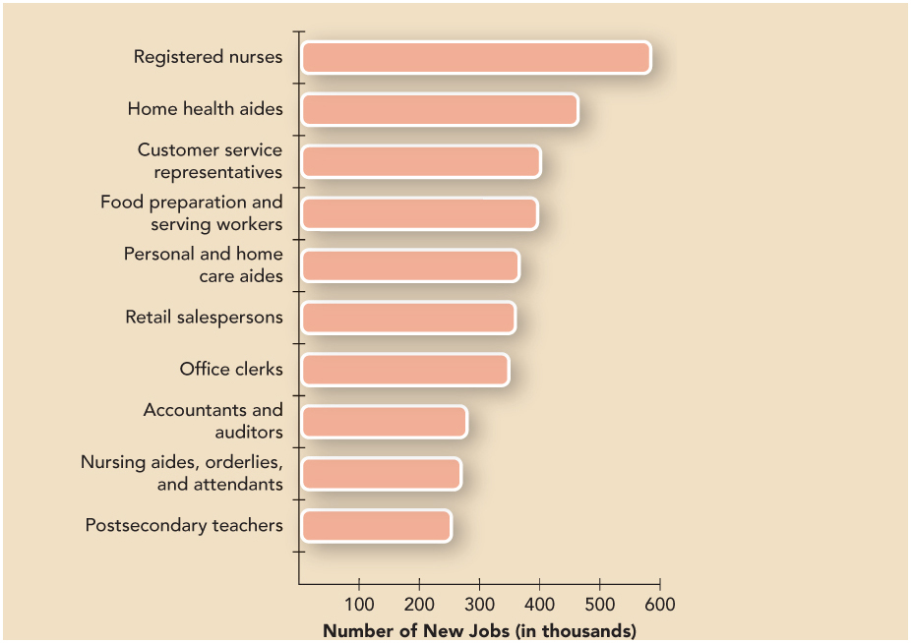
Top 10 Occupations for Job Growth
Notes:
This slide lists the 10 occupations expected to gain the most jobs between 2008 and 2018.
Of the jobs expected to have the greatest percentage increases, most are related to healthcare and computers.
The fastest-growing occupations are: biomedical engineers, network systems and data communications analysts, home health aides, personal and home care aides, and financial examiners. Many of these occupations require a college degree.

Slide 18
Test Your Knowledge
Ensuring that knowledge workers will share information and store it so that it is easily retrieved by others is the concern of which of the following HR activities.
  Turnover
  Employee Empowerment
  Knowledge Management
  Employee Selection
Notes:
Ensuring that knowledge workers will share information and store it so that it is easily retrieved by others is the concern of which of the following HR activities.
Turnover
Employee Empowerment
Knowledge Management
Employee Selection
Answer – C – knowledge management

Slide 19
Employee Empowerment
Employee Empowerment
Employee Engagement
Giving employees responsibility and authority to make decisions regarding all aspects of product development or customer service.
Full involvement in one’s work and commitment to one’s job and company.
This is associated with:
  higher productivity
  better customer service
  lower employee turnover
Notes:
To completely benefit from employees’ knowledge, organizations need a management style that focuses developing and empowering employees.

Slide 20
Teamwork
The assignment of work to groups of employees with various skills who interact to assemble a product or provide a service.
Work teams often assume many of the activities traditionally reserved for managers:
  selecting new team members
  scheduling work
  coordinating work with customers and other units of the organization
Notes:
Modern technology places the information that employees need for improving quality and providing customer service right at the point of sale or production.
As a result, the employees engaging in selling and producing must be able to make decisions about how to do their work.
One of the most popular ways to increase employee responsibility and control is to assign work to teams.
Teamwork can motivate employees by making work more interesting and significant.

Slide 21
Test Your Knowledge
Sharon is a very smart and conscientious worker. Lately, she has felt that her ideas were disregarded and she was denied autonomy in completing her work. This situation is probably caused by a lack of
  Employee Empowerment
  Knowledge Management
  Turnover
  Teamwork
Notes:
Sharon is a very smart and conscientious worker. Lately, she has felt that her ideas were disregarded and she was denied autonomy in completing her work. This situation is probably caused by a lack of
Employee Empowerment
Knowledge Management
Turnover
Teamwork
Answer – “A”

Slide 22
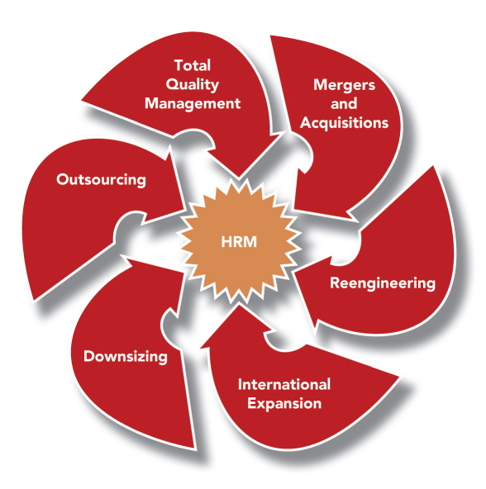
Figure 2-4: Strategic Business Issues Affecting HRM
Notes:
HR professionals are increasingly being asked to use their knowledge of the business and of human resources to help the organization develop strategies and align HRM policies and practices with those strategies.
Figure 2.4 summarizes the strategic issues facing human resource management.
These issues will be discussed on the slides that follow.

Slide 23
Total Quality Management (TQM)
TQM is a companywide effort to continuously improve the ways people, machines, and systems accomplish work.
The TQM approach provides guidelines for all the organization’s activities, including HRM.
Notes:
To compete in today’s economy, companies need to provide high-quality products and services.
If companies do not adhere to quality standards, they will have difficulty selling their product or service to vendors, suppliers, or customers.
Therefore, many organizations have adopted some form of total quality management (TQM).

Slide 24
TQM Core Values
Methods and processes are designed to meet the needs of internal and external customers.
Every employee in the organization receives training in quality.
Quality is designed into a product or service so that errors are prevented from occurring.
The organization promotes cooperation with vendors, suppliers, and customers to improve quality and hold down costs.
Managers measure progress with feedback based on data.

Slide 25
Mergers and Acquisitions
HRM should have a significant role in carrying out a merger or acquisition.
  Differences between the businesses involved in the deal make conflict inevitable.
  Training should include developing conflict resolution skills.
  There is a need to sort out differences in the two companies’ practices with regard to compensation, performance appraisal, and other HR systems.
Notes:
Often organizations join forces through mergers (two companies becoming one) and acquisitions (one company buying another).
HRM should have a significant role in carrying out a merger or acquisition:

Slide 26
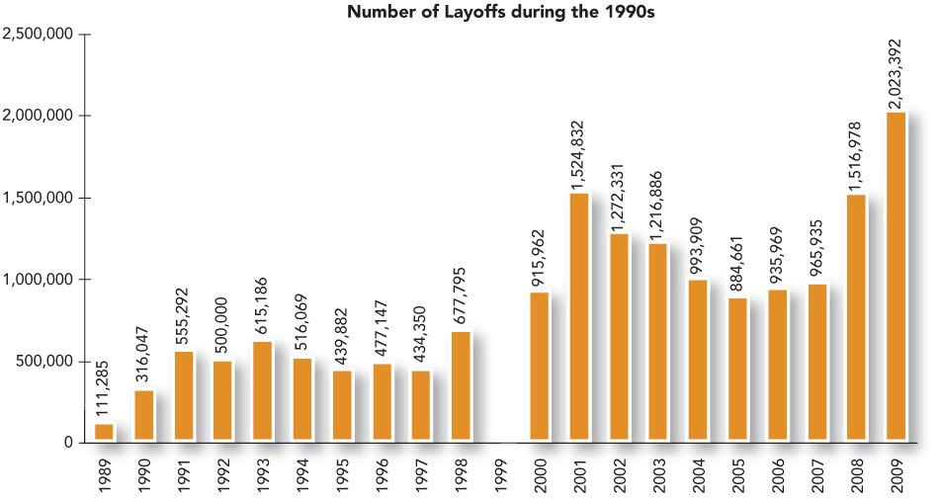
Figure 2.5: Number of Employees Laid Off During the Past Decade
Notes:
Downsizing presents a number of challenges and opportunities for HRM.
In terms of challenges, the HRM function must “surgically” reduce the workforce by cutting only the workers who are less valuable in their performance.
Achieving this is difficult because the best workers are most able (and often willing) to find alternative employment and may leave voluntarily before the organization lays off anyone.
Figure 2.5 illustrates the magnitude of the downsizing problem.

Slide 27
Reengineering
A complete review of the organization’s critical work processes to make them more efficient and able to deliver higher quality.
Involves reviewing all the processes performed by all the organization’s major functions.
  This includes human resources management.
Notes:
Rapidly changing customer needs and technology have caused many organizations to rethink the way they get work done. Therefore, many organizations have undertaken reengineering.

Slide 28
Reengineering (continued)
Reengineering affects human resource management in two ways:
  The way the HR department itself accomplishes its goals may change dramatically.
  The fundamental change throughout the organization requires the HR department to help design and implement change so that all employees will be committed to the success of the reengineered organization.
Notes:
Employees may need training for their reengineered jobs.
The organization may need to redesign the structure of its pay and benefits to make them more appropriate for its new way of operating.
It also may need to recruit employees with a new set of skills.

Slide 29
Outsourcing
Outsourcing – the practice of having another company (a vendor, third-party provider, or consultant) provide services.
Outsourcing gives the company access to in-depth expertise and is often more economical as well.
HR departments help with a transition to outsourcing.
Notes:
Many organizations are increasingly outsourcing business activities.
Many HR functions are being outsourced. One recent study suggests that 8 out of 10 companies outsource at least one human resource activity.

Slide 30
Expanding into Global Markets
Offshoring
The International Labor Pool
Moving operations from the country where a company is headquartered to a country where pay rates are lower but the necessary skills are available.
Hiring at home may may involve selection of employees from other countries.
The beginning of the 21st century has seen significant immigration.
Notes:
To survive, companies must compete in international markets.
Companies must develop global markets, keep up with competition from overseas, hire from an international labor pool, and prepare employees for global assignments.

Slide 31
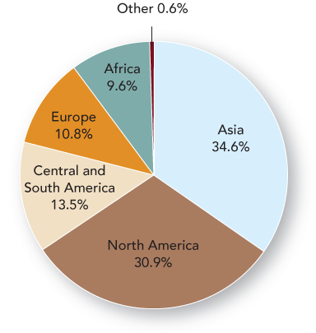
Figure 2.6: Where Immigrants to the U.S. Came from in 2008
Notes:
In 2008, over 1.1 million people obtained permanent resident status in the U.S.
Figure 2.6 shows the distribution of immigration by continent of origin.
Employers in tight labor markets (i.e., computer science, engineering, and information systems) are especially likely to recruit international students.

Slide 32
International Assignments
Besides hiring an international workforce, organizations must be prepared to send employees to other countries.
This requires HR expertise in selecting and preparing employees for international assignments.
Employees who take assignments in other countries are called expatriates.

Slide 33
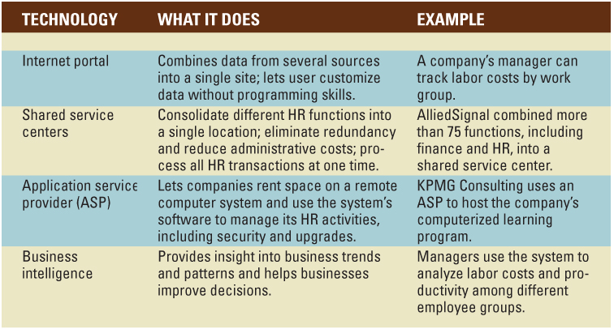
Table 2.1:
New Technologies Influencing HRM
Notes:
Advances in computer-related technology have had a major impact on the use of information for managing human resources.
Table 2.1 describes some of the technologies that may be included in an organization’s human resource information system (HRIS).

Slide 34
Human Resource Information System (HRIS)
A computer system used to acquire, store, manipulate, analyze, retrieve, and distribute information related to an organization’s human resources. An HRIS can:
  support strategic decision making
  help the organization avoid lawsuits
  provide data for evaluating programs or policies
  support day-to-day HR decisions
Notes:
Table 2.1 (on the previous slide) describes some of the new technologies that may be included in an organization’s HRIS.

Slide 35
Electronic Human Resource Management (e-HRM)
e-HRM: the processing and transmission of digitized HR information especially using computer networking and the Internet.
e-HRM has the potential to change all traditional HRM functions.
Self-Service: System in which employees have online access to information about HR issues and go online to enroll themselves in programs and provide feedback through surveys
Notes:
HRM activities have moved onto the Internet.

Slide 36
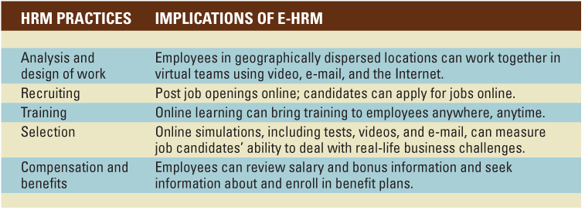
Table 2.2: Implications of e-HRM for HRM Practices
Notes:
E-HRM has the potential to change all traditional HRM functions.
Table 2.2 shows some major implications of e-HRM.
Privacy is an important issue in e-HRM. A great deal of information is confidential and not suitable for posting on a Web site for everyone to see.

Slide 37
Change in the Employment Relationship
A New Psychological Contract
Flexibility
Flexible Staffing Levels
Flexible Work Schedules
Notes:
Technology and the other trends described in Chapter 2 and in this presentation require managers at all levels to make rapid changes in response to new opportunities, competitive challenges, and customer demands.
These changes are most likely to succeed in flexible, forward-thinking organizations, and the employees who will thrive in such an environment need to be flexible and open to change as well.
In this environment, employers and employees have begun to reshape the employment relationship:
A new psychological contract
Flexibility
Flexible staffing levels
Flexible work schedules

Slide 38
The Nature of the Employment Relationship is Changing
The employment relationship takes the form of a “psychological contract” that describes what employees and employers expect from the employment relationship.
In the traditional version, organizations expected employees to contribute time, effort, skills, abilities, and loyalty in exchange for job security and opportunities for promotion.
Today, organizations’ needs are constantly changing.

Slide 39
The Nature of the Employment Relationship is Changing (continued)
Today, organizations are requiring top performance and longer work hours but cannot provide job security.
Instead, employees are looking for:
  flexible work schedules
  comfortable working conditions
  greater autonomy
  opportunities for training and development
  performance-related financial incentives
This requires planning for flexible staffing levels.

Slide 40
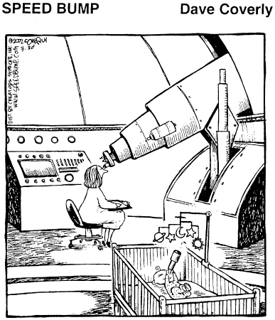
Flexibility: A Family-Friendly Work Arrangement

Slide 41
The Need for Flexibility Affects HRM
Organizations seek flexibility in staffing levels through alternatives to the traditional employment relationship:
  outsourcing, temporary, and contract workers
  flexible work schedules – including shortened work weeks
  allowing employees to adjust work hours to meet personal and family needs
  moving employees to different jobs to meet changes in demand

Slide 42
Summary
An organization’s internal labor force comes from its external labor market
In the U.S., this labor market is aging and becoming more racially and ethnically diverse.
Organizations must recruit from a diverse population, establish bias-free HR systems, and help employees understand and appreciate cultural differences.
HRM can help organizations find and keep the best possible fit between their social system and technical system.

Slide 43
Summary (continued)
Job design and appropriate systems for assessment and rewards have a central role in supporting employee empowerment and teamwork.
Employee empowerment means giving employees responsibility and authority to make decisions regarding all aspects of product development or customer service.
HRM must design jobs to give employees latitude for decision-making and interpersonal skills.

Slide 44
Summary (continued)
HR professionals should be familiar with the organization’s strategy and may even play a role in developing the strategy.
Specific HR practices vary according to type of strategy.
Organizations with international operations hire employees in foreign countries where they operate, so they need knowledge of differences in culture and business practices.

Slide 45
Summary (continued)
Information systems have become a tool for more HR professionals, and often these systems are provided through the Internet.
Online information sharing enables employee self-service for many HR needs.
The employment relationship takes the form of a “psychological contract” that describes what employees and employers expect from the employment relationship.
The traditional employment relationship is changing.

Slide 46
Summary (continued)
Organizations seek flexibility in staffing levels through alternatives to the traditional employment relationship.
Organizations also may seek flexible work schedules.
  Shortened workweeks
  Adjust work hours as a way for employees to meet personal needs

