Slide 1
Chapter 1
An Investment Perspective of Human Resource Management
Suggested book: A strategic Human Resource Management (2nd Ed) Charles R Greer.

Slide 2
The strategic view of Human Resource Management
Employees are human assets that increase in value to the organization and the marketplace when investment of appropriate policies and programs are applied.
Effective organization recognize that their employees do have the value, much as the same as the organization’s physical and capital asset have value.
Employees are a valuable source of sustainable competitive advantage.

Slide 3
Investment-Oriented Organization
They sees people as central to mission and strategy
Mission statement and strategic objectives incorporate the value of human assets in achieving goals.
Management Philosophy encourages the development and retention of Human assets
They do not treat human asset in the same way as physical assets.

Slide 4
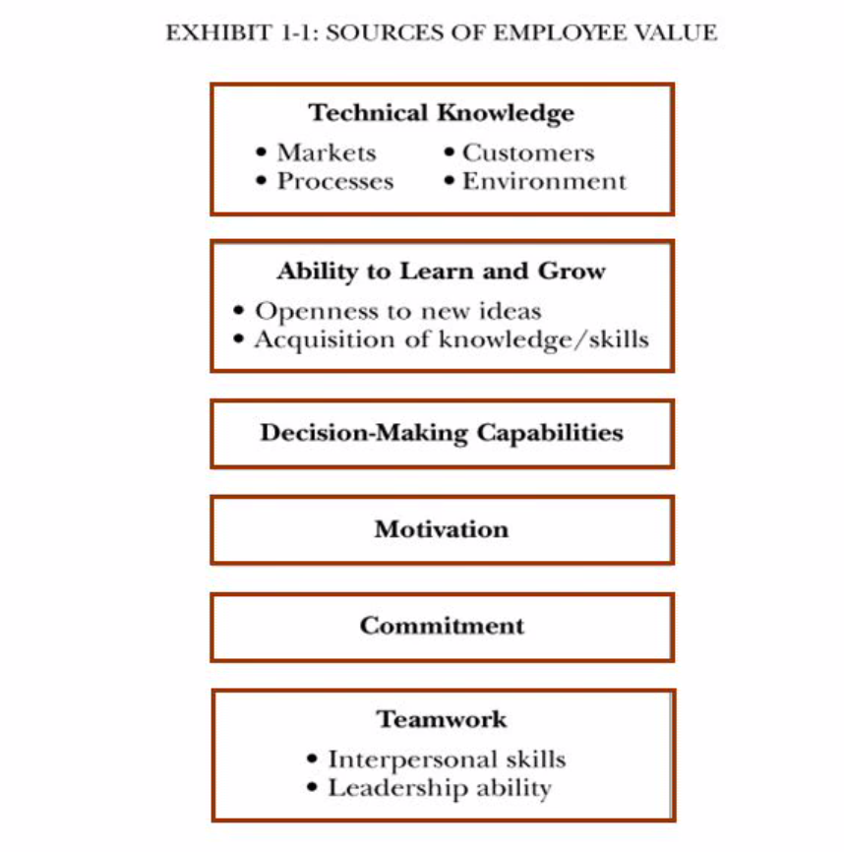

Slide 5
Sources of Sustainable Competitive Advantage
Valuable to the firm in that it exploits weakness or neutralizes threats.
Must be rare among competitors.
Must be difficult for competitors to imitate.
Must not be easily substitutable.

Slide 6
The New competitive Environment
Shortened product Life-cycles
Erosion of patent protection
Decreased regulation and protected markets
Increased access to capital markets
Increasing Importance of innovation, both process and product.

Slide 7
HR and competitive advantage
The international Motor Vehicle study, a worldwide research study of the automobile industry conducted at MIT showed that people-centered practices were associated with almost twice the productivity and quality as conventional mass production
Similar studies in steel, apparel and semiconductors, sponsored by the Alfred P. Sloan Foundation, revel similar positive effects for people-centric practices.

Slide 8
An investment perspective thinks about-
The best way to invest in people
Costs- Out of pocket vs Opportunity
Human Assets become competitive advantage
Required skills become less manual more knowledge based
Appropriate, integrated, strategy-consistent approach is needed.

Slide 9
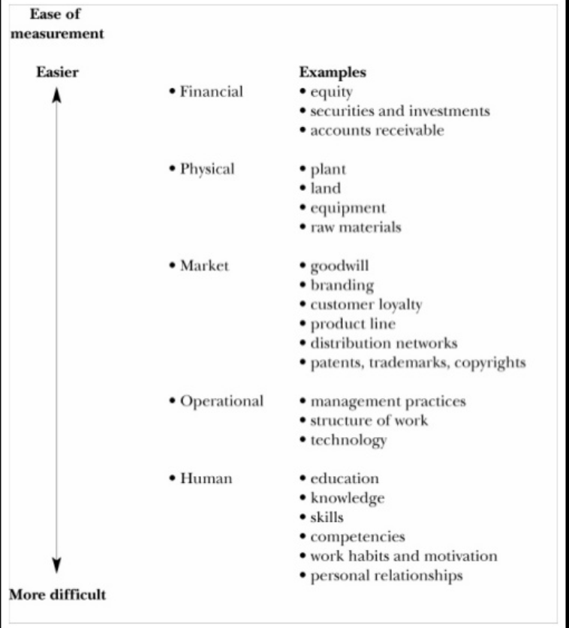

Slide 10
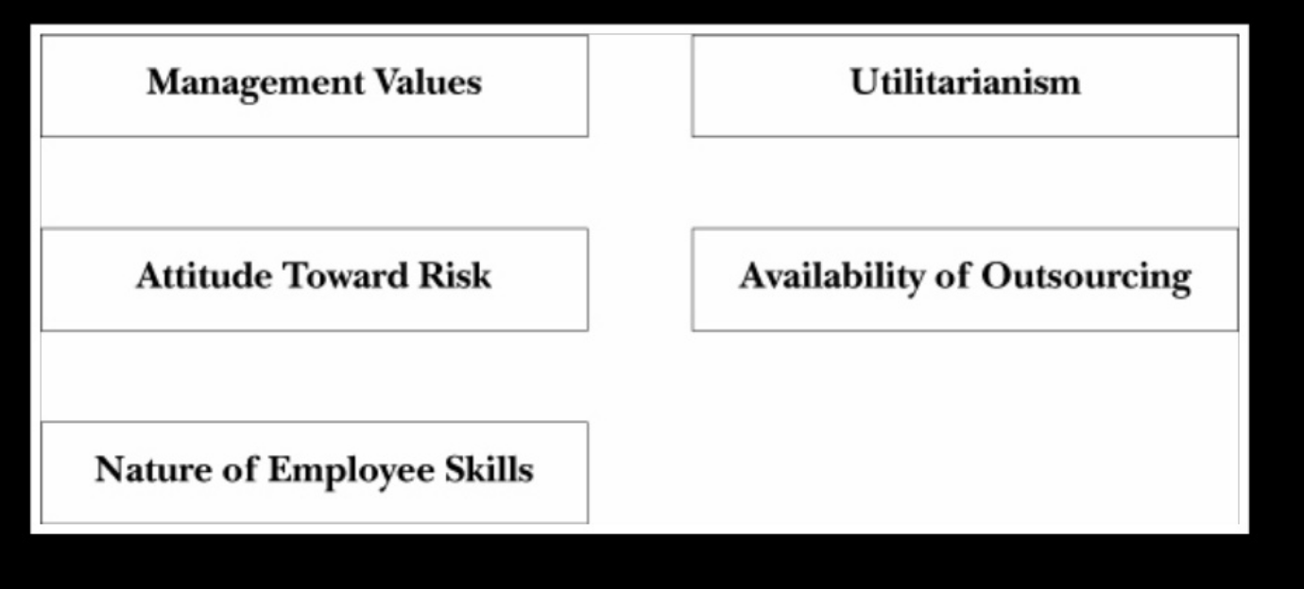
Factors Influencing Investment Orientation

Slide 11
Senior Management values and actions –
Managers need investment orientation towards people
Attitude towards risk-
Investment in human resource inherently riskier
Human assets never absolutely owned
Nature of Skills needed by employees-
The more marketable employee skills the riskier the firms investment in skill development

Slide 12
Utilitarian (Bottom line ) mentality
Attempt made to quantify employee worth through cost benefit analysis
Soft benefits of HR programs difficult to objectively quantify
Availability of Outsourcing
Given availability of cost effective outsourcing, investment in HR should produce highest returns and sustainable competitive advantage.

Slide 13
RISKS
Failure to invest in employees causes-
Inefficiency
Weakening of organizations competitive position
Human Assets are risky investments
Requires constant evaluation and feedback to measure the success.

Slide 14
Mercer Model of Measuring HR impact
Identify Problem HR can impact
Calculate actual cost of problem
Choose HR solution that addresses problem
Calculate cost of solution
Calculate value of improvement 6 to 24 months after implementation
Calculate specific return on investment
ROI in human asset often not realized until some time in future.

Slide 15
Investment in Training
It is important to differentiate between specific and general training.
In reality employers invest more in general training.
General training occurs in the form of on the job training. Such as SAP training for finance officers with a discounted salary.

Slide 16
Investment in Employability
Employers focus on making employees more employable through a learning environment, training and retraining thus providing growth opportunities.
Example: General Electronics. Their CEO had the vision of attracting employees with desirable achievement opportunities instead of job securities to maintain a stable workforce.

Slide 17
Investment in management development
Needs forecasted trends in the managerial environment.
Less hierarchical organization has lower number of middle management positions.
More work is now done in task forces or teams
Job rotation programs and cross functional assignments for managers are used to develop managers with challenging assignments (mostly used in larger workforce related companies and less in service industries.)

Slide 18
Investment practice for improved retention
Improving organizational Culture and interpersonal relationship values.
Effective selection procedure
Compensation and benefits
Job enrichment and job satisfaction
Provide work life balance
Confidence about the future – good org growth
Retention of technical employees

Slide 19
Recognizing the costs of downsizing and layoff
Firms lay off practices makes it less attractive to potential employer.
10-15% of an organization workforce will often quit after layoff.
The uncertainty of the future creates dissatisfaction.
Bumping effect. ( As lower level employees are laid off there is a time when the least seniors have been bumped out of a job causing training needs and union problems.)
Administrative costs.
Termination costs.
Read table 1-2

Slide 20
Alternates to avoiding lay offs
Direct human resource planning towards employment stability
Place emphasis on training and retraining
Maintain lean staffing
Maintain stability with buffers ( part timers, overtime)
Performance appraisal and evaluations.
Select product with long term retention goals
Probationary period for new hires.

Slide 21
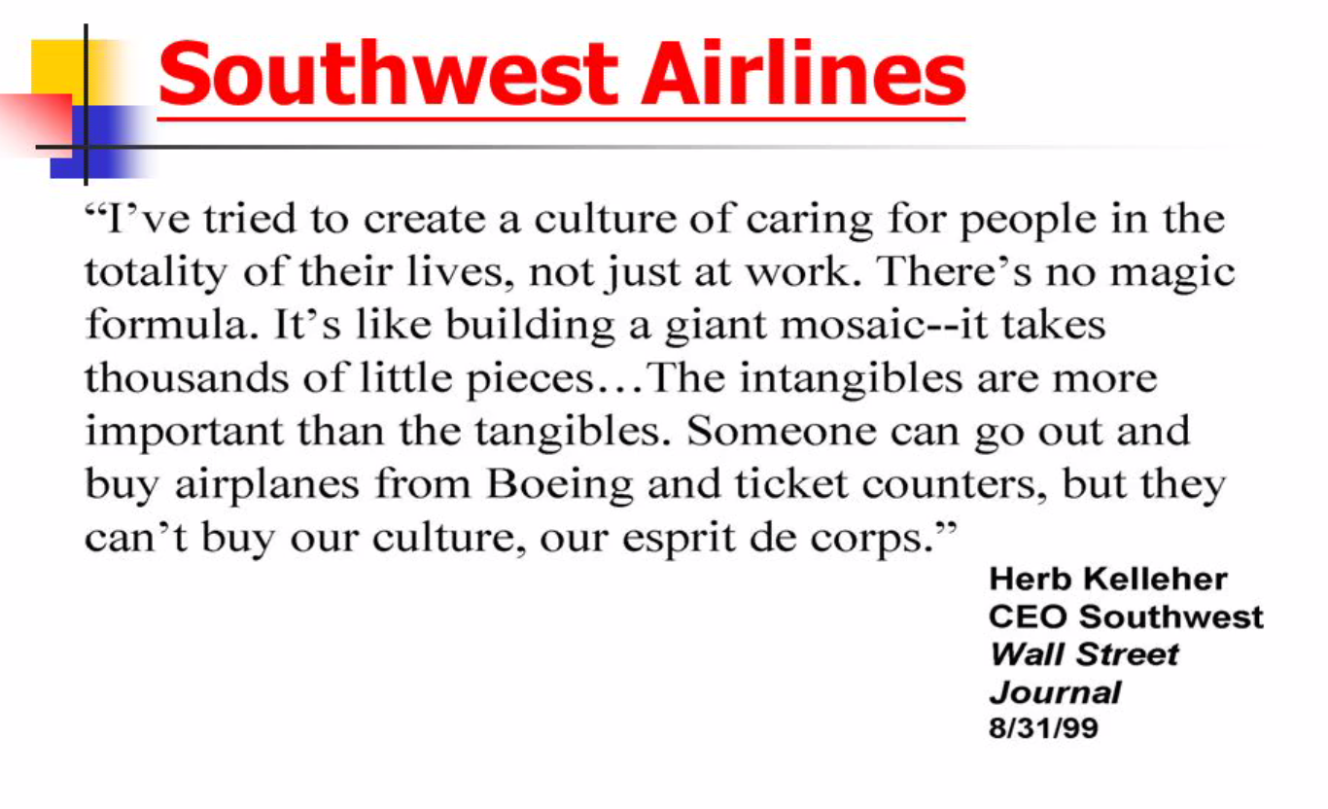

Slide 22
In 1994, a “Major Showdown in the airline industry” was shaping up involving Southwest, United and Continental Airlines. The other airlines (Southwest’s’ competitors) had been hurt by competition from Southwest and decided to try their hands at competing head-to-head with Southwest in the type of low fare, no frill, air service that Southwest had become known for. It didn’t work out as well for them as it had for Southwest. Continental Lite, could not match the efficiency of Southwest and their CEO was purportedly not particularly people-oriented. United’s “Shuttle” was plagued by unhappy employees and an abundance of intracompany rivalries and conflicts.

Slide 23
So where does Southwest’s completive advantage lie? Southwest believes their competitive advantage lies mainly with their people and how they are managed and not so much with their pricing structure. The leverage lies with the people! Among other things that were not so easy for the other airlines to imitate, Southwest encouraged their employees to deliver great customer service and have fun (which often go hand-on-hand

Slide 24
Not to be underestimated is the fact that Southwest’s workforce is very productive. Their turnaround time (arrival at gate to next departure) is about 15 minutes, as compared to an industry average of about 35 minutes. Also Southwest accomplishes this with great efficiency; they use fewer people at gate and a smaller ground crew. Harold Sirkin, an airline specialist with BCG said, “Southwest works because people pull together to do what they need to get a plane turned around. That is part of the Southwest culture. And if it means the pilots need to load bags, they’ll do it.” Southwest averages nearly forty percent fewer employees dedicated to an aircraft than industry average (81 vs. 130), a testament to their productivity. This means they need a smaller load factor (about 55%) on their planes to break even.

Slide 25
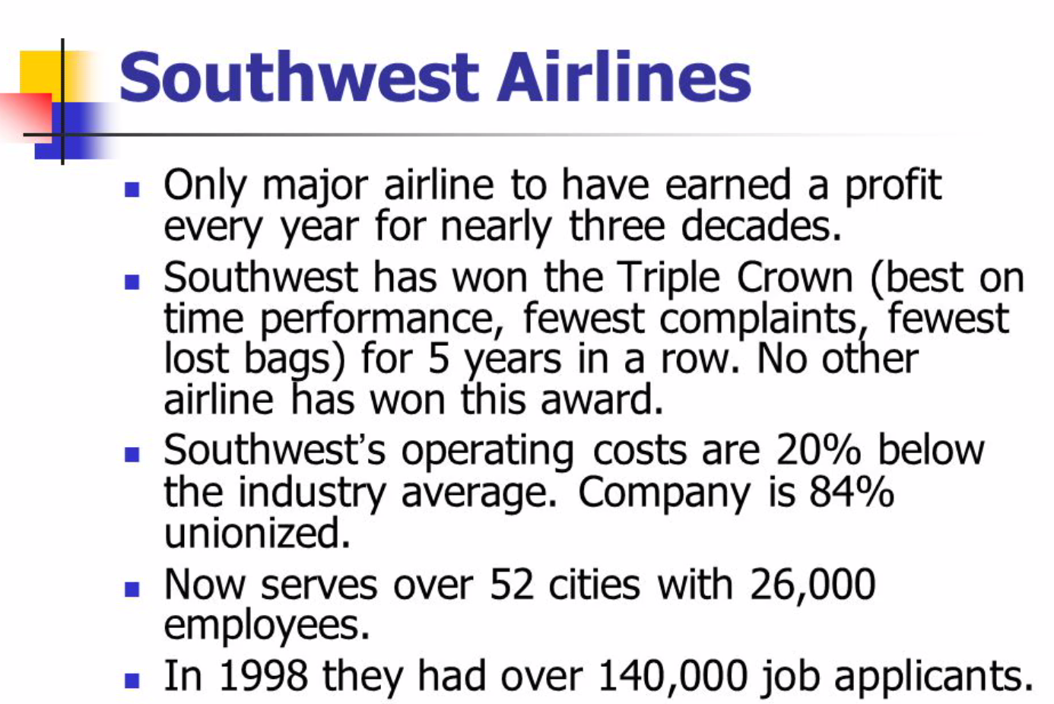

Slide 26
Southwest’s human resources department is named the “people department” and stresses the two “C’s”” compassion and common sense. They tell people to “break the rules” if they need to.
The “Southwest Spirit” appears to be: creative, not too uptight (loose), strong on teamwork, positive, a bit non-conformist, a little outrageous and extroverted.

Slide 27
What lessons can be drawn?
The leverage that corporate culture and the human resource can provide for strategic advantage and change cannot and should not be underestimated. However, it must also be “articulated, practiced and reinforced.” The employees who are the face of the company must also be bought in heart and mind, and actually do and say what the company values.

Slide 28
It is good practice to put one’s energy in figuring out how to do better every day and how to achieve continuous improvement and not to waste too much energy worrying about the competition.
An intracompany family spirit and atmosphere of trust as well as meaningful interpersonal connections go a long way to fostering motivation and a sense of job satisfaction. And have no doubt, this is directly related to the bottom line.
Growing too fast can hurt the “family” feel of a company.

