Slide 1
ILO and its conventions ratified by Bangladesh

Slide 2
What is ILO?
The International Labour Organization was created in 1919 by Part XIII of the Versailles Peace Treaty ending World War I
It grew out of nineteenth-century labor and social movements which culminated in widespread demands for social justice and higher living standards for the world's working people
In 1946, after the demise of the League of Nations, the ILO became the first specialized agency associated with the United Nations.
The original membership of forty-five countries in 1919 has grown to 121 in 1971.

Slide 3
In structure, the ILO is unique among world organizations in that the representatives of the workers and of the employers have an equal voice with those of governments in formulating its policies
The annual International Labor Conference, the ILO's supreme deliberative body, is composed of four representatives from each member country: two government delegates, one worker and one employer delegate, each of whom may speak and vote independently.

Slide 4
Between conferences, the work of the ILO is guided by the Governing Body, comprising twenty-four government, twelve worker and twelve employer members, plus twelve deputy members from each of these three groups.
The International Labor Office in Geneva, Switzerland, is the Organization's secretariat, operational headquarters, research center, and publishing house. Its operations are staffed at headquarters and around the world by more than 3,000 people of some 100 nationalities.

Slide 5
Function of ILO
The ILO has three major tasks
first of which is the adoption of international labor standards, called Conventions and Recommendations, for implementation by member states. The Conventions and Recommendations contain guidelines on child labor, protection of women workers, hours of work, rest and holidays with pay, labor inspection, vocational guidance and training, social security protection, workers' housing, occupational health and safety, conditions of work at sea, and protection of migrant workers.

Slide 6
They also cover questions of basic human rights, among them, freedom of association, collective bargaining, the abolition of forced labor, the elimination of discrimination in employment, and the promotion of full employment. By 1970, 134 Conventions and 142 Recommendations had been adopted by the ILO. Each of them is a stimulus, as well as a model, for national legislation and for practical application in member countries.

Slide 7
A second major task, which has steadily expanded for the past two decades, is that of technical cooperation to assist developing nations. More than half of ILO's resources are devoted to technical cooperation programs, carried out in close association with the United Nations Development Program and often with other UN specialized agencies.

Slide 8
These activities are concentrated in four major areas: development of human resources, through vocational training and management development; employment planning and promotion; the development of social institutions in such fields as labor administration, labor relations, cooperatives, and rural development; conditions of work and life - for example, occupational safety and health, social security, remuneration, hours of work, welfare, etc.

Slide 9
Marking the beginning of its second half-century, the ILO has launched the World Employment Program, designed to help countries provide employment and training opportunities for their swelling populations. The World Employment Program will be the ILO's main contribution to the United Nations Second Development Decade.
There are some 900 ILO experts of fifty-five different nationalities at work on more than 300 technical cooperation projects in over 100 countries around the world.

Slide 10
Third, standard-setting and technical cooperation are bolstered by an extensive research, training, education, and publications program. The ILO is a major source of publications and documentation on labor and social matters. It has established two specialized educational institutions: the International Institute for Labor Studies in Geneva, and the International Center for Advanced Technical and Vocational Training in Turin, Italy.

Slide 11
Preamble of ILO
There was keen appreciation of the importance of social justice in securing peace, against a background of exploitation of workers in the industrializing nations of that time. There was also increasing understanding of the world's economic interdependence and the need for cooperation to obtain similarity of working conditions in countries competing for markets. Reflecting these ideas, the Preamble states:

Slide 12
Whereas universal and lasting peace can be established only if it is based upon social justice;
And whereas conditions of labour exist involving such injustice hardship and privation to large numbers of people as to produce unrest so great that the peace and harmony of the world are imperilled; and an improvement of those conditions is urgently required;
Whereas also the failure of any nation to adopt humane conditions of labour is an obstacle in the way of other nations which desire to improve the conditions in their own countries.

Slide 13
Regulation of the hours of work including the establishment of a maximum working day and week;
Regulation of labour supply,
prevention of unemployment and provision of an adequate living wage;
Protection of the worker against sickness, disease and injury arising out of his employment;
Protection of children, young persons and women;

Slide 14
Provision for old age and injury, protection of the interests of workers when employed in countries other than their own;
Recognition of the principle of equal remuneration for work of equal value;
Recognition of the principle of freedom of association;
Organization of vocational and technical education, and other measures.

Slide 15
Principles and rights of ILO
Adopted in 1998, the Declaration commits Member States to respect and promote principles and rights in four categories, whether or not they have ratified the relevant Conventions.
These categories are:
freedom of association and the effective recognition of the right to collective bargaining,
the elimination of forced or compulsory labour,
the abolition of child labour
and the elimination of discrimination in respect of employment and occupation.

Slide 16
Four strategic objectives at the heart of the Decent Work agenda
Set and promote standards and fundamental principles and rights at work
Create greater opportunities for women and men to decent employment and income
Enhance the coverage and effectiveness of social protection for all
Strengthen tripartism and social dialogue

Slide 17
Employment promotion
Without productive employment, achieving the goals of decent living standards, social and economic integration, personal fulfillment and social development becomes a chimera. Enterprise promotion and human resource development are key elements in achieving these goals. The ILO conducts employment analysis and research, promotes employment-intensive investment and helps formulate employment policy. It also promotes skills development, job creation, enterprise development and cooperative

Slide 18
Social protection
Only 27 per cent of the world’s population has adequate social security coverage and more than half lack any coverage at all. The ILO actively promotes policies and provides assistance to countries to help extend adequate levels of social protection to all members of society. Social security involves access to health care and income security, particularly in cases of old age, unemployment, sickness, invalidity, work injury, maternity or loss of a main income earner.
The “Global Campaign on Social Security and Coverage for All” builds on efforts already underway in more than 30 countries. These include projects to help countries extend coverage at the national level and to strengthen community-based social security organizations.

Slide 19
Tripartism and social dialogue
Sound industrial relations and effective social dialogue are a means to promote better wages and working conditions as well as peace and social justice. As instruments of good governance they foster cooperation and economic performance, helping to create an enabling environment for the realization of the objective of Decent Work at the national level.

Slide 20
Social dialogue and tripartism covers:
Negotiation, consultation and information exchange between and among the different actors;
Collective bargaining;
Dispute prevention and resolution;
and Other instruments of social dialogue, Including corporate social responsibility and international framework agreements

Slide 21
The benefits of International Labour Standards
A path to decent work
International labour standards are first and foremost about the development of people as human beings. In the ILO's Declaration of Philadelphia of 1944, the international community recognized that "labour is not a commodity". Indeed, labour is not like an apple or a television set, an inanimate product that can be negotiated for the highest profit or the lowest price. Work is part of everyone's daily life and is crucial to a person's dignity, well-being and development as a human being. Economic development should include the creation of jobs and working conditions in which people can work in freedom, safety and dignity.

Slide 22
An international legal framework for fair and stable globalization
Achieving the goal of decent work in the globalized economy requires action at the international level. The world community is responding to this challenge in part by developing international legal instruments on trade, finance, environment, human rights and labour.

Slide 23
A level playing field
An international legal framework on social standards ensures a level playing field in the global economy. It helps governments and employers to avoid the temptation of lowering labour standards in the belief that this could give them a greater comparative advantage in international trade.
In the long run such practices do not benefit anyone. Lowering labour standards can encourage the spread of low-wage, low-skill, and high-turnover industries and prevent a country from developing more stable high-skilled employment, while at the same time making it more difficult for trading partners to develop their economies upwards

Slide 24
A means of improving economic performance
International labour standards are sometimes perceived as entailing significant costs and thus hindering economic development. A growing body of research indicates, however, that compliance with international labour standards often accompanies improvements in productivity and economic performance. Higher wage and working time standards and respect for equality can translate into better and more satisfied workers and lower turnover of staff. Investment in vocational training can result in a better-trained workforce and higher employment levels

Slide 25
A safety net in times of economic crisis
Even fast-growing economies with high-skilled workers can experience unforeseen economic downturns. The Asian financial crisis of 1997, the 2000 Dot-Com Bubble burst and the 2008 financial and economic crisis showed how decades of economic growth could be undone by dramatic currency devaluations or falling market prices. For instance, during the 1997 Asian crisis, as well as the 2008 crisis, unemployment increased significantly in many of the countries affected. The disastrous effects of these crises on workers were compounded by the fact that in many of these countries social protection systems (notably unemployment and health insurance), active labour market policies and social dialogue were non-existent or under tremendous pressure.

Slide 26
A strategy for reducing poverty
Economic development has always depended on the acceptance of rules. Legislation and functioning legal institutions ensure property rights, the enforcement of contracts, respect for procedure, and protection from crime - all legal elements of good governance without which no economy can operate. A market governed by a fair set of rules and institutions is more efficient and brings benefit to everyone. The labour market is no different. Fair labour practices set out in international labour standards and applied through a national legal system ensure an efficient and stable labour market for workers and employers alike.

Slide 27
The sum of international experience and knowledge
International labour standards are the result of discussions among governments, employers and workers, in consultation with experts from around the world. They represent the international consensus on how a particular labour problem could be tackled at the global level and reflect knowledge and experience from all corners of the world.

Slide 28
Conventions and Recommendations
International labour standards are legal instruments drawn up by the ILO's constituents (governments, employers and workers) and setting out basic principles and rights at work. They are either conventions, which are legally binding international treaties that may be ratified by member states, or recommendations, which serve as non-binding guidelines. In many cases, a convention lays down the basic principles to be implemented by ratifying countries, while a related recommendation supplements the convention by providing more detailed guidelines on how it could be applied. Recommendations can also be autonomous, i.e. not linked to any convention.

Slide 29
Conventions and recommendations are drawn up by representatives of governments, employers and workers and are adopted at the ILO's annual International Labour Conference. Once a standard is adopted, member states are required under the ILO Constitution to submit them to their competent authority (normally the parliament) for consideration. In the case of conventions, this means consideration for ratification

Slide 30
If it is ratified, a convention generally comes into force for that country one year after the date of ratification. Ratifying countries commit themselves to applying the convention in national law and practice and reporting on its application at regular intervals. The ILO provides technical assistance if necessary. In addition, representation and complaint procedures can be initiated against countries for violations of a convention they have ratified

Slide 31
The eight fundamental Conventions are:
1. Freedom of Association and Protection of the Right to Organise Convention, 1948 (No. 87)
2. Right to Organise and Collective Bargaining Convention, 1949 (No. 98)
3. Forced Labour Convention, 1930 (No. 29)
4. Abolition of Forced Labour Convention, 1957 (No. 105)
5. Minimum Age Convention, 1973 (No. 138)
6. Worst Forms of Child Labour Convention, 1999 (No. 182)
7. Equal Remuneration Convention, 1951 (No. 100)
8. Discrimination (Employment and Occupation) Convention, 1958 (No. 111)

Slide 32
Governance Conventions
The four governance Conventions are:
1. Labour Inspection Convention, 1947 (No. 81)
2. Employment Policy Convention, 1964 (No. 122)
3. Labour Inspection (Agriculture) Convention, 1969 (No. 129)
4. Tripartite Consultation (International Labour Standards) Convention, 1976 (No. 144)

Slide 33
Bangladesh Labour Act (2013)
The Bangladesh Government has made amendments to the 2006 Labour Act to make it more in line with International Labour Standards.
The government approved the new labour law in 2013 including 87 sections of amendments to boost workers' rights, including better access to freedom of association (i.e., to form trade unions), and improving occupational health and safety conditions.

Slide 34
Laws on export processing zones (EPZs)
The Government of Bangladesh is in the process of drafting a new law relating to EPZs, entitled the “Bangladesh EPZ Labour Act 2013”. The ILO is providing feedback on the draft law and encouraging that the law is in compliance with international labour standards especially the ILO Conventions Freedom of Association and Protection of the Right to Organise Convention, 1948 (No. 87) and Right to Organise and Collective Bargaining Convention, 1949 (No. 98) .

Slide 35
The ILO provided technical expertise and support to the development of the National Labour Policy (2012).
National Occupational Safety and Health (OSH) Policy (2013) The ILO provided financial and technical support to the development of a National OSH Policy.
National Skills Development Policy (2011) The development of a national policy for Technical and Vocational Education and Training (TVET) and skills development was a major outcome of the ILO implemented, European Commission-funded TVET Reform Project

Slide 36
Migration The ILO has worked to improve legal and policy frameworks, systems and services relating to labour migration. Support has been provided to the formulation of the Overseas Employment and Migrants Act, 2013 and the revised Overseas Employment Policy (2013)

Slide 37
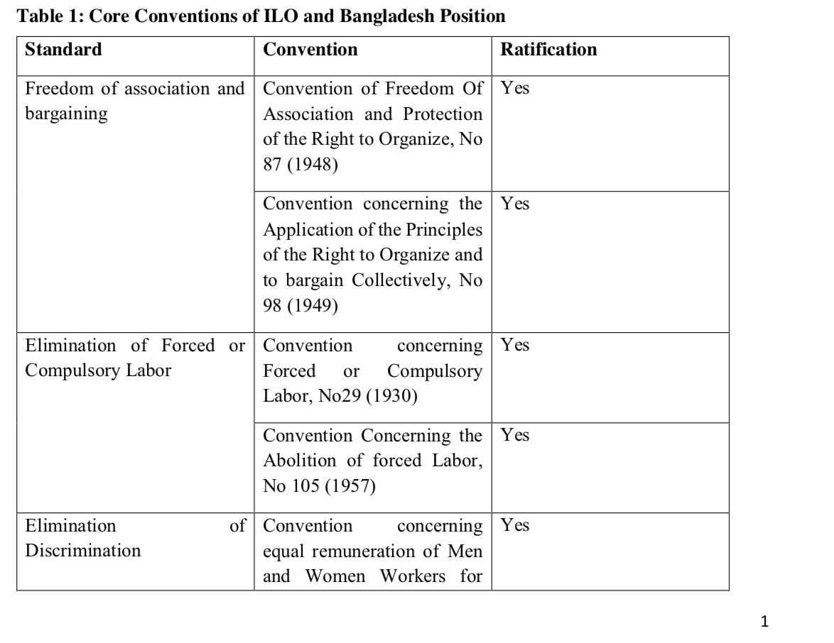

Slide 38
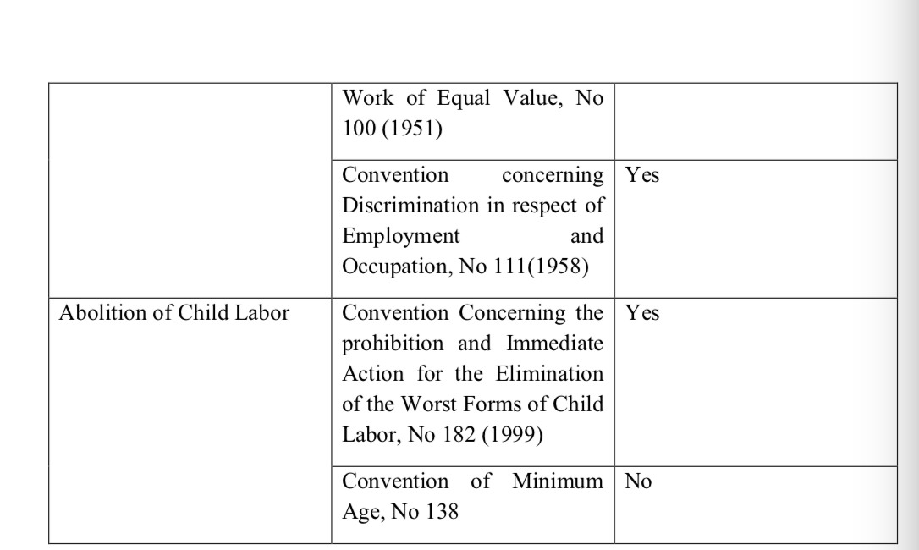

Slide 39
Convention concerning Freedom of Association and Protection of the Right to Organise (No.87, 1948)
Bangladesh ratified this ILO Convention on June 22, 1972. As such Bangladesh is expected to comply with the convention. Workers used to enjoy trade union rights under Industrial Relations Ordinance (IRO) 1969. The right to form trade unions gradually decreased since 1975 in Bangladesh. This is because successive regime since 1975 curtailed the trade union rights (through changes/formulation of new Rules) which were mandated by IRO1969.

Slide 40
Convention concerning Freedom of Association and Protection of the Right to Organise (No.87, 1948)
For instance Industrial Relations Rules of 1977 (framed under IRO1969) made provisions of 30 percent members to form union, and gave labour directors huge power to cancel registration of unions. As a result these changes, labour unions could not flourish in garments industry. At present there are 139 unions out of the 7000 garment factories. Among these, only 20-25 are active and there are only 5 collective bargaining agreements (Bhuiyan, 2012).

Slide 41
The new law also includes provisions for formation of a central fund to improve living standards of workers, depositing a 5.0% net profit of companies
However, to fully comply with all the issues of the labour law, a change in owners’ mindset to abide by the Labour laws and ILO Conventions seems vital. Strict enforcement and rigorous punishment for violations of labour law provisions are also important. As an LDC country, Bangladesh may ask for a gradual implementation of all the provisions;

Slide 42
IRO 1977 made provisions of 30 percent members to form union, banned fulltime trade unionist who are not employed at the enterprises to become leaders, and gave labour directorate unrestrained power to cancel registration of unions. All these provisions are the complete violation of ILO convention 87 and 98 which have been ratified by the Bangladesh government

Slide 43
The ILO Committee of Experts on the Application of Convention and recommendation has noted serious discrepancies between labour law of Bangladesh and ILO core conventions ratified by Bangladesh.

Slide 44
A study on Bangladesh garments industry finds that Bangladesh garments industry workers still face a number of problems such as compulsory long working hours, harassment by supervisors and the denial of trade union rights. Many Western organizations and some western c countries have taken up these issues (the cause of garments workers) such as National Labour league, Clean Cloth Campaign, United Students against sweatshops and War on Want

Slide 45
In sum, it is clear that Bangladesh still need to do a lot more work (in terms of legal reforms , change in mentality and implementation) to fully comply with the ILO convention no. 87. Bangladesh has already passed a bill named ‘Bangladesh Labour Amendment Bill, 2013 in Parliament (the Jatiya Sangsad) on July 15, 2013 incorporating some provisions to protect workers’ rights including allowing formation of trade unions without informing the factory owners.

Slide 46
2. Convention concerning the Application of the Principles of the Right to Organaize and to Bargain Collectively (No.98 1949) and Bangladesh Reality
The provisions of Bangladesh Labour law are frequently violated. For example, the garments workers are not mostly provided appointment letters, although they are provided with an identity card. As a result, they cannot bargain with the owners for the lack of proper documents.
As a result, the UN core convention 98 (right to organize and collective bargaining) are being frequently violated.

Slide 47
Khan (2013) finds that 123 published reports regarding violation of collective bargaining. Sometimes, workers are allowed to form union in limited scale or formation of union by the workers who are in favour of the owners. Under this process of the so called union formation, owners can manipulate the bargaining process and exploit the workers managing a few workers. It is common in Bangladesh that workers who want to form union have to lose their jobs or face threats from owner’s side.

Slide 48
There are however contrasting scenarios as well. Trade unions formed in public sector corporations such as in Bangladesh Bank, Titas Gas, Sonali Bank, Sadharan Bima Corporation, BADC often show hindhandedness and misuse their powers for personal benefits. A newspaper report reveals that highhandedness of a section of CBA leaders is found with its viciousness in the public sector banks, particularly in the banking sector regulator

Slide 49
At least, seven mid-level and high officials of the central bank including a deputy director of the bank were either physically or verbally abused by the pro-ruling CBAs leaders in the last years. The CBA leaders and their supporters in the public sector give a damn to organizational rules and discipline and interfere in the administrative decisions of the organizations including loan decisions of the banks (The Financial Express, 04 Nov 2010),

Slide 50
Trade Unions are also linked with major political parties such as The Bangladesh JatioSramik League is politically tied to the Awami League, The Bangladesh JatiyoSarmikJote (BJSJ) is politically tied to the Jatiyo Samajtantrik Dal (JSD) and The Bangladesh Jatiyatabadi Sramik Dal (BJSD)is politically tied to the Bangladesh Nationalist Party. In Bangladesh, the nature and role of trade unions vary from sector to sector, industry to industry, and region to region. Collective bargaining on pay and allowances is forbidden in the public sector (Robinson, 1996) as the government determines a single set of uniform pay scales and allowances for all the public sector enterprises (Akkas, 1998; Hoque, 1994; Miyan,1991).

Slide 51
3. Convention concerning Minimum Age for Admission to Employment, No 138 (1973) ILO 138 (Minimum Age Convention).
This is the only ILO core labor convention that Bangladesh did not ratify. The Bangladesh Labour Act (BLA, 2006), prohibits employment of children under 14 years of age , as well as prohibiting hazardous forms of child labour for persons under age 18. However, children who are aged 12 and above may be engaged in “light work” that does not endanger their health, development and education.

Slide 52
Economic realities and social context signify that child labour is widely accepted and very common in Bangladesh. According to the current socio economic condition of Bangladesh, a lion share of total population is still poor. As such children are compelled to work to ensure their daily meals. Even, many families rely on the income generation by their children for survival. Furthermore, employers often prefer to employ children because they are cheaper and considered to be more compliant and obedient than adults.

Slide 53
The Ministry of Labour and Employment has recently adopted a National Child Labour Elimination Policy 2010, which provides a framework to eradicate all forms of child labour by 2015 (UNICEF, 2010).
But , this provision of Bangladesh labour laws is often violated. It is often seen that garments factories and other non-government factories are suddenly closed without paying any notice and the wages of labour.

Slide 54
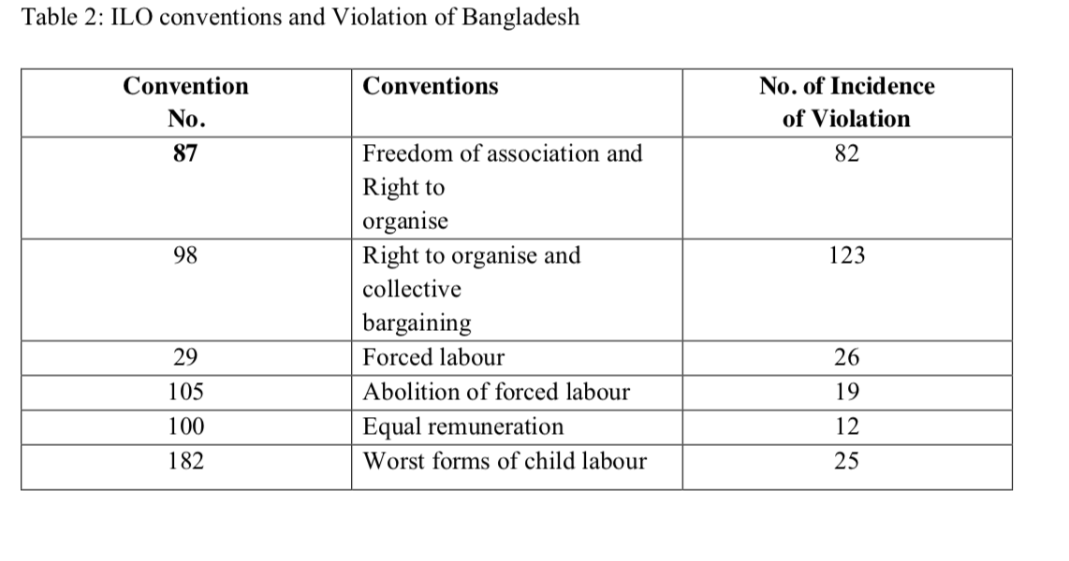

Slide 55
The incidents of violations of ILO core labour standards in Bangladesh suggests that there are also weaknesses in enforcement of ILO conventions and related labour laws that are in force in Bangladesh. In Particular, most employers still lack intention to comply with key labor standards. In such a scenario, Bangladesh probably need to work more with the industry and other stakeholders.

Slide 56
Convention concerning Forced or Compulsory Labor, No 29 (1930)
The ILO definition of forced labor comprises two basic elements: the work or service is exacted under the menace of a penalty, and it is undertaken involuntarily. However, the forced labor definition does not include military work, civil obligation, service of any person following the conviction of court, any work or service exacted in cases of emergency such as fire, flood, famine, earthquake, violent epidemic or epizootic diseases, invasion by animal, insect or vegetable pests, and in general any circumstance and minor communal services for community interest.

Slide 57
The use of forced labor depends on the highest civil authority of the territory. According to Article 9 and 10, if any authority has the opportunity to force labor to do work, it must satisfy the work to be necessary and of direct interest to the community, the work to be done not burden for the forced labor, the work to be safe for their residence. A person’s tenure as a forced labor shall not be more than 60 days in any one period of twelve months including the time spent in going to and from the place of work (article 12)

Slide 58
Forced or compulsory labor shall not be used for work underground in mines. Article 18 states that forced or compulsory labour for the transport of persons or goods, such as the labour of porters or boatmen, shall be abolished within the shortest possible period. Article 25 makes the illegal exaction of forced or compulsory labour shall be punishable as a penal offence, and it shall be an obligation on any Member ratifying this Convention to ensure that the penalties imposed by law are really adequate and are strictly enforced.

Slide 59
Bangladesh position: Most of the garments factories do not have standard working hours. Forced labour is common in Bangladesh especially in the RMG sector. Moreover, the factory management rarely informs workers in advance if they have overtime; it is only announced at the end of the working day

Slide 60
The Bangladesh Labor Act 2006 [XLII of 2006] (BLA) is fairly comprehensive and progressive. This labor act of 2006 prohibits forced labour (Hossain, Ahmed and Akter, 2010). The law is a consolidation and updating of the 25 separate acts. The BLA aligns the labor law system with the ILO core conventions. On the ILO core conventions, Bangladesh has ratified 7 out of 8 International Labor Conventions (ILCs). The only core convention not ratified by Bangladesh is ILC 138 (Minimum Age Convention).

Slide 61
Convention Concerning the Abolition of forced Labor, No 105 (1957)
This Convention requires Members of the International Labour Organisation (who ratifies this Convention) to suppress and not to make use of any form of forced or compulsory labour--
(a) as a means of political coercion or education or as a punishment for holding or expressing political views or views ideologically opposed to the established political, social or economic system;
(b) as a method of mobilising and using labour for purposes of economic development; (c) as a means of labour discipline;
(d) as a punishment for having participated in strikes;
(e) as a means of racial, social, national or religious discrimination.

Slide 62
As Bangladesh ratified this Convention, Bangladesh has the obligation to take effective measures to secure the immediate and complete abolition of forced or compulsory labour as specified in Article 1 of this Convention (Article 2). Bangladesh ratified this Convention on 22 June,1972 and it is in force.

Slide 63
Convention concerning Equal Remuneration of Men and Women Workers for Work of Equal Value, No 100 (1951)
Article 1 of this ILO convention of Equal remuneration for men and women workers for work of equal value refers to rates of remuneration established without discrimination based on sex. Each member shall ensure the application to all workers of the principle of equal remuneration for men and women workers for work of equal value.

Slide 64
This principle is applicable by means of national laws or regulations; legally established or recognized machinery for wage determination; collective agreements between employers and workers; or a combination of these various means. Differential rates between workers as determined by such objective appraisal, in the work to be performed, shall not be considered as being contrary to the principle of equal remuneration for men and women workers for work of equal value

Slide 65
Bangladesh ratified this convention on 28 January 1998. 2008 ILO and the 2007 Bangladesh Bureau of Statistics study find a wide and persistent gender pay gap.
The Bangladesh Employers’ Federation states that it will be very difficult to minimize the wage gaps in the unorganized informal economy until the economic condition of the country improves.

Slide 66
Convention, concerning the prohibition and Immediate Action for the elimination of the worst forms of Child Labour (No. 182), 1999
This Convention requires Each Member which ratifies this Convention to take immediate and effective measures to secure the prohibition and elimination of the worst forms of child labour as a matter of urgency. According to this Convention, the worst forms of child labour comprise:
(a) all forms of slavery /practices similar to slavery, such as the sale and trafficking of children, debt bondage and forced or compulsory labour, including forced recruitment of children for use in armed conflict.
(b) the use, procuring or offering of a child for prostitution, for the production of pornography or for pornographic performances;
(c) the use, procuring or offering of a child for illicit activities, in particular for the production and trafficking of drugs as defined in the relevant international treaties;
(d) work which, by its nature or the circumstances in which it is carried out, is likely to harm the health, safety or morals of children. (Article 3)
Each member shall design and implement, in consultation with relevant government institutions and employers’ and workers' organizations, programmes of action to eliminate as a priority the worst forms of child labour (Article 6).

Slide 67
Bangladesh scenario: Children in Bangladesh are engaged in the worst forms of child labor, primarily in dangerous activities in agriculture. Children also work in dangerous work that includes welding, carpentry, rickshaw pulling and automobile repair. . Girls often work as domestic servants in private households in Bangladesh in exploitative conditions and are vulnerable to abuse, including sexual abuse. Children work in poultry farming and in drying fish, which exposes them to harmful chemicals, dangerous machines that can cut off their fingers, and long hours of work in the hot sun. (Department of Labour Report, US, 2011).

Slide 68
Bangladesh passed the Human Trafficking Deterrence and Supression Act 2012 which makes trafficking (including labor trafficking) a capital offense. It has developed and fully funded a Child Labor Monitoring Information System to manage child labor related.

Slide 69
Convention concerning Discrimination in Respect of Employment and Occupation, No 111 (1958)
This is an ILO Convention adopted by the International Labour Conference in 1958, is an effort to promote the principle of equal rights. This convention defines discrimination as any distinction, exclusion, or preference based on race, color, sex, religion, political opinion, national extraction, or social origin that impairs equal access to vocational training, equal access to employment and to certain occupations, or equal terms and conditions of employment.

Slide 70
Bangladesh scenario: Equal opportunity for all citizens in respect of employment or office in the service of the republic irrespective of religion, race, caste, sex or place of birth has been clearly proclaimed in the Bangladesh Constitution. Bangladesh’s law provisions relating to protection against discrimination mainly are focused on wage and sex. Employers are obliged to ensure equal wages for male and female workers for work of equal nature or value, and no discrimination should be made on the ground of sex

Slide 71
However, the current provision lacks specific provisions on discrimination related to workplace facilities and treatment; only the sex of workers has been considered as discrimination ground; other grounds of discrimination such as race, caste, sex or place of birth ethnicity, and age is not included although discrimination made on those grounds is prohibited in the Constitution .

Slide 72
From the above discussions on different International Conventions and Bangladesh position, it becomes evident that Bangladesh has acceded/ratified most of the Conventions except Convention of Minimum Age. Bangladesh also has constitutional provisions and enacted necessary laws/regulations (as stated above) to comply with and conform to its International Obligations. What is lacking in Bangladesh is the enforcement of the legal provisions of various acts and rules. Our weaknesses lie in our enforcement.

