Slide 1
Fundamentals of human resource management 5th edition By R.A. Noe, J.R. Hollenbeck, B. Gerhart, and P.M. Wright
Chapter 1 managing human resources
Notes:
Chapter 1 introduces the scope of human resource management (HRM), why HRM is an essential element of an organization’s success, the elements of managing human resources: the roles and skills needed for effective, how all managers, not just human resource (HR) professionals, participate in the activities related to HRM, and ethical issues that arise with regard to HRM.

Slide 2
NEED TO KNOW
Definition of HRM and how HRM contributes to an organization’s performance.
Responsibilities of HR departments.
Types of skills needed HRM.
Role of supervisors.
Ethical issues in HRM.
Typical careers HRM.
Notes:
After reading and discussing this chapter, you should be able to:

Slide 3
Human Resource Management (HRM)
The policies, practices, and systems that influence employees’:
behavior
attitudes
performance
Notes:
Many companies refer to HRM as involving “people practices.”

Slide 4
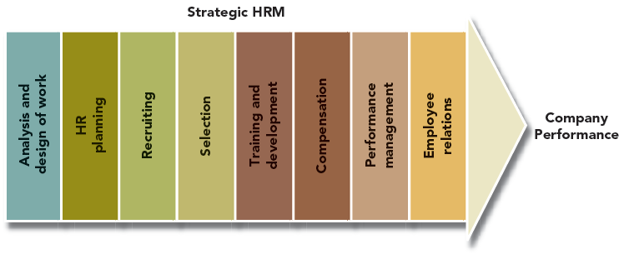
FIGURE 1.1: HRM PRACTICES
Notes:
Figure 1.1 emphasizes that there are several important HRM practices:
Analyzing work and designing jobs
Attracting potential employees (recruiting)
Choosing employees (selection)
Teaching employees how to perform their jobs and preparing them for the future (training and development)
Evaluating their performance (performance management)
Rewarding employees (compensation)
Creating a positive work environment (employee relations)
Supporting the organization’s strategy (HR planning and change management)
An organization performs best when all of these practices are managed well.

Slide 5
COMPANIES WITH EFFECTIVE HRM:
Employees and customers tend to be more satisfied.
The companies tend to:
be more innovative
have greater productivity
develop a more favorable reputation in the community
Notes:
At companies with effective HRM:

Slide 6
HUMAN CAPITAL
Human Capital – an organization’s employees described in terms of their:
training
experience
judgment
intelligence
relationships
insight
The concept of HRM implies that employees are resources of the employer.
Notes:
Managers and economists traditionally have seen HRM as a necessary expense, rather than as a source of value to their organizations. However, research has demonstrated that HRM practices can be valuable.

Slide 7
Figure 1.2: Impact of HRM
Notes:
For an organization to succeed at what it does, it needs employees with certain qualities, such as particular kinds of training and experience. This view means that employees are not interchangeable, easily replaced by parts of a system, but the source of the company’s success or failure. By influencing who works for the organization and how these people work,HRmanagement therefore contributes to such basic measures of an organization’s success as quality, profitability, and customer satisfaction.
Figure 1.2 (reproduced in this slide) shows this relationship.

Slide 8
HRM and Sustainable Competitive Advantage
An organization can succeed if it has sustainable competitive advantage.
HR have the necessary qualities to help give organizations this advantage:
HR are valuable, cannot be imitated, have no good substitutes and with needed skills and and knowledge are sometimes rare.
Notes:
In terms of business strategy, an organization can succeed if it has a sustainable competitive advantage (is better than competitors at something, and can hold that advantage over a sustained period of time). Organizations need the kind of resources that will give them such an advantage. .HR have these necessary qualities:
HR are valuable. High-quality employees provide a needed service as they perform many critical functions.
are rare in the sense that a person with high levels of the needed skills and knowledge is not common. An organization may spend months looking for a talented and experienced manager or technician.
HR cannot be imitated. To imitate resources at a high-performing competitor, you would have to figure out which employees are providing the advantage and how.
HR have no good substitutes. When people are well trained and highly motivated, they learn, develop their abilities, and care about customers.
These qualities imply that HR have enormous potential. An organization realizes this potential through the ways it practices HRM.

Slide 9
At Southwest Airlines, the company’s focus is on keeping employees loyal, motivated, trained, and compensated. In turn, there is a low turnover rate and a high rate of customer satisfaction.

Slide 10
High-Performance Work System
An organization in which technology, organizational structure, people, and processes all work together to give an organization a competitive advantage.
Notes:
Effective HRM can form the foundation of a high-performance work system. This is an organization in which technology, organizational structure, people, and processes all work together to give an organization an advantage in the competitive environment. Maintaining a high-performance work system may include development of training programs, recruitment of people with new skill sets, and establishment of rewards for such behaviors as teamwork, flexibility, and learning

Slide 11
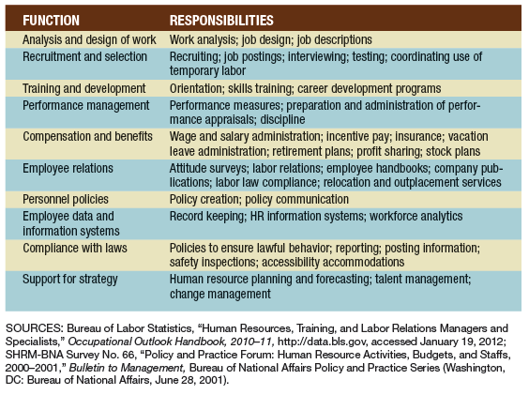
Table 1.1: Responsibilities of HR Departments
Notes:
In all but the smallest organizations, a human resource department is responsible for the functions of human resource management. On average, an organization has one HR staff person for every 93 employees served by the department Table 1.1 (in the slide above) details the responsibilities of human resource departments. These responsibilities include the practices introduced in Figure 1.1 plus two areas of responsibility that support those practices:
Establishing and administering personnel policies; and
Ensuring compliance with labor laws.

Slide 12
Analyzing and Designing Jobs
Job Analysis
Job Design
Process of getting detailed information about jobs.
Process of defining the way work will be performed and the tasks that a given job requires.
Notes:
To produce their given product or service (or set of products or services) companies require that a number of tasks be performed. The tasks are grouped together in various combinations to form jobs. Ideally, the tasks should be grouped in ways that help the organization to operate efficiently and to obtain people with the right qualifications to do the jobs well.
This function involves the activities of job analysis and job design.
As shown on the next slide, these activities shape many aspects of work that give employees their greatest satisfaction.

Slide 13
Recruiting and Hiring Employees
Recruitment
Selection
The process through which the organization seeks applicants for potential employment.
The process by which the organization attempts to identify applicants with the necessary knowledge, skills, abilities, and other characteristics that will help the organization achieve its goals.
Notes:
Based on job analysis and design, an organization can determine the kinds of employees it needs.
With this knowledge, it carries out the function of recruiting and hiring employees.

Slide 14
Qualities of Job Candidates
Which of the following qualities were in the top 5 as reported by employers?
Technical skills
Intelligence
Interpersonal skills
Computer skills
Notes:
This question came from Table 1.2 “Top 10 Qualities Employers Seek in Job Candidates”
Answer – C – Interpersonal skills
Communication skills (written and verbal)
Honesty/integrity
Interpersonal skills
Strong work ethic
Teamwork skills
Analytical skills
Motivation/initiative
Flexibility/adaptability
Computer skills
Detail orientation

Slide 15
Table 1.2: Top Qualities Employers Seek in Job Candidates
Notes:
Table 1.2 lists the top 10 qualities that employers say they are looking for in job candidates, based on a survey by the National Association of Colleges and Employers.

Slide 16
Training and Developing Employees
Training
Development
A planned effort to enable employees to learn job-related knowledge, skills, and behavior.
Acquisition of knowledge, skills, and behaviors that improve an employee’s ability to meet changes in job requirements and in customer demands.
Notes:
Although organizations base hiring decisions on candidates’ existing qualifications, most organizations provide ways for their employees to broaden or deepen their knowledge, skills, and abilities. To do this, organizations provide for employee training and development.

Slide 17
Managing Performance
Performance Management – The process of ensuring that employees’ activities and outputs match the organization’s goals.
HR department may be responsible for developing or obtaining questionnaires and other devices for measuring performance.
Notes:
ManagingHRincludes keeping track of how well employees are performing relative to objectives such as job descriptions and goals for for a particular position.

Slide 18
Planning & Administering Pay & Benefits
Planning Pay & Benefits
Administering
Pay & Benefits
How much salary, wages bonuses, commissions, and other performance -related pay to offer.
Which benefits to offer and how much of the cost will be shared by employees.
Systems for keeping track of employees’ earnings and benefits are needed.
Employees need information about their benefits plan.
Extensive record keeping and reporting is needed.
Notes:
The pay and benefits that employees earn play an important role in motivating them. This is especially true when rewards such as bonuses are linked to the individual’s or group’s achievements. Decisions about pay and benefits can also support other aspects of an organization’s strategy. All such decisions have implications for the organization’s bottom line, as well as for employee motivation. Administering pay and benefits is another big responsibility.

Slide 19
Maintaining Positive Employee Relations
Preparing and distributing:
employee handbooks and policies
company publications and newsletters
Dealing with and responding to communications from employees questions:
about benefits and company policy, possible discrimination or harassment, safety hazards etc.
Collective bargaining and contract administration.
Notes:
Organizations often depend onHRprofessionals to help them maintain positive relations with employees. This function includes:

Slide 20
Establishing and Administering Personnel Policies
Organizations depend on their HR department to help establish and communicate policies related to:
hiring
discipline
promotions
benefits
All aspects of HRM require careful and discreet record keeping.
Notes:
All HR activities described so far require fair and consistent decisions, and most require substantial record keeping.

Slide 21
Ensuring Compliance with Labor Laws
Government requirements include:
filing reports and displaying posters
avoiding unlawful behavior
Managers depend on HR professionals to help them keep track of these requirements.
Lawsuits will continue to influence HRM practices concern job security.
Notes:
The government has many laws and regulations concerning treatment of employees.
These laws govern such matters as equal employment opportunity, employee safety and health, employee pay and benefits, employee privacy, and job security.
Ensuring compliance with laws requires that HR personnel keep watch over a rapidly changing legal landscape.
Employers will need to review work rules, recruitment practices, and performance evaluation systems, revising them if necessary to ensure that they do not falsely communicate employment agreements the company does not intend to honor (such as lifetime employment) or discriminate on the basis of age.

Slide 22
One reason W.L. Gore & Associates is repeatedly named one of the 100 Best Companies to Work for in America is their unusual corporate culture where all employees are known as associates and bosses are not found.
Notes:
Ask the students: “How do you think this boosts morale in the workplace?”

Slide 23
Supporting the Organization’s Strategy
HR planning – identifying the numbers and types of employees the organization will require to meet its objectives.
The organization may turn to its HR department for help in managing the change process.
Skilled HR professionals can apply knowledge of human behavior, along with performance management tools, to help the organization manage change constructively.
Notes:
Today’s HR professionals need to understand the organization’s business operations, project how business trends might affect the business, reinforce positive aspects of the organization’s culture, develop talent for present and future needs, craft effective HR strategies, and make a case for them to top management.

Slide 24
Supporting the Organization’s Strategy
Evidence-based HR – Collecting and using data to show that human resource practices have a positive influence on the company’s bottom line or key stakeholders.
Notes:
To demonstrate how HR practices align with the organization’s strategy, HRM professionals are measuring how the HR-related practices that are in place (e.g., hiring, promotion process, benefits, development, etc.) promote the company’s success. Evidence-based HR refers to demonstrating how HR practices have a positive influence on the company’s profits or key stake holders (e.g., employees, customers, community, shareholders).
For example, showing the relationship between a new selection system and subsequent employee turnover would provide evidence that the new system support the organization’s goals of reducing turnover costs and improving organizational commitment among its employees.

Slide 25
Supporting the Organization’s Strategy
Corporate Social Responsibility
Stakeholders
A company’s commitment to meeting the needs of its stakeholders.
The parties with an interest in the company’s success (typically, shareholders, the community, customers, and employees).
Notes:
Organizations today are looking for ways to improve their profitability and to be socially responsible to their various stakeholders.
Being socially responsible can be strategic when it improves the company’s image with customers, opens access to new markets, and helps attract and retain talented employees.

Slide 26
Figure 1.3: Skills of HRM Professionals
Notes:
With such varied responsibilities, the human resource department needs to bring together a large pool of skills. These skills fall into the six basic categories shown in Figure 1.3 on this slide.
Credible activists – being so well respected in the organization that you can influence the positions taken by managers.
Cultural steward: involves understanding the organization’s culture and helping to build and strengthen or change that culture by identifying and expressing its values through words and actions
Talent manager/ organizational designer: knows the ways that people join the organization and move to different positions within it
Strategy architect: requires awareness of business trends and an understanding of how they might affect the business, as well as the opportunities and threats they might present.
Business allies – know how the business makes money, who its customers are, and why customers buy what the company sells
Operational executors: at the most basic level carry out particular HR functions such as handling the selection, training, or compensation of employees.
To excel in each of these areas it requires interpersonal skills to share information, build relationships and influence people.

Slide 27
Who is Responsible for HR?
In an organization, who should be concerned with human resource management?
Only HR departments
Only Managers
Managers and HR departments
Notes:
In an organization, who should be concerned with human resource management?
Only HR departments
Only Managers
Managers and HR departments
Answer “C” - Every operating manager is, in essence, an HR manager.
HR specialists design processes and systems that operating managers are integral in implementing.

Slide 28
Figure 1.4: Supervisors’ Involvement in HRM
Notes:
Supervisors typically have responsibilities related to all HR functions.
Figure 1.4 (on this slide) shows some HR responsibilities that supervisors are likely to be involved in.
In all these activities, supervisors can participate in HRM by taking into consideration the ways that decisions and policies will affect their employees.
Understanding the principles of communication, motivation, and other elements of human behavior can help supervisors inspire the best from the organization’s human resources.

Slide 29
ETHICS IN HRM
Ethics – fundamental principles of right and wrong.
Ethical behavior is behavior that is consistent with those principles.
Many ethical issues in the workplace involve HRM.
Notes:
Whenever people’s actions affect one another, ethical issues arise, and business decisions are no exception.
Business decisions, including HRM decisions, should be ethical.

Slide 30
Employee Rights
free consent
privacy
freedom of conscience
freedom of speech
due process
Notes:
In the context of ethical human resource management, HR managers must view employees as having basic rights. Such a view reflects ethical principles embodied in the U.S. Constitution and Bill of Rights.
Right of free consent – People have the right to be treated only as they knowingly and willingly consent to be treated.
Right of privacy – People have the right to do as they wish in their private lives, and they have the right to control what they reveal about private activities.
Right of freedom of conscience – People have the right to refuse to do what violates their moral beliefs, as long as these beliefs reflect commonly accepted norms.
Right of freedom of speech – People have the right to criticize an organization’s ethics, if they do so in good conscience and their criticism does not violate the rights of individuals in the organization.
Right to due process – If people believe their rights are being violated, they have the right to a fair and impartial hearing.
One way to think about ethics in business is that the morally correct action is the one that minimizes encroachments on and avoids violations of these rights.

Slide 31
Ethical companies act according to four principles:
In their relationships with customers, vendors, and clients, ethical companies emphasize mutual benefits.
Employees assume responsibility for the actions of the company.
The company has a sense of purpose or vision that employees value and use in their day-to-day work.
They emphasize fairness.
Notes:
Ethical, successful companies act according to four principles:

Slide 32
Figure 1.5: Standards for Identifying Ethical Practices
Notes:
For human resource practices to be considered ethical, they must satisfy the three basic standards summarized in Figure 1.5 on this slide.
These standards are discussed on the next slide.

Slide 33
STANDARDS FOR IDENTIFYING ETHICAL HRM PRACTICES
HRM practices must result in the greatest good for the largest number of people.
Employment practices must respect basic human rights of privacy, due process, consent, and free speech.
Managers must treat employees and customers equitably and fairly.
Notes:
For human resource management practices to be considered ethical, they must satisfy the three basic standards summarized in Figure 1.5 on the previous slide.
These standards are most vexing when none of the alternatives in a situation meets all three of them.

Slide 34
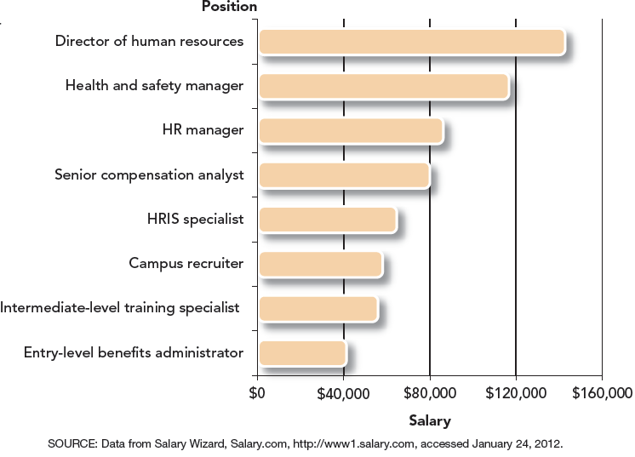
Figure 1.6: Median Salaries for HRM Positions
Notes:
There are many different types of jobs in the HRM Profession.
Figure 1.6 on this slide shows selected HRM positions and their salaries.
The salaries vary depending on education and experience, as well as the type of industry in which the person works.
As you can see from Figure 1.6, some positions involve work in specialized areas of HRM such as recruiting, training, or compensation.
The vast majority of HRM professionals have a college degree, and many also have completed post graduate work.
HR professionals can increase their career opportunities by taking advantage of training and development programs.
Some HRM professionals have a professional certification in HRM, but many more are members of professional associations. The primary professional organization for HRM is the Society for Human Resource Management (SHRM) with more than 250,000 members.

Slide 35
Test Your Knowledge
Which HR functions are primarily concerned with 1) ensuring employees are capable of doing their current job , 2) ensuring that employees are satisfied with their rewards.
1) Development; 2) Employee Relations
1) Training; 2) Legal Compliance
1) Selection; 2) Pay & Benefits
1) Training; 2) Pay & Benefits
Notes:
Answer - D

Slide 36
Summary
HRM consists of an organization’s “people practices”
policies, practices, and systems that influence employees’ behavior, attitudes, and performance.
HRM influences who works for the organization and how those people work.
HR departments have responsibility for a variety of functions related to acquiring and managing employees.

Slide 37
Summary (continued)
HRM requires human relations skills, including skill in:
communicating
negotiating
team development
HR professionals also need to :
understand the language of business
be a credible with line managers and executives
be strategic partners

Slide 38
Summary (continued)
Non-HR managers must be familiar with the basics of HRM and their own role with regard to managing human resources.
Supervisors typically have responsibilities related to all the HR functions.
HR professionals should make decisions consistent with sound ethical principles.

Slide 39
Summary (continued)
Decisions of HR professionals should:
result in the greatest good for the largest number of people.
respect basic rights of privacy, due process, consent, and free speech.
treat employees and customers equitably and fairly.
Careers in HRM may involve specialized work in fields
such as recruiting, training, or compensation

