Slide 1
Human resource planning

Slide 2
Human Resource Planning
Human resource planning may identify competitive advantages of the organization’s human resources or it may be used to assess the feasibility of various strategic alternatives, in terms of human resource capabilities
It is mostly effective when human resource planning is fully integrated with strategy and has a reciprocal relationship, it provides input in the formulation process.
Human resource planning is linked in several ways with strategy formulation and implementation.

Slide 3
Developmental Planning for Strategic Leadership
A management development expert observed that there is currently more interest in succession planning today than there has been during the past 30 years. Because of the rapidly changing environments in which companies must compete, there is concern that there will be a shortage of individuals with the requisite skills and talents who can lead companies in the twenty-first century.

Slide 4
Assessment of Strategic Alternatives
As organizations’ human resources are utilized more frequently as sources of competitive advantage, human resource planning and forecasting will become more central to the strategic planning process. It will be essential for human resource executives or other executives to be able to forecast the future availability of employees having knowledge in such critical areas as technology.

Slide 5
Adding Value
Unfortunately, it is typically difficult to quantify value added in human resource management. The results of some human resource programs and policies undoubtedly have major impacts on morale and motivation, although they are not easily translated into dollars and cents. However, many human resource programs probably do not add value and do not conform to the investment perspective advocated in this text. Fortunately, some progress has been made in the area of measurement with such techniques as utility analysis.

Slide 6
OVERVIEW OF HUMAN RESOURCE PLANNING
Interfacing with strategic planning and scanning the environment
Taking an inventory of the company’s current human resources
Forecasting the demand for human resources
Forecasting the supply of human resources both from within the organization and in the external labor market
Comparing forecasts of demand and supply
Planning the actions needed to deal with anticipated shortages or overages
Feeding back such information into the strategic planning process

Slide 7
Failure to Plan for Human Resources
Personal Implications
The planning process will have normally required the human resource manager to communicate with other managers, senior executives, and staff members about the future human resource environment and the associated staffing issues. It will also have forced the human resource manager and other managers with planning responsibilities to have thought through these staffing issues and to have examined their operating assumptions.

Slide 8
Changing Receptivity Toward Planning
It is evident that some corporate-wide planning objectives require centralized, sophisticated human resource planning processes. However, there has been a trend toward the use of simple planning and forecasting techniques on a decentralized basis by line managers.
The human resource function will need to help redesign organizations to meet the demands of the future, such as being able to respond to customer preferences more quickly, provide higher quality, make faster decisions, and be more cost competitive

Slide 9
SELECTING FORECASTING TECHNIQUES
Purpose of Planning
If the purpose is to forecast the supply of human resources in order to identify and eliminate bottlenecks in the career paths of promising managers, replacement charts or Markov analysis may be used. Conversely, if the purpose is to forecast the future age distribution of a company’s workforce in order to estimate its likely health care costs, it would be better to use some form of renewal analysis in which specific numbers of employees in various individual jobs, job categories, or job families would be relatively unimportant.

Slide 10
Organizational Characteristics
Several other factors influence the selection of forecasting techniques. One such factor is the size of the organization.
Another factor in selection of forecasting techniques is the complexity of the organization. With greater complexity there are more differences in model parameters and fewer common assumptions that can be applied.
Further, another factor is that with longer-range fore-casting horizons, there is a tendency to use more sophisticated forecasting techniques

Slide 11
Industry Characteristics
The type of industry also affects technique utilization, as companies in regulated industries tend to use more sophisticated forecasting techniques. These industries are normally subject to less change and, as a result, forecasts can be quite accurate. Not surprisingly, forecasts in utilities, insurance companies, and railroads have often been highly accurate. This accuracy could be contrasted with an industry, such as high-fashion women’s clothing, in which forecasts can be off by a wide order of magnitude.

Slide 12
Environmental Turbulence
There is a lower utilization of sophisticated techniques such as Markov analysis, operations research, and computer simulation, under conditions of moderately high and high perceived uncertainty.
Interestingly, those with low workforce volatility probably perceive less need for such planning whereas those with high volatility probably find it ineffective.

Slide 13
Other Considerations
The sheer number of forecasting techniques also can pose problems for those who must make decisions on which techniques to use. Several factors should be considered in making these decisions, including time horizon, level of technical or mathematical sophistication required of the forecaster, cost, whether appropriate data are available, the stability of the data on which forecasts will be based, and level of detailed data required.

Slide 14
FORECASTING THE SUPPLY OF HUMAN RESOURCES
Techniques used to forecast supplies of human resources may be classified as either quantitative or qualitative
some forecasting techniques may be used to forecast both the supply and demand of human resources
the category of quantitative techniques includes Markov analysis or network flow models, attrition analysis models, computer simulation, operations research techniques, and renewal models.
The category of qualitative supply forecasting techniques includes replacement charts or succession planning and supervisory estimates.

Slide 15
Replacement Charts
Replacement charts describe a company’s organizational structure in terms of individuals occupying various managerial and professional positions. For each position incumbent, potential replacements are identified along with such information as their individual potential for advancement and numbers of years’ experience needed before being qualified for the next higher position.

Slide 16
The individual’s age also may be included for estimating retirement dates. For each replacement, the potential replacements for that individual also are listed with similar information. Thus, the replacement chart, which is likely to be computerized, provides a description of how vacancies can be filled from the internal labor market. It also shows the associated cascading effects.

Slide 17
In determining the time when potential managerial replacements will be ready to take on higher-level responsibilities, an assessment of their current skills must be conducted and matched against those required for higher-level positions. There are two organizational dimensions that should guide such assessments: (1) the hierarchical or vertical level of various jobs and (2) where the job falls in a continuum from basically individual contributions to managing the efforts of others.

Slide 18
Thus, the assessment should include not only the skills that will be required for vertical moves, but also the skills to move horizontally, typically toward the broader orientation and responsibilities of general management. Movement upward often entails a shift toward the managerial end of the continuum.

Slide 19
Beginning with the individual contributor end of the continuum and moving toward the managerial end, employees would be assessed against skill requirements for the following tracks: technical development, technical application, technical management, operations management, and business management.

Slide 20
Another aspect of the utilization of replacement charts to forecast supplies of human resources involves the assessment of the organization’s current employees’ abilities and qualifications to take on future positions. Before the number of qualified replacements for a current or future position can be determined, there must be a means of comparing potential replacement candidates with the position’s requirements.

Slide 21
Emerson Electric provides a good example of replacement planning for managers.
If there is an Exhibit A for Mr. Knight’s [the CEO] management style, it is the “Organization Room,” an unmarked chamber at Emerson’s headquarters to which only a few people have a key. On the walls, floor to ceiling, are 1,400 2by 4-inch refrigerator magnets, one for every manager at the company.

Slide 22
Each magnet displays, in tiny print and color coding, date of hire, date of birth, international experience, a photo-graph, and postgraduate degrees. Separate organizational charts reduce elaborate personnel evaluations— entire career histories, really—to a single dot of color: orange for outstanding, green for above- average, red for underperforming. When a key job becomes open, Mr. Knight slips into the room and studies the walls, yanking down the magnets of a handful of candidates.

Slide 23
Succession Planning
Although similar to replacement planning and the use of replacement charts, succession planning tends to be directed toward a longer-range time horizon and is more focused on development. It is also more concerned with the development of pools of potential replacements, as opposed to individuals.

Slide 24
Succession planning involves more elaborate planning for skill development of potential replacements, is more systematic in the assessment of potential replacements and their developmental needs, and generally applies to higher levels of managerial positions.
For example, at Air Products and Chemicals, Inc., which has annual sales in excess of $1 billion, the succession plan involves only approximately 300 key jobs.

Slide 25
In some companies, succession planning also incorporates developmental planning for high-potential managers while they are still in lower-level positions. This is especially prevalent for minorities and women who are likely to become long-range successors. Additionally, succession planning also may be concerned with the future requirements of executive positions since the necessary personal skills and characteristics may differ substantially from current requirements.

Slide 26
To the extent that succession planning is participatory and plans are incorporated into career development sessions, there may be reduced turnover of valued managers. For those informed that they are next in line for a position, there may be a motivational effect as well as an enhanced likelihood that they will remain with the organization.

Slide 27
While there are important benefits of succession planning, there are increasing concerns about the ability of traditional succession planning to produce qualified successors, particularly on a position-by-position basis. Improvements to the process involve 360-degree feedback, more self-initiated programs, and developmental assignments across functions and units. Of course, events such as acquisitions and mergers also can make such plans meaningless and increase the level of top management turnover.

Slide 28
Fortunately, some of the complexity of the details of succession planning can be handled with computer software. For example, there are software packages that have been designed for succession planning, such as Succession Plus, which is available in Oracle versions

Slide 29
Markov Analysis
In setting up Markov models the forecaster must account for all possible moves or flows of employees in an organization. Such moves include moves into the organization, moves from one job to another, and exit moves. Moves between jobs can be upward moves in hierarchical level as well as moves across functions.

Slide 31
Essentially, Markov models begin with distributions of the number of employees in various job categories at a starting point in time. These distributions are then transformed by a transition probability matrix into a forecasted distribution of employees across these same job categories one period later. The transition probabilities in each row of the matrix must total to 1. The diagonal set of transitional probabilities, after excluding the column representing exit moves, represents the proportion of employees remaining in the same job from Time 1 to Time 2. Markov models cannot take into account more than one move per time period.

Slide 32
The transition probabilities for Markov models are typically derived from historical data on the movements of employees between jobs, as well as exit moves from the organization. For example, transition probabilities from Job 1 to Job 2 might be determined by computing the percentage of employees in Job 1 who make such a move over a one-year time period. An important consideration for the use of Markov models is that with small numbers of job incumbents, the transition probabilities become unstable.

Slide 33
For example, if there are only two employees in a job and one leaves, a transition probability based on the number remaining would be only .50. This could be a very misleading transition probability.
Another problem is that the probabilities derived from such percentages may not be stable if based on only the moves in one single year. Accordingly, the forecaster may want to compute an average percentage of employees making such moves over several years (e.g., from three to five years) in order to obtain a more stable transition probability.

Slide 34
Human resource forecasters can obtain the proper balance between slower and quicker tracking transition probabilities through a process of trial and error. For example, a forecaster may attempt to forecast the movements of employees between jobs that occurred last year. He or she could experiment with transition probabilities based on movements for one year prior to that, an average of the two previous years, an average of the three previous years, and so on, and compare these fore-casts with what actually happened. In this manner, the forecaster can determine the particular number of years that produces transition probabilities that will result in the most accurate forecast.

Slide 35
Aside from use in forecasting, Markov analysis also can be used for audits of the human resource function to determine whether there are any irregularities in the flow of employees through an organization’s different positions. This can be done by constructing separate Markov transition matrices for minorities and females and comparing their similarity.

Slide 36
Renewal Models
Another category of human resource forecasting techniques consists of renewal models. These models reflect the movement or flow of employees through companies as they are “pulled” upward to fill vacancies in higher-level job categories.

Slide 37
An advantage of renewal models is that they involve simple mathematics and are readily understood by managers. Renewal models, in their simplest form, can use age cohorts of employees as the focus of analysis. As the level of incumbent employees in an age group is projected forward into the future, the group is “aged” by one year

Slide 38
When greater rates of change are expected, shorter time periods may be used. The “aged” cohort is then adjusted for losses of employees due to various forms of attrition. Rates of attrition can be obtained from historical data and typically differ across the age cohorts. Typically, attrition would be relatively high with younger workers, such as recent college graduates and for age cohorts close to retirement

Slide 39
In addition to “aging” employee cohorts and adjusting age cohorts for attrition, renewal models also may be configured in accordance with the job classification hierarchy and also may reflect the hiring of new employees and promotions of current employees into different job categories. The numbers of employees in each job category may be adjusted during the process to reflect needs for growth or contraction, which is dictated by the company’s strategic plan.

Slide 40
Renewal models also can be run with different specifications of promotion rates so that their differential impacts can be determined. The models also can be run with different attrition rates and other planning assumptions. Additionally, renewal models can be applied to specific populations, such as minorities and females, so that a company’s future affirmative action status may be forecasted

Slide 41
Computer Simulation
It is sometimes stated that computer simulations are the most useful forecasting techniques for guiding business decisions. Simulations have the advantage of allowing the forecaster to create a number of different future scenarios by altering the values of the simulation’s parameters. Through this process, the forecaster can determine variations in forecasted values according to different formulations of future conditions and can plan alternative courses of actions to reduce uncertainty and manage risk.

Slide 42
Further, computer simulations allow planners and forecasters to assess the sensitivity of the simulation model’s parameters to alternative specifications. By running sensitivity analyses, forecasters can gain an understanding of the impact of inaccurate assumptions. With the rapidly increasing power of personal computers and advances in software, computer simulations are likely to grow in importance as human resource planning and forecasting techniques

Slide 43
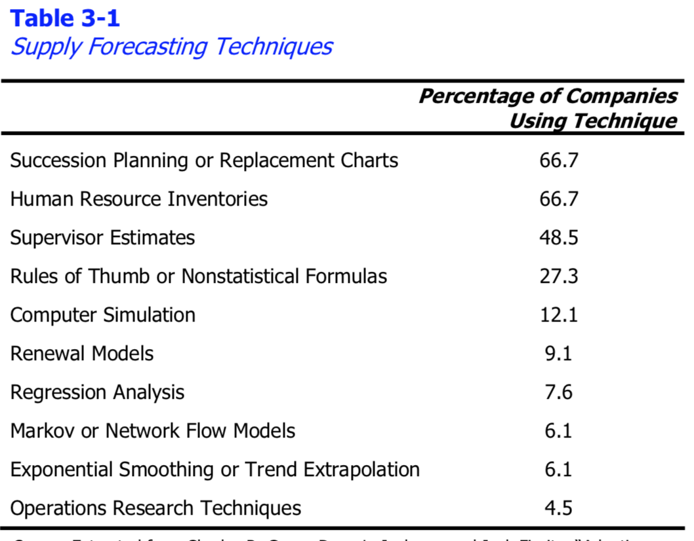
Utilization of Supply Forecasting Techniques

Slide 44
FORECASTING THE DEMAND FOR HUMAN RESOURCES
There are a number of practical difficulties in forecasting the demand for human resources. As a result, companies report dissatisfaction in this area and acknowledge that demand forecasting is the weakest link in their human resource or workforce planning efforts. For example, a common constraint on the value of forecasts, based on extrapolations of current labor and output relationships, is ignorance of whether current manning levels are appropriate.

Slide 45
The massive reductions in labor utilization by companies facing intense competition have highlighted this problem. With the strategic moves toward leaner organizations, there have been labor cuts beyond those prompted by the efficiencies of new technology. Interestingly, along this same line, some companies implementing total quality management (TQM) programs have found that they need fewer employees.

Slide 46
Similarly, the process of reengineering, which is often associated with the adoption of new technology and the utilization of new computer systems, can reduce the number of employees required to perform work. Thus, human resource planners must use appropriate learning curve parameters, which reflect expected productivity improvements, in order to avoid overestimating the demand for human resources

Slide 47
Heuristics, Rules of Thumb, and the Delphi Technique
Rules of thumb are simple guidelines that are used to predict demand for human resources. For example, a retailing chain may have developed a heuristic that specifies that for every 12 new stores, another regional manager will be hired.
forecasters might consider the strategic plans for the number of new stores the next year, then apply the heuristic to forecast the number of regional managers that will be needed.
One common qualitative approach for forecasting the demand for human resources is the “bottom-up” approach in which unit managers estimate their specific human resource needs for the next period. These estimates are then combined into aggregate forecasts for the whole company

Slide 48
Operations Research and Management Science Techniques
Techniques such as linear programming, integer programming, and network optimization techniques are generally considered as operations research or management science techniques.
Such techniques can be used to determine optimal personnel flows through organizations. These flows can be managed through specification of time-in-grade requirements for promotions, rates of turnover, and the like. Managed flows can produce desired stocks of personnel in various positions or ranks at points in the future.

Slide 49
They also are expensive to develop. Nonetheless, they are often key systems in large organizations, which produce savings of millions of dollars in labor costs. Such systems are developed by human resource planning specialists. Although they are developed and maintained on a centralized basis, they may be used on computerized networks by line managers for applications such as the development of optimal workforce schedules

Slide 50
The United Airlines Station Manpower Planning System provides an example of the application of such techniques. This system has been used to develop work schedules for several thousand United employees who work as customer service agents and reservation sales representatives. While the system is used primarily for short-range planning, it does enable managers to forecast the number of employees needed to maintain desired service levels a few weeks and months into the future.

Slide 51
Regression Analysis
Regression analysis is a robust statistical technique having applicability to forecasting demand for human resources. Although its greatest applicability may be for centralized human resource fore-casting at the corporate level by planning specialists, its wide availability as a feature of computerized spreadsheets makes it a potential technique for widespread adoption by line managers as well. Multiple regression analysis allows the forecaster to control for several potential influences on the number of employees needed in a particular specialty.

Slide 52
An example of the use of regression analysis for predicting demand is provided by an application at the New York Power Authority (an electric power utility). In this application, regression analysis was used to predict such dependent variables as the overall staffing level and staffing levels for various categories of employees

Slide 53
The predictor or independent variables used in the models include such variables as the number of kilowatt-hours produced, operating revenues, sales, and the capital budget. A limitation of this application is that the variables are only of a general nature. Therefore, they are inappropriate for predicting the demand for specific jobs, such as the various professional or managerial specialties.
Because utilities typically have stable environments, assumptions of stable relationships between the predictor variables and the dependent variable are more likely to be valid than in many environments characterized by turbulence

Slide 54
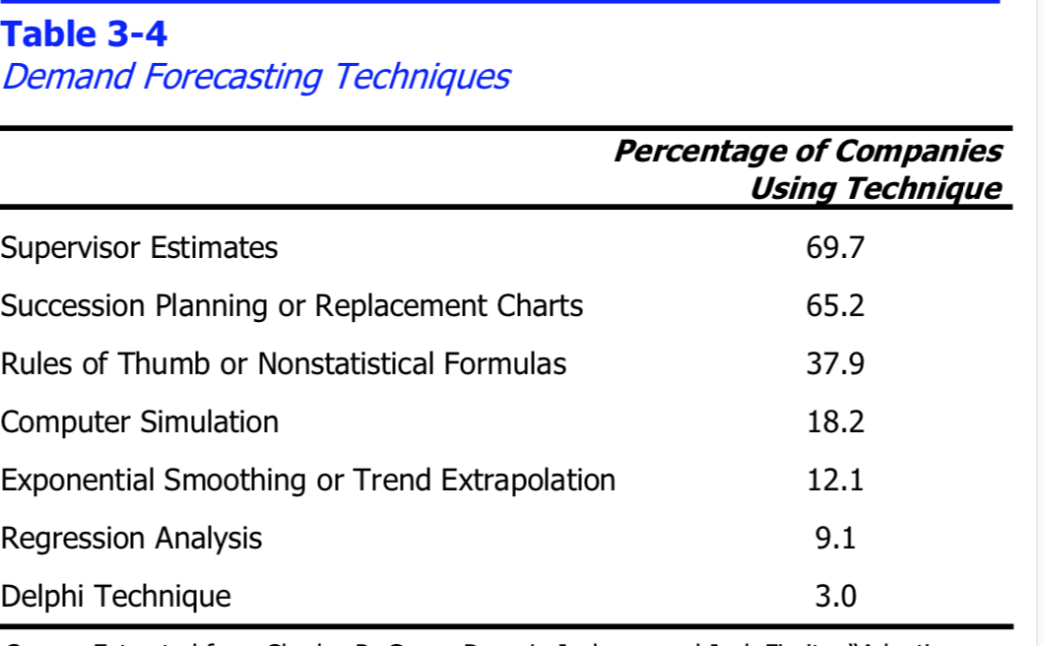
Utilization of Demand Forecasting Techniques

Slide 55
THE END! FINALLY!!!!!!!!! YAAAY

