Slide 1
SHRM LECTURE 2
THE HUMAN RESOURCE ENVIORNMENT

Slide 2
The Human Resource Environment
As indicated in the conceptual framework, following the development of an investment perspective for making strategic decisions about human resources, managers need to scan the environment before formulating strategy. This section examines the numerous factors making up the environment of human resources as well as emerging trends

Slide 3
Technology also had massive impacts as well. The Internet alone had an impact of epic pro-portions. Dot-com companies and existing businesses created thousands of e- business and e-commerce operations, employing some of the labor force’s most talented workers. Companies providing infrastructure for the Internet, such as Cisco Systems, Oracle, Sun Microsystems, and Microsoft became some of the largest companies in the world based on their market capitalization

Slide 4
TECHNOLOGY AND ORGANIZATIONAL STRUCTURE
Technology, particularly information technology, is having a major impact on the structure of organizations and on the nature of managerial work. Enterprise software systems have been implemented to integrate the major areas of business: manufacturing, sales, finance, supply-chain management, and human resources.

Slide 5
These information systems have enabled companies to gain numerous benefits such as efficiency gains, quicker response times, better inventory control, enhanced coordination, and improved decision making. Companies now spend $23 billion a year on enterprise software such as Oracle, SAP, and PeopleSoft, compared with only $1 billion in 1990

Slide 6
Managers who can be effective in such environments require new skills. Not only the number of managerial positions has changed, but also in many settings the nature of management has changed as well because of other developments. Thus, in information-based, lean and flat organizations, alternative job assignments and opportunities are needed for the development of tomorrow’s high-level managers

Slide 7
Another impact of increasing technology is that skill and managerial educational requirements tend to increase. Although managers in advanced technological environments cannot have detailed knowledge of all aspects of the technology with which their subordinates work, they must have a conceptual understanding in order to provide effective support and direction

Slide 8
Influences of Human Resource Information Systems
human resource information system (HRIS) components and provide immediate information to decision makers about the organization’s human resource capabilities. Human resource departments and the activities they perform have been affected dramatically by these enterprise software systems, and executives can now include more human resource information in the equation when making strategic or operational decisions.

Slide 9
Redeployment of Human Resource Staff to Operating Units
One of the outcomes of organizational decentralization has been that human resource generalists have been redeployed from human resource departments to individual operating units. Such decentralization provides better service to the units.

Slide 10
New Organizational Structures
Not only is the nature of work and management changing, but organizations also are changing as a result of advances in information technology. The distinctions between management and labor have become blurred. Workers are becoming increasingly responsible to act on matters that they become aware of through computerized information systems.

Slide 11
Many organizations have become much less hierarchical. More work is being performed in task force teams and project- oriented work groups. Temporary organizations, such as task forces, require different managerial skills. Likewise, there is evidence that organizations are becoming more flexible, porous, and adaptive. In some, the organizational structure may become less pyramidal and more like a set of concentric circles .

Slide 12
Aside from the structural changes noted, there are four new structural forms of interest:
(1) unbundled corporations,
(2) network organizations,
(3) cellular organizations,
(4) respondent organizations.

Slide 13
Unbundled Corporations
Essentially, unbundled corporations employ a portfolio or conglomerate approach toward their peripheral business units. As a result, units are retained or divested according to profitability and risk criteria. An example of an unbundled corporation is Johnson & Johnson, which has 190 autonomous operating companies in 51 countries .

Slide 14
Network Organizations or Virtual Corporations
One of the driving forces for the evolution or creation of network organizations is the need to outsource activities that other companies, consultants, or joint venture partners can perform better or more quickly.
Membership of the network may include companies from throughout the world. Like unbundled corporations, network organizations also have a permanent core member that performs a broker role.

Slide 15
Cellular Organizations
Another structural form is called the cellular organization, which has some similarities with classical guilds. Such organizations are typically groups of small technology-oriented companies that maintain affiliations over time.
Subsets of the organization’s companies join forces on various projects when their unique skills and capabilities are needed.

Slide 16
Respondent Organizations
Another structural form, the respondent organization, is essentially an entrepreneurial corporation that exists by filling niches to supply customized services to unbundled corporations and bureaucracies

Slide 17
WORKER VALUES AND ATTITUDINAL TRENDS
Younger workers who currently account for a major portion of the workforce and who will dominate it during the rest of the decade and beyond, feel entitled to meaningfulness and involvement. They want interesting work, to participate in decisions affecting them, autonomy, and opportunities to grow. Pay will remain important, but workers will probably not be as focused on pay as in the past

Slide 18
MANAGEMENT TRENDS
Management of Diversity
managers must be prepared to deal with the challenges associated with such demographic changes. Effective management of diversity can increase an organization’s productivity through several avenues, one of which is increased problem-solving ability.

Slide 19
Work Teams
Work teams have been of increasing interest to managers in a number of leading companies, such as Procter & Gamble, Eli Lilly, and Motorola. These companies have developed substantial expertise in the utilization of teams

Slide 20
A number of benefits have been attributed to the use of work teams as an organizational form. These include improved decision making, improved performance, improved quality, and increased flexibility afforded by the ease with which they can be created and disbanded.

Slide 21
In spite of the advantages, there also are disadvantages with the use of work teams as they are sometimes subject to the dysfunctional groupthink phenomenon and norms of production restriction.

Slide 22
Virtual Teams
Virtual teams have members who work closely together even though they are based at different locations, including different countries, and may even be in different time zones. They typically have members from different functions and work across organizational boundaries as well.

Slide 23
Human Resource Outsourcing
One of the most significant forces affecting human resource management has been the outsourcing of human resource functions.
recent surveys have found as many as 91 to 93 percent of responding companies engaging in outsourcing

Slide 24
The trend toward outsourcing has been caused by several strategic and operational influences.
human resource executives have used outsourcing to relieve their departments of some of the more mundane aspects of the function, such as those involving routine, low-value-added transactions.
Outsourcing also has been used to help reduce bureaucracy and to encourage a more responsive and cost-sensitive culture by introducing external market forces into the organization through the bidding process.

Slide 25
Outsourcing has been pursued for several operational reasons as well, such as for greater efficiency or better service in the performance of functions
Example- 401(k) plans and Medical claim processing.
outsourcing has been used to obtain specialized expertise that is not available in-house

Slide 26
Open-Book Management
The practice of sharing financial and performance information is often referred to as open-book management. Essentially, the practice relies on the notion that empowered employees can make informed decisions and take informed actions on behalf of the firm.
Jack Stack of Springfield Manufacturing has been credited for being the inventor of open-book management

Slide 27
Stack acquired a nearly bankrupt plant from International Harvester and was able to achieve a remarkable turnaround through the use of open-book management.
“He persuaded employees to view running the business as a game they could learn to play—and win.”
Open-book management is broader than many human resource practices as it combines a number of practices such as profit sharing, use of bonuses, scoreboarding (reporting results on score-boards), and training employees to understand the business.

Slide 28
Total Quality Management
pioneered by Edwards Deming, is a broad-based, systematic approach for achieving high levels of quality. Many leading companies such as Motorola, Cadillac, and Xerox, whose strategies require them to survive against the pressures of world-class competition uses TQM.
TQM is probably most accurately categorized as a tactic for carrying out strategies requiring high levels of product or service quality

Slide 29
TQM principles emphasize:
Articulation of a strategic vision
Objective and accurate measurements
Benchmarking
Widespread employee empowerment and team building
Striving for continuous improvement
Emphasis on a systems view of quality that
conceptualizes quality-related activities as being highly
interdependent
Leadership committed to quality
Great emphasis on customer satisfaction

Slide 30
One of the important impacts of TQM, from a human resource management perspective, is that it places great emphasis on training. TQM maintains that errors and mistakes, which detract from the quality of companies’ products and services, are a predictable result of untrained workers, and therefore training must be provided

Slide 31
Integrated Manufacturing
Integrated manufacturing systems provide a new approach for streamlined manufacturing.
Such systems are commonly composed of advanced manufacturing technology (AMT), TQM, and just-in-time (JIT) inventory control methods.
AMT is a manufacturing approach based on highly computerized technologies, such as computer-aided manufacturing (CAM).
JIT inventory control is a method for delivering manufacturing components to the production line at the shortest practical time before they are needed.

Slide 32
These systems require knowledge workers whose levels of technical and problem-solving skills are advanced beyond those needed for earlier forms of manufacturing and have major implications for human resource management.
In companies in which there is greater emphasis on AMT and TQM, there is more selectivity in hiring, more comprehensive training, greater developmental use of performance appraisal, and greater emphasis on external pay equity.

Slide 33
Reengineering
Reengineering, which is also called process innovation, core process redesign, and business process reengineering, has been practiced since the late 1980s
Essentially, reengineering is directed at achieving large cost savings by eliminating unneeded activities and consolidating work.

Slide 34
In order to reduce its operating costs the Banca di America e di Italia (BAI) reengineered its retail banking operations with the goal of becoming a paperless bank. After reengineering activities involved in depositing checks, the number declined from 64 to 25. As a result of these and other changes, employees in each branch declined from seven to nine prior to reengineering to three to four afterwards. With these labor savings, the bank was able to open 50 new branches with its existing workforce

Slide 35
Managing in the Aftermath of Mergers and Acquisitions
Whether a merger or acquisition is successful depends on more than financial considerations. Success often depends on how well the two organizations’ human resources are integrated. As a result, the degree to which human resource aspects of mergers and acquisitions are planned can be critical .
Assignment 1) Find out a Merger and Acquisition that failed and explain the reasons for the failure.

Slide 36
DEMOGRAPHICTRENDS
An Aging Workforce
an older workforce may lead to less flexibility as older workers may not adapt as quickly to a dynamic economy.
The Boomer Age Bulge
There will be a shortage of workers aged 25 to 44, while there will be an abundance of more experienced workers with the largest age category in the labor force of ages 45 to 54

Slide 37
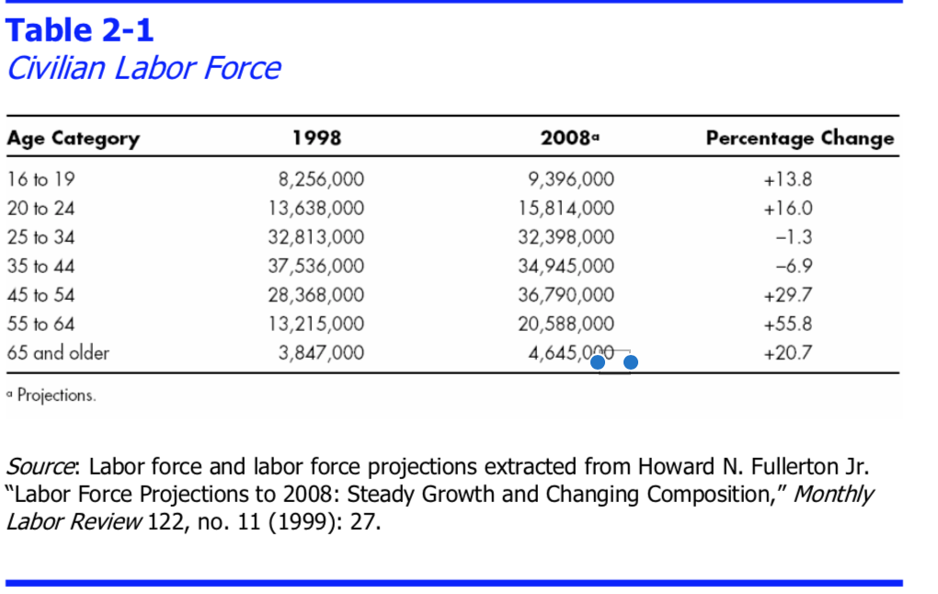

Slide 38
Labor Shortages
Employers responded by aggressive recruiting, using the internet, social media and retraining older workers.
Greater Racial Diversity
organizations will need to plan to take advantage of diversity instead of forcing conformity. organizations will need to be proactive in helping to create a work environment in which the creativity and innovativeness of diversity will flourish
Changing Occupational Distributions for Women
Women now account for 68.3 percent of the workers in training, human resources, and labor relations and for approximately 50 percent of accountants. (Flexibility, maternity, work place environment)

Slide 39
Dual-Career Couples
The number of couples having two wage earners has increased rapidly, having passed the two-thirds point more than a decade ago. In order to accommodate such families, many employers offer support services such as “sick child” care programs and day care. Such services are believed to pro duce reductions in absenteeism, lower turnover, recruiting advantages, and a positive impact on productivity

Slide 40
TRENDS IN THE UTILIZATION OF HUMAN RESOURCES
Telecommuting
Telecommuting, or telecommunicating, does not necessarily involve geographic relocation but simply involves working at home at least part of the time.
Relocation of Work
Employees prefer to move towards main cities where as companies tend to move towards favourable cost effective areas.
Growing Use of Temporary and Contingent Workers
Another important human resource issue is the increasing use of temporary or contingent workers.

Slide 41
INTERNATIONAL DEVELOPMENTS
Global Competition
Global Sourcing of Labor
North American Free Trade Agreement
European Community

