Slide 1
Stress Management

Slide 2
Managing stress at Darlot Mine
Employees at Homestake’s Darlot gold mine in Western Australia are managing their stress better through exercise, nutrition and awareness of how to cope with shift work. The idea is that healthier employees cope with stress more effectively.

Slide 3
Work-life balance initiatives
Flexible work time
Job sharing
Telecommuting
Personal leave
Childcare facilities

Slide 4
Flextime is a flexible hours schedule that allows workers to alter workday start and finish times. In contrast to traditional work arrangements that require employees to work a standard 9 a.m. to 5 p.m
Job sharing or work sharing is an employment arrangement where typically two people are retained on a part-time or reduced-time basis to perform a job normally fulfilled by one person working full-time. Since all positions are shared thus leads to a net reduction in per-employee income.

Slide 5
Telecommuting (also known as working from home, or e-commuting) is a work arrangement in which the employee works outside the office, often working from home or a location close to home (including coffee shops, libraries, and various other locations).
Personal Leave : An employee (including a casual employee) is entitled to two days of unpaid carer's leave for each occasion when a member of the employee's immediate family or household requires care or support because of a personal illness, injury, or an unexpected emergency.
Childcare facilities : Day care facilities to take care of children in the work place.

Slide 6
Other stress management practices
Withdrawing from the stressor
Permanent: better person-job fit
Temporary: work breaks, vacations
Changing stress perceptions
self-efficacy, self-leadership

Slide 7
Controlling stress consequences
fitness and lifestyle programs
relaxation and meditation
employee counselling
Social support
emotional and informational

Slide 8
INDIVIDUAL STRESS MANAGEMENT
Most interventions to reduce the risk to health associated with stress in the workplace involve both individual and organizational approaches. Individual approaches include training and one-to-one psychology services—clinical, occupational, health or counselling. They should aim to change individual skills and resources and help the individual change their situation.

Slide 9
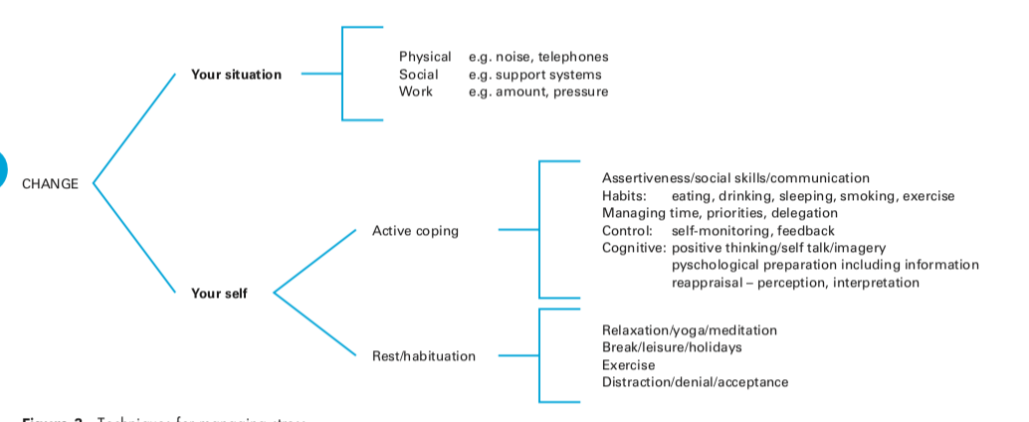

Slide 10
Reframing
Re-framing is a technique to change the way you look at things in order to feel better about them. There are many ways to interpret the same situation so pick the one you like. Re-framing does not change the external reality, but helps you view things in a different light and less stressfully.

Slide 11
Positive Thinking
Forget powerlessness, dejection, despair, failure
Stress leaves us vulnerable to negative suggestion so focus on positives
Focus on your strengths
Learn from the stress you are under
Look for opportunities
Seek out the positive- make a change.

Slide 12
Change your behavior
Be assertive
Get organised
Ventilation
Humour
Diversion and distraction

Slide 13
Time-Management
Make a list
What must be done
What should be done
What would you like to do
Cut out time wasting
Learn to drop unimportant activities
Learn to say no
Plan your day
Set Goals
Work towards achieving them.

Slide 14
Training helps prevent stress through:
becoming aware of the signs of stress
using this to interrupt behaviour patterns when the stress reaction is just beginning. Stress usually builds up gradually. The more stress builds up, the more difficult it is to deal with
analysing the situation and developing an active plan to minimise the stressors
learning skills of active coping and relaxation, developng a lifestyle that creates a buffer against stress
practising the above in low stress situations first to maximise chances of early success and boost self confidence and motivation to continue.

Slide 15
A wide variety of training courses may help in developing
active coping techniques—for example, assertiveness, communications skills, time management, problem solving, and effective management

Slide 16
However, there are many sources of stress that the individual is likely to perceive as outside his or her power to change, such as the structure, management style or culture of the organisation. It is important to note that stress management approaches that concentrate on changing the individual without changing the sources of stress are of limited effectiveness, and may be counterproductive by masking these sources.

Slide 17
For example, breathing deeply and thinking positively about a situation causing stress may make for a temporary feeling of well being, but will allow a damaging situation to continue, causing persistent stress and, probably, stress to others. The primary aim of the individual approach should be to develop people’s skills and confidence to change their situation, not to help them adapt to and accept a stressful situation.

Slide 18
ORGANISATIONAL STRESS MANAGEMENT
The prevention and management of workplace stress requires organisational level interventions, because it is the organisation that creates the stress. An approach that is limited to helping those already experiencing stress is analogous to administering sticking plaster on wounds, rather than dealing with the causes of the damage.

Slide 19
An alternative analogy is trying to run up an escalator that’s going down! Organisational interventions can be of many types, ranging from structural (for example, staffing levels, work schedules, physical environment) to psychological (for example, social support, control over work, participation).

Slide 20
The emphasis on the organisation, rather than the individual, being the problem is well illustrated by the princi- ples used in Scandinavia, where there is an excellent record of creating healthy and safe working environments

Slide 21
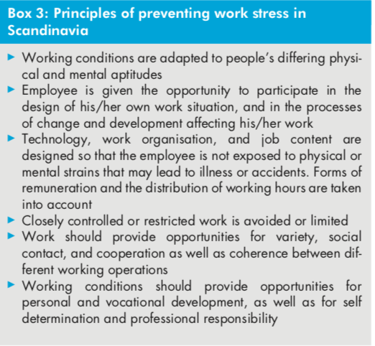

Slide 22
Assessing the risk of stress within the workplace must take into account:
the likelihood and the extent of ill health which could occur as a result of exposure to a particular hazard
the extent to which an individual is exposed to the hazard
the number of employees exposed to the hazard. The analysis of stressful hazards at work should consider all aspects of its design and management, and its social and organizational context.

Slide 23
Although the priority is prevention, protective measures can be introduced to control the risk and framework directive on the introduction of measures to encourage improvements in the safety and health of workers at work). Creating a safe system of work requires targeting equipment, materials, the environment and people (for example, ensuring sufficient skills for the tasks). It also requires having monitoring and review systems to assess the extent to which prevention and control strategies are effective.

Slide 24
The first stage of preventative stress management is called primary prevention and deals with the overall reduction or elimination of the stressor causing the individual's stress. Secondary prevention is the next stage of eliminating stress. This step helps mold the individual's or company's reaction to a stressor. The last stage of preventative stress management is tertiary prevention, which focuses zon healing the individual or organization from the symptoms caused by the stress.

Slide 25
Although associations between workplace factors and psychological ill health and associated sickness absence have been well documented, evidence based interventions to reduce these problems are scarce .
Successful interventions used training and organisational approaches to increase participation in decision making and problem solving, increase support and feedback and improve communication.

Slide 26
These studies found that:
those taught skills to mobilize support at work and to participate in problem solving and decision making reported more supportive feedback, feeling more able to cope, and better work team functioning and climate. Among those most at risk of leaving, those undergoing the training reported reduced depression

Slide 27
staff facing organisational change who were taught skills of stress management, how to participate in, and control, their work showed a decrease of stress hormone levels
staff taught verbal and non-verbal communication and empathy skills demonstrated reduced staff resignations and sick leave

Slide 28
physically inactive employees undergoing stress management training improved their perceived coping ability and those undergoing aerobic exercise improved their feelings of well being and decreased their complaints of muscle pain, but also reported reduced job satisfaction

Slide 29
Employees undergoing one of seven training programs emphasizing one or more aspects of stress management—physiological processes, coping with people or interpersonal awareness processes—showed reductions in depression, anxiety, psychological strain, and emotional exhaustion immediately after the program. There was a further reduction in psychological strain and emotional exhaustion at 9–16 months’ follow up.

Slide 30
Those on long term sickness absence who were referred early to the occupational health department (within two or three months absence) reduced their sickness absence from 40 to 25 weeks before resumption of work and from 72 to 53 weeks before leaving employment for medical reasons, leading to large financial savings.

Slide 31
Other tools to help negate work stress by HR
Job redesign
Goal setting
Role negotiation
Social support systems

Slide 32
Job Redisgn:
Restructuring the elements including tasks, duties and responsibilities of a specific job in order to make it more encouraging and inspiring for the employees or workers is known as job redesigning. The process includes revising, analyzing, altering, reforming and reshuffling the job-related content and dimensions to increase the variety of assignments and functions to motivate employees and make them feel as an important asset of the organization. The main objective of conducting job redesigning is to place the right person at the right job and get the maximum output while increasing their level of satisfaction.

Slide 33
Goal Setting
Goal setting involves the development of an action plan designed to motivate and guide a person or group toward a goal. Goal setting can be guided by goal-setting criteria (or rules) such as SMART criteria.
The letters S and M usually mean specific and measurable. Possibly the most common version has the remaining letters referring to attainable, relevant and time-bound.

Slide 34
Role negotiation
The expectations of others largely decide a person's role. When these are clear, role conflict and role ambiguity can reduce. Everyone knows what everyone else expects. Role negotiation is a process for clarifying these expectations. You negotiate with an individual not a group.

Slide 35
Social Support System
Social support is the perception and actuality that one is cared for, has assistance available from other people, and that one is part of a supportive social network. These supportive resources can be emotional (e.g., nurturance), tangible (e.g., financial assistance), informational (e.g., advice), or companionship (e.g., sense of belonging) and intangible (e.g., personal advice).

Slide 36
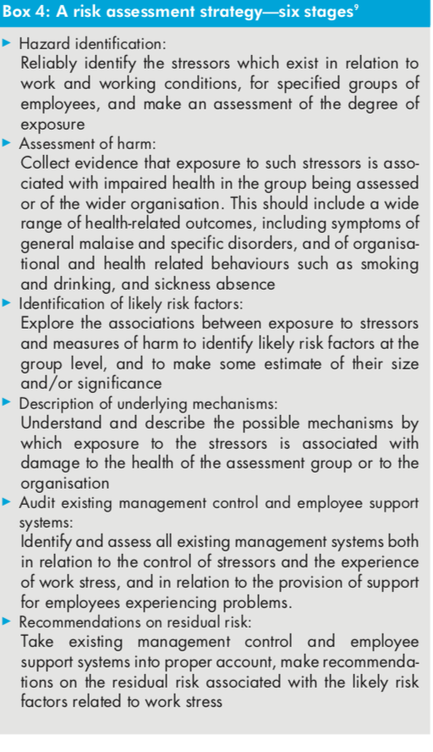

Slide 37
Organization Culture
Success in managing and preventing stress will depend on the culture in the organisation. Stress should be seen as help- ful information to guide action, not as weakness in individu- als. A culture of openness and understanding, rather than of blame and criticism, is essential

Slide 38
Organization Leadership
Building this type of culture requires active leadership and role models from the top of the organisation, the development and implementation of a stress policy throughout the organisation, and systems to identify problems early and to review and improve the strategies developed to address them. The policy and its implementation should be negotiated with the relevant trade unions and health and safety committees

Slide 39
Evaluation and feedback
Last, but by no means least, interventions should be evalu- ated, so that their effectiveness can be assessed. Ideally, the method of achieving this should include a high response rate, valid and reliable measures, and a control group. Two measures that provide a comprehensive analysis of work stress and have been widely used are the Job Content Questionnaire, which includes measures of the predictors of job strain described earlier,18 and the Occupational Stress Indicator.

