Slide 1
GRIEVANCE AND GRIEVANCE HANDLING
Lecture 4
Oeshwik Ahmed, faculty of HRM, Northern University

Slide 2
MEANING OF GRIEVANCE
Grievance refers to any dissatisfaction or sense of injustice which is felt by an employee in relation to his pay, working conditions, leave, recoveries of dues or other aspects of employment. Broadly speaking, “a grievance is any dissatisfaction that adversely affects organisational relations and productivity.”

Slide 3
MEANING OF GRIEVANCE
Grievance may sometimes be expressed and sometimes not. Even sometimes, it may not be valid also. The grievance arises when the employee feels that something’s happening or going to happen unfair and unjust to him in the organization.

Slide 4
MEANING OF GRIEVANCE
Complaints affecting one or more individual workers in respect of their wage payments, overtime, leave, transfer, promotions, seniority, work assignment, and discharge would constitute grievance.
Where the points at dispute are of general applicability or considerable magnitude, they will fall outside the scope of this procedure. However, some type of grievances may be beneficial for the organizations, as it may direct the attention of management towards improving the working conditions, incentive plans, leave plans etc.

Slide 5
MEANING OF GRIEVANCE
When grievances, generally, minor one are not expressed by the employees they just accumulate and lead to major conflicts inside the organization such as lockouts, strikes or any other collective disputes. Therefore, proper administration of grievance and grievance handling is necessary in an organization as unattended grievances may lead to frustration, low productivity, increase rate of absenteeism, feeling of discontent etc.

Slide 6
Causes of Grievances:
1. Concerning Working Conditions:-
Unsafe and unpleasant working conditions.
Inadequate toilet facilities, dirty toilets, etc.
Non-availability of necessary raw material, tools and machines.
Misfit between worker’s ability and job.

Slide 7
Causes of Grievances:
2. Concerning Management Policy and Practices:-
Wage rate and its payment.
Incentive.
Seniority.
Promotion.
Transfer.
Fines, punishments and penalties.

Slide 8
Causes of Grievances:
3. Concerning Violation of Rules and Regulations:-
Organizational rules and regulations.
Civic laws.
Past practices.
Procedure of collective bargaining

Slide 9
Causes of Grievances:
4. Concerning Personality Traits:-
Fault-finding attitude.
Over-ambitious.
Mental-tension.
Negative approach to life.
Excessive ego feelings.

Slide 10
Forms of Grievances
There may be three forms of grievances in an organization such as-
1. Factual: When an employee is dissatisfied with his employment because of legitimate or genuine reasons such as violation of employment contract by the employers or unfulfilling of any other factual needs. The grievance is regarded as factual.

Slide 11
Forms of Grievances
2. Imaginary: When an employee is dissatisfied with his employment because of a wrong perception, wrong attitude or wrong information, it gives rise to imaginary grievance. Though for such case the management is not liable but still the responsibility to resolve the problem rests with it.

Slide 12
Forms of Grievances
3. Disguised: The dissatisfaction among employees in such case may be due to the reasons that are not known to the employees themselves. This dissatisfaction may be due to the pressure from other directions like family, friends, neighbors etc. The manager himself has to detect such grievances and resolve them through counseling the related employee.

Slide 13
Effects of an Undressed Grievance:
If the grievances remain unidentified and thus undressed may have adverse effects such as:-
It reduces the quality and quantity of production.
Increases the wastage of material and thus the cost of production.
Increases the rate of absenteeism and rate of accidents at the work place.

Slide 14
Effects of an Undressed Grievance:
It reduces the morale of employees and thus reduces the level of commitment and sincerity of work.
Indiscipline cases increases which gives rise to increase in supervision.
Increase in industrial conflicts.

Slide 15
GRIEVANCE PROCEDURE:
In an organization, employees facing problems must be listened carefully and provided with prompt responses.
For this an effective grievance procedure must be followed by the institution.
Grievance procedure helps employees to raise their concerns, if any, about their job with the management.
The concerns may be related to their working conditions, wages, leaves, promotions etc.

Slide 16
GRIEVANCE PROCEDURE:
There is a specific procedure adopted by every institution.
This procedure is made well known to all the employees and they raise their grievances according to that procedure only.
Employees can use the procedure freely without any fear.

Slide 17
Need for Grievance Handling Procedure:
Grievance procedure helps an organization to identify and the grievance, its nature and its causes.
It provides an organization with an established and well known method of processing grievances.

Slide 18
Need for Grievance Handling Procedure:
The procedure helps employees to show their feelings to the management. The problems which can’t be solved by the first line managers can be easily resolved by it.
It helps the management to detect faults in working conditions and take corrective measures for their settlement.
It helps in increasing employees’ morale and his productivity.

Slide 19
Need for Grievance Handling Procedure:
It helps in keeping a check on the employers if being biased against the
workers, as their actions can be challenged by the employees.
It helps the management to know the feelings and opinions of their

Slide 20
Need for Grievance Handling Procedure:
Employees about the rules and regulation of the organization.
It provides uniformity in the grievance handling.
It helps in solving conflicts and disputes within an organization and thus
Strengthens good industrial relations.

Slide 21
Steps followed in Grievance Handling Procedure:
To handle grievance in a systematic manner certain basic steps are followed as-:
Prompt Actions
Identification of the Problem
Defining Correctly
Collection of Facts
Analyzing and solving the cause of Grievance
Implementation and Follow up

Slide 22
Steps followed in Grievance Handling Procedure:
1. Prompt Actions: The sooner the problems are solved, lesser the impact they have. So it’s necessary to settle down the problem as soon as it arose. The first line manager must be trained to recognize and solve such problems promptly and properly.

Slide 23
Steps followed in Grievance Handling Procedure:
2. Identification of the Problem: The supervisor has to identify the problem first, as every time the grievance expressed must not be legitimate, it’s possible that the grievance expressed by the employees may be imaginary, emotional or vague

Slide 24
Steps followed in Grievance Handling Procedure:
3. Defining Correctly: The problem once identified must be defined properly and accurately by the management.
4. Collection of Facts: Collection of relevant facts and data from all parties related to grievance is done under this step. The information thus collected is classified as facts, opinions and feelings to avoid distortion of the data.

Slide 25
Steps followed in Grievance Handling Procedure:
5. Analysing and solving the cause of Grievance: After collection of facts, the facts are analysed, to find out the real cause of grievance. Once the cause is identified, the alternative solutions to the problem are developed and the best one is selected, to settle the grievance and prevent its reoccurrence.

Slide 26
Steps followed in Grievance Handling Procedure:
6. Implementation and Follow up: The decision so selected is communicated to the employees and implemented immediately by the effective and efficient authority. After implementation the follow up must be done at every stage, to ensure effective and quick implementation.

Slide 27
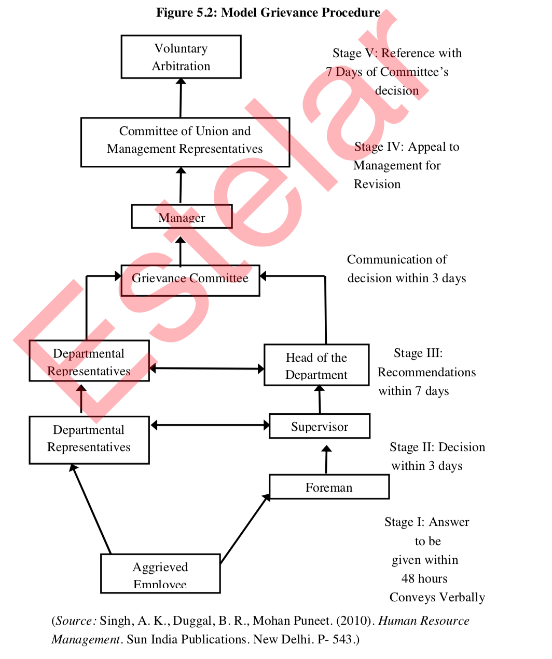

Slide 28
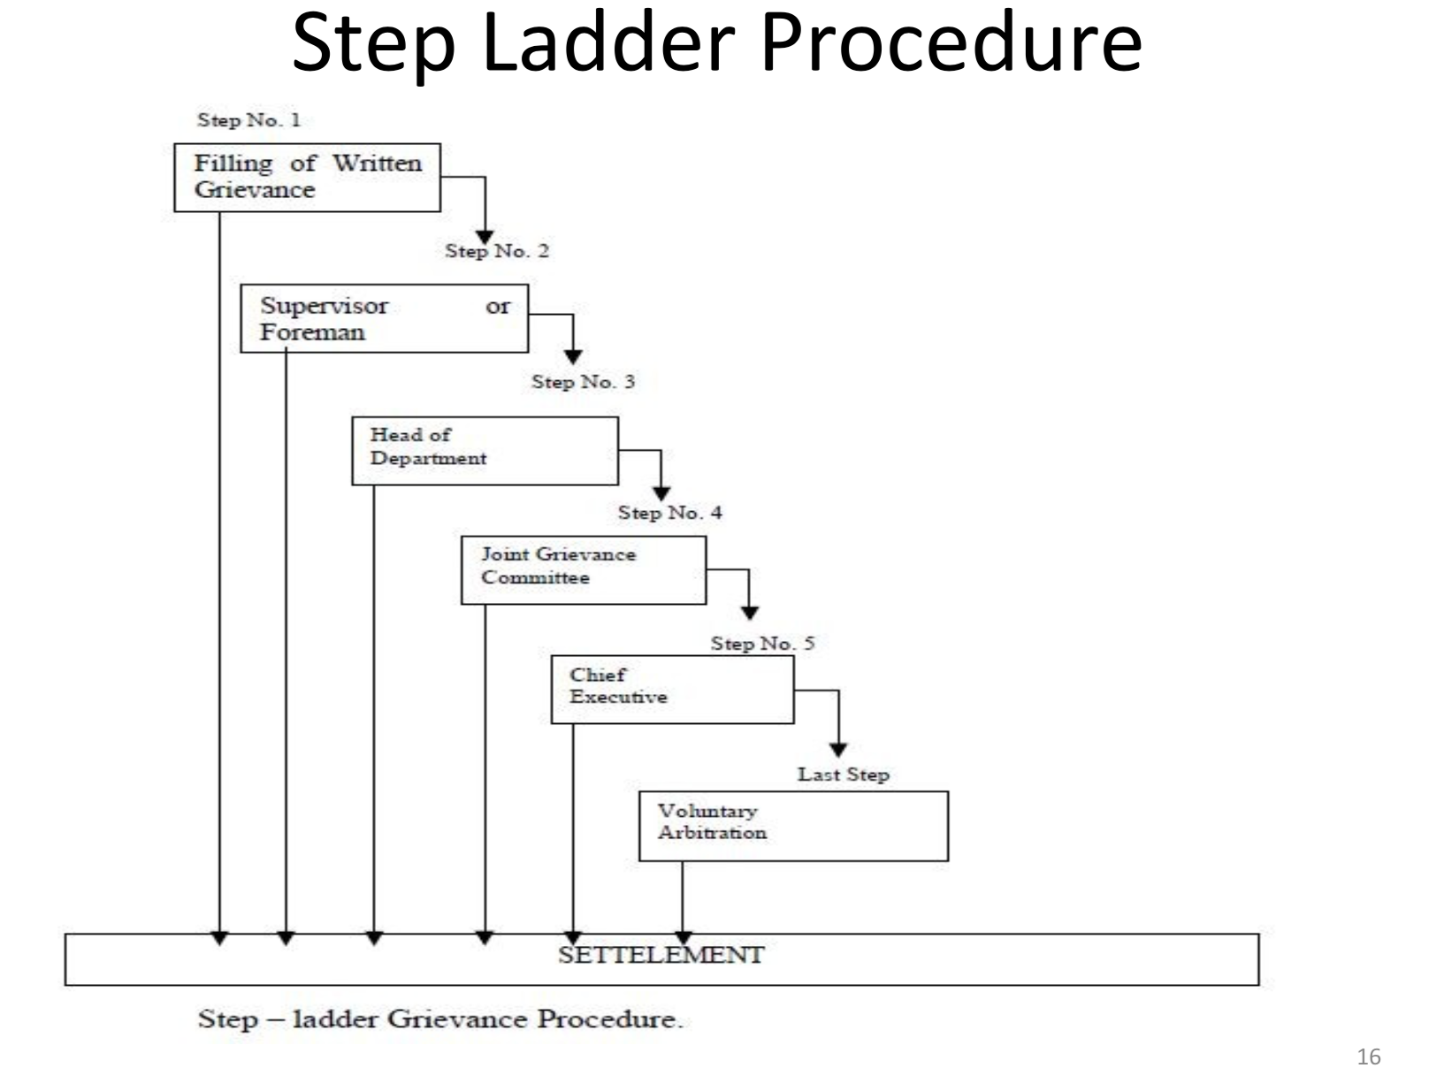

Slide 29
Grievance Procedure Steps in Unionised Organizations
In a unionized organisation, the operation of the grievance may contain the following steps:
Step 1: The aggrieved employee verbally explains his grievance to his immediate supervisor or in a conference or a discussion specifically arranged for the purpose. The employee seeks satisfaction from his supervisor.
The grievance can be settled if the supervisor has been properly trained for the purpose, and if he adheres strictly to a basic problem-solving method.

Slide 30
Grievance Procedure Steps in Unionised Organizations
Step 2: The second step begins when the grievance is not settled by the supervisor. In this case, it is sent to a higher level manager with a note in which are mentioned the time, place and nature of the action to which the employee objects. The higher level manager goes into the grievance and gives his decision on the matter.

Slide 31
Grievance Procedure Steps in Unionised Organizations
Step 3: This means that the grievance is to be submitted to the Grievance Committee since the decisions of the supervisor and of the higher level manager have not solved the problem. This committee, which is composed of some fellow-employees, the shop steward or a
combination of union and management representatives, considers the record and may suggest a possible solution.
It may call upon the grievant to accept the employer's proposed settlement.

Slide 32
Grievance Procedure Steps in Unionised Organizations
Step 4: If the decision or suggestion of the Grievance Committee is not accepted by the grievant, he may approach the management or the corporate executive.

Slide 33
Grievance Procedure Steps in Unionised Organizations
Step 5: The final step is taken when the grievance is referred to an arbitrator who is acceptable to the employee as well as the management.
They may agree beforehand that the arbitrator's award will be final and binding on both the parties.

