Slide 1
Organizational Development
Creating a learning environment and culture

Slide 2
What is OD?
Theory and practice of planned, systematic change in the attitudes, beliefs, and values of the employees through creation and reinforcement of long-term training programs.
OD is action oriented. It starts with a careful organization-wide analysis of the current situation and of the future requirements, and employs techniques of behavioral sciences such as behavior modeling, sensitivity training, and transactional analysis.
Its objective is to enable the organization in adopting-better to the fast-changing external environment of new markets, regulations, and technologies.

Slide 3
OD Values
Respect for people
Trust and support
Power equalization
Confrontation
participation

Slide 4
The underlying values of Organizational Development are humanistic:
Enabling people to work as human beings instead of being treated as mere resources in the huge productive process.
Encouraging organization members to achieve their full potential. Organizations have the opportunity to grow and live by their core values.
Taking into consideration all the goals of the organization when the Organizational Development consultant seeks to increase its effectiveness.

Slide 5
Laying the foundations of a challenging work environment that keeps members motivated and excited.
Offering the chance for organization members to change how they relate to the environment, the organization, and their individual work.
Viewing each person as an organization member that has needs that are highly significant to their life and work.

Slide 6
Organizational Development Objectives
Increasing trust among the members of the organization at an inter-personal level.
Boosting the members’ level of commitment and satisfaction.
Promoting confrontation and fixing of problems instead of postponing and neglecting them.
Handling conflicts in an effective way.
Increasing the collaboration and cooperation among employees within the working environment.

Slide 7
Promoting a problem-solving approach within the organization.
Increasing awareness of the organization’s vision among its members. Organizational Development aims to align the employees’ vision with the firm’s.
Smoothing the transition from formal authority to personal skills and knowledge.
Achieving a trustworthy working environment that enables new implementations.

Slide 8
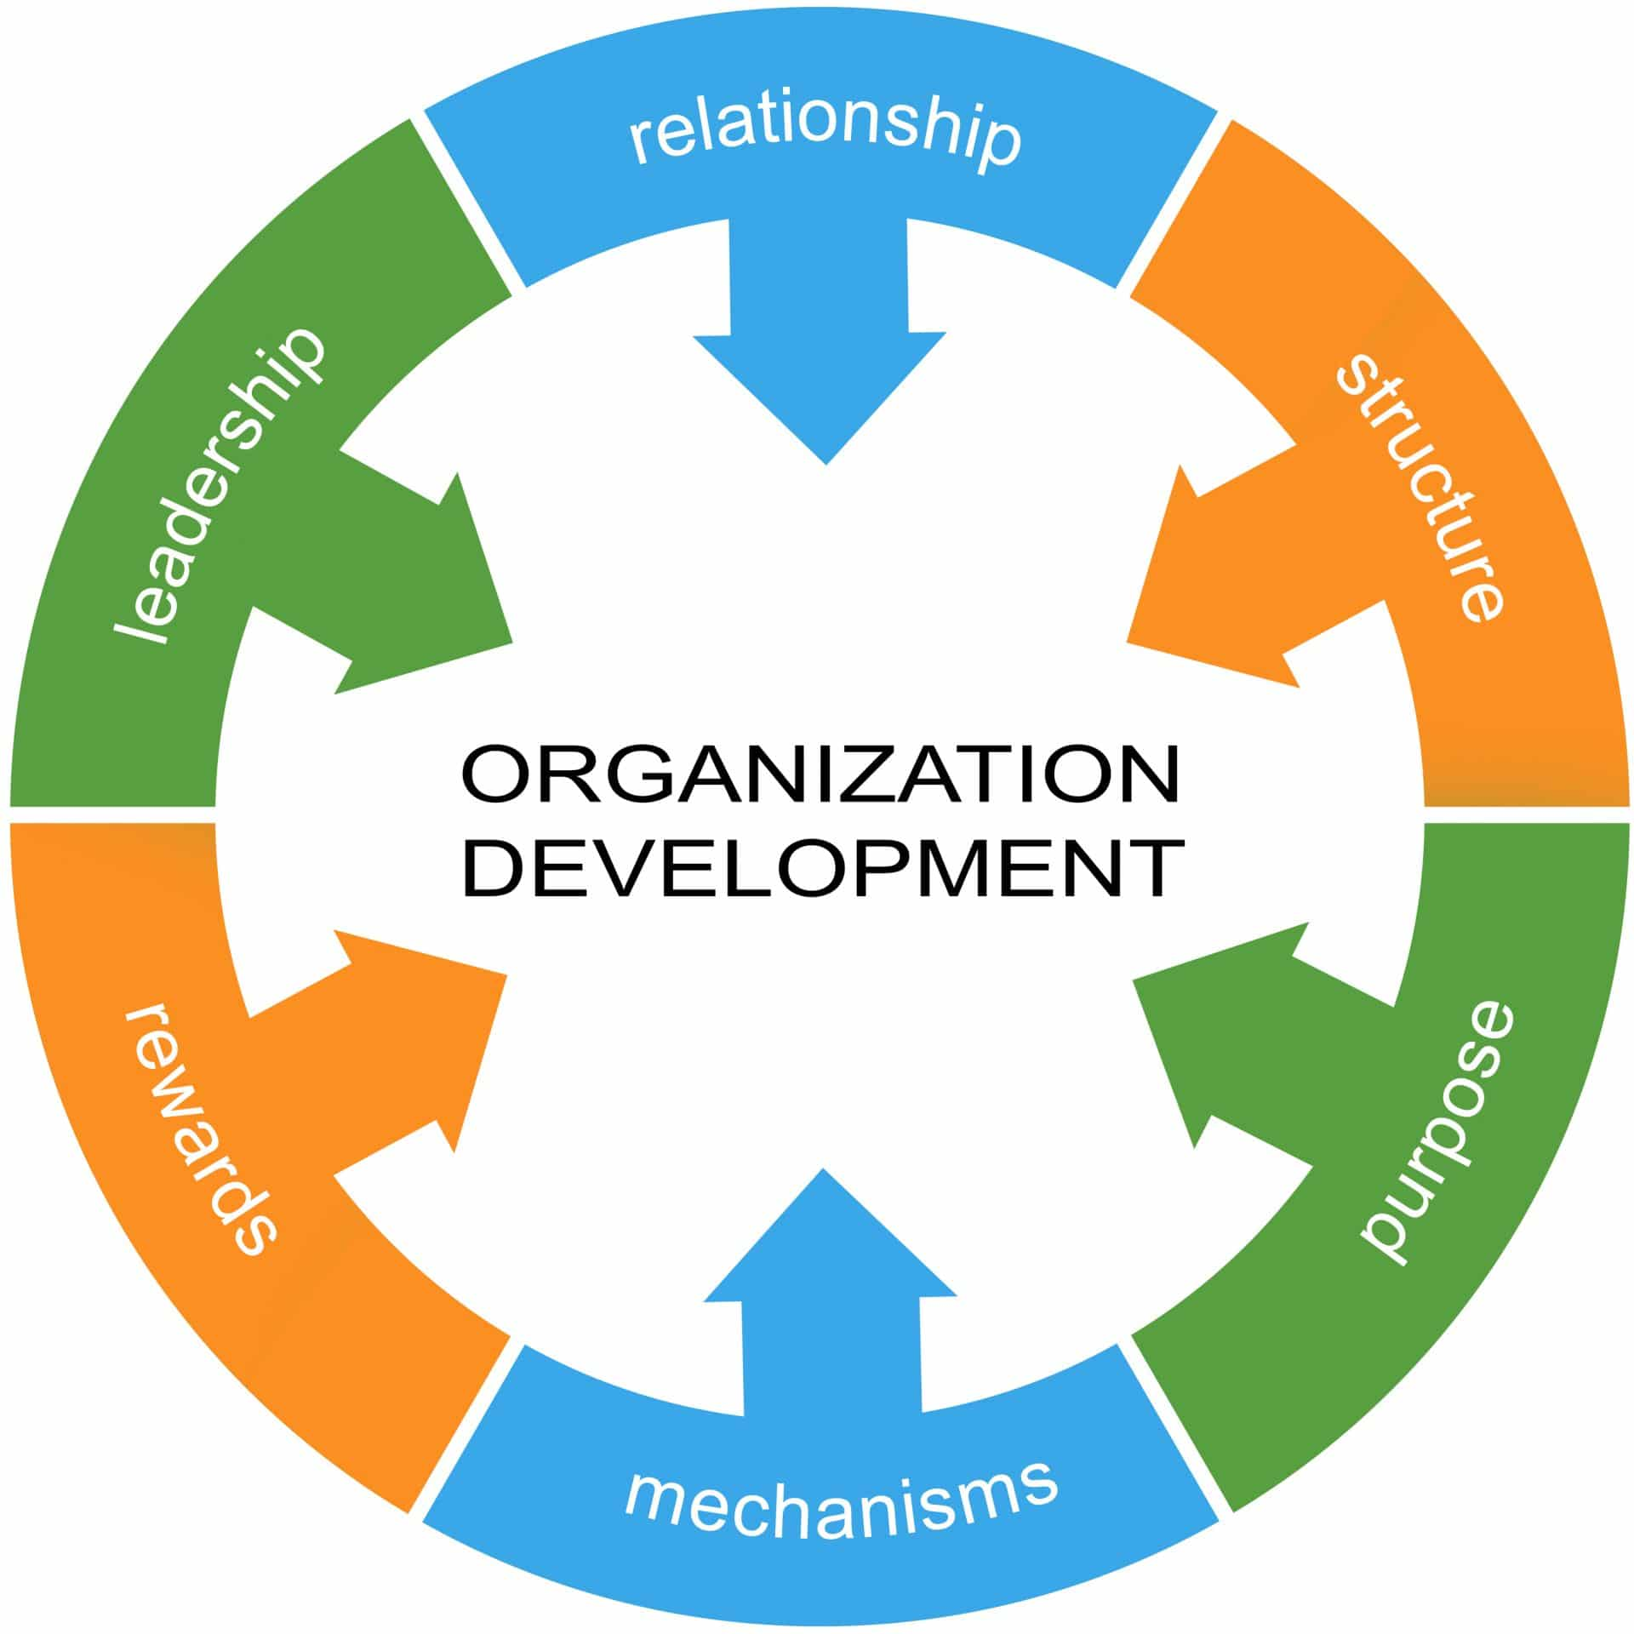

Slide 9
Organizational Development techniques
An organization will work together with a team of change agents in order to draft up the intervention plan and agree on the changes and techniques that are to be implemented. The following activities aim to help both organizations and employees get closer to and fulfill their potential.

Slide 10
1. Survey feedback
The survey technique involves data be collected via a questionnaire. The collected information is meant to help managers make decisions. The answers to the survey feedback will range from quality of work, working condition, working hours, salaries, and employees’ attitude in relation to all of the above.
The team of managers proceeds to analyze and interpret the gathered data. They pinpoint problems, assess the results and start drafting plans for solutions. All the members of the organization are expected to submit this data. Manager meetings are meant to bring subordinates and superiors together in order to discuss the information and interpret it. All levels of management play an active role in this technique whose end result is implementing necessary changes.

Slide 11
2. Team building
Team buildings have been increasing in popularity as an independent component of Organizational Development. Within OD, team buildings are designed to improve the capacity of the organization’s members of working together in a harmonious environment. Organizational effectiveness can be boosted through enhancing work group dynamics and promoting a safe and understanding working place.
In order to help team members open up and speak their minds on work related issues, the professional trainer will lead group discussions. The trainer does not actively participate in the discussion, but merely guides the conversation in order to ensure maximum efficiency. Team buildings’ main purpose is to increase sensitivity to team members’ behavior by promoting a healthy group functioning. Interpersonal interactions and behavior play a significant part of team buildings, encouraging employees to express their views.

Slide 12
3. Sensitivity Training
One of the most popular Organizational Development techniques, sensitivity training asks employees to interact in order to better understand each other. As a result, team members get better acquainted, form bonds, cease to be judgmental and prone to become more motivated and efficient in the working environment.
Carrying out free communications and forming interpersonal relationships are bound to improve their group experience as a team, offering members the chance to unequivocally express themselves in a safe and controlled workplace. Sensitivity training will not only increase awareness of self but also awareness of others. These two are some of the main pillars of Organizational Development, on which trust and comfort are meant to build a new order within the company.

Slide 13
4. Management by Objectives
Part of Management Development, this technique is also successfully used in Organizational Development as a method of reviewing and assessing performance. Management by Objectives implies clearly pinpointing the goals of the organization and assigning them to managers. Their responsibility is to deliver results in a time efficient manner.

Slide 14
This result oriented technique is meant to promote the joint effort of team leaders, laying the grounds for an excellent appraisal system. The accomplished objectives will be used to measure the performance of the managers.
The Management by Objectives technique is generally carried out in four essential steps:
Objectives set by top management.
Individual targets and objectives.
Autonomy in choosing strategies.
Performance review and appraisal.

Slide 15
5.Brain Storming
This Organizational Development technique involves six to eight managers coming together and pitching ideas for solving a problem. Brain Storming aims to promote creative thinking, whilst bringing team leaders together and helping them engage in a lucrative discussion of fixing a common issue. The participants are required to critically assess the matter that is put forward. They are then asked to contribute new ideas or new angles on tackling the conflict. The principle behind brain storming is that managers come together and build a plan based on all of their suggestions.
No expert conducts the discussions, which encourages all leaders to speak freely and make suggestions. The brain storming technique is meant to get participants to debate potential solutions and choose the best ones. All of this is done in a safe environment where members can express themselves freely.

Slide 16
6. Process consultation
An expert or an Organizational Development consultant gives feedback to the trainee and offers insight into solving problems. Process consultation can help team members experience a change of perspective and experiment with various problem fixing suggestions. The clear insight provided by the expert or consultant is extremely valuable since it offers both team members and top managers guidelines on how to approach, handle and tackle a wide array of work-related problems.

Slide 17
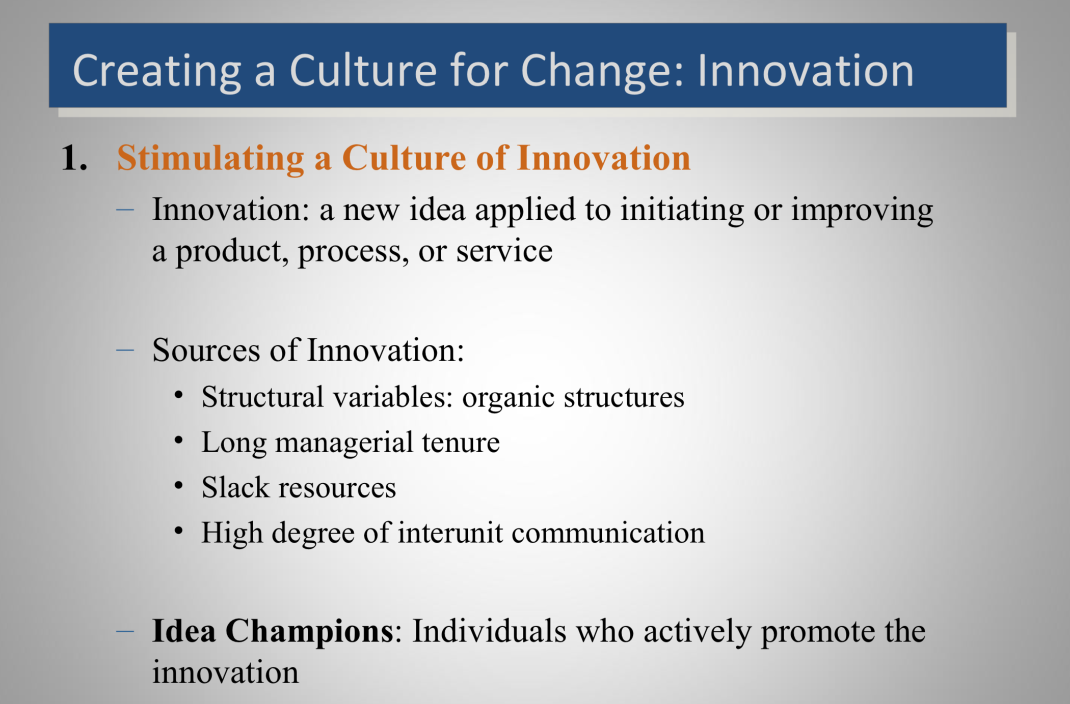

Slide 18
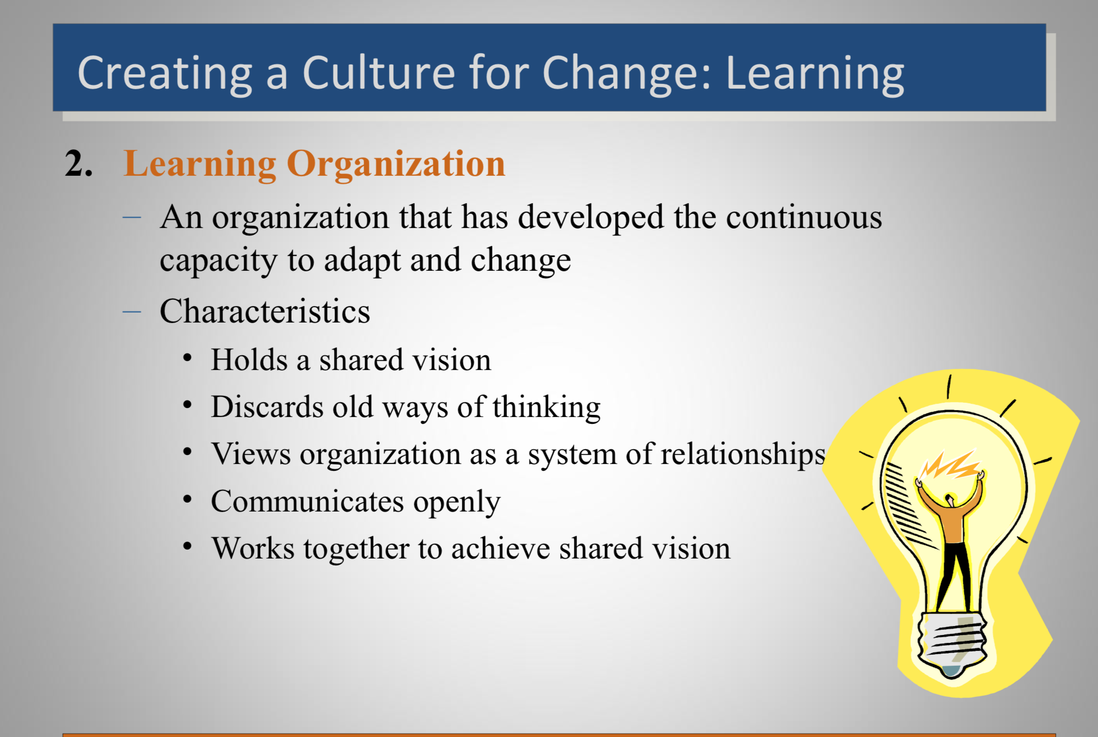

Slide 19
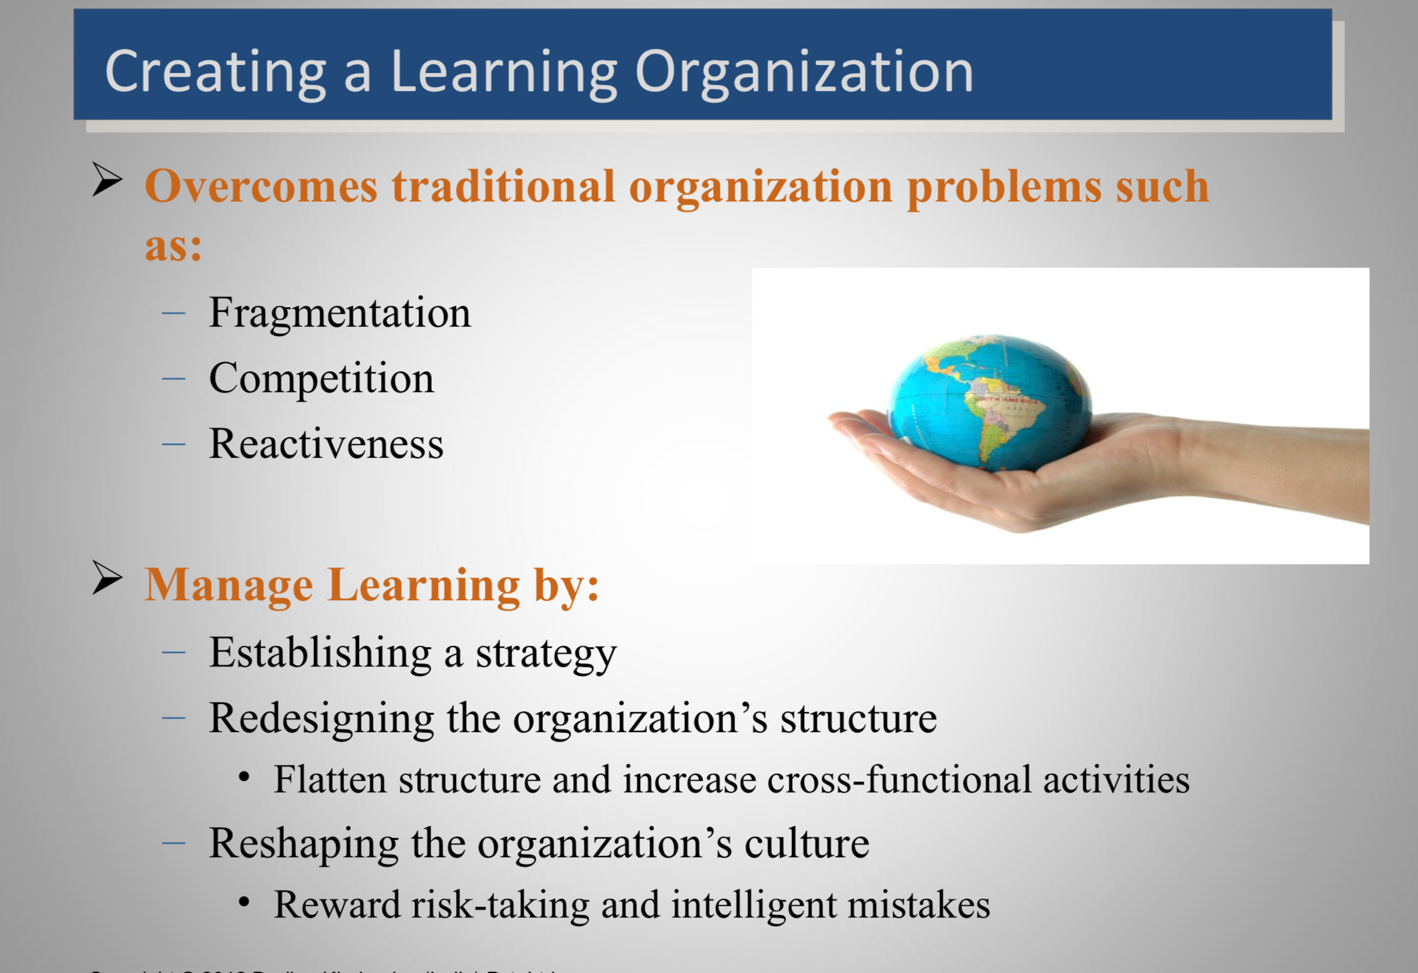
Notes:
Org Fragmentation: too many hierarchy, too many roles, to many unclear objectives

Slide 20
Using Leadership to Deal with Challenges and Promote Change
Effective new ways of leading and managing are critical for all levels of leadership when an agency is undergoing sweeping systems change. Absolutely essential is the ability to proactively envision and frame opportunities for the agency, as well as drive performance and innovation within teams and among employees agency-wide. Leaders in today’s changing organizations must marshal resources toward adaptation and innovation in the implementation and management of their CQI programs, and must energize and inspire those around them to achieve.

Slide 21
Communicating: An important step is having dialogue during solution-seeking that is probing and challenging, or having, in other words, “courageous conversations.” Since change often challenges deeply-held values and beliefs, courageous conversations are about confronting delicate issues and challenging assumptions.
Encouraging Experimentation and Creativity: Leaders can foster an atmosphere of exploring unprecedented ideas and measured risk-taking by framing solution-seeking efforts as experiments.

Slide 22
Tolerating Risk-Taking and Mistakes:Trial and error is often an important part of successful change, which means that those navigating the change process must develop the insight to risk and know failure and be able to learn and adapt from those failures.
Dealing With Loss:A common factor contributing to difficulty adapting or changing is fear of, and resistance to, loss and doing things a new way. When change involves real or potential loss, even in perceptions and beliefs, it can be painful and difficult. Those affected may respond out of fear and anxiety, and these feelings, if not addressed, can slow down or even derail a thoughtful, well-managed change effort.

