Slide 1
Conflict Management: Lecture 4
Complementary Forms of Conflict Management

Slide 2
They focus on the conflict itself and try to resolve it through the employment of different methods. These methods are known as: personal discussion, coaching, mediation, clarifying conversation, team development or supervision

Slide 3
Mediation
The goal of mediation is that conflict participants autonomously develop a sustainable solution for the future which corresponds to their interests and needs.
This is facilitated by a goal- oriented, structured phase model, by need-oriented discussions and by modification of the parties’ communication patterns.

Slide 4
The process is led by neutral (or impartial) mediators, who have an obligation of confidentiality and at the same time ensure openness and transparency in that all parties are present and participate equally in the mediation process.

Slide 5
The basic principles of mediation are:
Impartiality,
self-determination,
confidentiality
participation of all.
Mediation has gained recognition in many areas of conflict management.
Notes:
It is employed in resolving conflicts in partnerships and marriages, separations and divorces, questions of visitation rights, schools, clubs and associations, conflicts in the public arena, questions of environmental protection, neighbourhood conflicts, cross-cultural conflicts, conflicts between companies and, last but not least, conflicts in commercial enterprises and organisations.

Slide 6
Moderation
Moderation is a method which facilitates the working processes of groups by structuring, visualisation and other techniques. Areas of application include task coordination, planning, strategy development, problem analysis and problem solving.
An example of moderation: A team plans and implements a new product roll-out.

Slide 7
The moderator is responsible for the process and acts as impartial discussion leader. She ensures that all participants are equally involved, that participants’ contributions are clearly explained and that results are documented. She may draw on resources such as discussion rules, methods using flashcards, feedback or paraphrasing.

Slide 8
What distinguishes moderation from mediation? Moderation enables a group to structure and efficiently deal with the chosen topic. The moderator ensures optimal utilisation of the existing synergy potential and supports attaining agreed goals. In moderation, the management of the conflict is not the first priority, but rather the achievement of an objective. The aim of mediation on the other hand, is to amicably resolve a conflict between two or more people with the help of a neutral third party. Moderation techniques are also employed in mediation.

Slide 9
Supervision
Supervision is the specialist support of a team or a person by a trained supervisor, with the purpose of developing and expanding their capabilities. Supervision focuses on professional problems and helps make people aware of the social, institutional and subjective conditions associated with a professional occupation, and their effects on professional actions.

Slide 10
Team supervision is concerned with the complex network of relationships between employees, customers and the organisation. In this area, alongside the improvement of morale, cooperation and efficiency of working practices, the professional development of each individual is also a priority. The dynamics of team interaction and the institutional inconsistencies hidden behind them are frequently analysed.

Slide 11
Typically the supervisor and team meet together in a neutral place and work on problems presented by the group or by an individual. One variety of supervision is peer consulting, where people belonging to the same group of professionals work together without a supervisor.

Slide 12
What differentiates supervision from mediation? The role of mediation is not to improve professional capability or to analyse institutional relationships. A mediator accompanies the parties through the process from dissent to consensus.

Slide 13
Coaching
Coaching is goal-oriented counselling given to an individual to help them reflect on and deal with an existing problem. Coaching is consequently an interaction between two people, where the client is an expert in matters pertaining to him (problem) and the coach is an expert in the process (questions, structure, etc.). This equality between the positions of coach and coachee (the client of the coach) is of central importance, as the coaching process should be viewed as a dialogue between partners.

Slide 14
Initially, the coach agrees on a goal with the coachee and works with him on a strategy to achieve the goal. Opposition and obstacles are analysed and courses of action are agreed on. The coach is not a therapist, but acts as a discreet advisor, guiding the coachee through the process and providing continual feedback. New points of view and potential courses of action become apparent to the client.

Slide 15
Dealing with conflicts is frequently a key issue in coaching. If conflicts are suppressed, glossed over or denied, they often escalate and lead to crisis situations. Coaching can make a valuable contribution to conflict prevention as well as to dealing with conflicts.

Slide 16
What differentiates coaching from mediation? In mediation, there are always at least two parties to the conflict and two different positions. While a mediator works on bringing the two parties together, a coach focuses on the interests of his client and assists him in understanding and dealing with conflicts.

Slide 17
Team Development
Team development has the purpose of transforming a group of people into a team. To achieve this goal, a process driven by group dynamics takes place. Team development presents a multitude of problems (power struggles, formation of coalitions, conflicts of customs...), which can paralyse or even destroy a group before they become a team. In team development, the process is managed by a professional advisor to quickly get the team fit for work.

Slide 18
Possible reasons for team development: improvement of communication, co-operation and working relationships between team members, development of a team identity or clarification of functional roles. Team development is used in particular when companies or departments merge, or when new teams are put together.

Slide 19
What differentiates team development from mediation? Team development enables a group to work together and deal with conflicts. From this perspective, team development is a means of conflict prevention, as the team is brought into a position that enables it to independently deal with and resolve conflicts.

Slide 20
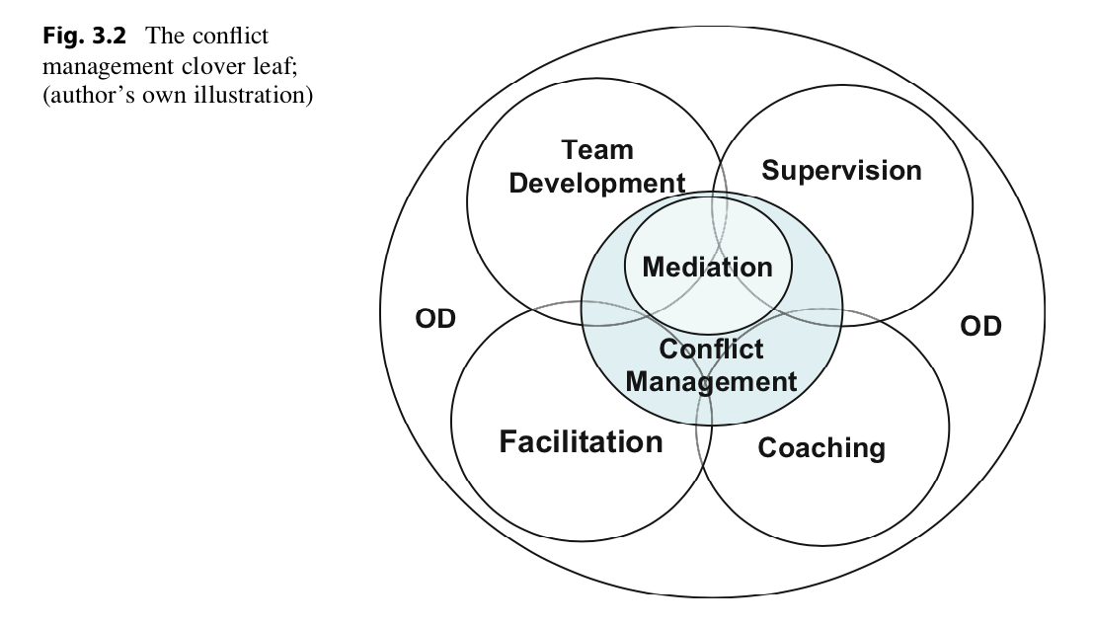

Slide 21
Organisational Development Versus Mediation?
Organisational development (“OD”) is a long-term process aimed at the further development and transformation of an organisation or part of an organisation. The objective of the process is the simultaneous improvement of the performance of the organisation (efficiency and effectiveness) and the quality of working conditions. Depending on the context, OD is concerned with strategic, structural and/or cultural problems.

Slide 22
OD can be viewed as a comprehensive advisory concept, in which the methods described above (coaching, team development, moderation and mediation) can be employed. The role of the OD advisor is to help the customer organisation to solve the problems and tasks itself. The focus is on process management (expertise in the methods applied) and less on technical business advice (professional business expertise).

Slide 23
Organisational Development and Conflict Management
Traditionally, the relationship between the individual and the organisation was interpreted as a relationship of tension. Some literally speak of a “fundamental conflict” between person and organisation.
It is often assumed that, within the scope of organisational development, differences and conflicts can be settled by addressing them openly, or that this results in them resolving themselves

Slide 24
Organisational development provides some indications as to how conflicts can be avoided:
Make clear agreements about objectives and targets
Involve your employees in the decision making process
Reduce the dependency of employees on supervisors
Give employees more individual room for maneuver
Improve the information flow
Take the conflict skills(!) of candidates into consideration in the employee selection process
Create promotion and career opportunities along with opportunities for personal and professional development
Direct training not only towards professional skills, but also social skills.

Slide 25
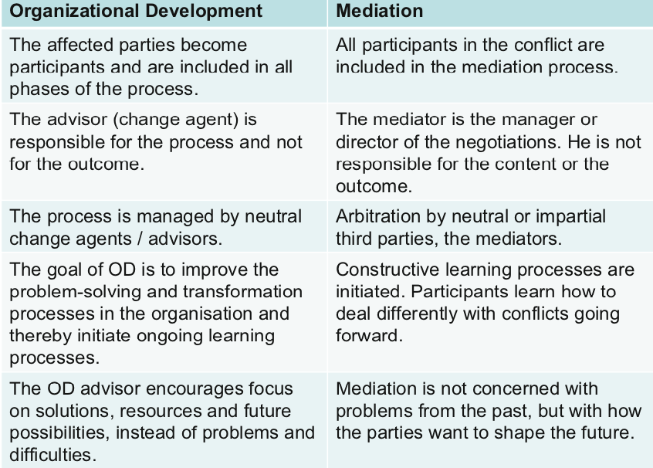
Mediation Is Complementary to Organisational Development

Slide 26
It becomes apparent that working with new organisational forms requires differ- ent conflict resolution processes.
If these are not employed, new organisational forms cannot become effective.
Teams only become independent, self-governing units when they are also able to resolve the conflicts that affect them

Slide 27
Why Mediation is not used frequently:
Mediation costs time and money
Conflict aversion
Loss of power and control
Fear of discovery and exposure
Loss of image among colleagues
Lack of know how in dealing with conflicts

Slide 28
Mediation Costs Time and Money
Integrative methods, such as mediation, team development, moderation or supervi- sion require time and cost money. A search must be undertaken for a suitable mediator or advisor, time (one’s own or that of employees) needs to be allocated and, fees must be paid. Isn’t making a decision much more efficient?

Slide 29
Conflict Aversion
We all know that conflicts create unpleasant feelings (even naked fear).
This negative aspect of conflicts is related to deep-rooted conflict experience. It is likely connected to our historical development.
Our own experiences with respect to conflicts also play a major role.

Slide 30
Loss of Power and Control
It is not only fear of emotion that makes managers recoil from dealing with conflicts. Worry about losing power and control is another reason to shy away from them.
Decisions often have unforeseeable effects
Managers can be nervous of taking decisions

Slide 31
Fear of Discovery and Exposure
In every social system, from the working group to the entire organisation, there are taboos, “skeletons in the closet”, i.e. potentially dangerous information known by a few, some or all, but people keep quiet or deny its existence because they fear the consequences. Examples of this include financial inconsistencies, affairs, favours to individuals and so forth. Some managers worry that integrative forms of conflict management set processes in motion that bring unwanted things to light.

Slide 32
Loss of Image Among Colleagues
Sometimes loss of image among colleagues acts as a constraint to dealing with conflict. Managers often aspire to the ideal of being a successful, strong-willed executive, who can personally solve all problems. What would colleagues say if it became known that he had drawn on external support to resolve a conflict in his team? Company culture plays an important role here. Is bringing in external support a sign of weakness?

Slide 33
Lack of Know-how in Dealing with Conflicts
Last but not least, lack of know-how in dealing with conflicts prevents managers from actively participating in resolving them. What do I do if I’m attacked? How do I deal with it, if a colleague has an emotional outburst or even becomes aggressive? Maybe I’ll end up in a situation I can’t handle?

Slide 34
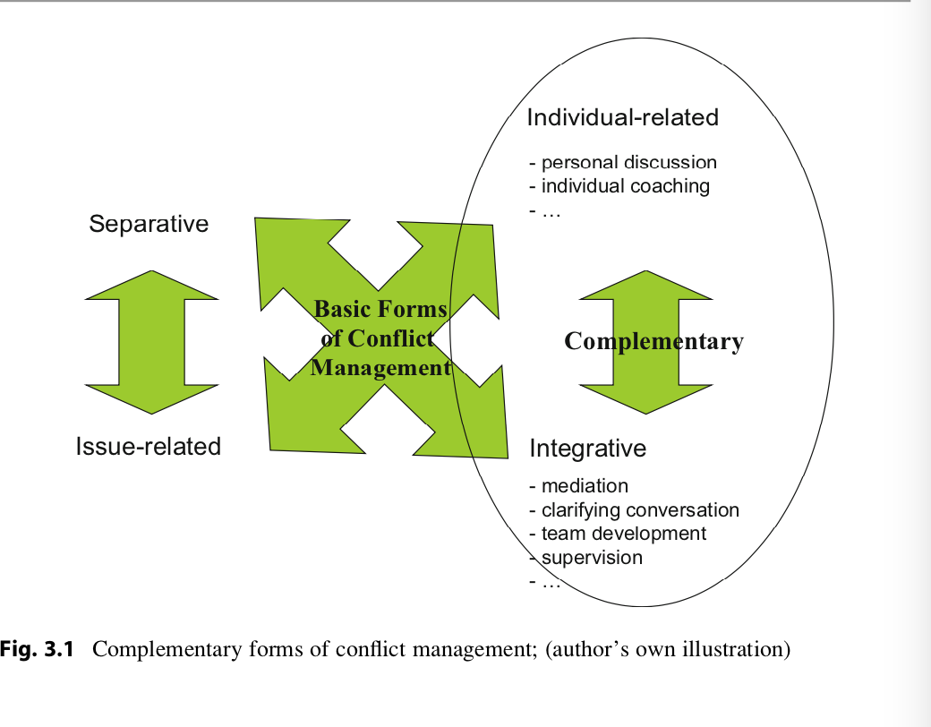

Slide 35
Consequences of the Rare Usage of Integrative Forms of Conflict Management
Decreased Productivity
Employee Turnover
Divided Teams
Poorly Reflected Management
Unhealthy Confrontation

