Slide 1
Conflict Management- Lecture 8
Conflict Prevention

Slide 2
There are even situations in which management needs to provoke conflicts, in order to set changes to entrenched habits in motion
There are however disputes and battles in firms that can be avoided. It is therefore helpful to differentiate between unproductive and productive conflict
Conflict prevention consists of avoiding unproductive conflicts and promoting constructive debate.

Slide 3
Productive and Unproductive Conflicts
Productive disputes are those which are aimed at change and which ultimately have a positive effect on the organisation. In these instances, the conflict is a means to an end. Examples include a debate about a strategic decision, allocation of financial resources or a new advertising campaign.

Slide 4
Unproductive conflicts are those which arise, for example, through misunderstandings, inadequate information or strong emotional reactions. In these cases, the conflict is an end in itself or serves the purpose of asserting one point of view over another

Slide 5
Most conflicts are hybrid forms and contain both productive as well as unproductive elements.
Conflict prevention aims at keeping unproductive conflicts to a minimum
prevention can be categorised according to three different levels: structural, communicative and personal

Slide 6
The structural level refers to the organised forms of communication within a company
The communicative level identifies how and for which reasons people in the organisation speak to one other or exchange written communications.
The personal level relates to the way in which employees and managers consider their own behaviour and how they think about approaching tense situations.

Slide 7
On the structural level, conflicts arise because of deficiencies in the surrounding conditions. These may include a lack of regular possibilities to communicate, such as meetings, or too many meetings, unclear or inflexible duty and role allocation, etc.

Slide 8
On the communicative level, conflicts arise as a result of insufficient discussion of expectations and needs, or from a breakdown of communication. For example, one employee may expect a particular form of politeness and social intercourse. If these expectations are not met, it can lead to confrontation.

Slide 9
On the personal level, conflicts occur due to inner tensions, individual dissatis- faction, frustration, etc. All states of mind that a person experiences and which can erupt into conflicts in the work environment.

Slide 10
Conflict Prevention Through Communication Structure Configuration
The first fundamental aspect of conflict prevention is the structural organisation of the team. A solid basis for constructive team work can be established by means of an “appreciative” communication structure.

Slide 11
If a team or a department has the opportunity to frequently exchange ideas and information, varying points of view can be aligned, differences can be recognised and tensions can be eased by discussion before they escalate. Consequently, communication channels to facilitate regular exchange of information need to be established

Slide 12
Formal Communication Structures
In order to ensure an optimal flow of information and keep relationships between colleagues intact, every employee should regularly participate in horizontal and vertical forms of interaction. No individual should only have contact with their immediate group of colleagues.
Different organizations have different levels of interactions with each other. For example: School vs software house.

Slide 13
The communication structure in a company could look like this:
Regular weekly meeting with colleagues and direct manager, in which work- related issues are addressed, problems and possible solutions discussed, courses of action agreed on, etc.
Quarterly or semi-annual personal review meeting with direct manager, to assess and define the employee’s position. The manager has the opportunity to convey specific goals and any open questions can be addressed jointly.
Annual staff outing or informal team development workshop for the entire team. This has the purpose of facilitating personal interaction and thereby strengthening cooperation.

Slide 14
Communication of a manager
Regular weekly meetings with employees
Quarterly or semi-annual personal review meeting with direct manager
Quarterly or semi-annual personal review meeting with each employee
Regular monthly team or department head meeting
Annual staff outing or informal team development workshop

Slide 15
Naturally, alongside formal communication there is also informal communication. It’s importance cannot be overestimated. Companies would be well-advised to establish or allow discussion corners, kitchen areas for coffee-making, social spaces, etc., as in these areas information can be exchanged in an unbureaucratic way and employees can interact with one another on a personal level.

Slide 16
Other Structural Forms of Communication
The company structure- Organogram
The mission statement
Company vision and mission
Company Culture – norms and values.

Slide 17
Conflict Prevention Through Discussion and Expectation Management
When someone takes on a new responsibility, starts a new role or puts a plan into action, they attach expectations to it. Most people develop an idea, sometimes vague, sometimes fixed, of the results that their actions will have.
Often, however, the vision does not correspond to the reality, which leads to disappointment. This in turn has a negative impact on productivity and commitment, and can lead to tensions.

Slide 18
Managing expectations is therefore an important function of successful leaders. If employees’ expectations are kept at a realistic level, their degree of satisfaction tends to be higher, and unproductive conflicts are avoided.

Slide 19
What does that mean in practice?
It means regularly seeking discussions with employees. It also means creating opportunities to talk on an informal level, such as over coffee or during lunch break, to address needs and interests, and making time for the expression of personal concerns and expectations.

Slide 20
The first step should therefore be to encourage the party concerned to engage in a self- reflection process, for example with questions such as “What is your view of...” or “What are your expectations in terms of...”.
The second step consists of comparing the demands from both sides.

Slide 21
Conflict Prevention Through Self-Reflection and Personal Development
Where individuals are concerned, conflicts can arise as a result of inner tensions, discontent and similar issues
Example: An older employee, for example, envies a younger one because he has better qualifications and consequently better promotion prospects. He treats him with excessive criticism and contempt. This leads to an unproductive conflict for the company.

Slide 22
Depth psychology i
Depth psychology is based on the idea that conflicts arise as a result of the tension between biological instincts, the “id”, and social nature (formed by parents and upbringing), the “super-ego”. The “ego” stands between the two and is supposed to bring both poles together.

Slide 23
During the course of socialisation of human beings, through upbringing and living within the community, we learn to keep our instincts, the “id” (aggression, sexual drive), under control and not to let them run free unchecked.
If however the other pole, the “super-ego”, becomes too strong, it causes instinct-driven, creative energy to dwindle. Therefore, the (healthy) “ego” has to integrate both tendencies, in order to mature into a productive collective entity.

Slide 24
Decision Theory
Decision theorists argue that we are confronted with contradictory demands on a daily basis
Expectations can conflict with our values. Shall I go home and have dinner with my partner, or finish my work?
This gives rise to dissonance, an inner conflict, which the person must in some way resolve

Slide 25
This is achieved by information selection, reinterpretation or re-evaluation. Sometimes it is done by bringing the inner conflict into the outside world by way of substitution.
Inner conflicts are the norm. Some people are successful in overcoming their conflicts without negatively affecting their surroundings. These people are referred to as conflict competent personalities.

Slide 26
People who have a tendency to act out their inner conflicts in their environment, or turn against themselves, are referred to as conflict-prone personalities.
Conflict competent people are able to integrate different and opposing tendencies, in that they-

Slide 27
– adapt to different people and situations, while not losing sight of their own goals;
– develop their own personality and at the same time can follow an idea and be helpful to others;
– withstand unclear and contradictory situations but nevertheless behave decisively and in a considerate manner;
– form and hold their own opinion but question their own assumptions and are prepared to compromise;
– have confidence in themselves and others, while being able to live with disappointment;
– have their own values, but nevertheless respect the values of others.

Slide 28
Inhouse Conflict Management System?
If an employee or a manager has a problem, let’s say with a colleague, then generally they have three options to address the issue: another colleague, their supervisor or the works council. All three have disadvantages.

Slide 29
An internal conflict management system (ICMS) has the purpose of facilitating and supporting a structured, reliable and accountable way of dealing with tensions, disagreements and conflicts. The goal is not, to relieve management of its responsibility or to replace management functions, but to support management and offer employees alternative options for dealing with disagreement.

Slide 30
An ICMS creates a new way to solve problems. It provides an opportunity to address organisational conflicts in a dedicated arena. That way the creative poten- tial that lies dormant in conflicts can be put to beneficial use. At the same time, the burden on both employees and management is reduced.

Slide 31
An in-house conflict management system increases transparency and provides some sense of security for employees. The benefit of this system lies in the improvement of the atmosphere in the company, lower staff turnover and absentee- ism, and ultimately in higher levels of employee motivation.

Slide 32
The Core Elements of an Internal Conflict Management System
Internal Conflict Managers
Internal conflict managers are employees who can be contacted in the event of tensions or disputes. They conduct mediation themselves or take appropriate measures to resolve to an existing problem. These individuals have either completed training at an independent institution or have been trained to become internal conflict managers or mediators in the course of the project. Finding the right people for this function is a delicate area in the implementation.

Slide 33
The Role of Management
Senior company executives play an important role in conflict management. It is indisputable that management influences the social behaviour of its employees and thereby the corporate culture of an organisation.
If management sets the example of an open and direct communication and conflict culture, it is likely that employees will also have the courage to deal with disagreements and conflicts.

Slide 34
Information and Internal Marketing
When announcing the project, intensive use of the standard internal communication channels is necessary, for example the employee newsletter, email, etc.
There should be clear communication and transparency towards who gets which projects.
Discreet handling of issues and information is a central aspect of conflict management and mediation activities.

Slide 35
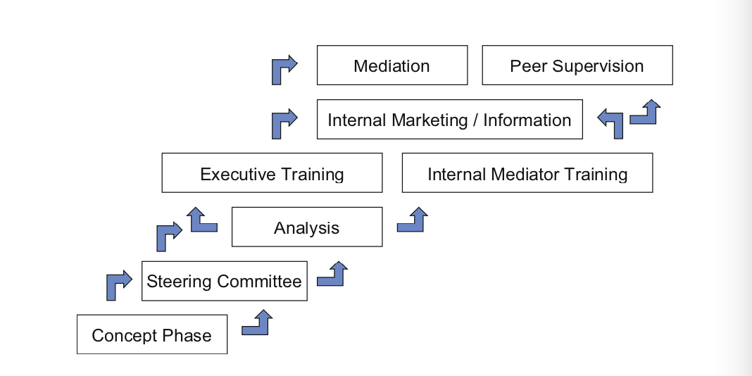
Guidelines for the Implementation of Cooperative Conflict Management

