Slide 1
Conflict Lecture 7
Questioning Techniques and Conflict Prevention

Slide 2
Questioning Techniques
Question Formulation:
You probably know people who like to talk about themselves more than any- thing else.
That can be entertaining, but at some point you may become bored, irritated or even angry.
The person who doesn’t ask any questions sooner or later inevitably annoys the other person. Questions enable us to engage with the other person.

Slide 3
A constructive questioning technique creates a positive atmosphere and helps obtain relevant information.
Questions enable you to steer the discussion, recognise problems, clear up misunderstandings and find the way to suitable solutions.
Questions can however also put pressure on others or drive them into a corner. It all depends on how you ask.

Slide 4
Good questions serve the following purposes:
Conversation steering As every question requires an answer, the respondent is compelled to think about the content of the question.
This enables you to focus on specific aspects and in this way steer the discussion.

Slide 5
Problem definition
The use of targeted questions clarifies the problem and helps in arriving at a problem definition.

Slide 6
Clearing up misunderstandings
Questions enable us to prevent misunderstandings. When you better understand your discussion partner, misunderstandings can be avoided.
Finally, questions enable you to obtain relevant information, bringing you closer to a solution.

Slide 7
There are different forms of discussion technique using questions: the interview, the interrogation, the dialogue and “appreciative enquiry”.
Each form produces a different type of atmosphere and consequently has an effect on the partner to the discussion.

Slide 8
The Three Levels of Mediation Questioning Techniques
A “mediative questioning technique” involves filtering the questions that spontaneously arise in a situation according to a specific framework, as not all questions are useful and helpful in the context of the mediative form of discussion management.

Slide 9
The first filter is known as the “mediation approach”, the second as the “question form” and the third as the “questioning methodology”.

Slide 10
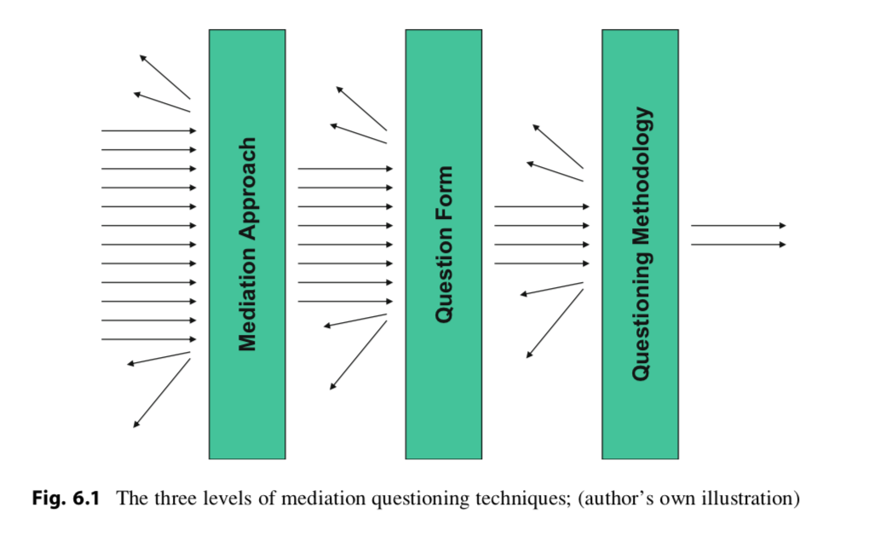
Mediation Approach

Slide 11
This is distinguished by five aspects:
Appreciation An appreciative orientation means treating people with consideration and respect, and strengthening their sense of self-esteem.
It also means never treating people as objects or as a means to an end.
In conflict management, it also means taking into consideration that rules and laws are made to serve people and not vice versa.

Slide 12
Impartiality Impartiality is related to neutrality. The difference between the two is that neutrality implies an “objective distance” from the people involved and the problem.
Impartiality on the other hand requires equal support of both parties to the conflict. It also means accepting the differences pertaining to the conflict participants themselves.
This impartiality, is not a fixed mindset, but needs to be regained and reviewed on an ongoing basis during the course of the process

Slide 13
Empathy and acceptance The ability to put oneself in someone else’s shoes and to accept them with their strengths and weaknesses, even when we don’t agree with everything.
We nevertheless accept this person, and their interests and needs. Empathy and acceptance also relate to the concerns of the party to the conflict. Seemingly unimportant issues can have great importance in the eyes of the affected person.

Slide 14
Confidence Confidence on the part of the impartial third party is the first step in the direction of problem resolution.
If there is no optimism and belief in the chances for a solution, it is best to turn down the assignment.
Optimism, as well as scepticism, will be noticeable to the other party in the course of the discussion and have a supportive or detrimental effect on its progression.

Slide 15
Openness In conflict management, it is essential to enable the parties to progress towards a solution to the problem.
This requires flexibility on the part of the conflict manager to accompany the participants in their search for a solution and openness towards reassessing one’s opinions and discarding some of one’s own ideas about how to reach a resolution.

Slide 16
Question Forms
We all know different ways to ask a question. There are questions which only permit a “yes” or “no” answer (polar questions), those that don’t require any answer (rhetorical questions) and those which leave the answer completely open.
Rhetorical questions are more of a stylistic device than a question and are therefore not dealt with here.

Slide 17
Different forms of questions
Open questions Open questions are those which basically leave all options open with respect to the answer.
These questions therefore make the respondent feel that he is invited to explain his point of view.
A resulting advantage is that—in contrast to closed questions—one obtains new information instead of just checking one’s own assumptions. An example: “How did this situation arise in your view?”

Slide 18
Clarification questions Clarification questions are aimed at comprehension and serve the purpose of helping to pin down exactly what has been said.
The goal is not to obtain new information but to check one’s own understanding. An example: “Did I under- stand correctly that the whole salesforce reports to you?”

Slide 19
W-questions The so-called “w-questions”, a sub-group of open questions, are those which begin with a w, such as who, what, where, when, why, etc.
They are useful in clarifying the circumstances surrounding the issue. Hidden in the w-questions is however one question which should be avoided in the open discussion rounds, namely the question of why.

Slide 20
A why-question obliges the respondent to justify himself. He will feel under attack and consequently evade the question or blame other people.
The why-question can be somewhat watered down and the “why” replaced for example with “what prompted you to. . .”

Slide 21
Circular questions Circular questions invite the respondent to take the positions of other people into consideration and to explore new angles.
By this means he is able to put his own point of view into perspective and become open to new viewpoints, e.g. “How does your colleague explain your behaviour to herself?” or “How would the project leader describe the situation?”

Slide 22
Hypothetical questions Hypothetical questions encourage the respondent to undertake thought experiments in the sense of “what would happen if. . .”
In this way you trigger a reflection process that can go beyond the existing explanatory framework.
This enables new options and ideas to be developed. Conclusions about current hopes and fears can also be drawn, which may not always become clear from direct questions, e.g. “What would you personally do differently?” or “What would happen if you told your superior about it?”

Slide 23
Scaling questions Scaling questions ask for assessments based on a notional quantitative scale (e.g. from 1 to 10), and can be further refined with follow-up questions.
These questions are helpful in reducing complexity. The absolute numerical value is less important here than the relative value, which may change during the course of the mediation process, e.g. “on a scale of 0 to 10, how would you rate the willingness of the other party to participate in the solution to the problem?”

Slide 24
Solution-oriented questions We frequently find that a lot of energy is invested in describing problems and surprisingly little in the development of solutions.
It is recommended that possible solutions are given a central role in the considerations. This can be achieved, for example, by looking for situations that were unaffected by the problem.
By identifying contexts and conditions in which the problem did not arise, strategies can be developed to create these conditions more frequently, e.g. “When does it work well?” or “What would have to happen in order for everything to work out and for everyone to be satisfied?”

Slide 25
Paradoxical questions While paradoxical questions can on the one hand irritate the respondent, on the other they carry the potential to identify ways in which the discussion partner can actively influence events.
This way one’s own role and possible courses of action can be ascertained, e.g. “How could you make the situation even worse?”

Slide 26
Should only be used with caution:
Closed or Polar questions These questions can only be answered “yes” or “no”. An example of this would be: “Did you use the copier yesterday?” Polar questions greatly restrict the respondent.
They will therefore carefully consider the answer or evade the question. As a result, the answer tends to be of a defensive nature. Polar questions are not to be confused with clarification questions (see above).
The answer to clarification questions is also often “yes” or “no”, but they are always based on what the respondent has previously said himself and are therefore not perceived as confrontational.

Slide 27
Alternative questions
These are very similar to polar questions, in that they allow only two possible answers. An example: “Is that the exception or the rule with you?” Alternative questions have the same advantages and disadvantages as polar questions.

Slide 28
Leading questions These are questions which only permit one answer. The answer is put into the mouth of the respondent, so to speak.
This type of question is unpleasant for the respondent and is manipulative in nature. An example: “You surely don’t believe that you’re going to get something for nothing here?”

Slide 30
Which Question forms to use?
If it is the intention of the mediator, for example at the start of a consultation, to understand a situation, he utilises linear (also known as or “lineal”) or circular questions. If he wants to steer the discussion in the direction of a possible solution, he uses strategic or reflexive questions

Slide 31
Linear questions are based on the assumption that there is a clear (that is a linear) relationship between events in the sense of cause and effect. Example: Because there is X, there is therefore Y. The aim is to find out: Who did what, where and why.
A few examples: “What is the problem? Do you have an explanation for it? What consequences does it have for the company? What costs have arisen? Are other colleagues also affected by it?” etc.

Slide 32
Open questions, w-questions and clarification questions are all types of linear questions. A weakness of linear questions lies in their tendency to over-simplify.
A phenomenon is attributed to a single cause, and little attention is given to other influences.

Slide 33
Circular questions are based on the assumption that perception is structured in a cyclical way.
The premise is an ongoing process in which things continually influence each other.
This form of questioning serves the purpose of bringing patterns and interactions to light. Circular questions are directed at,
for example, seeking disparities, or the context of a situation. A few examples: “Why did you come to me? In which situation did the problem appear? How do you react when you’re confronted with X? Ho

Slide 34
Questioning Methodology
Open up the discussion Initially, the questioner tries to ask questions in a way that helps the respondent explain the details that are relevant to understanding the problem.
He will then be encouraged to develop new ideas and points of view. Open questions allow the respondent a broad array of possibilities in terms of answering. New information can come to light that way.

Slide 35
Listen instead of talking and pause in the conversation The person asking the questions should not take up more than around 10 % of the discussion time!
A short pause should follow a question. After posing a question, avoid asking the next one and then the next one immediately after- wards.
If the person to whom the question is addressed doesn’t answer straight away, give them some time! Important thoughts and ideas often arise during pauses in the discussion.

Slide 36
Don’t be too strongly attached to one particular model or guideline
Prepared guidelines only provide information that is useful in the context of that particular theoretical framework.
A discussion plan is certainly practical and useful, however one should also be prepared to abandon it and follow a different direction.

Slide 37
Allow time
An intensive discussion requires adequate time. Half an hour won’t be enough. Don’t give the impression that you need to run to the next meeting. Ask sufficient follow-up questions. Also listen to (seemingly) irrelevant details. This facilitates trust and an atmosphere conducive to open conversation.
Show understanding; avoid other types of reaction

Slide 38
Allow emotions Emotions can be important sources of information. Don’t attempt to suppress or gloss over emotions.
Cautious understanding is advisable (“How did you feel in this situation?”). Under no circumstances should you ask persistent follow-up questions, or try to confirm your own opinion.

