Slide 1
Conflict Management: Lecture 5
Mediation

Slide 2
Mediation: The Origins
Mediation is an old method of conflict management, which became known in its current form in the USA in the 1960s and 1970s
the process itself is a mixture of conflict resolution practices from diverse countries and cultures.
The basic principle of mediation, drawing on the support of a neutral third party as intermediary, could be found long ago in ancient China and Japan, countries in which religion and philosophy have always placed strong emphasis on cooperation and consensus.

Slide 3
Mediation has proved to be successful in many areas of business and can be used to deal with most escalation levels of a conflict. In organisations, mediation is employed in conflicts which arise as a result of restructuring measures and headcount reduction, in disputes between managers, between departments, within a given working process or in cross-cultural conflicts, to name just a few examples.

Slide 4
In-company mediation refers to mediation between members of the same organization. This type of mediation can be conducted by either internal or external mediators. Internal mediation is a specific type of in-company mediation. Internal mediators are people who are employed by the company and either hold formal qualifications in mediation, or have completed training in a comparable area. When these people undertake mediation within their organisation, it is referred to as internal mediation.

Slide 5
External mediators are independent. They are not employed by the company and receive fees for their services. The decision to select internal or external mediators should be based on the overall assessment of the problem.

Slide 6
The Mediation Phase Model
As mentioned, mediation comprises a diverse range of conflict resolution practices. What is new about mediation today is the clear structuring of the process, which is known as the phase model.
This model can assist you as a manager, a project leader or an employee in being able to better—and more reliably—find constructive solutions to conflicts.

Slide 7
The model essentially consists of five phases:
parameter definition,
issue compilation,
conflict discussion,
solution finding
and agreement.
These five phases are preceded by a pre-mediation phase and are followed by a post-mediation phase.

Slide 8
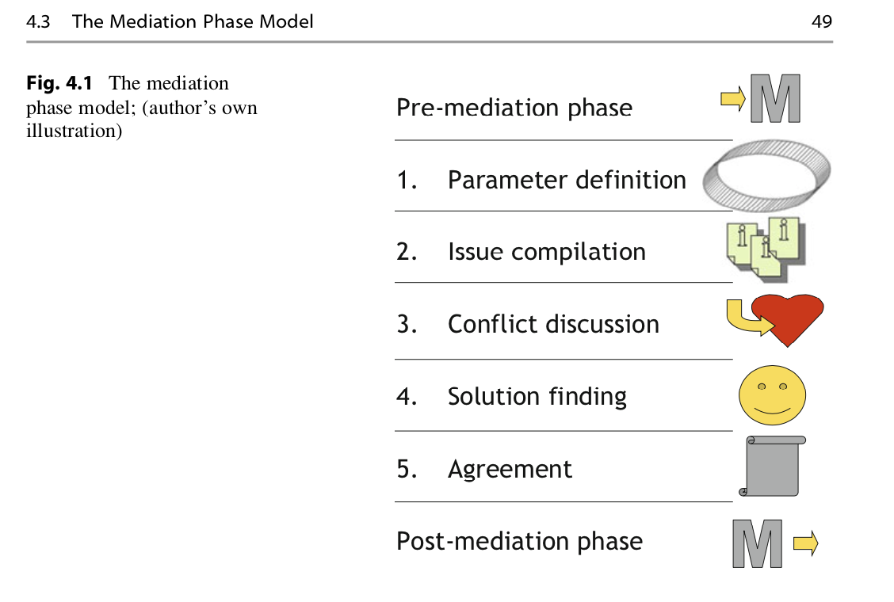

Slide 9
Pre-mediation Phase
The success of a mediation is to a large extent dependent on the preparation in the pre-mediation phase. Inadequate preparation is one of the most frequent reasons for failure.
The pre-mediation phase consists of three stages:
– preliminary talks,
– conflict analysis and
– implementation planning.

Slide 10
Preliminary Talks
The first step is to conduct a one-on-one dialogue with each of the respective participants. It is risky to embark on the conflict resolution process without first obtaining an overview of the situation. The conflict landscape is often complex and the problems are frequently intertwined. As a conflict manager, you must isolate the situation, analyse the conflict, determine the prospects of success, and assess the willingness of the parties to engage in the process.

Slide 11
In the course of these one-on-one dialogues with the conflict parties, the following issues should be addressed:
  – Wherein lies the problem in the view of the respective person?
  – Who is participating in the conflict?
  – What are the objectives and the interests of the client?
  – What do the participants expect from you (as manager, as project leader, . . .?)
  – Are the parties to the conflict willing to resolve the dispute?
  – Which surrounding conditions play a role?
  – Who will conduct the mediation?

Slide 12
Conflict Analysis
Once you have concluded the preliminary talks, the next step is to carry out an analysis of these conversations. The result of this will determine the form that the conflict resolution process will take

Slide 13
You must now decide whether you feel confident in dealing with the issue and whether you have the time and interest to step into the role of mediator.
Otherwise external mediators will be needed if there is conflict of interest.

Slide 14
Implementation Planning
If you have decided in favour of mediation, you can now set about preparing for the first discussion meetings. A quiet place where one can work without disturbance is an important prerequisite for successful conflict management. A flipchart should be available, so that important aspects of the discussion can be visibly recorded for all participants.

Slide 15
Parameter Definition Phase
In this phase, the parameters are set for working together on the resolution of the conflict. Openness and transparency generate trust and are consequently an important prerequisite for successfully working towards a solution. From this point forward, discussions should only be held in the presence of all participants.

Slide 16
Before you give each party the opportunity to describe the problem from their perspective, discuss the objectives with them. Jointly develop a goal based on what you heard in the preliminary talks. This should be broad, that is to say not very specific, and positively formulated.

Slide 17
A specific goal would excessively restrict the possibilities for resolution. Positively formulated means that: The clients must articulate what they want instead of saying what they don’t want.
Depending on the situation and the level of escalation, it may be advisable to agree on rules of discussion with the participants at the beginning of the joint meetings (e.g. allow people to finish speaking, no destructive undertone. . .)

Slide 18
Issue Compilation
The next step, is to give the parties feedback on the results of the preliminary talks. Do not go into detail about the individual conversations when doing this, as these are confidential, but provide a conceptual overview of the problem as you see it. It is also helpful in this phase to highlight the common interests of the parties as conveyed in the individual discussions. You facilitate a positive and future-oriented start to the process

Slide 19
The examination of the problem can give rise to focus areas for the commence- ment of the process. Additionally, ask the participants to highlight topics they would like to address. This phase is consequently referred to as the issue compila- tion or structuring phase. A flipchart is useful for compiling and visualising a list of the issues. That way the “table of contents” for the mediation emerges. Next, the issues are worked through, one after the other. At this stage, tight management of the discussion is recommended. Arguments between the parties should not be allowed in this phase.

Slide 20
Conflict Discussion
The purpose of the conflict discussion phase is to understand which motives, needs and interests are concealed behind the different positions.
If the topic with which you would like to begin has been identified, then each participant (finally) gets the chance to express his opinion, one after the other, but only on this subject
That way heated accounts or lashing out are prevented.

Slide 21
At the beginning of the mediation process the parties are frequently unclear about their own interests and needs, which are being compromised or threatened by the conflict
The participants often only become aware of their concerns as a result of the verbal description.
The concerns of the opposite side also frequently only become clear to the other party after listening. As a mediator, you support the exchange by guiding the discussion in an open and enquiring way.

Slide 22
When people are affected by a conflict, they usually know exactly what they don’t want. They rarely know what they do want instead. They almost never know why they want something and what their needs are. If the mediator is successful in identifying the needs of the parties in the course of the conflict resolution process, this paves the way to finding a solution.

Slide 23
The most important steps in this phase are: Recognition of all meaningful concerns of the parties (whereby “winning” and “punishment” lose their impor- tance), as well as those of the company or relevant third parties.
A “process of understanding” is set in motion. The mediator or conflict manager facilitates this with questions such as: “What is your goal?”, “What is important for you?” or “What do you want to achieve?” etc.

Slide 24
Search for a Solution
After the points of view and the needs of all parties have been explained in sufficient depth, the search for a solution commences.
In the first step, the creative method of brainstorming is employed. All solutions that spring to the minds of the participants are noted on a flipchart.
All ideas are allowed, regardless of how unconventional they are. Criticism of suggestions and ideas is forbidden.

Slide 25
Creative or fully unconventional ideas can inspire and provide the necessary courage to step into a new way of thinking. Sometimes, constituent elements of impractical ideas can be useful in arriving at innovative solutions.
This process helps to move away from the established solution models. Once the creative process is concluded, one proceeds to the evaluation of ideas.
If no solution stands out as optimal, it is advisable to undertake an ABC analysis to simplify the search for a solution

Slide 26
ABC analysis:
The parties are given red, yellow and green- coloured stickers. A sticker is assigned to each different solution according to the following system: green means “a good solution in my view”, yellow means “could be a possibility in certain circumstances” and red means “out of the question for me”. The solutions evaluated as red are discarded. The green solutions are, in order of the highest number of total points, examined in more detail and augmented by the yellow solutions if necessary.

Slide 27
Agreement
First, the mediator writes the agreed solution in note form on the flipchart. The agreement is now subjected to a feasibility check: Does the settlement correspond to the goals defined at the outset? Are interests adequately taken into account? Are the parties aware of the possible disadvantages and risks?

Slide 28
Next, the parties formu- late the closing agreement, supported by the conflict manager. Both sides can arrange for the solution to be subsequently checked once more, for example by a colleague or another relevant person. Afterwards, the agreement is signed by both parties and thereby becomes binding.

Slide 29
Post-mediation Phase
The solutions are not “set in stone”. On the one hand, circumstances and surrounding conditions continually change and on the other, unexpected difficulties can arise in the implementation of the agreement. Arranging a follow-up meeting at the final appointment has proven helpful.
If no problems have arisen in the implementation, a new meeting can serve to strengthen the positive sentiment: Everyone enjoys talking about successes and a meeting in this context underscores the feeling that something important has been jointly accomplished.

Slide 30
