Slide 1
Conflict Management Lecture 3
Power usage and conflict management in organization

Slide 2
Excursus: Forms of Power Usage
The exercise of power rarely solves conflicts, but for the most part delays and suppresses them. Nevertheless, power is still frequently employed when dealing with conflicts.
These are the ways power is used in an organization:

Slide 3
Official authority:
This is understood as officially legitimised power (culminating in the possibility to reward or to punish), for example the power of a superior over his employees due to his managerial role. Legitimisation is a type of social confirmation that is vital for the stabilisation of relationships involving power. When a manager takes a decision about a conflict, then the conflict is settled; to again broach the issue of the conflict would be equivalent to questioning his authority.

Slide 4
Control of scarce resources:
Organisations are reliant on an adequate supply of resources (money, raw materials, technology, staff. . .). The ability to control one or more of these resources therefore constitutes an important source of power. By providing more transparency with respect to resources and searching for alternative resources, conflict management can provide a constructive way of dealing with this.

Slide 5
Use of the organisational structure, rules and regulations:
Structures, rules and regulations are considered to be rational instruments for the fulfilment of duties. They can however be consciously used, in the same way as they can be consciously ignored, and consequently they represent a not to be underestimated source of power for those who are well-informed about them. They provide a potential source of power to those who control as well as to those who are controlled.

Slide 6
Control of decision-making processes
As part of the strategy, better referred to as organisational decision-making policy, it is not unusual to avoid important decisions and take only those which a particular interest group really wants. Here it can be differentiated between the basis for a decision, the substance of a decision and its objectives. Organisations are to a large extent decision-finding systems and consequently a single person or a group with influence over the decision-making process can have a considerable impact on the affairs of the organisation.

Slide 7
Expert power/control of expertise and information:
The basis of expert power is knowledge and expertise. This type of power is sometimes utilised effectively by consultants and experts. In addition, this type of power can easily spread to other areas, in which the expert is not competent (halo effect12). The mediator or conflict manager is an expert in the negotiation process. He should be aware of his power, in order to avoid its pitfalls.

Slide 8
Control of borders:
The term “border” is used for the interface between different parts of the organisation or between the organisation and the environment. By monitoring and controlling transactions on the borders, people can gain a considerable degree of power. For example, secretaries or assistants often wield substantial influence over how their boss assesses a particular situation, in that they determine who has access to him when, and which information he obtains (Gatekeeper Function).

Slide 9
Ability to deal with uncertainty:
An organisation demands a certain degree of mutual dependency and consequently disruptions or interruptions in one area can have considerable effects. People who have the ability to restore normal pro- cesses can as a result gain power and status. One only needs to think of the influence that IT specialists have within a company because they can solve computer problems.

Slide 10
Control of technology:
Since time immemorial, mastery of technology has served as an instrument of power which humans have utilised to manipulate and control their environment. The adoption of assembly line work had, for example, the unwanted effect that employees gained power over the production process. Strikes on the production line could (and can) bring production to a standstill.

Slide 11
Interpersonal alliances and networks:
Considerable informal power can be built up through personal contacts, friendships and family relationships. An example from a mediation case within a company: One party was friends with the wife of the CEO, which she mentioned in passing time and again. This fact influenced the process and the disequilibrium of power was difficult to offset.

Slide 12
Control of opposition movements:
As soon as one group succeeds in gaining a degree of power, so-called “opposition movements” are often formed in order to establish a balance of power. The best known are the unions. This fact is especially significant in mediation, as the “weaker” party is often unaware of which opposition movements exist and how support or a balancing of power can be established.

Slide 13
Symbolism and management of meanings:
One method of obtaining power is to define reality and to win acceptance of that definition. Spacious offices and expensive cars suggest power and can in this way gain meaning.

Slide 14
Conflicts are regulated by deployment of the various forms of power. But for the most part they are not resolved, as the cause of the conflict often remains ignored.

Slide 15
The Four Basic Forms of Conflict Management in Organisations
The basic forms are therefore known as
– Separative measures
– Integrative measures
– Individual-related measures
– Issue-related measures

Slide 16
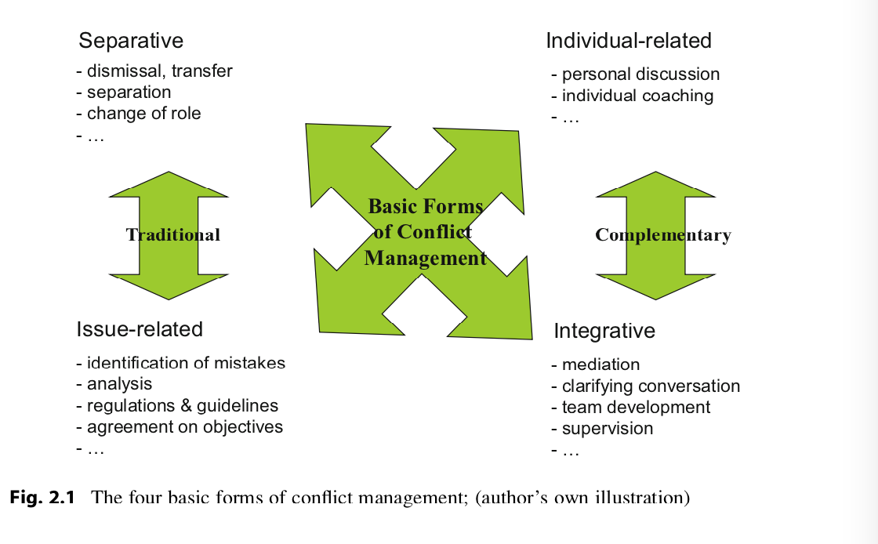

Slide 17
Separative Measures
Separative measures are those which are geared towards separating the parties, thereby pulling the rug from under the conflict.
Examples of this are dismissal or transfer of the employee to another part of the organisation.
These forms are used relatively often and constitute a “classic” form of conflict management, whereby existing conflicts can be seemingly, and sometimes genuinely, made to vanish from the face of the earth relatively quickly and effectively.

Slide 18
It is particularly useful when individual behaviour can no longer be brought into line with company culture or when, in the view of the company, the “emergency brake” has to be pulled.
In some cases a separation will not settle the conflict, but instead exacerbate it, for example if the conflict is subsequently brought before a court. If a similar conflict arises time and again, then it is probably a structural conflict.

Slide 19
Issue-Related Measures
When employing issue-related measures, an organisational or technical solution to the problem is sought independently of the people involved. Mistakes are identified and analysed.
The next step is to draw up regulations, guidelines or standards aimed at preventing a recurrence of the same conflict.

Slide 20
Instructions, can be given or procedures established. Regulations, organisational charts, business process models and so forth are likewise effective tools to organise the way in which people work together

Slide 21
Increasing scarce resources is also an issue-related measure. Disputes over limited resources are a frequent cause of conflict. When the bottleneck is removed, the basis for the conflict is eliminated as a result of the lower degree of mutual dependency.

Slide 22
These methods prove successful if a problem is caused by unclear guidelines or boundaries, or when assignments are open to misinterpretation. They have the advantage that participants do not have to get involved in a confrontation. However, these methods fail if the factual problem is only a pretext and there are underlying personal issues or conflicts relating to company culture.

Slide 23
Individual-Related Measures
Individual-related measures are aimed at seeking a solution on the level of the individual. In this instance, personal discussions, for example, are conducted or coaching is offered.

Slide 24
These methods are primarily oriented towards the affected people. If the conflict cannot be rectified through discussions, one sometimes turns to making somebody responsible. The search for culprits commences. It can be easier to resolve disagreements by the categorisation of events into right or wrong, good or bad.

Slide 25
Our judicial system is built on this principle, in order to ensure order and security. In a professional context, this approach has limitations, as conflicts do not (only) arise from differing personality structures, but a large number of influencing factors play a role, which taken together lead to conflict: organisational frameworks, customs, power structures or limited resources.
The disadvantage of this approach to conflict management is that while the work with an individual develops suitable strategies, a consensual solution cannot be developed with the other party to the conflict.

Slide 26
Integrative Measures
Integrative measures involve the parties examining the problem together. Examples include a clarifying conversation, team development or mediation. These approaches foster direct communication, creating favourable framework conditions for dismantling deadlocks and improving interaction, thereby facilitating resolution of the conflict.

Slide 27
The specification of overall objectives is also a possible measure. This compels the parties to the conflict to look beyond their differences and learn how to cooperate with one another, as their own success becomes linked to the achievement of the objectives.

Slide 28
The simplest form of dealing with the problem is when the parties seek discussions with one another. This should always be the first step. In many cases this helps. However, at the same time the danger exists that the participating parties blame each other’s point of view and consequently become more and more caught up in the conflict instead of looking for a solution. In this case, support should be sought from a neutral third party, for example a mediator.

Slide 29
Integrative forms of conflict management have the advantage that they address the conflict itself and do not—like, many traditional conflict-circumventing forms—seek a solution which avoids dealing directly with the conflict.
This form of conflict management does however require time, so setting a time frame is advisable.

Slide 30
Uses and Limitations of the Traditional Methods
The benefits can be that existing conflicts initially disappear.
On occasion, the situation also calms down and business as usual can resume.
There are circumstances where that approach leads to a resolution of the conflict.

Slide 31
Disadvantages
– Often the same or similar conflicts re-emerge in other places. This indicates that the symptoms rather than the causes have been treated.
– The solutions sometimes produce unexpected consequences in the organisation which constitute an even larger problem. One has “thrown out the baby with the bath water”.
– Hasty solutions are often very expensive. A dismissal for example results not only in recruitment and training costs, but sometimes in litigation costs as well.
– Nothing is learned from the conflict situation. The conflict itself is not addressed.

Slide 32
Conflict Management: The Holistic View
In the context of a holistic (systemic) perspective, a conflict is no longer just a disruption to the regular work routine, but something more. A conflict arises when a difference between two points of view or positions develops.
The systemic view breaks away from the idea that there is “right” and “wrong”. When two people argue, often both have reasonable demands. If one tries to find out who is right and who is wrong, then legitimate needs of one or both sides are often neglected.

Slide 33
The holistic approach accepts divergent points of view as legitimate interests. It tries to reconcile the differing positions, to integrate them instead of taking a decision which separates them.

Slide 34
This approach paved the way for a number of methods and techniques:
Moderation
Coaching
Supervision
Team Development
Mediation

