Slide 1
Computing Fundamentals
Lecture one [Computer Basics ]
Oeshwik Ahmed
Lecturer

Slide 2
Introduction
What You Will Learn
◾ Computing Concepts: You will learn about hardware and software and how they work together. The key areas in this unit are:
◾ Operating systems: You’ll compare major operating systems and learn what types of devices each operating system is designed to run on. You’ll learn how to navigate in Windows 7 too, including how to run applications and manage files.
◾ Computer hardware and concepts: You’ll learn about the physical parts of computers, including input, processing, output, and storage.
◾ Computer software and concepts: You will find out about the main types of application software and what each type is useful for. You’ll learn how to choose, install, update, use, and remove applications in Windows 7.
◾ Troubleshooting: You’ll find out what the most common problems are when working with computers and how to solve them.
◾ Applications: You will learn about Microsoft Office 2010’s business productivity applica- tions. The key areas of this unit are:
◾ Common application features: You’ll find out what all the Office applications have in common, such as commands for saving, printing, and using the Clipboard.
◾ Word processing: You’ll learn how to create documents with Microsoft Word.
◾ Spreadsheets: You’ll learn how to create spreadsheets with Microsoft Excel.
◾ Presentations: You’ll learn how to create presentation graphics with Microsoft Power- Point.
◾ Databases: You’ll learn how to create basic databases with Microsoft Access.
◾ Collaboration: You will learn about the collaboration features in Office applications, such as comments and markup.

Slide 3
Computer Basics
An information system is a complete interconnected environment in which raw data—quantifiable facts and figures—is turned into useful information. An information system includes the following parts: people, hardware, software, procedures, and data
People
Hardware
Software
Procedures
Data

Slide 4
What is a hardware?
hardware is the physical part of the computer system. Hardware consists of components inside a com- puter as well as the external devices that interact with it, such as printers, cables, and monitors.

Slide 5
Personal Computers
When most people think about computers, they picture a personal computer, or PC. This type of computer is called personal because it is designed for only one person to use at a time. Personal computers fall into several categories that are differentiated from one another by their sizes.

Slide 6
Desktop PC: A com- puter designed to be used at a desk, and seldom moved. This type of computer consists of a large metal box called a system unit that con- tains most of the essen- tial components, with a separate monitor, key- board, and mouse that all plug into the system unit (
Notebook PC: A portable computer designed to fold up like a notebook for carrying, as shown in Figure 1.3. The cover opens up to reveal a built-in screen, keyboard, and point- ing device, which substitutes for a mouse. This type of computer is sometimes called a laptop. A smaller version of a notebook PC is sometimes referred to as a netbook (which is short for Internet book, implying that this type of computer is primarily for accessing the Internet rather than running applications).

Slide 7
Tablet PC: A portable computer that consists of a touch-sensitive display screen mounted on a tablet-size plastic frame with a small computer inside, as in Figure 1.4. There is no built-in key- board or pointing device; a software-based key- board pops up onscreen when needed, and your finger sliding on the screen serves as a point- ing device.
Smartphone: A mobile phone that can run com- puter applications and has Internet access capa- bility (see Figure 1.5). Smartphones usually have a touch-sensitive screen, provide voice calls, text messaging, and Internet access. Many have a variety of loca- tion-aware applications, such as a global posi- tioning system (GPS) and mapping program and a local business guide.

Slide 8
Multi-User Computers
Multi-user computers are designed to serve groups of people, from a small office to a huge international enterprise. Here are some common types of multi-user computers:
Servers
Server farm
Mainframe

Slide 9
Server: A computer dedicated to serving and supporting a network, a group of network users, and/or their information needs. Many networks employ servers to provide a centrally accessible storage space for data, and share common devices like printers and scanners. A small network server may look similar to a desktop PC, but may have a different operating system, such as Windows Server or Linux. A large server that manages a wide-ranging network may look similar to a mainframe. A group of servers located together in a single room or facility is called a server farm, or server cluster. Large Internet service provider (ISP) com- panies maintain extensive server farms.

Slide 10
Mainframe:Alargeandpowerfulcomputer capable of processing and storing large amounts of business data. For example, a mainframe might collect all the sales data from hundreds of cash registers in a large department store and make it avail- able to executives. The modern mainframe unit itself is a large cabinet, or a series of cabinets, each about the size of a refrigera- tor (see Figure 1.6). A mainframe may be stored in its own air-conditioned room in a business or school, and may have multiple employees monitoring and maintaining it. In earlier decades, smaller and less expensive multi-user computers called minicomput- ers were employed in many businesses, but minicomputers are no longer widely used.

Slide 11
Supercomputer: A supercomputer is the largest and most powerful type of computer available, occupying large rooms and even entire floors of a building. Supercomputers are often employed in fields such as cryptanalysis (code breaking), molecular modeling, weather forecasting, and climate mapping. Supercomputers typically are used in high-tech academic, governmental, and scientific research facilities.

Slide 12
Software
Software tells the hardware what to do, but different kinds of software accomplish that at different levels.
BIOS
The most basic software is the Basic Input Output System (BIOS). This software is stored on a read-only chip on the motherboard so that it doesn’t accidentally get changed or corrupted. This important soft- ware helps the computer start up and performs some basic testing on the hardware.

Slide 13
Operating Systems
The operating system (OS) manages all the computer’s activities after startup. The operating system serves several purposes:
◾ It provides the user interface that humans use to communicate commands and receive feedback.
◾ It runs applications, and enables humans to interact with them.
◾ It controls and manages the file storage system.
◾ It communicates with the hardware, instructing it to take action to accomplish tasks. For example, the OS tells the printer to print a document, and tells the monitor what image to display.
Microsoft Windows is the most popular operating system; Figure 1.8 shows the Windows 7 interface. Other operating systems include Mac OS and Linux for desktop and notebook PCs, UNIX for mainframes and servers, and Android for tablets and smartphones. Special versions of Windows and Mac OS also power tablets and smartphones. Each operat- ing system has its own unique set of features, benefits, and drawbacks, so it pays to learn as much as you can about the operating systems available and choose a computer that will run the operating system that best fits your needs.

Slide 14
Utilities
In addition to the main components of an operating system, utility software may also be available, either provided free with the OS or added on. Utility programs assist with a wide range of system mainte- nance and security functions, such as checking storage disks for errors, blocking security and privacy threats, and backing up important files.

Slide 15
Application Software
Application software is software that is designed to do something pro- ductive or fun, something of interest to a human user. The OS keeps the computer running, but the applications give people a reason to use the computer.
Most computers come with some application software already installed. You can purchase additional software, and many applications are available for free. The software may be provided on a CD or DVD disc, or may be downloaded and installed over from the Internet.

Slide 16
Productivity software helps you accomplish practical tasks such as man- aging your money, charting numeric data, writing documents, storing data, and sending email. Perhaps the best known example in this soft- ware category is Microsoft Office, a suite of applications that includes
a word processor, a spreadsheet application, a database application, an application for creating business presentations, and an email and contact management system. A suite is a group of applications that are designed to work well together and which share some common interface charac- teristics.

Slide 17
Computer System Components
Every computer system is made up of multiple electronic components. These components fall into four broad categories that serve different purposes in the information processing cycle
Input>Process>Output>Storage>Back to input

Slide 18
◾ Input: Components that help humans put data into the computer.
Examples include a keyboard, mouse, and touch screen.
◾ Processing: Components that move and process the data inside the computer. The motherboard and its processor and memory chips fall into this category.
◾ Output: Components that provide the results of the processing to humans. The monitor is the primary output device; other examples include printers and speakers.
◾ Storage: Components that store software and data until it is needed. Storage components include hard drives, USB flash drives, and DVDs.

Slide 19
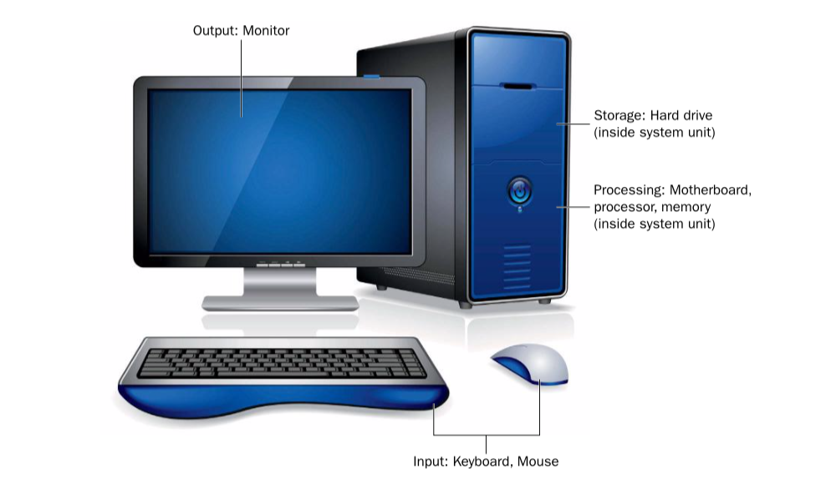

Slide 20
How Data Is Represented on a Computer
The smallest unit of data in a computer is a bit. A bit is a single binary digit, with either a 1 (on) or 0 (off) value. Eight bits can combine to make a byte, which is an 8-digit binary numbe Modern systems work with thousands, millions, and even billions of bytes at a time -
Killobyte (1024}
Megabyte (1M)
Gigabyte (1B)
Terabyte
Petrabyte

Slide 21
Input Devices
An input device provides a way to get data into the computer. The old- est and most common input device is a keyboard. A desktop PC has an external keyboard, while a notebook PC has a built-in keyboard. Tablets and smartphones have a software-based keyboard that pops up onscreen when needed.
Computers that use a graphical interface usually employ a pointing device. The pointing device moves an on-screen pointer (usually an arrow) to align with objects onscreen, and then the user presses a but- ton on the pointing device to do something to the pointed-at object. A mouse is the most common pointing device, but there are many other types too, such as trackballs, touchpads, and touch-sensitive screens.

Slide 22
Processing Devices
The motherboard is the large circuit board inside the computer that everything else plugs into. The key components located on the moth- erboard are the processor (also called the Central Processing Unit, or CPU) and the memory (also called Random Access Memory, or RAM). To support these components, the motherboard has electrically conduc- tive pathways called buses that carry the data from place to place, and
a chipset, which is a controller that directs the bus traffic.

Slide 23
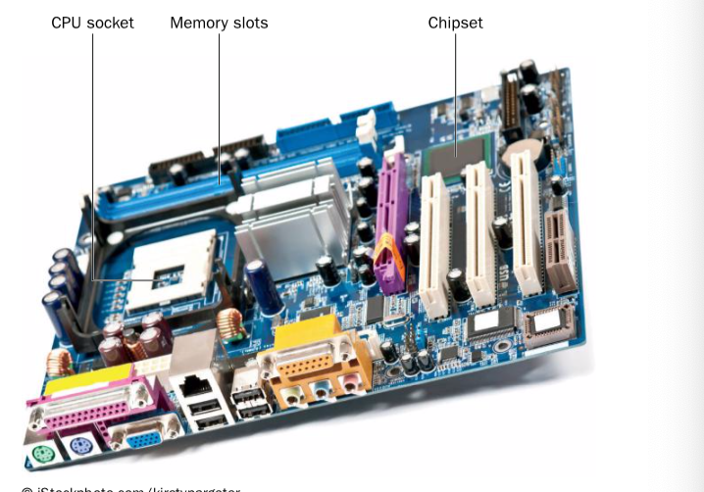

Slide 24
Output Devices
Information comes out of a computer through an output device such as a monitor. When you move the mouse or type a character on a key- board, you see the results instantly on the monitor. The monitor helps you communicate with the operating system; without the monitor, you wouldn’t know if the OS had received and understood your instructions or if the application had accepted the data you input. Besides monitors, other output devices include printers (for producing hard-copy output) and speakers (for providing audio feedback).

Slide 25
Storage Devices
Storage devices enable software and data to be preserved and reused. Storage can be either removable or non-removable. (Non-removable stor- age is actually removable too if you have the right tools and knowledge, but in this case the distinction refers to being easily removable or not.)
The most common type of storage is an internal hard drive, which is a sealed metal box inside the system unit. Hard drives are usually internal, making them non-removable. Some hard drives are removable, though; external hard drives easily connect to and disconnect from a port on the outside of the system unit. Other removable storage devices include USB flash drives and optical discs (CDs and DVDs)

Slide 26
How Computers Communicate
Early computers did not communicate easily with one another. Data was typically carried between computers on floppy disks and other low-capacity removable disks, or using slow dial-up modems. Network connections were difficult to set up and transferred data very slowly. Nowadays, how- ever, communication technology has advanced greatly, and there are many choices for making computers connect to one another.

Slide 27
Ethernet Networking
Most computers today are part of one or more networks. A network is a group of computers that share resources (such as printers or Internet service) and/or data (such as files). The most common network standard is Ethernet. Ethernet networks can be either wired or wireless (or a combination of the two), but the term Ethernet is most often applied to the wired kind of con- nection.

Slide 28
Wireless Ethernet is more often called Wi-Fi, or 802.11. That number refers to the standard number assigned to it by the Institute of Electrical and Electronics Engineers.
Different Wi-Fi sub-types have different letter designations, such as 802.11g or 802.11n. Most portable devices such as tablets and phones use wire-less connections and do not have the capability for wired networking.

Slide 29
In a small network, such as in a home or small business, one end of an Ethernet cable plugs into the computer, and the other into a controller box called a router that manages the network traffic between the connected devices. If you have broadband (always on) Internet access, the device that brings that service into your home or business is frequently called the router, and then the router shares the Internet con- nection among all the computers.
If you have a Wi-Fi wireless router and a wireless network adapter in the computer, the computer can connect to the router via radio frequency (RF) waves, so no cables are required.

Slide 30
In large-scale networks, Ethernet is still the standard, but some different hardware is employed. Large panels of switches can connect hundreds of computers into a central network system, as shown in Figure 1.15. Cables with fiber optic technology are used in the network’s backbone to carry large amounts of network traffic faster and more efficiently.
Some networks, such as small home and business networks with fewer than a dozen or so computers, are peer-to-peer. That means there is no one computer that controls the network; all the computers can cooperate to share data with each other. Networks that are larger than that typically have one or more servers dedicated to network data sharing, and such networks are called client/server networks.

Slide 31
Bluetooth is a short-range wireless alternative to wireless Ethernet (Wi-Fi), used primarily to connect wireless devices directly to specific computers. For example, you might have a Bluetooth wireless headset for your cell phone, or a Bluetooth speaker for your MP3 player. Bluetooth’s limited range (10 meters) makes it impractical as a replacement for Wi-Fi, but it provides an easy and economical way for one device to con- nect with another within a limited space without Ethernet hardware.

Slide 32
The Internet
The Internet is the world’s largest network. When you use the Internet, your computer becomes a member of this giant network, and you can com- municate with any other computer on the Internet, to the extent that its owner has chosen to make it available. For example, you can exchange email messages, download files, and view web pages stored anywhere in the world.

Slide 33
Individual computers don’t connect directly to the Internet, however; they go through an Internet service provider (ISP), a company that provides a connection to the Internet for a fee. Your ISP may be your local phone or cable TV company, or at work it may be a service that your school or employer partners with. An ISP provides a device (a modem or terminal adapter) that translates your computer’s requests into Internet-compatible data.

Slide 34
The Internet functions using a set of standards called Transmission Control Protocol/Internet Protocol (TCP/IP). It is this shared com- munication language that makes global communication possible. TCP/ IP defines how data will be treated as it is broken up into packets for transmission, sent through a series of routers across the world, and reas- sembled into its original form at the receiving end.

Slide 35
The End

