Slide 1
Operating System Basics
Lecture 4 – Oeshwik Ahmed, Lecturer, Department of Business Administration, Northern University Bangladesh

Slide 2
system software Software that starts the computer and keeps it running, performing basic system tasks such as running applications, man- aging files, and correcting errors.
System software includes BIOS, the operating system, and utility programs that perform system maintenance and protection tasks such as error correction and backup. Let’s look at each category in more detail.

Slide 3
The System BIOS
the Basic Input/Output System (BIOS) is the built-in software on the motherboard that startsthe computer.
It performs a power-on self-test (POST) at start-up, which ensures that all the critical hardware devices are functioning properly, including the CPU, the RAM, and the motherboard.
If the hardware passes the tests, the BIOS looks for an operating system on one of the available drives, and then passes off control to the operating system to complete the boot process.
BIOS has a list of default settings it uses for managing memory and devices, but those settings can be overridden by user settings that you specify.

Slide 4
The Operating System
The BIOS starts the computer at a basic level, but the operating system does the bulk of work to keep it running and to help the user accomplish tasks
◾ It provides the user interface that humans use to communicate commands and receive feedback.
◾ It communicates with the hardware, instructing it to take action to accomplish tasks. For example, it communicates with the keyboard and mouse to accept input, and it communicates with the display screen to show output.

Slide 5
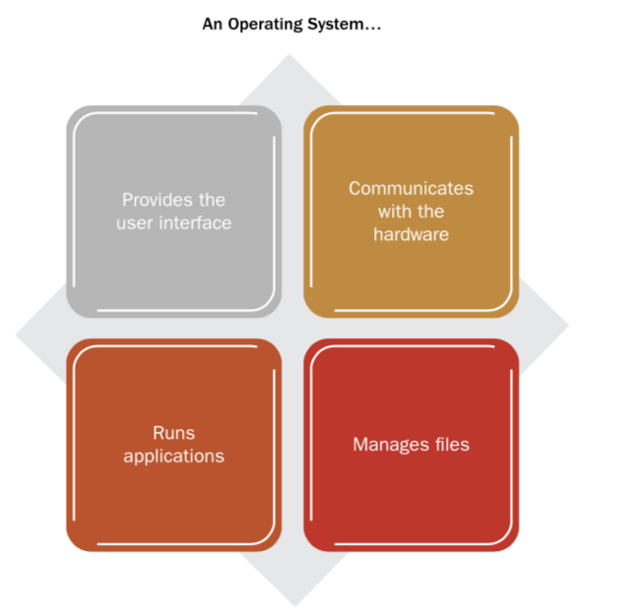
◾ It runs applications, and enables humans to interact with them.
◾ It controls and manages the file storage system.

Slide 6
There are many kinds of operating systems, suited for a wide range of devices, from supercomputers to smartphones. Each operating system is optimized for the hardware it runs on and the tasks the user is likely to want to perform.
operating system on a tablet com- puter is designed to be compact
operat- ing system in a server is designed to give computer professionals many options for managing and configuring the serve

Slide 7
platform A type of computer hardware that is compatible with certain operating systems.
For example, the type of hardware used in most Windows-based computers is called the Intel platform or the IBM-compatible platform.
. Those names originate from the makers of the early CPUs (Intel) and personal desktop computers (IBM). Several different operating systems run on the Intel platform, including Microsoft Windows, UNIX, and Linux.

Slide 8
Most tablets and smartphones, on the other hand, support only one operating system. For example, devices built on the Macintosh platform such as the Apple iPad and iPhone support only the Apple iOS operating system.
An operating system can have either a graphical user interface (GUI) or a command-line interface. GUI interfaces are the norm in operating systems designed for most personal computing devices, such as desktops, notebooks, tablets, and smartphones.

Slide 9
In a command-line interface, users employ a keyboard to type commands at a prompt; the interface is text-only. Command-line operating systems were common in the early days of computing, but nowadays they are confined mostly to server operating systems.
The 32-bit Intel platform is sometimes called x86 . That name is a nod to the old Intel line of CPUs where the model numbers all ended in 86, such as 286, 386, and 486 . The 64-bit Intel platform is sometimes called x64 . Windows 7 comes in both 32-bit and 64-bit versions, and when purchasing a copy of Windows, you must match the Windows version to the hardware platform you have .

Slide 10
Utility Software
Utility software performs a task (or set of tasks) that optimizes, repairs, or safeguards the computer or its data. The difference between utility software and the operating system is sometimes not clear-cut, because most operating systems come with many utility programs built-in.
Microsoft Windows comes with utilities for checking a disk for errors and optimizing the way files are stored on an HDD (hard disk drive). Third-party utility software is also available, and may do a more thorough job at the task, combine multiple functions in a single inter- face, or have more advanced options for configuring how the tasks will run.

Slide 11
There are many types of utilities that protect the computer from attack by malware (harmful or maliciously created software
Antivirus pro- grams find and remove viruses, for example, anti-spyware software finds and removes spyware and adware, firewall software blocks hackers from invading your system
anti-spam software detects and seg- regates junk email. Some all-in-one protection suites such as Norton Security Suite protect against many types of threats at once.

Slide 12
a disk checking program can find and fix errors in the file system on a volume,
a registry cleanup program can find and fix inconsistent or unneeded entries in the registry, which is the system configuration database that Microsoft Windows uses
An uninstaller utility removes installed software along with any associated files and registry entries.

Slide 13
Comparing the Major Operating.Systems
There are two main hardware platforms for desktop and notebook com- puters: Apple and Intel (IBM-compatible). The Apple Macintosh plat- form supports only the Apple operating system: Mac OS X
The Macintosh platform has been popular with graphics professionals for decades, and much of the best page layout and graphics editing software was originally developed for the Mac.

Slide 14
Mac hardware is not cross-compatible with Windows software, Mac software is cross-compatible with the Intel platform. The latest ver- sion of Mac OS X will run on both Macintosh and Intel computer
Most Intel-based systems use Microsoft Windows. Like Mac OS X, Windows also has an attractive GUI and is easy to learn and use. Windows has the advantage of being the most popular OS, and therefore the one that more applications are written to run on.

Slide 15
Linux (pronounced LIN-ucks) is an operating system that looks and feels very similar to UNIX. It can run on a variety of platforms, including Intel- based desktops and notebooks, servers, and handheld devices. (Android, a popular OS for smartphones and tablets, is a variant of Linux.)
Linux was developed by Linus Torvalds. The name Linux is a combina- tion of the words Linus and UNIX. Linux is open-source, which means that Mr. Torvalds retains ownership of his original code, but it is free to the public to use in any way they see fit. Users are free to modify

Slide 16
the code, improve it, and redistribute it. Developers are not allowed to charge money for the Linux kernel itself (the main part of the operat- ing system), but they can charge money for distributions (distros for short), which are packaged collections of add-ons and utility programs for Linux. Some of the most popular distros include SUSE Linux, Ubuntu Linux, and Red Hat Linux
If you want to run multiple operating systems on a single PC, one way is to set it up to multi-boot . Each time you start the computer, a menu appears asking which operating system you want to start up . Each operating system must be on a separate volume in order to multi-boot .

Slide 17
Linux is, at its core, a command-line operating system, as is UNIX. However, nearly all the distros contain multiple shells—utilities that allows a user to interact with the operating system. Most distros have a GUI sitting on top of the shell. These are highly graphical, and as attrac- tive and easy to use as Windows and Mac OS X.

Slide 18
thin client A computer with minimal hardware, designed for a specific task. For example, a thin web client is designed for using the Internet.
Some portable computers, such as netbooks, don’t require a powerful operating system like Windows for the simple tasks they are designed to perform, like checking email and surfing the web. On such comput- ers, performance is better, and more storage space remains when a thin client operating system is used.
One popular thin client operating system is Chrome OS.

Slide 19
Servers are computers that share resources so they are available over a network for multiple users to access. For example, a network might have a mail server that handles the company’s internal email delivery, and a file server for storing and sharing files that everyone needs 24/7 access to. A company might also have a web server that makes the company’s website available to the public on the Internet.
Most servers use the Intel hardware platform
The three most popular server operating sys- tems are UNIX, Windows Server, and Linux.

Slide 20
UNIX (pronounced YOU-nix) is an older operating system, first devel- oped in the 1970s for servers, and still popular today for that purpose. It’s a command-line operating system
Graphical shells are available, but server administrators often find it easier to work at the command prompt to accomplish the tasks they need to do. UNIX, like Linux, is cross-platform, so it runs on many different types of computer hardware.

Slide 21
Windows Server is a version of Microsoft Windows that is optimized for use on servers. Its GUI is similar to that of the client version of Windows but it has different fea- tures and utilities designed to help IT professionals control server activi- ties.

Slide 22
Tablets and smartphones have special operating system needs. They use solid state storage, which is expensive, so the amount of storage space is limited. Therefore, a large operating system is impractical; the operating system must be simple, easy to use, and above all, compact in size.
They use SoC
system-on-chip (SoC) An operating system that comes preinstalled on a chip on a portable device such as a smartphone.

Slide 23
For most of their capabilities, tablet and phone operating systems rely on third-party applications (apps) purchased or downloaded for free from an online store. Because users can freely select their own apps, there is no need to provide lots of preinstalled apps with the operating system, and each person’s device can be customized for his or her preferred activities.
Portable Apple devices (iPhone and iPad) use an operating system called iOS.
The main competitor to iOS is Android, an open-source OS created by Google.

Slide 24
Microsoft has two different versions of Windows for portable devices. For tablets, there is Windows RT, which is much like the desktop ver- sion of Windows but designed for SoC devices.
For smartphones, there is Windows Phone, an operating sys- tem designed specifically for phone use.

Slide 25
Understanding Device Drivers
Device drivers are files that translate the oper- ating system’s requests into the language of a particular device, and then translate back again when the device sends a message in return. Each device driver is designed for one specific device and one specific operat- ing system, although it may work, fully or partially, with other similar devices or operating systems.
A device driver can be essential to a device’s performance, and often when a device appears to be malfunctioning, it is really the driver’s fault.

Slide 26
Key part of device managers
Device Manager A Windows utility that provides detailed information about the hardware devices installed on the PC.
roll back To return to a previous version, as in rolling back a device driver.
Plug and Play A standard that enables the BIOS and operating system to identify a hardware device and install a driver for it automatically if one is available.

Slide 27
Understanding drives, volumes and file system
To prepare a hard drive for use, it must first be partitioned. Partitioning creates the logical divisions of the available space. A physical drive can logically be a single volume (one big partition with one volume letter assigned), or it can be split up into many pieces, each with its own vol- ume letter. Each volume must then be formatted.
Formatting organizes the available space by creating a file system on it. The file system deter- mines how the files will be stored and retrieved logically.

Slide 28
Modern versions of Windows prefer the New Technology File System (NTFS) for the system volume (that is, the volume on which Windows itself is installed), but can also support FAT32, a file system used in earlier Windows versions.
Mac OS X uses a file system called Hierarchical File System Plus (HFS+).
Linux supports several different file systems, and the default file system installed depends on the distro
CDs and DVDs commonly use the ISO 9660 (also called CD File System, or CDFS) or the Universal Disc Format (UDF) file system

Slide 29
File Extensions and File Types
A file extension is a code following the name of the file that indicates its type. Extensions are separated from the filename by a period, like this: Myfile.docx. In this example, docx is the extension, and it indicates the Microsoft Word format.
Almost all files have file extensions in Windows, not just data files. For example, the executable files that run applications also have extensions, as do the Windows system files and their helper files

Slide 30
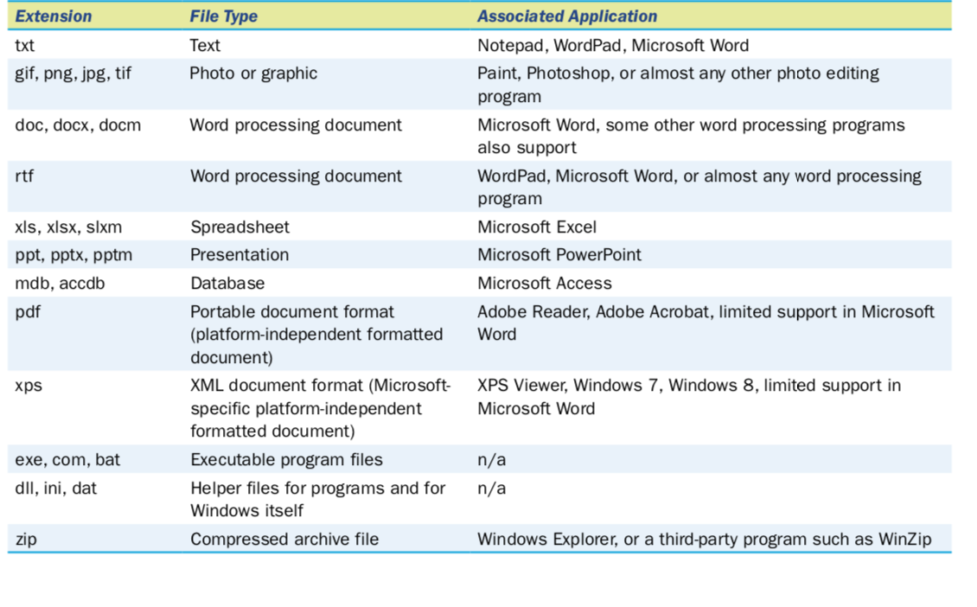

Slide 31
File Compression
Files can be made to take up less space by compressing them. Compressing a file applies an algorithm to it that makes the file smaller by storingit using more efficient notation.
compressed archive A compressed file that contains one or more other files.
Example: winZip, winRar

Slide 32
File Encryption
As an extra layer of security, NTFS can encrypt files. Encryption stores the files in a scrambled format, so that anyone browsing them from outside the operating system will see nothing useful. When an authorized user attempts to access them from within the operating system, the files are automatically decrypted (de-encrypted) and shown to the user as if they were not encrypted at all.
BitLocker A whole-drive encryption utility provided with some editions of Windows 7.
BitLocker prevents thieves from stealing data by taking the entire hard drive out of a computer.

Slide 33
Backups
Because storage media sometimes fail, it’s important to back up impor- tant files frequently.
Businesses spend thousands of dollars on robust, automated systems that back up their servers nightly, as well as key files on individual computers in some cases.
backup software Software that enables and automates the process of backing up files to external media.
backup set A set of backup files created during a single backup operation.

Slide 34
archive attribute A file attribute that indicates whether or not a file has changed since its last backup.
full backup A backup operation that backs up all files and sets their archive attribute to Off.
differential backup (partial backup) A backup operation that backs up all files that have the archive attribute set to On but does not change that attribute. (backs up only files that have changed since the last full backup.)
incremental backup (partial Backup) A backup operation that backs up all files that have the archive attribute set to On and then sets the attribute to Off.

