Slide 1
Input, Output, and Storage
Lecture 3
Oeshwik Ahmed
CIT 1101

Slide 2
INPUT DEVICES
Whenever you type a letter in a word processor, or issue the command to open or close the word processing program, you use an input device. Input devices allow the user to communicate with the operating system and applications. In this section, you will learn about several types of input devices.

Slide 3
Keyboards
A keyboard enables you to enter typed data—letters, numbers, and sym- bols. A keyboard can be a separate device that plugs into the system unit (as with a desktop PC) or a built-in keyboard (as with a notebook PC).
There are many sizes and types of keyboards, but most English-language keyboards use the same key arrangement, called QWERTY. The name comes from the first six letter keys on the top row, from left to right. This type of keyboard has a number of specialty keys as well as the num- bers, letters, and symbols.

Slide 4
Function keys (F1 through F12) perform special actions when pressed. The action assigned to each key depends on the operating system or application you are using.
◾ Toggle keys turn a feature on or off each time they are pressed. For example, the Caps Lock key toggles between upper- and lowercase letter typing mode, and the Num Lock key toggles between the numeric keypad on the keyboard (if it has one) providing number entry or functioning as a set of directional arrows.
◾ Modifier keys change the meaning of other keys when they are pressed in combination with them. For example, the Shift key, when pressed in combination with a letter, makes that letter upper- case. Other keys, such as Ctrl and Alt, can be used with other keys to issue special command shortcuts. For example, a common key- board shortcut in Windows 7 is Ctrl+C (press both keys simultane- ously) for copying selected content.

Slide 5
◾ Positional keys such as the Home, End, Page Up, and Page Down keys, as well as the directional arrow keys, scroll the display or move the insertion point in applications.

Slide 6
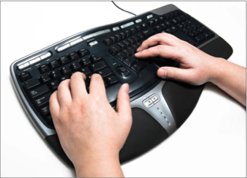
A wireless keyboard does not require a cable connection to the com- puter, allowing for greater ease of use. An ergonomic keyboard is a keyboard that is designed to minimize the stress on the user’s body
It may have a built-in palm or wrist support, for example. A bilingual keyboard has characters in more than one language on its keys, so when you switch to a different keyboard layout in the operating system, the characters on the keyboard match what you are typing.

Slide 7
virtual or onscreen keyboard A replica of a keyboard on the screen that users can tap or click to simulate typing
Pointing Devices
A pointing device is a piece of hardware that enables you to move an onscreen pointer in a graphical user interface like Microsoft Windows. A mouse is the most common pointing device. It is a palm-sized object that you move across a flat surface to move the pointer on the display. A mouse has one or more buttons on it; you press the buttons to act upon whatever the pointer is pointing at.

Slide 8
A mouse can be either mechanical or optical. A mechanical mouse has a chamber on its underside with a rubber ball in it. As you roll the mouse across a flat surface, the ball turns, activating sensors inside the chamber that translate the ball’s movement to onscreen pointer activity. An optical mouse has a light-emitting diode (LED) and a sensor on its underside. The light bounces off the surface and the sensor measures it, and those measurements are reported back to the computer to tell the pointer how to move. Mechanical mice need frequent cleaning; optical mice are maintenance-free and have virtually replaced the mechanical type.

Slide 9
wireless mouse A mouse that communicates wirelessly with a transceiver connected to the computer, so it does not need a cord.
transceiver A unit that provides the wireless transmission for a cordless device like keyboard or mouse, usually plugged in to a USB port.
trackball A pointing device in which the user moves the pointer by rolling a ball with his or her fingers.
touchpad A pointing device consisting of a touch-sensitive pad on which the user drags a finger to move the pointer.

Slide 10
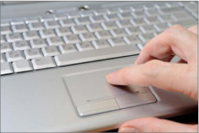

Slide 11
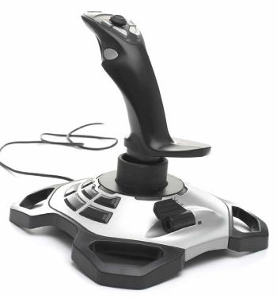
A touch screen can enable you to use your finger as a pointing device. Tap or drag your finger across a touch screen to perform mouse-equivalent operations.
joystick A pointing device consisting of a vertically mounted stick that can be tilted in any direction.

Slide 12
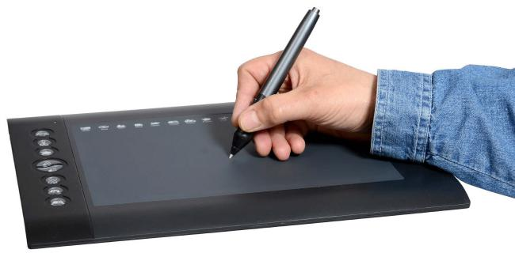
drawing tablet A flat rectangular touch-sensitive surface on which a user can draw with a stylus to create onscreen artwork.
stylus A pen-shaped pointer used to drag across the surface of a touch-sensitive screen

Slide 13
Sensory Input
Many portable devices, such as smartphones and tablets, have new types of input technology that detect direc- tion, motion, and/or location . For example, some devices have a global positioning system (GPS) to detect your location, an accelerometer to tell how fast you are moving, a compass to report what direction you are facing, and a gyroscope to report the orientation of the device . It is the gyroscope, for example, that tells a phone or tablet when you turn it on its side so it can change the orientation of the screen .

Slide 14
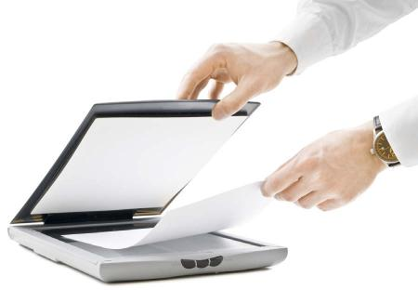
Scanning Devices
A scanner digitizes hard-copy photos and documents and stores them electronically. Scanners work by shining a bright light on the surface of the page and measuring the amount of light that bounces back from it using a photosensitive charge-coupled device (CCD). Lighter areas bounce back more light than darker areas. For color scanning, multiple sensors are used, each one picking up a different color: red, green, and blue.

Slide 15
multi-function device (MFD) A device that combines the functions of a printer, a copier, and a scanner into one unit, and also a fax in some models.
flatbed scanner A scanner that has a large flat glass surface on which the page to be scanned is placed.
document feeder A mechanical feature of some scanners that enables multiple pages to be scanned consecutively without user intervention.
When you scan text, you can use optical character recognition (OCR) software to convert the scanned image to text that you can work with in a text editing program.

Slide 16
bar code reader A scanner that reads and interprets bar codes such as UPC symbols. A bar code reader examines the bars and inputs their numeric values into the computer
Universal Product Code (UPC) A bar code system used for identifying products for sale.
QR code (which stands for Quick Response) is a new type of scanner-readable code that is replacing UPC codes in many places. It’s a two-dimensional barcode. Whereas a standard bar code is read in only one direction (analyzing the width and spac-ng of the bars), a QR code is a square panel with encoded data in both directions. QR codes can store more data than bar codes, making them more useful for pro- viding information about an item

Slide 17
Another type of scanner used in many businesses is a magnetic card reader You use one of these every time you swipe a credit card to pay for a purchase.
Some credit cards have a radio frequency identifica- tion (RFID) chip in them that enables you to pass them in front of a radio frequency card reader to read the card’s data without it physically touching a reader. R
A fingerprint reader is a type of biometric scanner— that is, a scanner that scans something about a human body that is used to identify that person

Slide 18
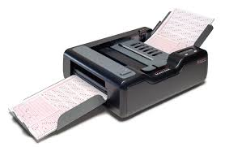
optical mark recognition A scanner that detects the presence of a pencil or ink mark on certain areas of a standardized form.
magnetic-ink character recognition (MICR) The scanning system used in the banking industry to read routing and account numbers on checks and deposit slips.

Slide 19
Capture Devices
A capture device can capture either still images or motion video. Some devices do both, but most are designed primarily for one type or another. A digital camera is designed primarily for still photos, and looks much like a film camera; a digital video camera is designed primarily for motion video.
Both work using the same basic tech- nology; the digital video camera captures many frames (individual still images) per second and stores them in a single file. When you play back the still images in chronological order, the image appears to be moving. Digital video cameras can also capture sound to accompany the video clips, which can be played back synchronously with the images.

Slide 20
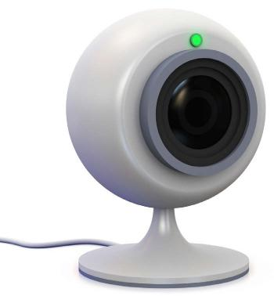
webcam A digital video camera that must remain connected to a computer as it operates. Webcams are often used for online video chatting through services such as Skype

Slide 21
Audio Input Devices
Most personal computers support audio input, either through a built-in audio adapter on the motherboard or through an add-on sound card. A computer’s audio ports may support speakers, headphones, microphones, and both analog and digital external audio device input. An example of an external audio input device is a home stereo system; an external digital audio device might be a digital piano keyboard.
voice recognition software Software that recognizes spoken words that match words in its database to digitize spoken language.
speech recognition software Software that can learn an individual’s pronunciation and vocal inflection and translate it into digitized text.

Slide 22
OUTPUT DEVICE
A display screen is a video screen that the computer uses to provide information to a human user. A display screen can be built into a device, as it is with smartphones, tablets, and notebook PCs, or it can be a sepa- rate unit (a monitor), as it is with the majority of desktop PCs.
pixel An individual colored dot in a raster graphic or on a display screen.
Display screens create their images by filling in tiny dots called pixels with different colors. The pixels are so small and so close together that the human eye sees them as continuous color gradients rather than indi- vidual blocks. Monitors differ in the technology they use to illuminate those pixels.

Slide 23
liquid crystal display (LCD) A flat-screen display technology that passes electricity through liquid crystals to create a display image.
organic light-emitting diode (OLED) A flat- screen technology that uses organic matter that lights up in response to electrical current to create a display image.
active matrix An LCD type in which each pixel is actively maintained by a separate transistor.
thin-film transistor An improved type of active matrix common in modern monitors and display screens.
passive matrix An LCD type in which each pixel maintains its state on its own until it decays or is refreshed.

Slide 24
high-definition TV (HDTV) A television that displays at least 1920 × 1080 resolution (also known as 1080p).
high-definition multimedia interface (HDMI) A type of connector used to connect an HDTV to another device, such as a computer or a home theater system.
cathode ray tube (CRT) An older type of monitor technology that uses a vacuum tube and electron guns to create a display image.
triad A cluster of three phosphors: one red, one green, and one blue. Depending on what color a particular pixel should be, different phosphors illuminate within that triad.

Slide 25
e-paper A monitor technology used in book read- ers in which the screen retains its image but is unpowered except when the display changes.
digital whiteboard A whiteboard that is con- nected to a computer, so that whatever is written on the board is saved on the computer.
digital projector A projector that accepts input from a computer.

Slide 26
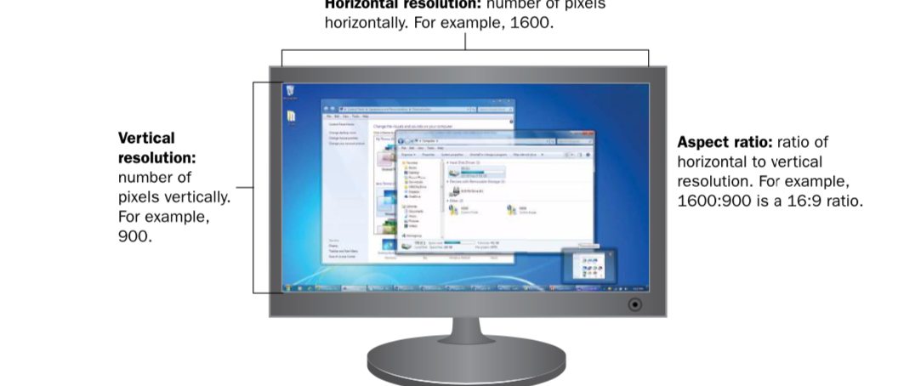
A display screen has a maximum resolution, which is the highest display mode it can support. Display modes are expressed as horizontal number of pixels × vertical number of pixels, such as 1600 × 900. On an LCD monitor, maximum resolution is sometimes called native resolution.

Slide 27
When selecting a display mode in the operating system, you should choose one that matches the aspect ratio of the display screen. The aspect ratio is the ratio of width to height—in other words, the relative dimensions of the screen. Some monitors have a traditional 4:3 aspect ratio, but many LCD screens use a wide-screen 16:9 aspect ratio instead.
All display screens have a maximum refresh rate, the number of times each pixel is refreshed per second. The operating system’s display mode determines the actual refresh rate that is used. On a CRT, using a high refresh rate (greater than 80 Hz) makes the monitor flicker less, result- ing in less eyestrain for the user. On an LCD monitor, the refresh rate is somewhere around 60 Hz but is not as important because an LCD monitor is not prone to flickering.

Slide 28
A display mode specifies a color depth, which is the number of binary digits needed to uniquely describe the color of each pixel. For example, an 8-digit binary number has 256 possible combinations of 0 and 1, so 8-bit color would allow for 256 different colors. Windows 7 defaults
to 32-bit color that would allow for over four billion colors (also called True Color); an alternative is 16-bit color (also called High Color).
display adapter The computer component that communicates instructions from the operating system to the display.

Slide 29
Printers
Printers generate hard copy—that is, physical printed pages you can hold in your hands. Over the years there have been many different printer technologies, each with its own characteristics and benefits. In this sec- tion, you’ll learn about several printer types and find out what differenti- ates one printer from another.

Slide 30
Printer Features
When selecting a printer, there are a number of factors to consider:
◾ Initial cost: How much does the printer cost?
◾ Per-page cost: How much does it cost to print a page, taking into account the price of the consumables? How much does the ink, toner, or ribbon cost, and how many pages will it print before you have to replace it? Are there other parts in the printer that wear out and have to be replaced after a certain number of pages?
◾ Resolution: How many individual dots per inch (dpi) does the printed image consist of? A higher resolution results in a sharper image. A low-resolution printer might output at 300 dpi, while a high-resolution printer might output at 1200 dpi.

Slide 31
◾ Speed: How many pages per minute can the printer output? A typi- cal printer might output at somewhere between 10 and 20 pages per minute for black-and-white, and slightly less than that for color.
◾ Color: Does the printer print in color, or just in black-and-white? If it prints in color, can it print photos well? Some printers are designed specifically for photos, and have special inks for them and/or use special glossy paper for photos.
◾ Paper handling: Does it have multiple paper trays, so you can have two sizes of paper loaded at once? How much paper can it hold at once? How well does it print on heavy cardstock or enve- lopes without bending or creasing them? Does the printer have any special paper-handling features, such as the capability to print on both sides of the paper (duplexing) without the user manu- ally flipping the paper over? What is the largest size paper it can accept?

Slide 32
◾ Interface: Most printers use the USB interface to connect directly to a computer. Can the printer also connect to a network? Does it require a cable to connect it to the network, or can it connect wirelessly?
◾ Multi-function: Is it just a printer, or can it perform other tasks too, like scanning, copying, and/or faxing? A multi-function device (MFD) can save you money and space if you would otherwise have to buy separate machines for those functions.

Slide 33
Impact versus Non-Impact Printers
impact printer A printer that makes the image on the page by striking it through an inked ribbon.
non-impact printer A printer that makes the image on the page using a method that does not physically strike the paper.
dot matrix A in impact printer that uses movable pins to form letters and then strikes the page through an inked ribbon with the pins.
cost per page The total cost of the consum- able supplies required to print a page, calculated by dividing the cost of the paper and ink/toner/ ribbon by the number of pages it produces before being depleted.

Slide 34
Inkjet Printers
An inkjet printer sprays liquid ink onto a page through a set of very small nozzles (ink jets). The depending on the model, an ink jet printer uses either heat or electricity to make the ink squirt out of the nozzles.
Inkjet printers are popular in homes and small businesses because the cost of the printer is very low, so it’s economical to get started. However, the ink cartridges are expensive and don’t last for very many pages, so high-volume printing on an inkjet printer can be very expen- sive.

Slide 35
Laser printers are popular in business because they are fast, they handle high-volume printing well, and the cost per page is low. They also pro- duce good quality, high-resolution output, and both color and black- and-white models are available. The main drawback is the initial cost, which can be higher than for other printer types
thermal printer A printer that transfers images to paper using heat.
direct thermal printer A printer that heats certain areas of specially coated paper so that it turns black and forms the image.

Slide 36
thermal wax transfer printer A printer that melts a wax-based ink onto paper in tiny dots.
dithering Placing different colored dots side by side in an image so that from a distance they appear to be a third color.
thermal dye transfer printer A printer that heats ribbons containing dye and then diffuses the dye onto specially coated paper.
plotter A large-format printer that creates high- precision documents such as maps and engineer- ing drawings.

Slide 37
Audio Output Devices
The audio adapter in a computer handles both input and output. You learned earlier in this chapter how audio input comes in from micro- phones and digital musical instruments. The most common audio output devices are speakers and headphones
Another difference in computer speaker systems is that the speakers have magnetic shielding to protect nearby computer devices from electromag- netic interference (EMI). Most speakers are powered speakers, mean- ing they require an AC adapter or batteries to function. The power boosts the amplification of the sound, and is necessary because most computers don’t have a built-in amplifier the way most home stereo systems do.

Slide 38
STORAGE
RAM is known as primary storage because it’s where the data must be in order to interact with the CPU. Data waits for the CPU’s attention in memory, and then it waits again in memory when the CPU has finished processing it.
For data to be safely and permanently stored, however, it must be placed in secondary storage. Secondary storage devices are nonvolatile, so they don’t lose their contents when the computer’s power is turned off. Secondary storage can include hard disk drives, solid state drives, CDs,

Slide 39
Data Storage Basics
A file is a named collection of bits that work together to represent a single object, such as an executable program, a spreadsheet, a picture, or a system file. Folders are logical organizing units for files. For example, a Windows- based computer has a Windows folder containing the system files needed to run Windows, a Users folder containing the data files and settings for each user account, and a Program Files folder containing the files needed for each installed application. A folder within a folder is called a subfolder; each of the aforementioned folders contains multiple subfolders. Files and folders are stored on volumes. Each volume has a letter followed by a colon, such as C: or D:.

Slide 40
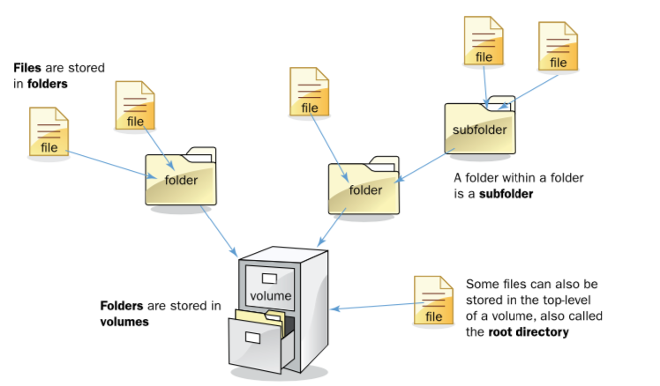

Slide 41
Hard Disk Drives
A hard disk drive (HDD) is the most popular type of secondary stor- age for personal computers. Although newer technologies are emerging, HDDs remain the standard because of their high capacity and low cost.
An HDD consists of a stack of metal platters (usually 4 to 6) that are coated with iron dust. These platters spin on a common spindle inside a sealed metal casing. A set of read/write heads inside the HDD casing reads and writes data on the platters; there are heads on each side of each platter. The arms move in and out to reach different spots on the platters, and the disks move past the heads as they spin. The most common platter sizes are 3.5” in diameter on HDDs for desktop systems and 2.5” on HDDs for note- books

Slide 42
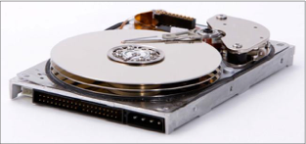
The data is stored on the platters in patterns of magnetic polarity. The iron dust on the surface is very sensitive to magnetic polarity and can be easily magnetized. As the disk surface moves past a read/write head, the write head switches its polarity between positive and negative to change the polarity on the surface, creating a pattern of polarity changes. Each polar- ity change represents a 1 bit, and each area where there could have been a polarity change but there isn’t one represents a 0 bit. An HDD has an inter- nal controller that manages the physical reading and writing operations.

Slide 43
A precise system exists for describing the physical locations on an HDD. The platters are divided into concentric circles, like the rings on a tree trunk cross-section, called tracks. Each platter’s first track is track 0, the next one track 1, and so on. The track number tells the drive where to position the actuator arm that controls the position of the read/write heads. All the heads move together, so if one head is reading track 1 on one side of one platter, all the other heads are also reading track 1 on their side of their platter too. For this reason, tracks are not referred to individually, but as cylinders. A cylinder is the group of all the tracks at a single arm position.

Slide 44
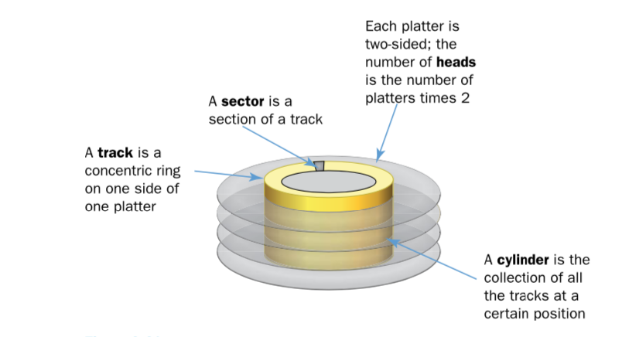

Slide 45
Each track is divided into segments called sectors. A sector holds exactly
512 bytes. Because there are so many sectors, and because almost every file is much larger than 512 bytes, sectors are grouped together into clusters, and the drive’s controller addresses clusters rather than individ- ual sectors. The number of sectors per cluster is determined by the drive’s size and formatting, but most modern HDDs have 32 sectors per cluster.
An HDD can be internal or external,

Slide 46
Optical Drives
An optical drive uses a light beam and sensor to read the data. The surface of a blank optical disc is shiny and reflects light strongly. When data is written to an optical disc, certain areas are burned with a laser so they are less reflective. The shiny areas are called land, and the less-shiny areas are called pits.
compact disc (CD) An optical disc used for storing music and data, holding up to 900 MB.
digital versatile disc (DVD) An optical disc used for storing standard-definition movies and data, holding up to 4.17 GB per side per layer.
Blu-ray disc (BD) An optical disc used for stor- ing high-definition movies and data, holding up to 25 GB per layer.

Slide 47
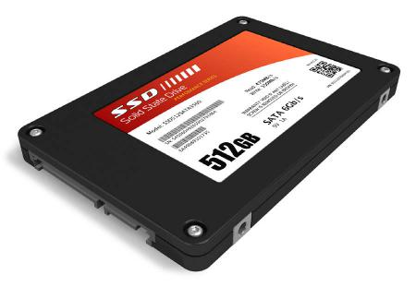
Solid-State Drives
solid-state hard drive (SSHD) A high-capacity solid state storage device that substitutes for an HDD as the main storage drive in a computer. Because it is electrically erasable, the computer can erase what’s written there and rewrite it.

Slide 48
Cloud-Based Storage
A cloud is a secure computing environment consisting of a set of remote servers that users access via the Internet. A cloud can include applications, communication with other users, and storage space
One of the most popular individual cloud storage systems is Microsoft OneDrive. or Dropbox.

Slide 49
THE END

