Slide 1

fundamentals of
Human Resource Management 4th edition
by R.A. Noe, J.R. Hollenbeck, B. Gerhart, and P.M. Wright
CHAPTER 7
Training Employees
McGraw-Hill/Irwin
Copyright © 2011 by The McGraw-Hill Companies, Inc. All Rights Reserved.
7-1

Slide 2
What Do I Need to Know?
Discuss how to link training programs to organizational needs.
Explain how to assess the need for training.
Explain how to assess employees’ readiness for training.
Describe how to plan an effective training program.
Compare widely used training methods.

Slide 3
What Do I Need to Know? (continued)
Summarize how to implement a successful training program.
Evaluate the success of a training program.
Describe training methods for employee orientation and diversity management.

Slide 4
Introduction
Training: an organization’s planned efforts to help employees acquire job-related knowledge, skills, abilities, and behaviors, with the goal of applying these on the job.
Training can benefit the organization when it is linked to organizational needs and when it motivates employees.

Slide 5
Training Linked to Organizational Needs
The nature of the modern business environment makes training important.
Rapid change requires that employees continually learn new skills.
Growing reliance on teamwork creates a demand for the ability to solve problems in teams, an ability that often requires formal training.

Slide 6
Your Experience
Have you participated in a company sponsored training program?
A=Yes B=No
If yes, was the training effective?
A=Yes B=No
How do you know

Slide 7
Instructional Design
• •
An effective training program is designed to teach skills and behaviors that will help the organization achieve its goals.
HR professionals approach training through instructional design.
Instructional design: a process of systematically developing training to meet specified needs.
•

Slide 8

Pfizer employees go through a representative training phase which teaches them about different Pfizer products and how to market them.
Workers typically need to be trained in several processes to work in flexible manufacturing.

Slide 9
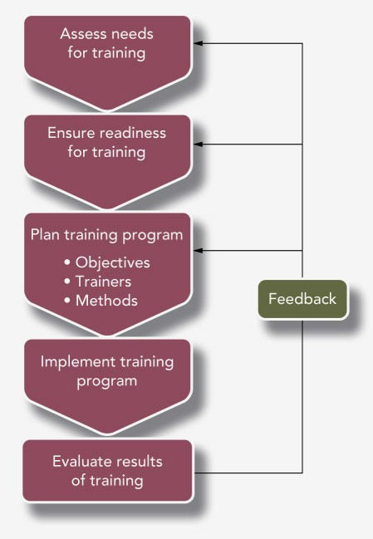
Figure 7.1: Stages of Instructional Design

Slide 10
Learning Management System
Learning management system (LMS): a computer application that automates the administration, development, and delivery of training programs.
LMS is being used by organizations to carry out the instructional design process more efficiently and effectively.

Slide 11
Learning Management System (continued)
The system can be linked to the organization’s performance management system to plan for and manage:
  training needs
  training outcomes
  associated rewards

Slide 12
Needs Assessment
Needs assessment: the process of evaluating the organization, individual employees, and employees’ tasks to determine what kinds of training, if any, are necessary.
Needs assessment answers three questions:
  Organization – What is the context in which training will occur?
  Person – Who needs training?
  Task – What subjects should the training cover?

Slide 13
Needs Assessment: Organization Analysis
Organization analysis: a process for determining the appropriateness of training by evaluating the characteristics of the organization.
The organization analysis looks at training needs in the light of:
  the organization’s strategy,
  resources available for training, and
  management’s support for training activities.

Slide 14
Needs Assessment: Person Analysis
Person analysis: a process of determining individuals’ needs and readiness for training.
It involves answering three questions:
  Do performance deficiencies result from a lack of knowledge, skill, or ability?
  Who needs training?
  Are these employees ready for training?

Slide 15
Needs Assessment: Task Analysis
Task analysis: the process of identifying and analyzing tasks to be trained for.
To carry out the task analysis, the conditions in which tasks are performed are looked at.
  The equipment and environment of the job
  Time constraints
  Safety considerations
  Performance standards

Slide 16
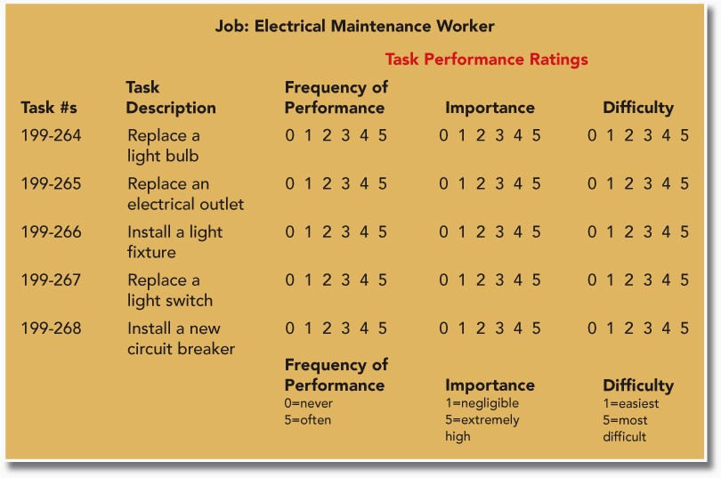
Table 7.1: Sample Items from a Task Analysis Questionnaire

Slide 17
Test Your Knowledge
An examination of the causes of performance deficiencies in a group or individual is called:
  Organizational analysis
  Task analysis
  Person analysis
  Needs analysis

Slide 18
Test Your Knowledge
Training most effectively addresses:
  Motivation problems
  Skill and ability deficiencies
  Lack of performance feedback
  Lack of resources to do job

Slide 19
Readiness for Training
Readiness for training: a combination of employee characteristics and positive work environment that permit training.
The necessary employee characteristics:
  Ability to learn the subject matter
  Favorable attitudes toward the training
  Motivation to learn
A positive work environment encourages learning and avoids interfering with training.

Slide 20
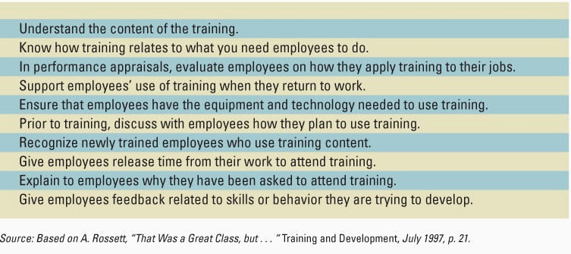
Table 7.2: What Managers Should Do to Support Training

Slide 21
Test Your Knowledge
Which of the following comments from a manager would support training?
  “You can attend the course but you’ll have to make up the work you missed on your own time.”
  “I’m glad you were trained on ‘X’ but I need you to keep working on ‘Y’ for the next few months.”
  Good luck with your training next week, what is it about again?
  “Your performance has improved, especially with regard to the aspects you have been trained on.”

Slide 22
Planning the Training Program
Planning begins with establishing objectives for the training program.
Based on those objectives, the planner decides:
  Who will provide the training
  What topics the training will cover
  What training methods to use
  How to evaluate the training

Slide 23
Characteristics of Effective
Training Objectives
They include a statement of:
  What the employee is expected to do
  The quality or level of acceptable performance
  The conditions under which the employee is to apply what he or she learned
They include measurable performance standards.
They identify the resources needed to carry out the desired performance or outcome.

Slide 24
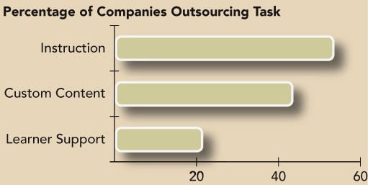
In-House or Contracted Out?

Slide 25
Your Experience
What types of training have you taken?
  Classroom/Presentation
  Hands-on
  Team training
  Combination

Slide 26
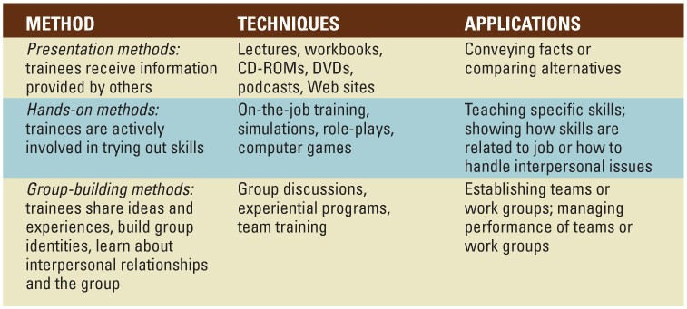
Table 7.3: Categories of Training Methods

Slide 27
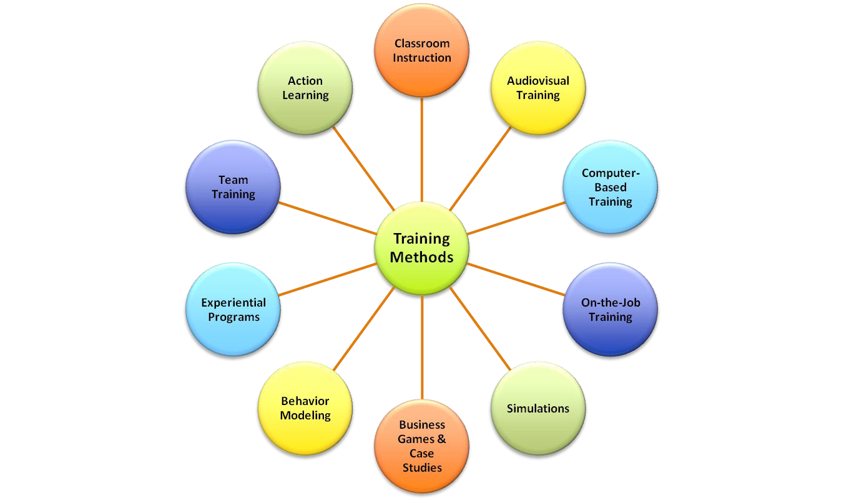
Training Methods

Slide 28
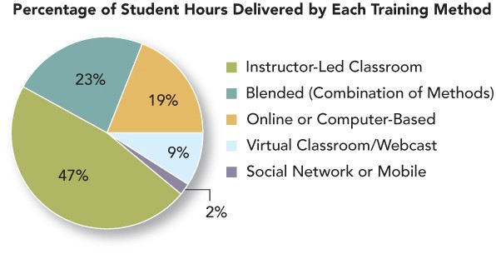
Figure 7.2: Use of Instructional Methods

Slide 29

Mobile technology is useful not only for entertainment, but can also be used for employees who travel and need to be in touch with the office.
iPods and PDAs also give employees the ability to listen to and participate in training programs at their own leisure.

Slide 30
Current applications of computer-based training can extend its benefits:
E-learning: involves receiving training via the Internet or the organization’s intranet.
E-learning uses electronic networks for delivering and sharing information, and it offers tools and information for helping trainees improve performance.
Training involves links to other online information resources.

Slide 31
Current applications of computer-based training can extend its benefits: (continued)
Electronic Performance Support Systems (EPSS): provide access to skills training, information, and expert advice when a problem occurs on the job. As employees need to learn new skills, they can use the EPSS, which gives them access to the particular information they need. – e.g., detailed instructions on how to perform an unfamiliar task.

Slide 32
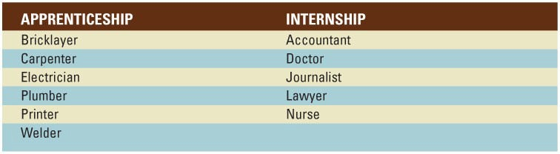
Table 7.4: Typical Jobs for Apprentices and Interns

Slide 33
Characteristics of Effective On-the-Job Training (OJT)
The organization should issue a policy statement describing the purpose of OJT and emphasizing the organization’s support for it.
The organization should specify who is accountable for conducting OJT.
The organization should review OJT practices at companies in similar industries.
Managers and peers should be trained in OJT principles.
•
•
•
•

Slide 34
Characteristics of Effective On-the-Job Training (OJT) (continued)
Employees who conduct OJT should have access to lesson plans, checklists, procedure manuals, training manuals, learning contracts, and progress report forms.
Before conducting OJT with an employee, the organization should assess the employee’s level of basic skills.
•
•

Slide 35
Other Training Methods
• •
Simulations: A training method that represents a real-life situation, with trainees making decisions resulting in outcomes that mirror what would happen on the job. Uses:
Avatars
Virtual Reality
Business Games and Case Studies:
Case studies are detailed descriptions of a situation that trainees study and discuss
Business games require trainees to gather information, analyze it and make decisions that influence the outcome of the game

Slide 36
Other Training Methods (continued)
• •
Experiential programs: Participants learn concepts and apply them by simulating behaviors involved and analyzing the activity, connecting it with real- life situations
Adventure Learning: a teamwork and leadership training program based on the use of challenging, structured outdoor activities

Slide 37

One of the most important features of organizations today is teamwork. Experiential programs include team-building exercises like wall climbing and rafting to help build trust and cooperation among employees.

Slide 38
Implementing the Training Program:
Principles of Learning
•
Employees are most likely to learn when training is linked to their current job experiences and tasks.
Employees need a chance to demonstrate and practice what they have learned.
Trainees need to understand whether or not they are succeeding.
Well-designed training helps people remember the content.
Written materials should have an appropriate reading level.
•
•
•
•

Slide 39
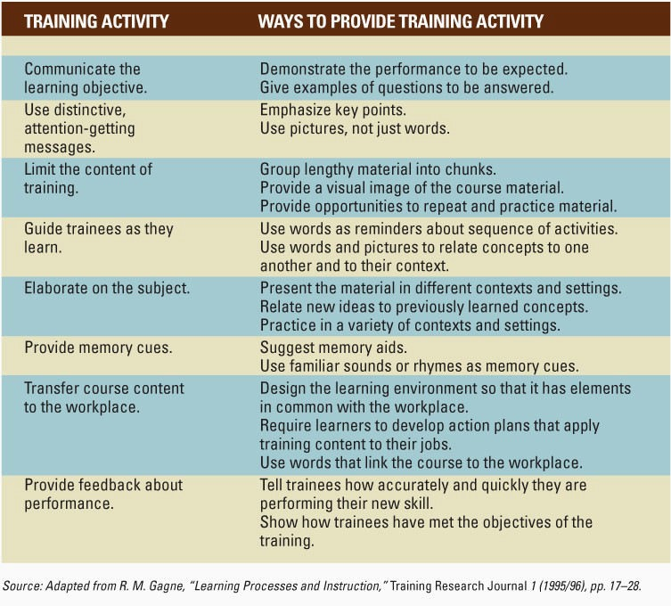
Table 7.5: Ways That Training Helps Employees Learn

Slide 40
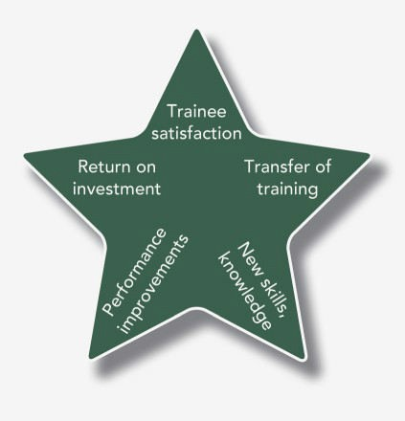
Figure 7.3: Measures of Training Success

Slide 41
Evaluation Methods: Transfer of Training
Transfer of training: on-the-job use of knowledge, skills, and behaviors learned in training.
Can be measured by asking employees three questions about specific training tasks:
  Do you perform the task?
  How many times do you perform the task?
  To what extent do you perform difficult and challenging learned tasks?

Slide 42
Evaluation Methods: Training Outcomes
•
Information such as facts, techniques, and procedures that trainees can recall after the training.
Skills that trainees can demonstrate in tests or on the job.
Trainee and supervisor satisfaction with the training program.
Changes in attitude related to the content of the training.
Improvements in individual, group, or company performance.
•
•
•
•

Slide 43
Test Your Knowledge
The most effective way to measure employee satisfaction with training is and learning acquired is .
  Survey; pre-post test with control group
  Post-test; survey
  Cost-benefit analysis; pre-post test
  Interview managers; cost-benefit analysis

Slide 44
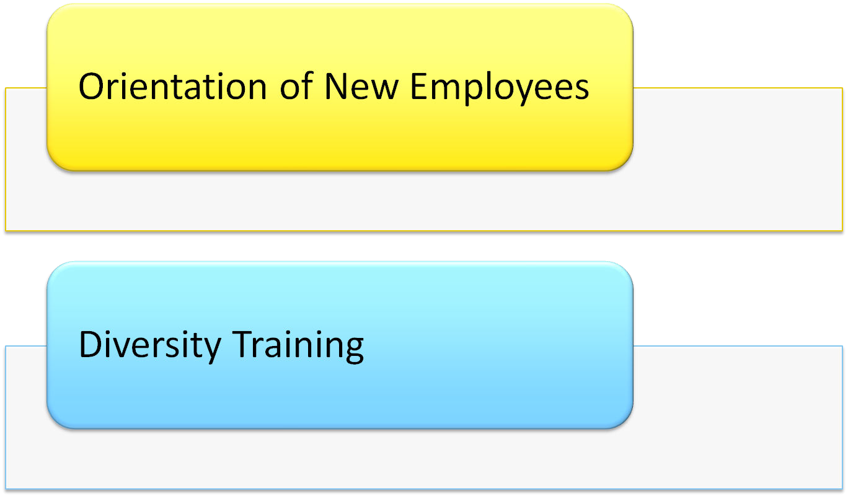
Applications of Training

Slide 45
Orientation of New Employees
• •
Orientation: training designed to prepare employees
to perform their jobs effectively,
learn about their organization, and
establish work relationships.
The objectives of orientation programs include making new employees familiar with the organization’s rules, policies, and procedures.

Slide 46
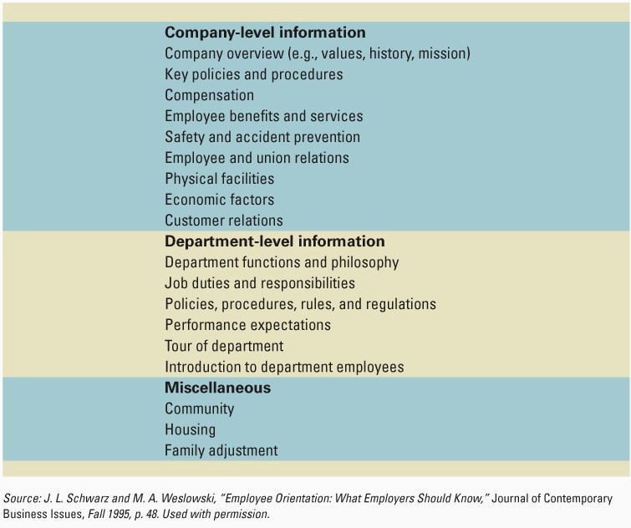
Table 7.6: Content of a Typical Orientation Program

Slide 47
Diversity Training
Diversity training: training designed to change employee attitudes about diversity and/or develop skills needed to work in a diverse workforce.
These programs generally emphasize either
  attitude awareness and change, or
  behavior change

Slide 48
Your Experience
Have you ever participated in Diversity Training?
A=Yes B=No
What was it like?
Why did the organization offer it?
What were the goals of the program?

Slide 49
Characteristics of Effective Diversity Training Programs
•
•
The training should be tied to business objectives.
Top management involvement and support, and the involvement of managers at all levels are important.
Training should emphasize learning behaviors and skills, not blaming employees.
The program should be:
well structured
deliver rewards for performance
include a way to measure the success of the training
•
•

Slide 50
Test Your Knowledge
What type of diversity training tends to bring about better business results?
  Training focused on awareness and changing attitudes
  Training focused on behaviors and skills
  It doesn’t matter, research shows all diversity training is good for the organization

Slide 51
Summary
•
Organizations need to establish training programs that are effective.
They teach what they are designed to teach.
They teach skills and behaviors that will help the organization achieve its goals.
Organizations create such programs through instructional design.
This process begins with a needs assessment.
The organization then ensures readiness for training.
•
•

Slide 52
Summary (continued)
Next the organization plans a training program, implements the program, and evaluates the results.
Needs assessment consists of an organization analysis, person analysis, and task analysis.
Readiness for training is a combination of employee characteristics and positive work environment that permit training.
Planning begins with establishing objectives for the program.
•
•
•
•

Slide 53
Summary (continued)
•
Based on the objectives, the planner decides:
Who will provide the training
What topics the training will cover
What training methods to use
How to evaluate the training
The training methods selected should be related to the objectives and content of the training program.
Training methods may include presentation methods, hands-on methods, or group-building methods.
•
•

Slide 54
Summary (continued)
•
•
Implementation should apply principles of learning.
Effective training communicates learning objectives, presents information in distinctive and memorable ways, and helps trainees link the subject matter to their jobs.
Evaluation of training should look for transfer of training by measuring whether employees are performing the tasks taught in the training program.
Assessment of training also should evaluate training outcomes.
•
•

Slide 55
Summary (continued)
•
Organizations should provide for orientation because no matter how realistic the information provided during employment interviews and site visits, people feel shock and surprise when they start a new job, and they need to learn the details of how to perform the job.
Diversity training is designed to change employee attitudes about diversity and/or develop skills needed to work with a diverse workforce.
•

