Slide 1







Technology-Based
Training Methods
Chapter 8
6th Edition Raymond A. Noe
McGraw-Hill/Irwin
Copyright © 2013 by The McGraw-Hill Companies, Inc. All rights reserved.

Slide 2
Learning Objectives
Explain how new technologies are influencing training
Evaluate a web-based training site
Explain how learning and transfer of training are enhanced by new training technologies
Explain the strengths and limitations of e-learning, mobile learning training methods (such as iPads), and simulations
Explain the different types of social media and the
conditions conducive to their use for training

Slide 3
Learning Objectives
Describe to a manager the different types of distance learning
Recommend what should be included in an
electronic performance support system
Compare and contrast the strengths and weaknesses of traditional training methods versus those of technology-based training methods
Identify and explain the benefits of learning management systems

Slide 4
Technology’s Influence on Training and
Learning
New technologies have made it possible to:
  Reduce costs associated with delivering training
  Increase effectiveness of the learning environment
  Help training contribute to business goals

Slide 5
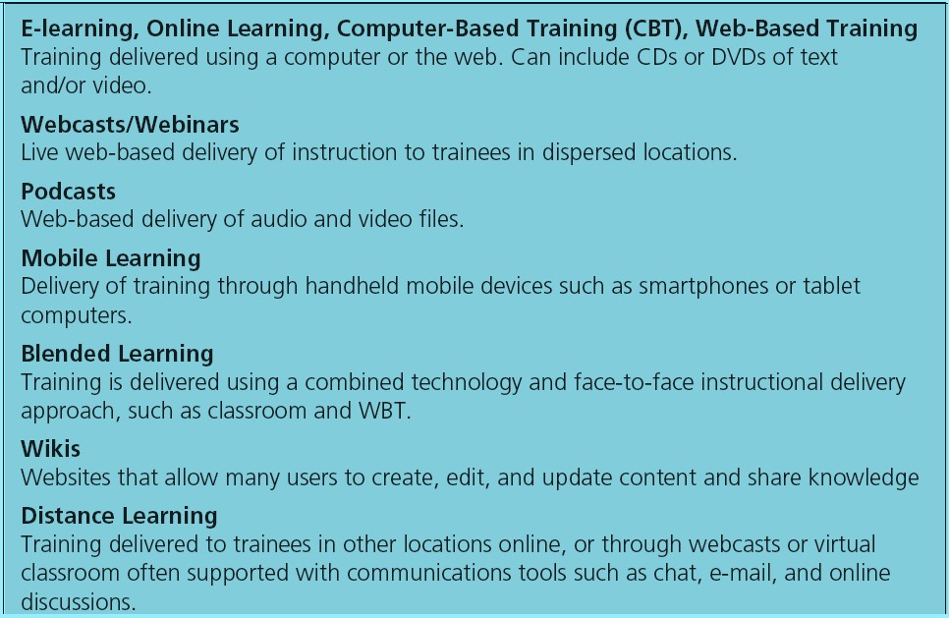
Table 8.2 - New Technologies Used for Training

Slide 6
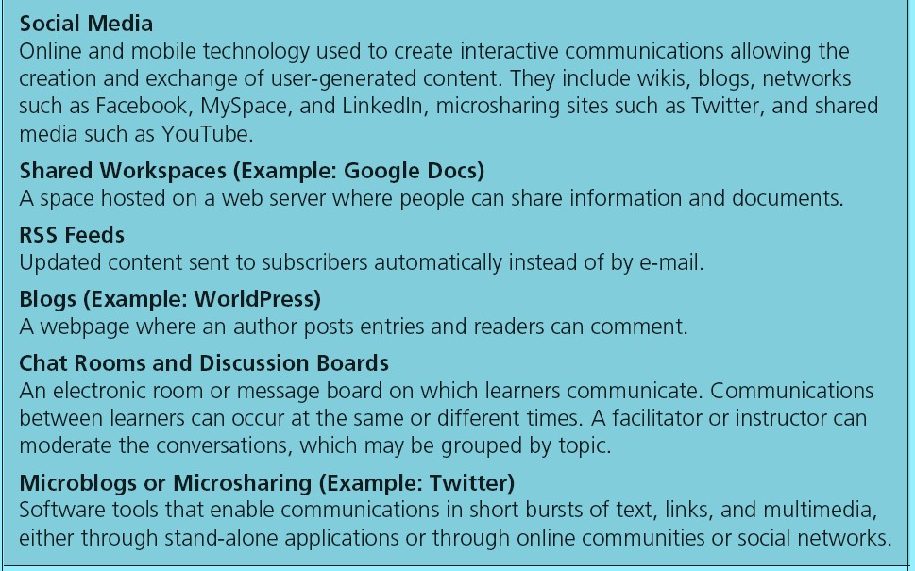
Table 8.2 cont. - New Technologies Used for Training

Slide 7
Benefits of Technology
Employees can gain control over when and where they receive training
Employees can access knowledge and expert
systems on an as-needed basis
The learning environment can look, feel, and sound just like the work environment
Employees can choose the type of media they want
to use in a training program

Slide 8
Benefits of Technology
Paperwork and time needed for administrative activities is reduced
Employees’ accomplishments during training can be
monitored
Traditional training methods can be delivered to trainees rather than requiring them to come to a central training location

Slide 9
Technology and Collaboration
Digital collaboration: Use of technology to enhance and extend employees’ abilities to work together regardless of their geographic proximity
  Requires a computer, tablet, or phone with a web browser or app, but collaborative

Slide 10
Technology and Collaboration
Types
  Synchronous communication: Trainers, experts, and learners interact with each other live and in real time, the same way they would in face-to-face classroom instruction
  Asynchronous communication: Non-real-time
interactions

Slide 11
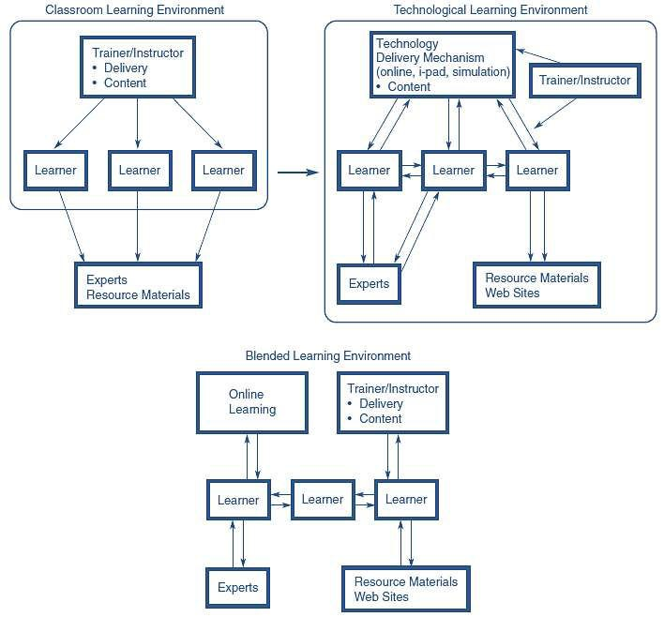
Figure 8.2 - Types of Learning Environments

Slide 12
Computer-Based Training, Online Learning,
Web-Based Training, E-learning
Refers to instruction and delivery of training by computer through the Internet or the web
Include and integrate into instruction text:
  Interaction using simulations and games, and video
  Collaboration using blogs, wikis, and social networks
  Hyperlinks to additional resources
In some types of CBT training:
  Content is provided stand-alone using software or DVDs with no connection to the Internet
Online learning, e-learning, and web-based training include delivery of instruction using the Internet or
web
8-12

Slide 13
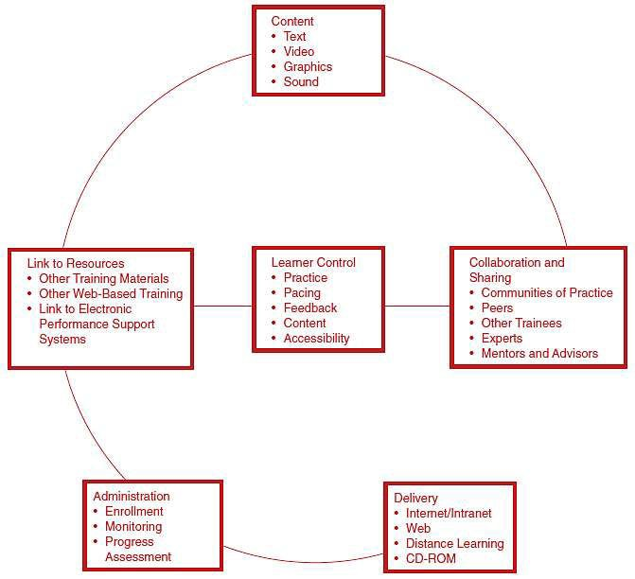
learning

Slide 14
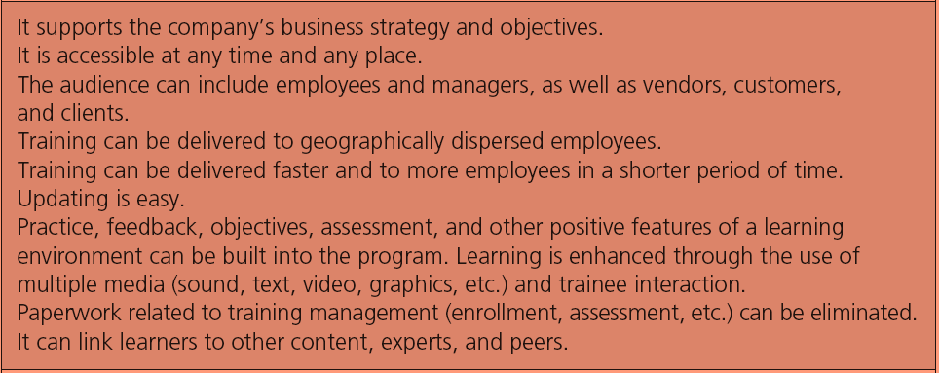
Table 8.3 - Advantages of E-
learning

Slide 15
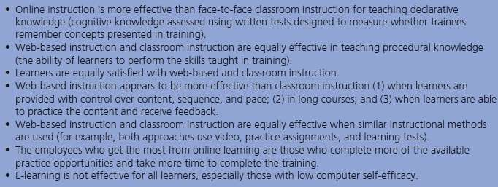
Regarding the Effectiveness of Online Learning

Slide 16
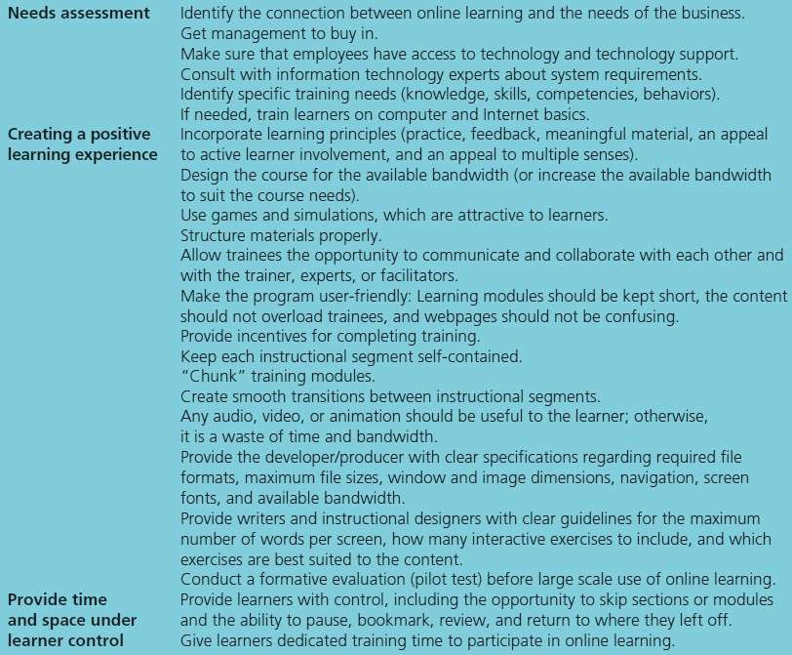
Table 8.5
- Tips for Developing Effective Online Learning

Slide 17
Developing Effective Online
Learning
Needs assessment - Includes getting management to support online learning
  Bandwidth: The number of bytes and bits (information)
that can travel between computers per second
  Plug-ins: Additional software that needs to be loaded on the computer to listen to sound, watch video, or perform other functions
Creating a positive online learning experience
  Rapid prototyping: An iterative process in which initial design ideas are proposed and provided in rough form in an online working prototype that is reviewed and refined by design team members
  Repurposing: Directly translating an instructor-led,
face-to-face training program to an online format
8-17

Slide 18
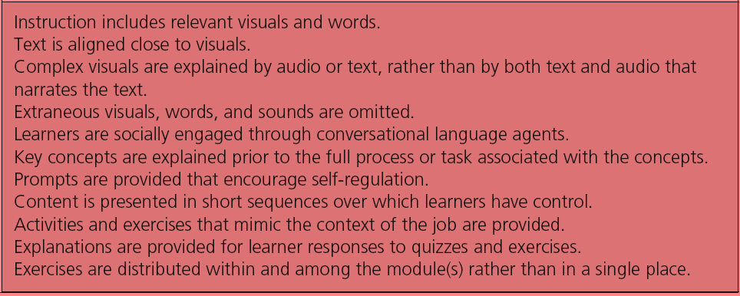
Table 8.6 - Principles for Creating a
Positive Learning Experience

Slide 19
Developing Effective Online Learning
Learner control: Giving trainees the option to learn actively through:
  Self-pacing
  Exercises
  Exploring links to other material
  Conversations with other trainees and experts

Slide 20
Providing Time and Space for Online Learning
Given the work demands that employees face, trainees need incentives to complete online learning
  Presenting cash awards and merchandise
  Certifying programs to ensure that online courses are completed

Slide 21
Technology for Collaboration and Linking
Hyperlinks: Links that allow a trainee to access other websites that include:
  Printed materials
  Communications links to experts, trainers, and other learners
Learning with and creating a network with peers an
important aspect for some employees
  Prefer instructor-led face-to-face instruction over online learning

Slide 22
Online and mobile technology used to create interactive communications allowing the creation and exchange of user-generated content
Social Media: Wikis, Blogs, Microblogs, and Social Networks

Slide 23
Social Media: Wikis, Blogs, Microblogs, and Social Networks
Useful for:
  Providing links to resources related to new learning
content
  Helping determine future training needs reinforcing and sustaining learning
  Being used as a coaching and mentoring tool
  Linking learners through a formal training event
  Engaging Generation X and millennial employees
  Providing content before a face-to-face learning event

Slide 24
Social Media: Blogs
A webpage where an author posts entries and readers can comment
  Personal blogs - Written by one person
  Company blogs - Used for marketing and branding purposes
  Topic blogs - Focus on a specific topic area
  Video blogs and mobile device blog

Slide 25
Social Media: Wikis and Microblogs
Wiki: A website that allows many users to create, edit, and update content and share knowledge
Microblog: Software tools like Twitter
  Enable communications in short bursts of text, links, and multimedia through:
    Stand-alone applications, online communities or social networks
  Shared media: Audio or video such as YouTube that can be accessed and shared with others

Slide 26
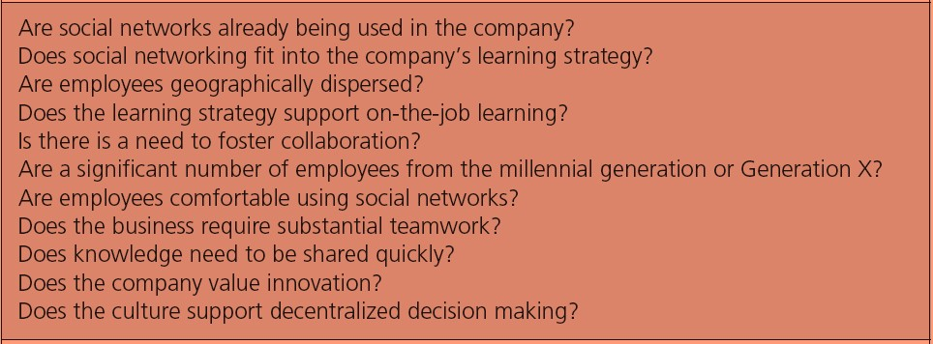
Table 8.7 - Factors to Consider in Deciding to
Use Social Media for Training and Learning

Slide 27
Blended Learning
Combines online learning, face-to-face instruction, and other methods for distributing learning content and instruction
  Provides increased learner control
  Allows for self-directedness
  Requires learners to take more responsibility for their
learning
  More face-to-face social interaction
  Ensures a dedicated learning environment

Slide 28
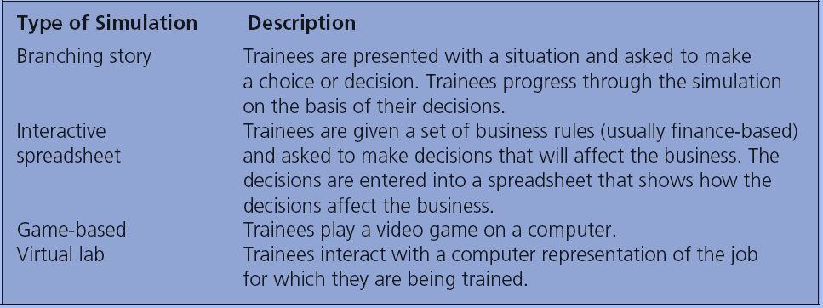
Table 8.8 – Types of Simulations

Slide 29
Simulations and Games
Avatars: Computer depictions of humans that are used as:
  Imaginary coaches
  Coworkers
  Customers in simulations

Slide 30
Simulations and Games
Advantages | Disadvantages
Eliminate need to travel to a central training location Get trainees involved in learning, and are emotionally engaging Provide a consistent message of what needs to be learned Put employees in situations that would be dangerous in the real world Result in positive outcomes as shorter training times and increased ROI | High development costs Trainees may not be comfortable in learning situations that lack human contact

Slide 31
Virtual Reality
A computer-based technology that provides trainees with a three-dimensional learning experience
Advantages:
  Allows trainees to practice dangerous tasks without
putting themselves or others in danger
  More memory available for learning
Disadvantages:
  Poor equipment that results in a reduced sense of presence
  Poor presence may result in the trainee experiencing simulator sickness

Slide 32
Virtual Worlds
Computer-based, simulated online three-dimensional representations of the real world where learning programs or experiences can be hosted
Advantages
  Imitates an actual workplace without any harm
  Provides a place to meet with trainers, managers, or other employees who can serve as teachers
Disadvantages
  Lack of ease of use for first-time users
  Potential risk of a difficult keyboard and mouse interface
  High investment of time and money
  Lack of evidence supporting effectiveness

Slide 33
Mobile Technology
Consists of:
  Wireless transmission systems - Wi-Fi and Bluetooth
  Mobile devices - PDAs, smartphones
  Software applications related to processing audio files, word processing, spreadsheets, Internet, e-mail, and instant messaging

Slide 34
Mobile Learning
Training delivered using a mobile device such as a smartphone, netbook, notebook computer, or iPad
Involves:
  Formal learning - Include e-learning courses, podcasts, or videos on the mobile device
  Informal learning - Engaging in communication and
messaging via Twitter, blogs, or Facebook
Apps: Applications designed specifically for smartphones and tablet computers

Slide 35
Intelligent Tutoring Systems (ITS )
Instructional systems that use artificial intelligence
Three types of ITS environments:
  Tutoring - Increases trainee understanding of a content
domain
  Coaching - Provides trainees with flexibility to practice skills in artificial environments
  Empowering - Refers to the student’s ability to explore
the content of the training program freely

Slide 36
Intelligent Tutoring Systems (ITS )
Different from other technologies:
  Has the ability to match instruction to individual student
needs
  Can communicate and respond to the student
  Can model the trainee’s learning process
  Can decide, on basis of a trainee’s previous
performance, what information to provide
  Can make decisions about trainee’s level of
understanding
  Can complete a self-assessment resulting in a
modification of its teaching process

Slide 37
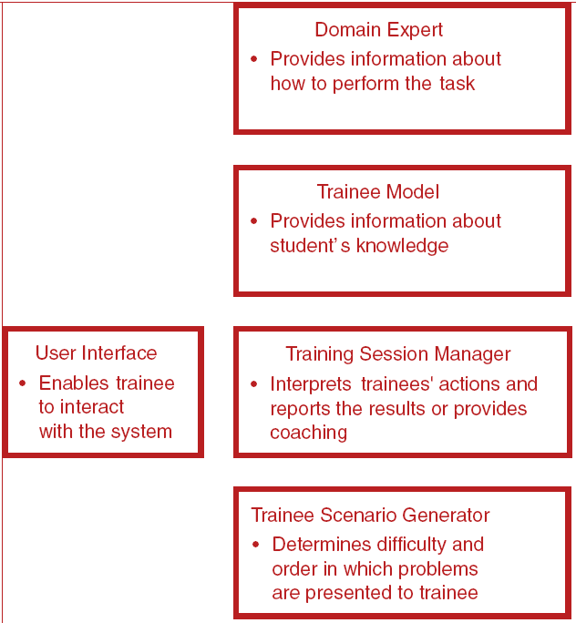
Figure 8.4 - Components of Intelligent Tutoring Systems

Slide 38
Distance Learning
Involves two types of technology:
  Teleconferencing: Synchronous exchange of audio, video, and/or text between two or more individuals or groups at two or more locations
    Virtual classroom: Using a computer and the Internet to distribute instructor-led training to geographically dispersed employees
Distance Learning: Used by geographically dispersed companies to provide information about new products, policies, or procedures, as well as deliver skills training and expert lectures to field location

Slide 39
Distance Learning
Interactive distance learning (IDL): Uses satellite technology to broadcast programs to different locations and allows trainees to respond to questions posed during the training program using a keypad
  Webcasting: Involves instruction that is provided online through live broadcasts

Slide 40
Distance Learning
Advantages
  Company saves on travel costs
  Allows employees in geographically dispersed sites to receive training from experts who would not otherwise be available to visit each location
Disadvantages
  Lack of interaction between the trainer and the
audience
  Technology failures
  Unprepared trainers

Slide 41
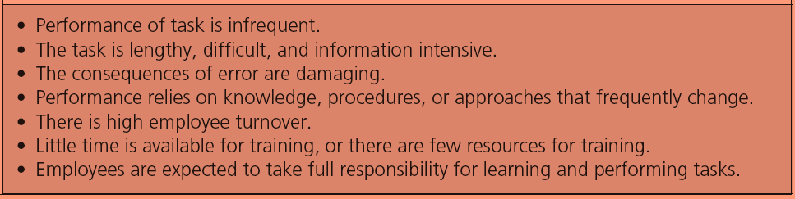
Table 8.9 - Conditions When Training Support Technologies are Most Needed

Slide 42
Technologies for Training Support
Expert systems: Technology (usually software) that organizes and applies the knowledge of human experts to specific problems
Three elements:
  Knowledge base
  Decision-making capability
  User interface

Slide 43
Technologies for Training Support
Electronic Performance Support Systems (EPSSs):
  An electronic infrastructure that captures, stores, and distributes individual and corporate knowledge assets throughout an organization
    To enable individuals to achieve required levels of performance in the fastest possible time and with a minimum of support from other people

Slide 44
Technologies for Training Support
The typical EPSS includes:
  An assistant to automate tasks and lighten the
workload
  A librarian to provide task-specific information
  A teacher to guide the user through the process step by step
  An advisor to provide expert advice

Slide 45
Learning Management Systems: Systems
for Training Delivery, Support, and
Administration
A technology platform that can be used to automate the administration, development, and delivery of all of a company’s training programs

Slide 46
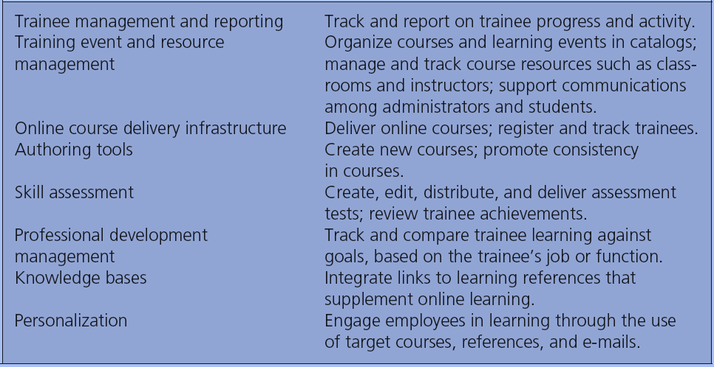
Table 8.10 - Features of LMSs

Slide 47
Why Develop an LMS?
Important for human capital management
  Human capital management: Integrates training with all aspects of the human resource function to determine how:
    Training dollars are spent
    Training expenses translate into business dollars for the company

Slide 48
Why Develop an LMS?
Major reasons companies adopt an LMS:
  Centralize management of learning activities
  Track regulatory compliance
  Measure training usage
  Measure employee performance

Slide 49
Developing an LMS
Senior management needs to be convinced that an LMS will:
  Benefit employees
  Improve business functions
  Contribute to overall business strategies and goals
The company must have an e-learning culture
The online learning environment needs to be under
the control of the learner

Slide 50
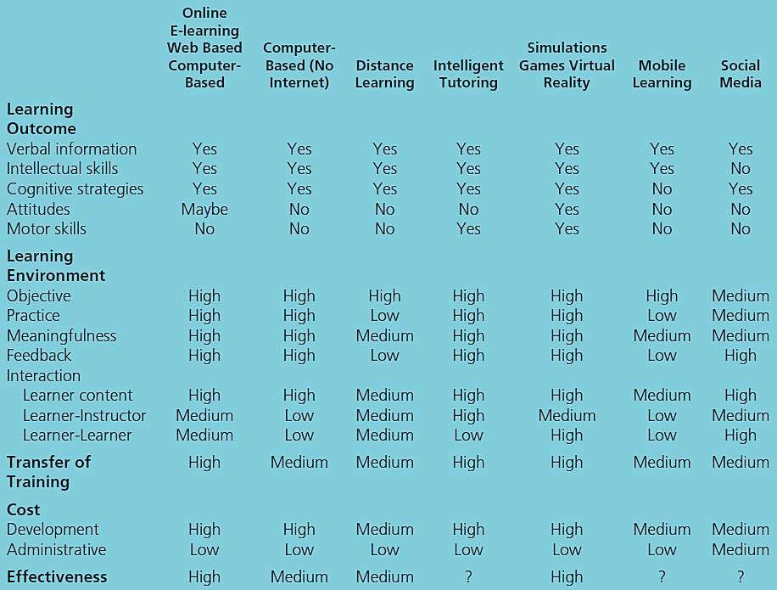
Table 8.11
Comparison of Technology- Based Training Methods

Slide 51
Choosing New Technology Training Methods
Advantages of these methods:
  Cost savings due to training being accessible to
employees at their home or office
  Reduced number of trainers needed
  Reduced costs associated with employees traveling to a central training location (e.g., airfare, food, and lodging)

Slide 52
Choosing New Technology Training Methods
Should be considered when:
  Sufficient budget and resources are provided
  Trainees are geographically dispersed
  Trainees are comfortable using technology
  It is a part of the company’s business strategy and suits
its culture

Slide 53
Choosing New Technology Training Methods
Employees have limited or no time for training
Current training methods allow limited time for practice,
feedback, and assessment
Its use fits into the organizational culture or business strategy

