Slide 1







Traditional Training
Methods
Chapter 7
6th Edition Raymond A. Noe
McGraw-Hill/Irwin
Copyright © 2013 by The McGraw-Hill Companies, Inc. All rights reserved.

Slide 2
Learning Objectives
Discuss the strengths and weaknesses of presentational, hands-on, and group building training methods
Provide recommendations for effective on-the-job training (OJT)
Develop a case study
Develop a self-directed learning module

Slide 3
Learning Objectives
Discuss the key components of behavior modeling training
Explain the conditions necessary for adventure
learning to be effective
Discuss what team training should focus on to improve team performance

Slide 4
Introduction
Traditional training methods
  Require an instructor or facilitator
  Involve face-to-face interactions

Slide 5
Presentation Methods
Trainees are passive recipients of information, which may include:
  Facts or information
  Processes
  Problem-solving methods
Includes lectures and audio-visual techniques

Slide 6
Presentation Methods
Lecture
  Trainers communicate through spoken words
  Least expensive and least time-consuming ways to
present information
  Easily employed with large groups of trainees
  Supports behavior modeling and technology-based
techniques

Slide 7
Presentation Method
Disadvantages
  Lacks participant involvement, feedback, and meaningful connection to work environment
  Appeals to few of the trainees’ senses
  Makes it difficult to judge learners’ level of understanding

Slide 8
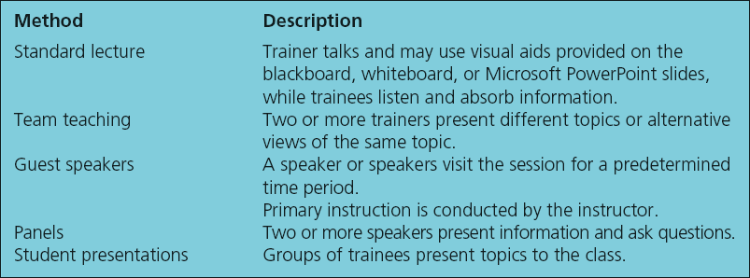
Table 7.1 - Variations of the Lecture
Method

Slide 9
Presentation Methods
Audiovisual instruction
  Used for improving communications, interviewing, and
customer-service skills
  Used for illustrating how procedures should be followed
  Disadvantages
    Too much content for the trainee to learn
    Poor dialogue between the actors hinders credibility or clarity of
the message
    Overuse of humor, music, or drama may make it difficult to understand the important learning points

Slide 10
Hands-on Methods
Require trainee to be actively involved in learning
On-the-job training (OJT)
  New or inexperienced employees learn work by:
    Observing peers or managers performing the job
    Trying to imitate their behavior
  Needs less investment in terms of time or money

Slide 11


Hands-on Methods
 | Advantages | Disadvantages
On-the-job training (OJT) | Customized to the experiences and abilities of trainees Training is immediately applicable to the job Save costs Can be offered at any time, and trainers will be available because they are peers | Managers and peers may not use the same process to complete a task Managers/Peers may pass on bad habit as useful skill Unstructured OJT can result in poorly trained employees

Slide 12
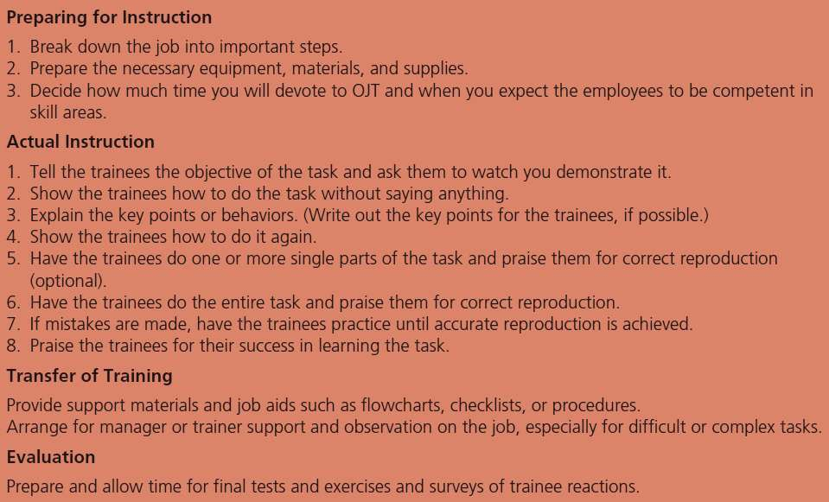
Table 7.2 - Principles of On-the-Job
Training (OJT)

Slide 13
Hands-on Methods
An effective OJT program should include:
  A policy statement that describes OJT purpose
  Clear specification of who is accountable for
conducting OJT
  Review of OJT practices in other companies
  Availability of lesson plans, checklists, manuals,
learning contracts, and progress reports
  Evaluation of employees’ levels of basic skills

Slide 14
Hands-on Methods
 | Advantages | Disadvantages
Self directed learning Employees Take responsibility for all aspects of learning Determine when it is conducted and who will be involved Trainers serve as facilitators | Allows trainees to learn at their own pace and receive feedback about the learning performance Requires fewer trainers, reduces costs associated with travel and meeting rooms, and makes multiple-site training more realistic Provides consistent training content Makes it easier for shift employees to gain access to training materials | Trainees must be motivated to learn on their own Higher development costs Development time is longer

Slide 15
Hands-on Methods
Necessary steps to develop effective self-directed learning:
  Conduct job analysis to identify the tasks that must be
covered
  Write trainee-centered learning objectives directly related to the tasks
  Develop the content for the learning package
  Break the content into smaller pieces (“chunks”)
  Develop an evaluation package

Slide 16
Hands-on Methods
 | Advantages | Disadvantages
Apprenticeship Work-study training method with both on-the- job and classroom training | Learners can earn pay while they learn Involves effective learning about ͞why and how͟ Results in full-time employment for trainees Meets specific business training needs and help attract talented employees | High development costs Increased time commitment required of management and journey workers Limited access for minorities and women No guarantee of full- time employment Training results in narrow focus expertise

Slide 17
Hands-on Methods
Simulation
  Represents a real-life situation
  Trainees’ decisions and the resulting outcomes mirror
what would happen in real work situations
  Replicates the physical equipment that employees use on the job
  Is used to teach production, process skills,
management, and interpersonal skills

Slide 18
Hands-on Methods
Case studies
  Description about how employees or an organization
dealt with a difficult situation
  Trainees are required to:
    Analyze and critique the actions taken
    Indicate the appropriate actions
    Suggest what might have been done differently
  Assumes that recall and use knowledge and skills is better if:
    Learnt through the process of discovery

Slide 19
Hands-on Methods
Appropriate for developing higher order intellectual skills
Help trainees develop the willingness to take risks
Case may not actually relate to the work situation or problem that the trainee will encounter

Slide 20
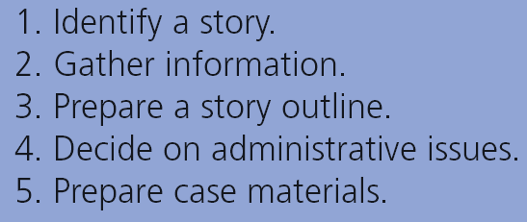
Table 7.5 - Process for Case
Development

Slide 21
Hands-on Methods
Business games
  Require trainees to gather information, analyze it, and
make decisions
  Primarily used for management skill development
  Mimic the competitive nature of business
  Designed to demonstrate understanding or application
of knowledge, skill, or behavior
  Provides several alternative courses of action
  Rules limit participant behavior

Slide 22

Table 7.6- Questions to Use When
Debriefing A Game

Slide 23
Hands-on Methods
Role plays: Trainees act out characters assigned to them
  Trainers need to engage in several activities before,
during, and after the role play
  Differ from simulations on the basis of:
    Response choices available to the trainees
    Level of detail of the situation given to trainees
    Outcomes of the trainees’ response

Slide 24
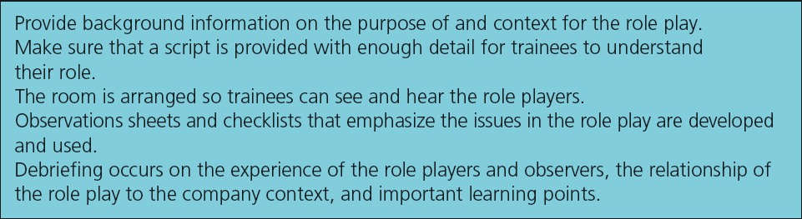
Table 7.7 - Activities for Effective Role
Plays

Slide 25
Hands-on Methods
Behavior modeling
  Demonstrates key behaviors to replicate
  Provides trainees with the opportunity to practice the
key behaviors
  Based on the principles of social learning theory
  More appropriate for teaching skills and behaviors than
factual information

Slide 26
Hands-on Methods
Developing behavior modeling training programs requires determining:
  The tasks that are not being adequately performed due to lack of skill or behavior
  The key behaviors that are required to perform the task.
Key behavior: Set of behaviors that are necessary to complete a task
Modeling display: Key behaviors that trainees will
practice to develop the same set of behaviors

Slide 27
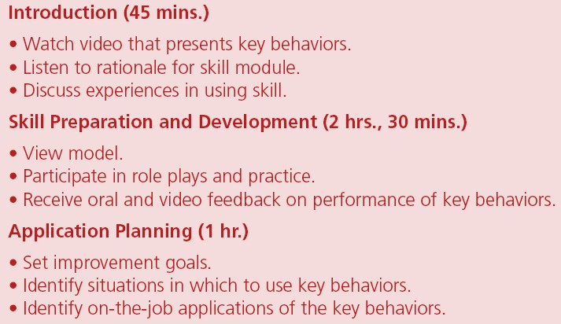
Table 7.8 - Activities in a Behavior
Modeling Training Program

Slide 28
Hands-on Methods
Modeling display
  Key behaviors that the trainees will practice to develop the same set of behaviors
  Characteristics of effective modeling display
    Clearly presents key behaviors
    Is credible to trainees
    Overview of key behaviors is presented
    Key behavior is repeated
    Review of key behaviors is included
    Both positive and negative use of key behaviors is presented

Slide 29
Hands-on Methods
Application planning: Prepares trainees to use the key behaviors on the job
  Involves identifying specific situations in which to use the key behaviors

Slide 30
Group Building Methods
Designed to improve team or group effectiveness
  Team
    Two or more people with specific roles and shared
responsibilities working to achieve a common goal
Experiential learning: Four stages are:
  Gaining conceptual knowledge and theory
  Taking part in a behavioral simulation
  Analyzing the activity
  Connecting the theory and activity to real-life situations

Slide 31
Group Building Methods
Adventure learning
  Focuses on the development of teamwork and
leadership skills through structured activities
  Includes wilderness training, outdoor training, drum circles, and cooking classes
  Develops skills related to group effectiveness

Slide 32
Group Building Methods
To be successful:
  Exercises should be related to the types of skills participants are expected to develop
  After the exercises, a skilled facilitator should lead a discussion about:
    What happened in the exercise
    What was learned
    How events in the exercise relate to job situation
    How to apply what was learned on the job

Slide 33
Group Building Methods
Team training: Designed to improve team effectiveness
Effective team training helps
  Develop procedures to identify and resolve errors
  Coordinate information gathering
Three components of team performance:
  Knowledge
  Attitudes
  Behavior

Slide 34
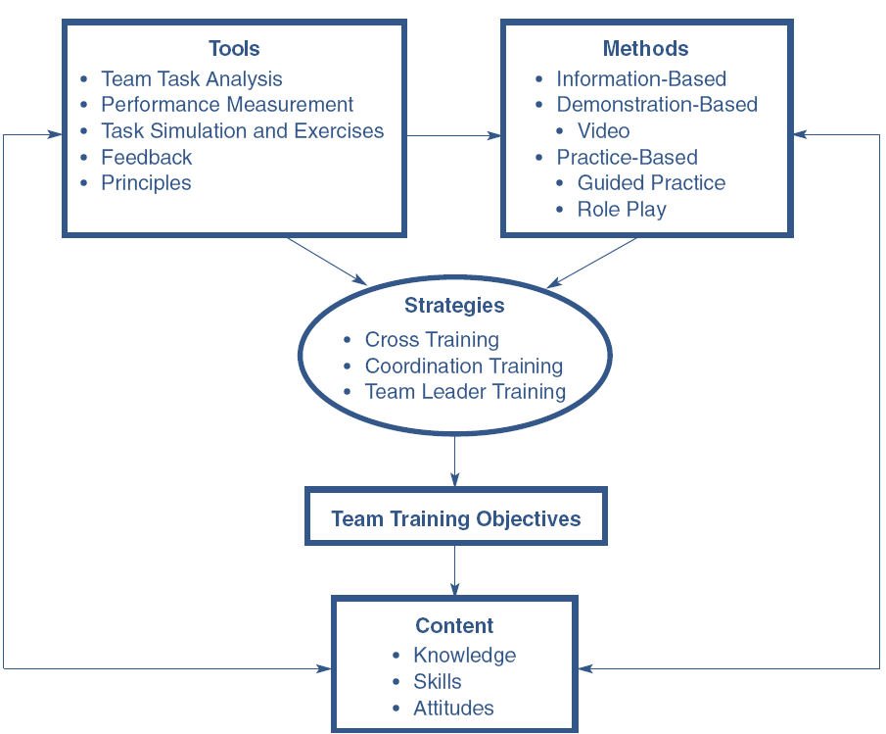
Figure 7.4 - Main Elements of the
Structure of Team Training

Slide 35
Group Building Methods
Cross training: Team members understand and
practice each other’s skills
Coordination training
  Sharing information and decision- making responsibilities to maximize team performance
Leader training: Training for team manager or
facilitator

Slide 36
Group Building Methods
Scenario-based training: Places team members in a realistic context while learning
Guided team self-correction: Emphasizes
continuous learning and knowledge sharing in teams

Slide 37
Group Building Methods
Action learning: Teams or work groups:
  Solve an actual problem
  Commit to an action plan
  Are accountable for carrying out the plan
Addresses how to:
  Change the business
  Better utilize technology
  Remove barriers between the customer and company
  Develop global leaders

Slide 38
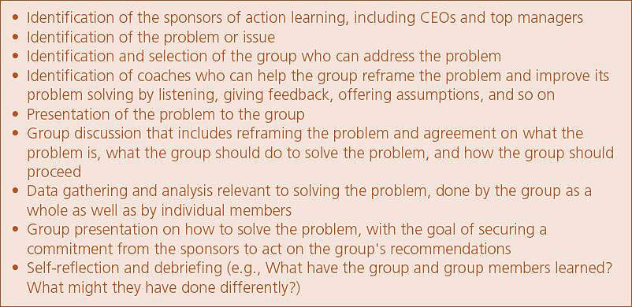
Table 7.10 - Steps in Action Learning

Slide 39
Group Building Methods
Six sigma
  Quality standard with a goal of no more than 3.4
defects per million processes
  Training involves several levels
  On completion employees become certified as green belts, champions, or black belts
Kaizen
  Focuses on continuous improvement of business processes

Slide 40
Choosing a Training Method
Identify the type of learning outcome
Consider the extent to which the learning method
facilitates
  Learning
  Transfer of training
Evaluate the related costs
Consider the effectiveness of training method

Slide 41
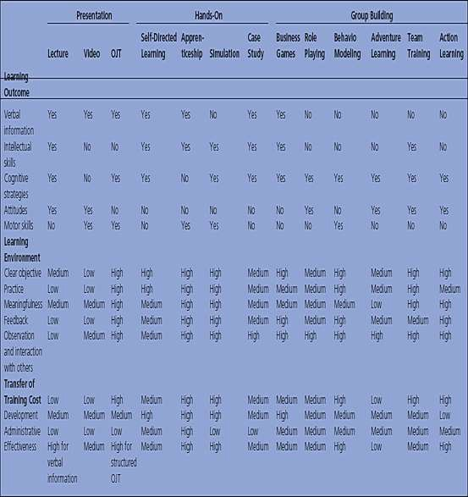
Table 7.11- Comparison of Training
Methods

