Slide 1







Training Evaluation
Chapter 6
6th Edition Raymond A. Noe
Copyright © 2013 by The McGraw-Hill Companies, Inc. All rights reserved.
McGraw-Hill/Irwin

Slide 2
Objectives
Explain why evaluation is important
Identify and choose outcomes to evaluate a training
program
Discuss the process used to plan and implement a good training evaluation
Discuss the strengths and weaknesses of different evaluation designs

Slide 3
Objectives
Choose the appropriate evaluation design based on the characteristics of the company and the importance and purpose of the training
Conduct a cost-benefit analysis for a training program
Explain the role of workforce analytics and dashboards in determining the value of training practices

Slide 4
Introduction
Training effectiveness: Benefits that the company and the trainees receive from training
Training outcomes or criteria: Measures that the trainer and the company use to evaluate training programs

Slide 5
Introduction
Training evaluation: The process of collecting the outcomes needed to determine if training is effective
Evaluation design: Collection of information, including whom, what, when, and how, for determining the effectiveness of the training program

Slide 6
Reasons for Evaluating Training
Companies make large investments in training and education and view them as a strategy to be successful; they expect the outcomes of training to be measurable
Training evaluation provides the data needed to demonstrate that training does provide benefits to the company
  It involves formative and summative evaluation

Slide 7
Formative Evaluation
Takes place during program design and development
  It helps ensure that the training program is well
organized and runs smoothly
  Trainees learn and are satisfied with the program
It provides information about how to make the program better; it involves collecting qualitative data about the program
Pilot testing: Process of previewing the training program with potential trainees and managers or with other customers

Slide 8
Summative Evaluation
Determines the extent to which trainees have changed as a result of participating in the training program
  It may include measuring the monetary benefits that the company receives from the program (ROI)
  It involves collecting quantitative data

Slide 9
Summative Evaluation
A training program should be evaluated:
  To identify the program’s strengths and weaknesses
  To assess whether content, organization, and administration of the program contribute to learning and the use of training content on the job
  To identify which trainees benefited most or least from
the program

Slide 10
Summative Evaluation
To gather data to assist in marketing training programs
To determine the financial benefits and costs of the
program
To compare the costs and benefits of:
  Training versus non-training investments
  Different training programs to choose the best program

Slide 11
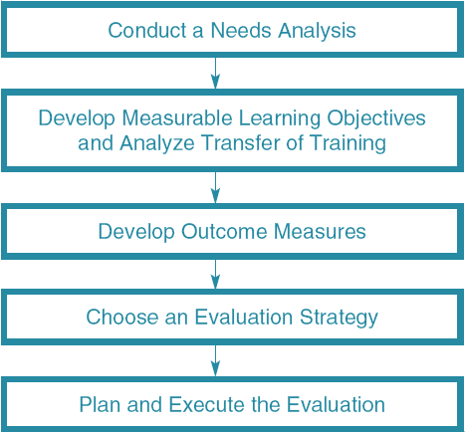
Figure 6.1 - The Evaluation Process

Slide 12
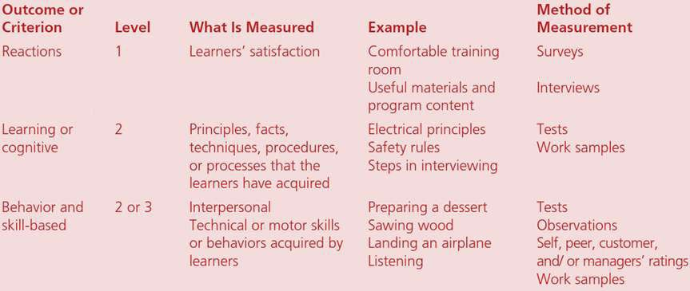
Table 6.1 - Evaluation Outcomes

Slide 13
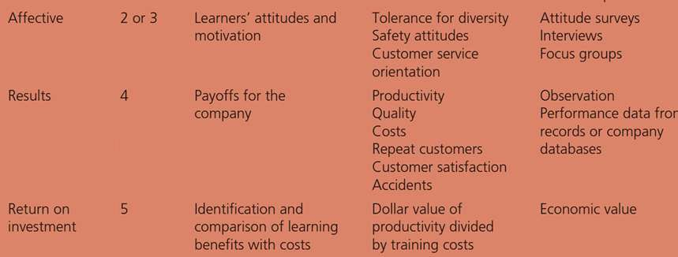
Table 6.1 - Evaluation Outcomes

Slide 14
Outcomes Used in the Evaluation of Training Programs
Reaction outcomes
  It is collected at the program’s conclusion
Cognitive outcomes
  Determine the degree to which trainees are familiar with the principles, techniques, and processes emphasized in the training program
Skill-based outcomes
  The extent to which trainees have learned skills can be evaluated by observing their performance in work samples such as simulators

Slide 15
Outcomes Used in the Evaluation of Training Programs
Affective outcomes
  If trainees were asked about their attitudes on a survey,
that would be considered a learning measure
Results: Used to determine the training program’s
payoff for the company

Slide 16
Outcomes Used in the Evaluation of Training Programs
Return on investment
  Direct costs: Salaries and benefits for all employees involved in training; program material and supplies; equipment or classroom rentals or purchases; and travel costs
  Indirect costs: Not related directly to the design,
development, or delivery of the training program
  Benefits: Value that the company gains from the training program

Slide 17
Outcomes Used in the Evaluation of Training Programs
Training Quality Index (TQI): Computer application that collects data about training department performance, productivity, budget, and courses, and allows detailed analysis of this data
  Quality of training is included in the effectiveness category

Slide 18
Determining Whether Outcomes are
Appropriate
Criteria Relevance | The extent to which training outcomes are related to the learned capabilities emphasized in the training program. Criterion contamination - the extent that training outcomes measure inappropriate capabilities or are affected by extraneous conditions. Criterion deficiency - the failure to measure training outcomes that were emphasized in the training objectives.
Reliability | The degree to which outcomes can be measured consistently over time.
Discrimination | The degree to which trainees’ performance on the outcome actually reflects true differences in performance.
Practicality | The ease with which the outcome measures can be collected.

Slide 19
Figure 6.2 - Criterion Deficiency, Relevance, and Contamination
Outcomes
Identified by Needs Assessment
and Included in Training Objectives
Outcomes Measured in Evaluation
Outcomes Related to Training Objectives
Contamination
Relevance
Deficiency

Slide 20
Evaluation Practices
It is important to recognize the limitations of choosing to measure only reaction and cognitive outcomes
  To ensure an adequate training evaluation, companies must collect outcome measures related to both learning and transfer

Slide 21
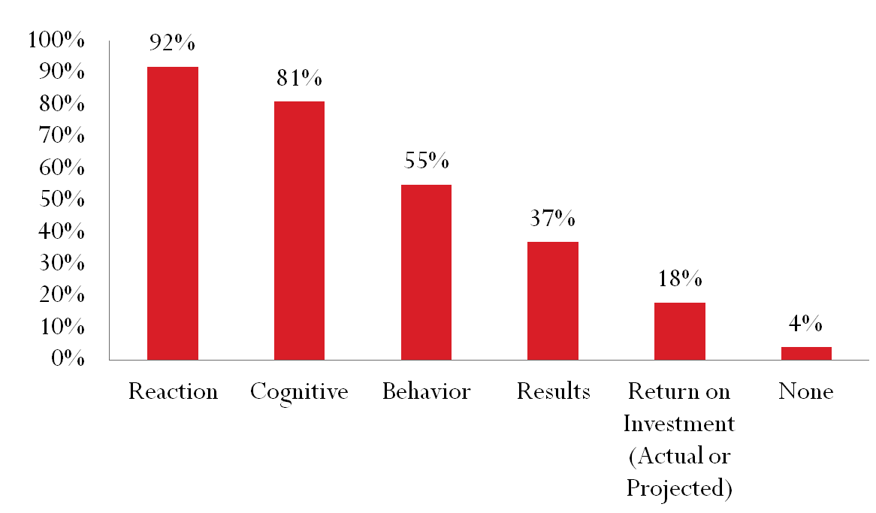
Figure 6.3 - Training Evaluation Practices
Percentage of Companies Using Outcome
Outcomes

Slide 22
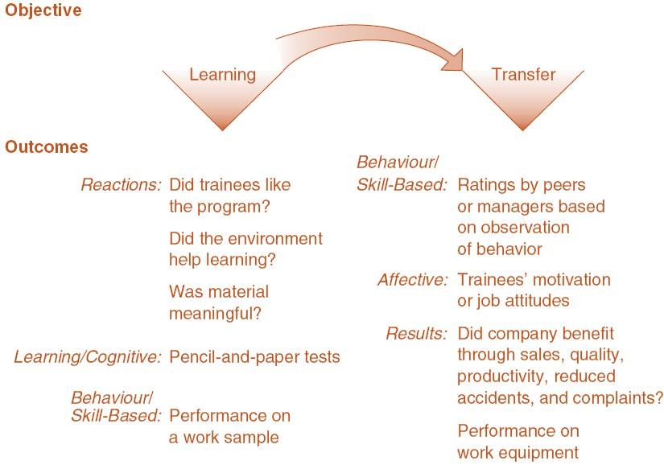
Objectives and Their Implications for Evaluation

Slide 23
Evaluation Designs
Threats to validity: Factors that will lead an evaluator to question either the:
  Internal validity: The believability of the study results
  External validity: The extent to which the evaluation results are generalizable to other groups of trainees and situations

Slide 24
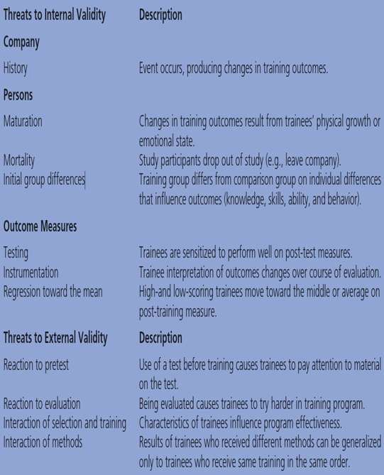
Table 6.6 - Threats to Validity

Slide 25
Methods to Control for Threats to Validity
Pretests and post-tests: Comparison of the post- training and pretraining measures can indicate the degree to which trainees have changed as a result of training
Use of comparison groups: Group of employees who participate in the evaluation study but do not attend the training program
  Hawthorne effect

Slide 26
Methods to Control for Threats to Validity
Random assignment: Assigning employees to the training or comparison group on the basis of chance alone
  It is often impractical
  Analysis of covariance

Slide 27
Types of Evaluation Designs
Post-test only: Only post-training outcomes are collected
  Appropriate when trainees can be expected to have similar levels of knowledge, behavior, or results outcomes prior to training
Pretest/post-test: Pretraining and post-training
outcome measures are collected
  Used by companies that want to evaluate a training program but are uncomfortable with excluding certain employees

Slide 28
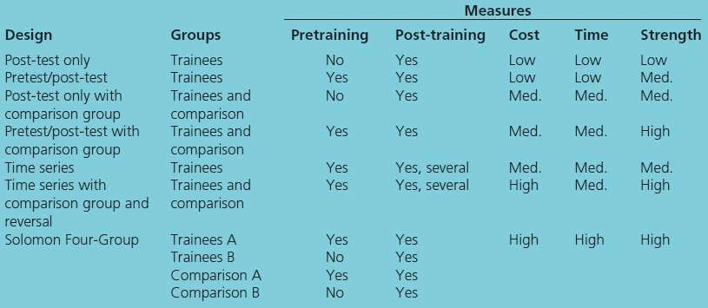
Table 6.7 Comparison of Evaluation Designs

Slide 29
Types of Evaluation Designs
Pretest/post-test with comparison group: Includes trainees and a comparison group
  Differences between each of the training conditions and the comparison group are analyzed determining whether differences between the groups were caused by training

Slide 30
Types of Evaluation Designs
Time series: Training outcomes are collected at periodic intervals both before and after training
  It allows an analysis of the stability of training outcomes
over time
  Reversal: Time period in which participants no longer receive the training intervention
Solomon four-group: Combines the pretest/post- test comparison group and the post-test-only control group design
  This design controls for most threats to internal and
external validity

Slide 31
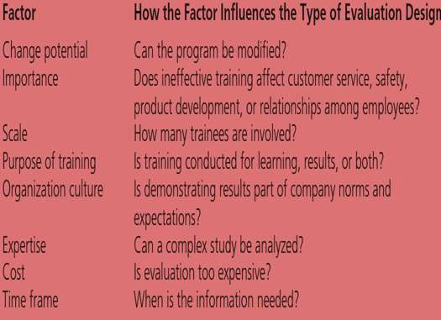
Table 6.10 - Factors that Influence the Type of Evaluation Design

Slide 32
Determining Return on Investment
Cost-benefit analysis: Process of determining the economic benefits of a training program using accounting methods that look at training costs and benefits
ROI should be limited only to certain training programs, because it can be costly
Determining costs
  Methods for comparing costs of alternative training programs include the resource requirements model and accounting

Slide 33
Determining Return on Investment
Determining benefits – Methods include:
  Technical, academic, and practitioner literature
  Pilot training programs and observance of successful job
performers
  Observance of successful job performers
  Estimates by trainees and their managers
To calculate ROI
  Identify outcomes
  Place a value on the outcomes
  Determine the change in performance after eliminating other potential influences on training results
  Obtain an annual amount of benefits
  Determine the training costs
  Calculate the total benefits by subtracting the training costs from benefits (operational results)
  Calculate the ROI by dividing operational results by costs
    The ROI gives an estimate of the dollar return expected from each
dollar invested in training

Slide 34
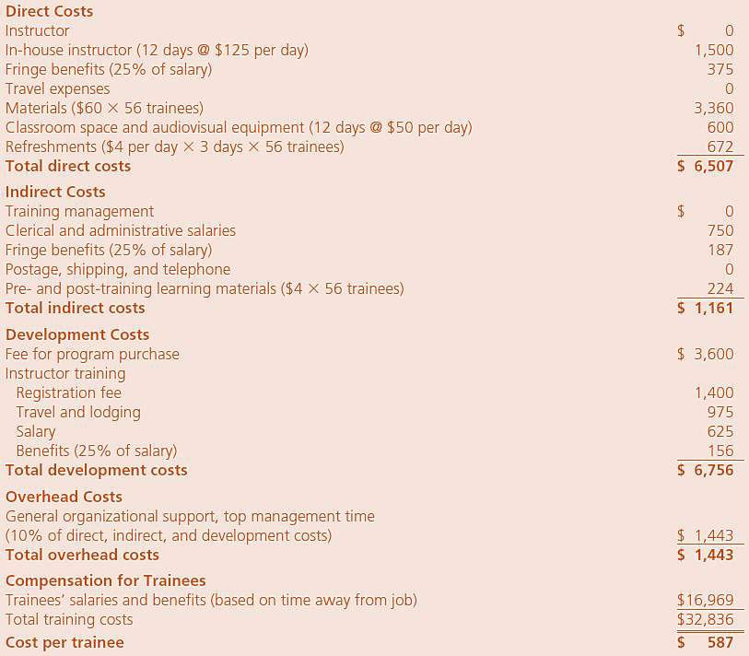
Table
6.11-
Determining Costs for a Cost Benefit Analysis

Slide 35
Determining Return on Investment
Utility analysis: Cost-benefit analysis method that involves assessing the dollar value of training based on:
  Estimates of the difference in job performance between trained and untrained employees
  The number of individuals trained
  The length of time a training program is expected to
influence performance
  The variability in job performance in the untrained group of employees

Slide 36
Practical Considerations in Determining ROI
Training programs best suited for ROI analysis:
  Have clearly identified outcomes
  Are not one-time events
  Are highly visible in the company
  Are strategically focused
  Have effects that can be isolated

Slide 37
Practical Considerations in Determining ROI
Showing the link between training and market share gain or other higher-level strategic business outcomes can be very problematic
  Outcomes can be influenced by too many other factors not directly related to training
  Business units may not be collecting the data needed
to identify the ROI of training programs
  Measurement of training can be expensive

Slide 38
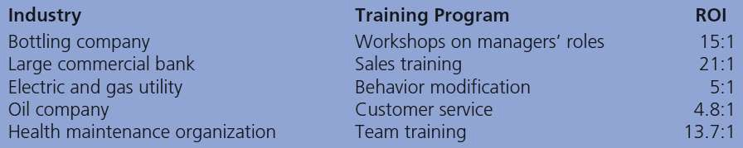
Table 6.13-Examples of ROI’s

Slide 39
Success Cases and Return on Expectations
Return on expectations (ROE): Process through which evaluation demonstrates to key business stakeholders that their expectations about training have been satisfied
Success cases: Concrete examples of the impact of training that show how learning has led to results that the company finds worthwhile

Slide 40
Measuring Human Capital and Training Activity
American Society of Training and Development (ASTD): Provides information about training hours and delivery methods that companies can use to benchmark
Workforce analytics: Practice of using quantitative methods and scientific methods to analyze data from human resource databases and other databases to influence important company metrics

Slide 41
Measuring Human Capital and Training Activity
Dashboards: Computer interface designed to receive and analyze the data from departments within the company to provide information to managers and other decision makers
  Useful because they can provide a visual display using charts of the relationship between learning activities and business performance data

Slide 42
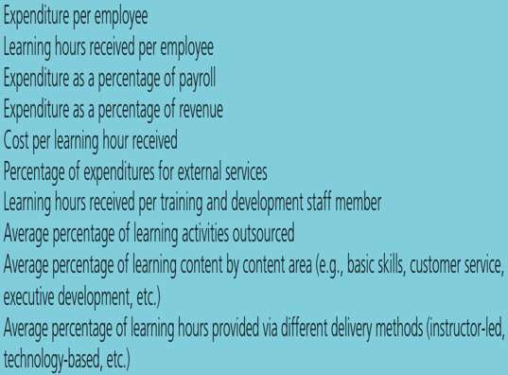
Table 6.14 - Training Metrics

