Slide 1


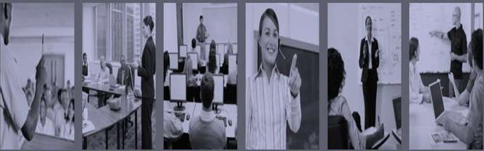




Learning and Transfer of
Training
Chapter 4
6th Edition Raymond A. Noe
McGraw-Hill/Irwin
Copyright © 2013 by The McGraw-Hill Companies, Inc. All rights reserved.

Slide 2
Objectives
Discuss the five types of learner outcomes
Explain the implications of learning theory for instructional
design
Incorporate adult learning theory into the design of a training program
Describe how learners receive, process, store, retrieve, and act upon information

Slide 3
Objectives
Discuss the internal conditions (within the learner) and external conditions (learning environment) necessary for the trainee to learn each type of capability
Discuss the implications of open and closed skills and near and far transfer for designing training programs
Explain the features of instruction and the work environment that are necessary for learning and transfer of training

Slide 4
Introduction
Certain conditions must be present for learning to occur:
  Provide opportunities for trainees to practice and receive feedback
  Offer meaningful training content
  Identify any prerequisites that trainees need to complete the program successfully
  Allow trainees to learn through observation and experience and
ensure that the work environment supports use of skills

Slide 5
Introduction
Transfer of training:Trainees effectively and continually applying what they have learned in training to their jobs
Generalization:Trainee’s ability to apply what they
learned to on-the job work problems
Maintenance: Process of trainees continuing to use what
they learned over time

Slide 6
Table 4.1 – Learning Outcomes
Type of Learning Outcome
Description of Capability
Example
Verbal information
State, tell, or describe previously stored information.
State three reasons for following company safety procedures.
Intellectual skills
Apply generalizable concepts and rules to solve problems and generate novel products.
Design and code a computer program that meets customer requirements.
Motor skills
Execute a physical action with
precision and timing.
Shoot a gun and consistently hit a
small moving target.
Attitudes
Choose a personal course of action.
Choose to respond to all incoming mail within 24 hours.
Cognitive strategies
Manage one's own thinking and learning processes.
Use three different strategies selectively to diagnose engine malfunctions.

Slide 7
Figure 4.1 A Model of Learning and Transfer of Training
Trainee Characteristics
Learning
Transfer of Training
Generalization
Maintenance
Training Design
Work Environment

Slide 8








Learning Theories
Reinforcement
Theory
Social Learning
Theory
Goal Theories
Need Theories
Expectancy Theory
Adult Learning Theory
Information Processing Theory

Slide 9
Reinforcement Theory
Emphasizes that people are motivated to perform or avoid certain behaviors because of past outcomes that have resulted from those behaviors
  Processes in reinforcement theory
    Positive reinforcement
    Negative reinforcement
    Extinction
    Punishment
The trainer needs to identify what outcomes the learner finds most positive and negative

Slide 10
Reinforcement Theory
Trainers then need to link these outcomes to learners acquiring knowledge, skills, or changing behaviours
Trainers can withhold or provide job-related, personal, and career-related benefits to learners who master program content
Behavior modification is a training method that is primarily based on reinforcement theory
  Employees were encouraged to increase the number of safe behaviors they demonstrated on the job

Slide 11
Social Learning Theory
Emphasizes that people learn by observing other persons (models) whom they believe are credible and knowledgeable
The theory recognizes that behavior that is reinforced or
rewarded tends to be repeated
Learning new skills or behavior comes from:
  Directly experiencing the consequences of using a behavior or
skill
  The process of observing others and seeing the consequences of their behavior

Slide 12
Social Learning Theory
Person’s self-efficacy can be increased using several methods
  Verbal persuasion
  Logical verification
  Observation of others (modeling)
  Past accomplishments

Slide 13
Figure 4.2 - Processes of Social Learning
Theory
Motor
Attention
Retention
Reproduction
Motivational Processes
Match Modeled Performance
Model Stimuli
• Trainee
Characteristics
Coding
Organization
Rehearsal
Physical
Capability
Accuracy
Feedback
Reinforcement

Slide 14
Goal Theories
Goal setting theory: Assumes that behavior results from a
person’s conscious goals and intentions
Goals influence a person’s behavior by:
  Directing energy and attention
  Sustaining effort over time
  Motivating the person to develop strategies for goal attainment

Slide 15
Goal Theories
Goal setting theory
  It is used in training program design
  It suggests that learning can be facilitated by providing trainees
with specific challenging goals and objectives
  The influence of goal setting theory can be seen in the development of training lesson plans

Slide 16
Goal Theories
Goal orientation: Goals held by a trainee in a learning situation
  Includes learning and performance orientation
  Learning orientation:Trying to increase ability or competence in a task
  Performance orientation: Learners who focus on task performance and how they compare to others

Slide 17
Goal Theories
Goal orientation
  It affects the amount of effort a trainee will expend in learning
(motivation to learn)
  Learners with a high learning orientation will direct greater attention to the task and learn for the sake of learning in comparison to learners with a performance orientation
  Learners with a performance orientation will direct more
attention to performing well and less effort to learning

Slide 18
Need Theories
Helps to explain the value that a person places on certain outcomes
Need: A deficiency that a person is experiencing at any
point in time
Maslow’s and Alderfer’s need theories focused on
physiological needs, relatedness needs, and growth needs

Slide 19
Need Theories
The major difference between Alderfer’s and Maslow’s hierarchies of needs is that Alderfer allows the possibility that if higher-level needs are not satisfied, employees will refocus on lower-level needs
McClelland’s need theory focused primarily on needs for
achievement, affiliation, and power

Slide 20
Need Theories
Suggest that to motivate learning, trainers should identify trainees’ needs and communicate how training program content relates to fulfilling these needs
  If certain basic needs of trainees are not met, they are unlikely to be motivated to learn
Implication of need theory relates to providing employees with a choice of training programs to attend

Slide 21
Expectancy Theory
It suggests that a person’s behavior is based on three factors:
  Expectancies: Link between trying to perform a behavior
and actually performing well
  Instrumentality: Belief that performing a given behavior is associated with a particular outcome
  Valence:Value that a person places on an outcome

Slide 22
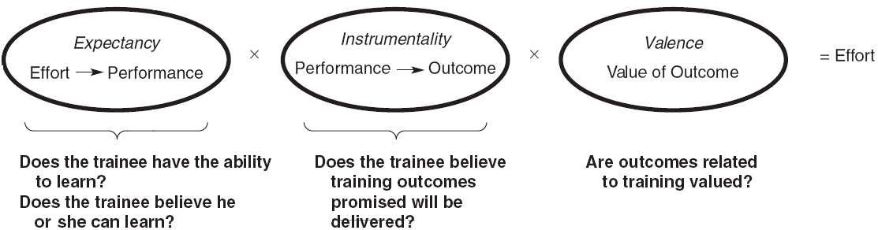
Figure 4.3 - Expectancy Theory of
Motivation

Slide 23
Adult Learning Theory
Was developed out of a need for a specific theory of how adults learn
Andragogy:Theory of adult learning

Slide 24
Adult Learning Theory
Assumptions of the theory
  Adults have the need to know why they are learning something
  Adults have a need to be self-directed
  Adults bring more work-related experiences into the learning situation
  Adults enter a learning experience with a problem-centered approach to learning
  Adults are motivated to learn by both extrinsic and intrinsic motivators

Slide 25
Table 4.2 - Implications of
Adult Learning Theory for Training
Design Issues
Self-concept Experience Readiness
Time Perspective Orientation to learning
Implications
Mutual planning and collaboration in instruction
Use learner experience as basis for examples and applications
Develop instruction based on the learner’s
interests and competencies
Immediate application of content
Problem-centered instead of subject- centered

Slide 26
Information Processing Theory
It gives more emphasis to the internal processes that occur when training content is learned and retained
Highlights external events influencing learning
  Changes in the intensity of the stimulus that affect attention
  Informing the learner of the objectives to establish an expectation
  Enhancing perceptual features of the material

Slide 27
Information Processing Theory
Verbal instructions, pictures, diagrams, and maps suggesting ways to code the training content so that it can be stored in memory
Meaningful learning context (examples, problems) creating cues that facilitate coding
Demonstration or verbal instructions helping to organize the learner’s response as well as facilitating the selection of the correct response

Slide 28
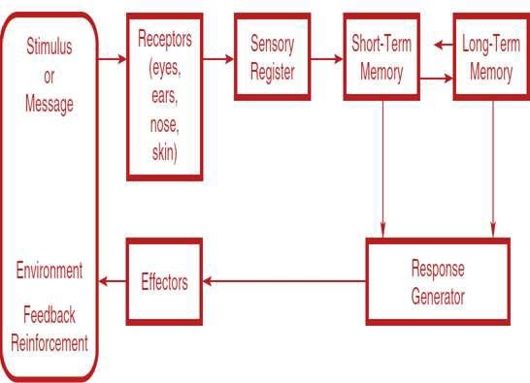
Figure 4.4 – A Model of Human Information
Processing

Slide 29
Transfer of Training Theory
Transfer of training is more difficult when tasks during training are different from the work environment
  Closed skills:Training objectives that are linked to learning specific skills that are to be identically produced by the trainee on their job
  Open skills: Linked to more general learning principles

Slide 30
Table 4.3 - Transfer of Training Theories
Theory
Emphasis
Appropriate Conditions
Type of Transfer
Identical elements
Training environment is identical to work environment.
Training focuses on closed skills
Work environment features are predictable and stable. Example:Training to use equipment.Training focuses
on open skills.
Near
Stimulus generalization
General principles are applicable to many different work situations.
Work environment is unpredictable and highly variable.
Example:Training
In interpersonal skills.
Far
Cognitive theory
Meaningful material and coding schemes
enhance storage and recall of training content.
All types of training and environments.
Near and far

Slide 31
The Learning Process
Mental and physical processes
  Expectancy: Mental state that the learner brings to the
instructional process
  Perception: Ability to organize the message from the environment so that it can be processed and acted upon
  Working storage: Rehearsal and repetition of information occurs
  Semantic encoding: Actual coding process of incoming messages

Slide 32
The Learning Process
Learning strategies
  Rehearsal: Focuses on learning through repetition
  Organizing: Requires the learner to find similarities and
themes in the training material
  Elaboration: Requires the trainee to relate the training material to other, more familiar knowledge

Slide 33
The Learning Process
The learning cycle involves four stages:
  Concrete experience
  Reflective observation
  Abstract conceptualization
  Active experimentation

Slide 34
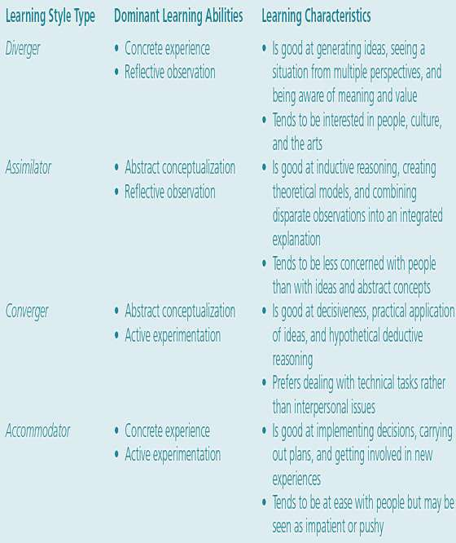
Table 4.5 – Learning Styles

Slide 35
The Learning Process
Instruction:Trainer’s manipulation of the environment in
order to help trainees learn
Training context:The physical, intellectual, and
emotional environment in which training occurs.
Practice: Physical or mental rehearsal of a task, knowledge, or skill to achieve proficiency in performing the task or skill or demonstrating the knowledge.

Slide 36
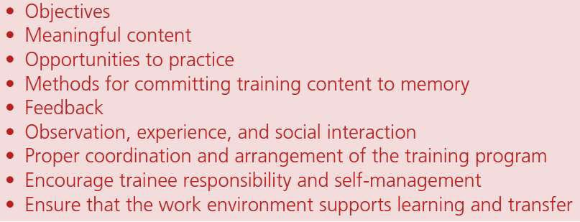
Table 4.6 - Features of Instruction and the Work Environment
that Facilitate Learning and Transfer of Training

Slide 37
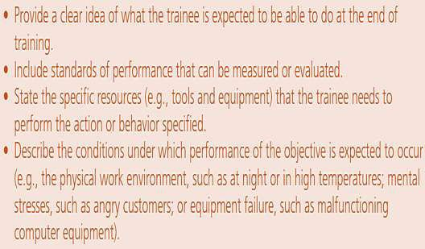
Table 4.8 - Characteristics of Good Training
Objectives

Slide 38
The Learning Process
Pre-practice conditions
  Provide information about the process or strategy
  Encourage trainees to develop a strategy (metacognition) to
reflect on their own learning process
  Provide advance organizers
  Help trainees set challenging learning goals
  Create realistic expectations
  Communicate performance expectations

Slide 39
The Learning Process
Overlearning:Trainees need to continue to practice even if they have been able to perform the objective several times
Error management training: Giving trainees opportunities to make errors during training and to learn from them
Massed practice: Individuals practice a task continuously, without resting

Slide 40
The Learning Process
Spaced practice: Individuals are given rest intervals within practice sessions
  Spaced practice is superior to massed practice
Overall task complexity: Degree to which a task requires a number of distinct behaviors, the number of choices involved in performing the task, and the degree of uncertainty in performing the task
Mental requirements: Degree to which the task requires the subject to use or demonstrate mental skills or cognitive skills or abilities to perform the task

Slide 41
The Learning Process
Physical requirements: Degree to which the task requires the person to use or demonstrate physical skills and abilities to perform and complete the task
Whole practice: All tasks or objectives should be practiced at the same time
Part practice: An objective or task should be practiced individually as soon as each is introduced in the training program
Practice must be related to the training objectives

Slide 42
The Learning Process
To create long-term memory, training programs must be explicit on content and elaborate on details
If a lengthy process or procedure is to be taught, instruction needs to be delivered in short sessions in order to not exceed memory limits
Automatization: Making performance of a task, recall of knowledge, or demonstration of a skill so automatic that it requires little thought or attention
Feedback: Information about how well people are meeting
the training objectives

Slide 43
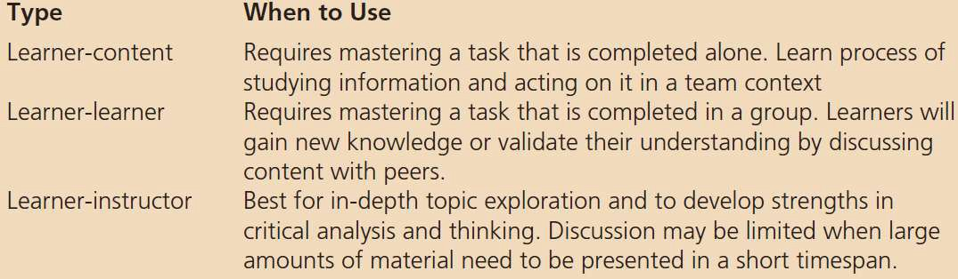
Table 4.12 - Three Types of Instructional
Interaction

Slide 44
The Learning Process
Employees learn through observation, experience, and interacting with others
Communities of practice: Groups of employees who work together, learn from each other, and develop a common understanding of how to get work accomplished

Slide 45
The Learning Process
Training administration: Coordinating activities before, during, and after the program
  Communicating courses and programs to employees
  Enrolling employees in courses and programs
  Preparing and processing any pretraining materials
  Preparing materials that will be used in instruction
  Arranging for the training facility and room
  Testing equipment that will be used in instruction
  Having backup equipment

Slide 46
The Learning Process
Providing support during instruction
Distributing evaluation materials
Facilitating communications between trainer and trainees
during and after training
Recording course completion in the trainees’ training records

Slide 47
Encourage Trainee Responsibility and Self-
Management
Self-management: Person’s attempt to control certain
aspects of decision making and behavior
  Determining the degree of support and negative consequences
in the work setting
  Setting goals for using learned capabilities
  Applying learned capabilities
  Monitoring use of learned capabilities
  Engaging in self-reinforcement

Slide 48
Ensure that the Work Environment Supports
Learning and Transfer
Lapses:Take place when the trainee uses previously learned, less effective capabilities instead of trying to apply the capability emphasized in the training program
Climate for transfer:Trainees’ perceptions about a wide variety of characteristics of the work environment that facilitate or inhibit the use of trained skills or behavior

Slide 49
Table 4.13 - Examples of Obstacles in the Work Environment That Inhibit Transfer of Training
Obstacle Work Conditions Description of Influence
Time pressures Inadequate equipment
Few opportunities to use skills Inadequate budget
Description of Influence
Trainee has difficulty using new knowledge, skills, or behavior.
Lack of Peer Support
Peers discourage use of new knowledge and skills on the job. Peers are unwilling to provide feedback.
Peers see training as waste of time.
Peers do not support use of new knowledge, skills, or behavior.
Lack of Management Support Managers do not reinforce training or provide opportunities to Management does not accept ideas or suggestions that are use new knowledge, skills, or behavior
learned in training.
Management does not discuss training opportunities. Management opposes use of skills learned in training. Management communicates that training is a waste of time. Management is unwilling to provide reinforcement, feedback, and encouragement needed for trainees
to use training content.

Slide 50
Instructional Emphasis for Learning Outcomes
Internal conditions: Processes within the learner that must be present for learning to occur
  Processes include how information is registered, stored in
memory, and recalled
External conditions: Processes in the learning environment that facilitate learning
  Include the physical learning environment

Slide 51
Table 4.15 - Internal and External Conditions
Necessary for Learning Outcomes
Learning Outcomes Verbal Information Labels, facts, and propositions | Internal Conditions Previously learned knowledge and verbal information Strategies for coding information into memory | External Conditions Repeated practice Meaningful chunks Advance organizers Recall cues
Intellectual Skills Knowing how |  | Link between new and previously learned knowledge
Cognitive Strategies Process of thinking and learning | Recall of prerequisites, similar tasks, and strategies | Verbal description of strategy Strategy demonstration Practice with feedback Variety of tasks that provide opportunity to apply strategy
Attitudes Choice of personal action | Mastery of prerequisites Identification with model Cognitive dissonance | Demonstration by a model Positive learning environment Strong message from credible source Reinforcement
Motor Skills Muscular actions | Recall of part skills Coordination program | Practice Demonstration Gradual decrease of external feedback

