Slide 1







Needs Assessment
Chapter 3
6th Edition Raymond A. Noe
Copyright © 2013 by The McGraw-Hill Companies, Inc. All rights reserved.
McGraw-Hill/Irwin

Slide 2
Objectives
Discuss the role of organization analysis, person analysis, and task analysis in needs assessment
Identify different methods used in needs assessment and identify the advantages and disadvantages of each method
Discuss the concerns of upper- and mid-level managers and trainers in needs assessment
Explain how personal characteristics, input, output, consequences, and feedback influence performance and learning

Slide 3
Objectives
Create conditions to ensure that employees are receptive to training
Discuss the steps involved in conducting a task
analysis
Analyze task analysis data to determine the
tasks for which people need to be trained
Explain competency models and the process used to develop them

Slide 4
Introduction
The design process begins with a needs assessment
Subsequent steps in the process include
  Ensuring that employees have the motivation and basic skills necessary to learn
  Creating a positive learning environment
  Making sure that trainees use learned skills on the job
  Choosing the training method and evaluating the
results
Needs assessment: Process used to determine
whether training is necessary

Slide 5
Introduction
Involves
  Organizational analysis: Determines the appropriateness of training, given the company’s business strategy and resources
  Person analysis: Determines
    Whether performance deficiencies result from a lack of
knowledge, skill, or ability
    Who needs training
    Employee readiness for training

Slide 6
Introduction
Task analysis: Identifies the important tasks and knowledge, skills, and behaviors that need to be emphasized in training for employees to complete their tasks

Slide 7
Why is Needs Assessment Necessary?
Training may be incorrectly used as a solution to a performance problem
Training programs may have the wrong content,
objectives, or methods
Trainees may be sent to training programs for which they do not have the basic skills, prerequisite skills, or confidence needed to learn

Slide 8
Why is Needs Assessment Necessary?
Training will not deliver the expected learning, behavior change, or financial results that the company expects
Money will be spent on training programs that are unnecessary because they are unrelated to the company’s business strategy

Slide 9
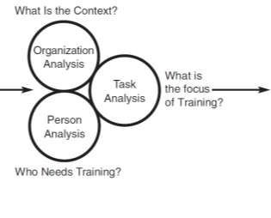
Figure 3.1 – Causes and Outcomes of
Needs Assessment
Reasons or “Pressure Points”
Legislation
Lack of Basic Skills
Poor Performance
New Technology
Customer Requests
New Products
Higher Performance Standards
New Jobs
Customer Dissatisfaction
Reduce Scrap
Improve Quality
Outcomes
• What Trainees Need to Learn
• Who Receives Training
• What Training Method is Appropriate
• Frequency of Training
• Buy versus Build Training Decision
• Training versus Other HR Options Such as Selection or Job Redesign
• How Training Should Be Evaluated
• How to Facilitate Transfer of Training

Slide 10
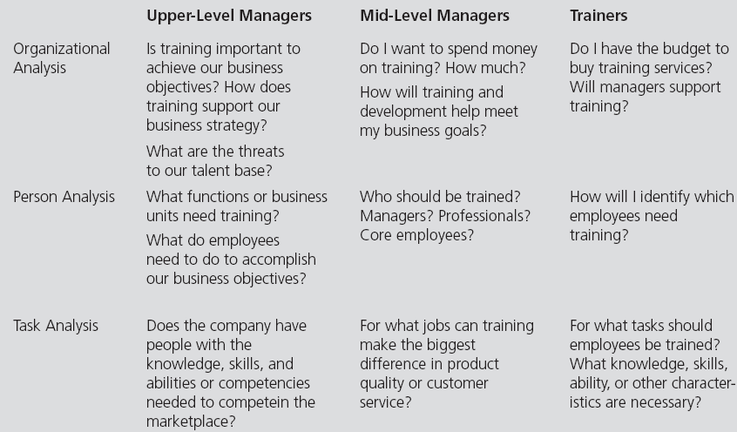
Table 3.1 – Key Concerns of Upper-Level and Mid-
Level Managers and Trainers in Needs Assessment

Slide 11
Who Should Participate in Needs
Assessment
Subject-matter experts (SMEs): Employees, academics, managers, technical experts, trainers, and even customers or suppliers who are knowledgeable with regard to
  Training issues
  Knowledge, skills, and abilities required for successful task performance
  Necessary equipment and conditions under which task has to be performed

Slide 12
Who Should Participate in Needs
Assessment
Job incumbents: Employees who are currently performing the job
It is important to get a sample of job incumbents
involved in the needs assessment because:
  They tend to be most knowledgeable about the job
  They can be a great hindrance to the training process if they do not feel they have had input in the process

Slide 13
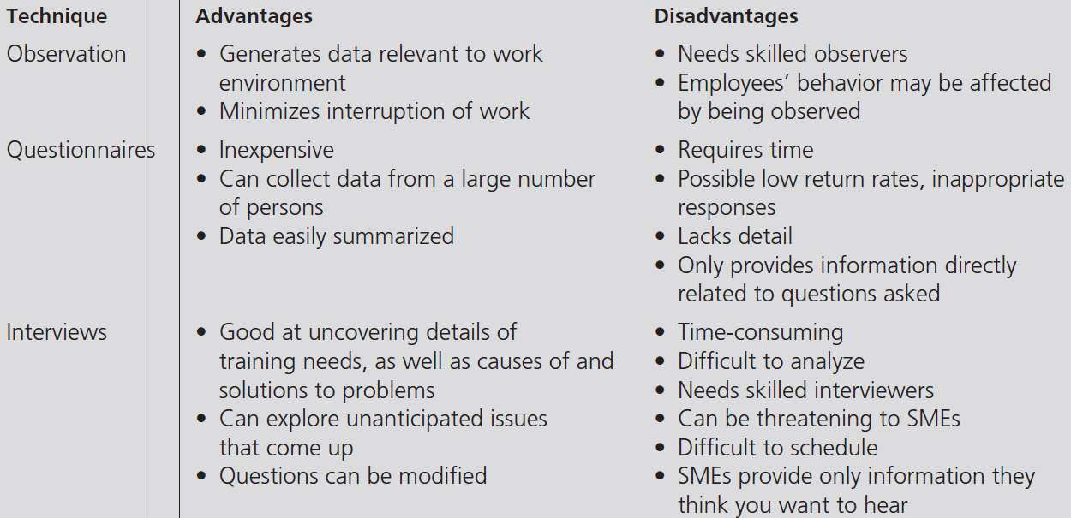
Table 3.2 – Advantages and Disadvantages
of Needs Assessment Techniques

Slide 14
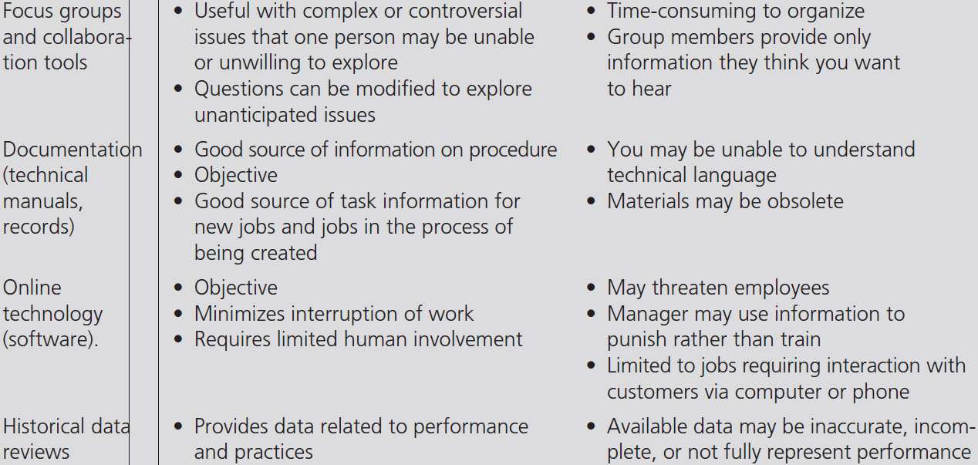
Table 3.2 – Advantages and Disadvantages
of Needs Assessment Techniques

Slide 15
Methods Used in Needs Assessment
For newly created jobs, trainers often do not have job incumbents to rely on for this information
Historical data review provides information regarding current performance levels
Online technology is available to monitor and track employee performance
Because no one technique of conducting needs assessment is superior to the others, multiple methods are used

Slide 16
Methods Used in Needs Assessment
Focus groups: Type of SME interview that involves a face-to-face meeting with groups of SMEs in which the questions that are asked relate to specific training needs
Crowdsourcing: Asking a large group of employees to help provide information for needs assessment that they are not traditionally asked to do
Benchmarking: Using information about other companies’ training practices to help determine the appropriate type, level, and frequency of
training

Slide 17
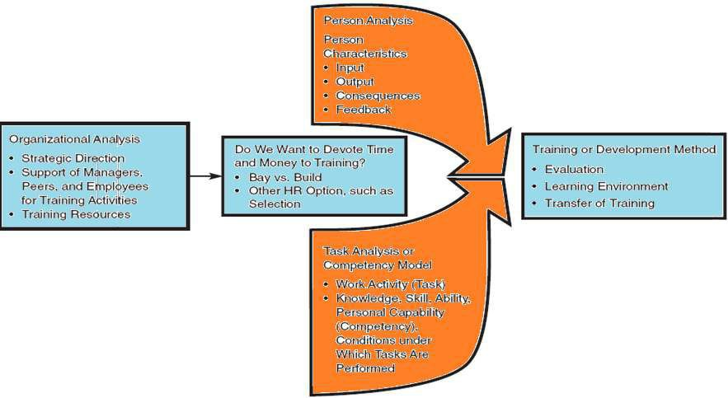
Figure 3.2 - The Needs Assessment
Process

Slide 18
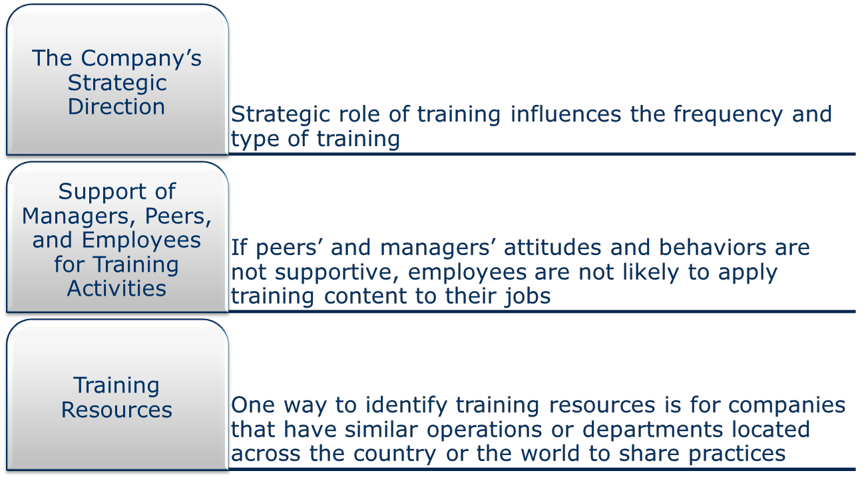
Organizational Analysis

Slide 19
Person Analysis
Helps to identify employees who need training
The need for training may result from the
pressure points
Readiness for training: Refers to whether:
  Employees have the personal characteristics necessary to learn program content and apply it on the job
  The work environment will facilitate learning and not interfere with performance

Slide 20
Person Analysis
This process includes evaluating person characteristics, input, output, consequences, and feedback
A major pressure point for training is substandard or poor performance
Another potential indicator of the need for training is if the job changes such that current levels of performance need to be improved or employees must be able to complete new tasks

Slide 21
Figure 3.3 – Process for Analyzing the Factors That Influence Employee Performance and Learning
Person Characteristics
Basic Skills
Cognitive Ability
Reading Level
Self-efficacy
Awareness of Training Needs, Career Interests, Goals,er
Age & Generation
+
Input
Understand What, How, When to Perform
Situational Constraints
Social Support
Opportunity to Perform
+
Output
Expectations for Learning and Performance
+
Consequences
Norms
Benefits
Rewards
+
Feedback
Frequency
Specificity
Detail
Motivation to Learn Learning
Job Performance
3-21

Slide 22
Person Analysis
Consequences: Type of incentives that employees receive for performing well
Feedback: Information that employees receive
while they are performing
Motivation to learn: Trainees’ desire to learn the
content of training programs
Personal characteristics include basic skills, cognitive ability, language skills, and other traits that employees need to perform their jobs or learn in training and development programs effectively

Slide 23
Basic Skills
Skills that are necessary for employees to perform on the job and learn the content of training programs successfully
  Cognitive ability
  Reading skills
  Writing skills

Slide 24
Cognitive Ability
Includes three dimensions:
  Verbal comprehension, quantitative ability, and
reasoning ability
Trainees’ level of cognitive ability also can influence how well they can learn in training programs
To identify employees without the cognitive ability to succeed on the job, companies use paper- and-pencil cognitive ability tests

Slide 25
Reading Ability
Readability: Difficulty level of written materials
Readability assessment usually involves analysis
of sentence length and word difficulty
If trainees’ reading level does not match the level needed for the training materials, four options are available
  Trainers can determine whether it is feasible to lower the reading level of training materials or on- the-job training
3-25

Slide 26
Reading Ability
Employees without the necessary reading level could be identified through reading tests and reassigned to other positions more congruent with their skill levels
Using reading tests, trainers can identify employees who lack the necessary reading skills and provide them with remedial training
Alternative training methods need to be considered, or managers can elect a nontraining option
To develop basic skills or close the skills gap,
many companies are engaging in skills
3-26

Slide 27
Self-Efficacy
Employees’ belief that they can perform their job or learn the content of the training program successfully
Employees’ self-efficacy level can be increased by:
  Letting employees know the purpose of training
  Providing as much information as possible about the training program and the purpose of training prior to the actual training

Slide 28
Self-Efficacy
Showing employees the training success of their peers who are now in similar jobs
Providing employees with feedback that learning is under their control and they have the ability and the responsibility to overcome any learning difficulties they experience in the program

Slide 29
Awareness of Training Needs, Career
Interests, and Goals
Managers should communicate the link between training and improvement of skill weaknesses or knowledge deficiencies
Employees need to be given a choice of what programs to attend and must understand how actual training assignments are made to maximize motivation to learn

Slide 30
Awareness of Training Needs, Career
Interests, and Goals
To ensure that the work environment enhances
trainees’ motivation to learn:
  Provide materials, time, job-related information, and other work aids necessary for employees to use new skills or behavior before participating in training programs
  Speak positively about the company’s training
programs to employees

Slide 31
Age and Generation
Millenniums and Generation Y (born after 1980): Optimistic, willing to work and learn, and technology-literate
Gen Xers (1965 to 1980): Need feedback and flexibility; they dislike close supervision
Baby boomers (1946 and 1964): Competitive, hardworking, and concerned that all employees be fairly treated

Slide 32
Traditionalists (1925 and 1945): Patriotic and loyal; great deal of knowledge of the history of organizations and work life
Age and Generation

Slide 33
Input
Situational constraints: Include lack of proper tools and equipment, materials and supplies, budgetary support, and time
Social support: Managers’ and peers’ willingness to provide feedback and reinforcement

Slide 34
Output, Consequences, and Feedback
Trainees need to understand what specifically they are expected to learn in the training program
Norms: Accepted standards of behavior for workgroup members
For employees to perform to standard, feedback needs to be given frequently, not just during a yearly performance evaluation

Slide 35
Determining Whether Training is the Best
Solution
If employees lack the knowledge and skill to perform a job and the other factors are satisfactory, training is needed
If employees have the knowledge and skill to perform but input, output, consequences, or feedback is inadequate, training may not be the best solution

Slide 36
Table 3.5 - Example of the Relationships Among a
Critical Job Issue, a Critical Process Issue, and a
Critical Business Issue
Critical Job Issue
Desired Results
No incomplete order forms 100% accurate orders Current Results
10% incomplete order forms
83% accurate orders
Critical Process Issue
Desired Results
Order cycle time of three
days
Critical Business Issue
Desired Results
Market share of 60%
Current Results
Market Share of 48%
Current Results
Order cycle time of thirty days

Slide 37
Task Analysis
Job: Specific position requiring the completion of certain tasks
Task: Employee’s work activity in a specific job

Slide 38
The Needs Assessment Process (cont.)
Knowledge – Includes facts or procedures
Skill – Indicates competency in performing a
task
Ability – Includes the physical and mental capacities to perform a task

Slide 39
Task Analysis
Steps involved in a task analysis
  Select the job or jobs to be analyzed
  Develop a preliminary list of tasks performed on
the job by:
    Interviewing and observing expert employees and their managers
    Talking with others who have performed a task analysis
  Validate or confirm the preliminary list of tasks
  Once the tasks have been identified, it is important to identify the knowledge, skills, or abilities necessary to successfully perform each task

Slide 40
Competency Models
Identifies the competencies necessary for each job
Competency models provide descriptions of competencies that are common for an entire occupation or organization
They can be used for:
  Performance management
  Identifying the best employees to fill open positions

Slide 41
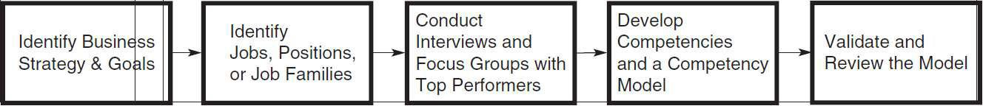
Figure 3.5 - Process Used in Developing
a Competency Model

Slide 42
Competency Models
Competency models are useful for training and development in several ways
  Identify behaviors needed for effective job
performance
  Evaluate the relationship between the company’s
current training programs and present needs

Slide 43
Competency Models
Provide a framework for ongoing coaching and feedback to develop employees for current and future roles
Help in succession planning
Help integrate and align the company’s HR
systems and practices

Slide 44
Scope of Needs Assessment
Rapid needs assessment: Needs assessment that is done quickly and accurately, but without sacrificing the quality of the process or the outcomes
There are several ways to conduct a rapid needs assessment
  Scope of needs assessment depends on the size of the potential pressure point

Slide 45
Scope of Needs Assessment
Consider using already available data collected for other purposes
If business problems, technological developments, and other issues facing the organization are attuned to, training needs can be anticipated

Slide 46
Needs Assessment in Practice
The manufacturing operations of the Owens- Corning insulation business were interested in increasing the productivity, product quality, and safety performance of the business
  Training was viewed as critical for helping the company meet its strategic objectives

Slide 47
Needs Assessment in Practice
Person analysis consisted of a survey of supervisor skills
Training programs were developed to improve the identified skill deficiencies through methods that were congruent with the plant environment and culture

