Slide 1
Strategic Training
Chapter 2
6th Edition Raymond A. Noe
Copyright © 2013 by The McGraw-Hill Companies, Inc. All rights reserved.
McGraw-Hill/Irwin

Slide 2
Learning Objectives
Discuss how business strategy influences the type and amount of training in a company
Describe the strategic training and development
process
Discuss how a company’s staffing and human resource planning strategies influence training
Explain the training needs created by concentration, internal growth external growth, and disinvestment business strategies

Slide 3
Learning Objectives
Discuss the advantages and disadvantages of centralizing the training function
Discuss the strengths of the business embedded
model for organizing the training function
Explain a corporate university and its benefits

Slide 4
Introduction
Business strategy
Integrates the company's goals, policies, and actions
Influences how the company uses:
Physical capital, financial capital, and human capital
Goals- What the company hopes to achieve in the medium- and long-term future

Slide 5
Introduction
Strategy determines:
Amount of training required for current or future job
skills
Extent to which training should be customized for particular needs
Extent to which training is restricted to specific groups
of employees or open to all
Extent to which training is planned and systematically administered
Importance placed on training compared to other HR
practices

Slide 6
Learning as a Strategic Focus
Learning organization: A company that has:
An enhanced capacity to learn, adapt, and change
Carefully scrutinized and aligned training processes
with company goals
Training as a part of system designed to create human capital

Slide 7
Table 2.1- Key Features of a Learning
Organization
Supportive Learning Environment
Employees feel safe expressing their thoughts about work, asking questions,
disagreeing with managers,
and admitting mistakes.
Different functional and cultural perspectives are appreciated.
Employees are encouraged to take risks, innovate, and explore the untested and unknown, such as trying new processes and developing new products and services.
Thoughtful review of the company’s processes is encouraged.
Learning Processes and Practices
Knowledge creation, dissemination, sharing, and application are practiced.
Systems are developed for creating, capturing, and sharing knowledge.
Managers Reinforce Learning
Managers actively question and listen to employees, encouraging dialogue and
debate.
Managers are willing to consider alternative points of view.
Time is devoted to problem identification, learning processes and practices, and
post-performance audits.
Learning is rewarded, promoted, and supported.

Slide 8
Implications of Learning for Human
Capital Development
Recognition that learning should help:
Employees improve performance
Achieve business goals
Learning should occur on as needed basis
Need to support informal learning
Learning should be supported psychologically

Slide 9
Implications of Learning for Human
Capital Development
Key capabilities
Aligning learning goals to business goals
Measuring of business impact of learning
Movement of learning outside the company
Developing competencies for critical jobs
Integrating learning with other human resource
functions
Including classroom as well as e-learning
Designing and delivering leadership development courses

Slide 10
Figure 2.1- The Strategic Training and
Development Process
Strategic Training & Development Initiatives
Training & Development Activities
Metrics That Show Value of Training
Business Strategy
Diversify the Learning Portfolio
Improve Customer Service
Accelerate the Pace of Employee Learning
Capture and Share Knowledge
Use Web-Based Training
Make Development
Planning Mandatory
Develop Web Sites for Knowledge Sharing
Increase Amount of Customer Service Training
Learning
Performance Improvement
Reduced Customer Complaints
Reduced Turnover
Employee Engagement

Slide 11
The Strategic Training and Development
Process
Mission: Company's reason for existing
Vision: Is the picture of the future that the company
wants to achieve
Values: What the company stands for
SWOT analysis
Internal analysis of strengths and weaknesses
External analysis of opportunities and threats
External analysis: Examining the operating environment to identify opportunities and threats

Slide 12
The Strategic Training and Development
Process
Internal analysis
Identifies the company’s strength and weaknesses
Examines the available quantity and quality of
financial, physical, and human capital
Strategic choice: The strategy believed to be the best alternative to achieve the company goals

Slide 13
Figure 2.2- Formulating the Business
Strategy
External Analysis
Opportunities Threats
Goals
Strategic Choice
Mission
Company Objectives
Why does the Company Exist?
How will we Compete?
Internal Analysis
Strengths Weaknesses

Slide 14
Table 2.2- Possible Business Goals
Influenced by Training
Productivity
Reduced scrap and rework Increased customer satisfaction
Reduced operational risks and accidents due to employee carelessness Increased employee satisfaction and retention
Increased time and value-producing goods, such as increase in billable project time
hours
Better management decisions
Increased development of human capital
Succession planning needed for competitive advantage and growth.

Slide 15
Table 2.3- Decisions a Company Must Make
About How to Compete to Reach its Goals
Where to compete?
In what markets (industries, products, etc.) will we compete?
How to compete?
On what outcome or differentiating characteristic will we compete?
Cost? Quality?
Reliability? Delivery? Innovativeness?
With what will w compete?
What resources will allow us to beat the competition? How will we acquire, develop,
and deploy those resources to compete?

Slide 16
Strategic training and development initiatives: Learning-related actions that help to achieve business strategy
The Strategic Training and Development
Process

Slide 17
Table 2.4- Strategic Training and Development Initiatives and Their ImpIliclaicattiioonns s
Strategic Training and Development Initiatives Diversify the Learning Portfolio
Use technology, such as the Internet, for training
Facilitate informal learning
Provide more personalized learning opportunities
Train customers, suppliers, and employees
Offer more learning opportunities to nonmanagerial employees
Quickly identify needs and provide a high-quality learning solution
Reduce the time to develop training programs
Facilitate access to learning resources on an as-needed basis
Ensure that employees have product and service knowledge
Ensure that employees have skills needed to interact with customers
Ensure that employees understand their roles and decision-making authority
Ensure that employees have opportunities to develop
Ensure that employees understand career opportunities and personal growth opportunities
Ensure that training and development addresses employees’ needs in current job as well as
growth opportunities
Capture insight and information from knowledgeable employees
Organize and store information logically
Provide methods to make information available (e.g., resource guides, websites)
Identify needed knowledge, skills, abilities, or competencies
Ensure that current training and development programs support the company’s strategic
needs
Remove constraints to learning, such as lack of time, resources, and equipment
Dedicate physical space to encourage teamwork, collaboration, creativity, and knowledge
sharing
Ensure that employees understand the importance of learning
Expand Who Is Trained
Accelerate the Pace of Employee Learning
Improve Customer Service
Provide Development Opportunities and Communicate with Employees
Capture and Share Knowledge
Align Training and Development with the Company’s Direction
Ensure that the Work Environment Supports Learning and Transfer of Training

Slide 18
Table 2.5 - Questions to Ask to Develop
1. What is the vision and missi_{I}o_{n}n _{i}o_{t}f_{i}t_{a}he_{ti}c_{v}om_{e}p_{s}any? Identify the strategic
Strategic Training and Development
drivers of the
business strategy.
2. What capabilities does the company need as a result of the business
strategy and
business environment challenges?
What types of training and development will best attract, retain, and
develop the
talent needed for success?
Which competencies are critical for company success and the business strategy?
Does the company have a plan for making the link between training and development
and the business strategy understood by executives, managers, and employees or
customers?
Will the senior management team publicly support and champion training and
development?
7. Does the company provide opportunities for training and developing not only
individuals but also teams?
2-18

Slide 19
The Strategic Training and Development
Process
Metrics
Business-level outcomes chosen to measure the
overall value of training or learning
Strategic business related measures not linked to one course or program
Balance scorecard
Means of measurement for:
Overall company performance
Performance of departments or functions

Slide 20
The Strategic Training and Development
Process (cont.)
Considers four perspectives
Customer
Internal innovation
Learning
Financial

Slide 21
Organizational Characteristics That
Influence Training
Role of employees and managers
Employees- Responsible for quality of goods and
services
Managers must:
Manage individual and performance
Develop employees and encourage continuous learning
Plan and allocate resources
Coordinate activities and interdependent team
Facilitate decision making
Create and maintain trust
Represent one’s work unit

Slide 22
Organizational Characteristics That
Influence Training
Top management support
The CEO is responsible for
Setting a clear direction for learning
Providing encouragement, resources and commitment for strategic learning
Governing learning and reviewing objectives
Developing new learning programs for the company
Teaching program or providing online resources
Serving as role model for learning
Promoting the companies commitment to learning

Slide 23
Organizational Characteristics That
Influence Training
Integration of business units
Training likely includes rotating employees between
jobs in different businesses
Global presence
Training helps prepare employees for temporary or long-term overseas assignments
Business conditions
Impact the ability to find employees with necessary skills, and retain current employees

Slide 24
Organizational Characteristics That
Influence Training
Other HRM practices
Human resource management (HRM) practices:
Activities related to:
Investments
Staffing
Performance management
Training
Compensation and benefits

Slide 25
Organizational Characteristics That
Influence Training
Staffing strategy: Company's decisions regarding:
Where to find employees
How to select them
The desired mix of employee skills and statuses

Slide 26
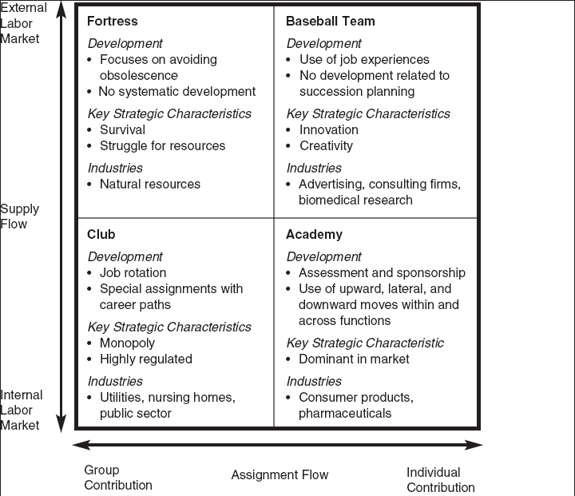
Figure 2.4 - Implications of Staffing
Strategy for Training

Slide 27
Organizational Characteristics That
Influence Training
Strategic value of Job and employee uniqueness
Uniqueness: Extent to which employees are rare and
specialized and not highly available
Strategic value
Employee potential to improve company effectiveness and efficiency
Results in four types of employees
Knowledge-based workers
Job-based employees
Contract employees
Alliance/partnerships

Slide 28
Organizational Characteristics That
Influence Training
Human resource planning
Identification, analysis, forecasting, and planning of changes to help meet changing business conditions

Slide 29
Organizational Characteristics That
Influence Training
Extent of unionization
Joint union-management programs help employees
prepare for new jobs
Staff involvement in training and development
Effectiveness of the training program depends on the level of involvement of:
Managers
Employees
Specialized development staff

Slide 30
Organizational Characteristics That
Influence Training (cont.)
Staff involvement in training and development
If line managers are aware of what development activity can achieve, they will be more willing to become involved in it.
They will also become more involved in the training process if they are rewarded for participating.
An emerging trend is that companies expect employees to initiate the training process.

Slide 31
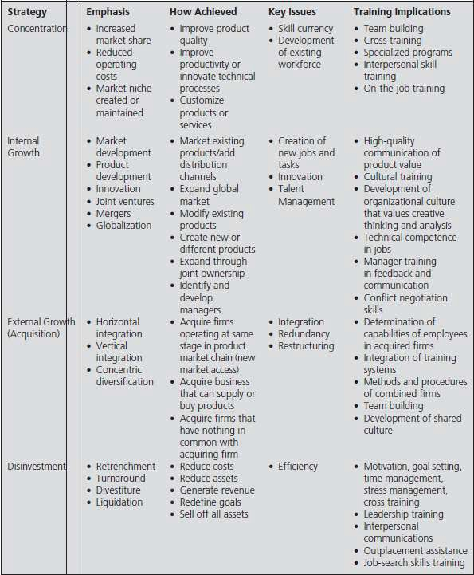
Table 2.7 - Implications of Business Strategy for Training

Slide 32
Training Needs in Different Strategies
Internal growth strategy
Focuses on new market and product development,
innovation, and joint ventures
External growth strategy
Emphasizes acquiring vendors and suppliers or buying businesses to expand into new markets
Disinvestment strategy: Emphasizes liquidation
and divestiture of businesses

Slide 33
Models of Organizing the Training
Department
Centralized training
Training and development resources, and
professionals are housed in one location
Training investment and delivery methods decisions are made from one department
Advantages- Helps integrate programs for developing
leaders and managing talent

Slide 34
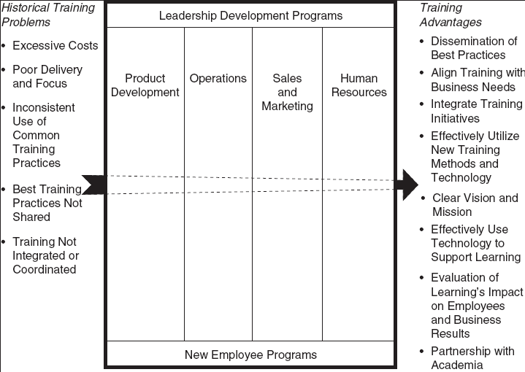
Figure 2.5- The Corporate University
Model

Slide 35
Table 2.9- Features of Training Function Organized by the BE Model
Strategic Direction
Broadly disseminates a clearly articulated mission Recognizes that its customer base is segmented Provides customized solutions to its clients’ needs Understands product life cycles
Organizes its offerings by competencies Competes for internal customers Product Design
Uses benchmarking and other innovative design Implements strategies to develop products quickly Involves suppliers strategically
Structural Versatility
Employs professionals who serve as product and classroom instructors, managers, and internal consultants
Uses resources from many areas
Involves line managers in determining the direction of the department’s offerings and content
Product Delivery
Offers a menu of learning options Delivers training at the work site Accountability for Results
Believes that individual employees must take responsibility for their personal growth Provides follow-up on the job to ensure that learning takes place
Considers the manager the key player in supporting learning Evaluates the strategic effects of training and it’s bottom-line results Guarantees that training will improve performance

Slide 36
Models of Organizing the Training
Department
The BE model with Centralized training
Allows the company to gain the benefits of centralized
training
Ensures that training content and delivery methods that are business specific

Slide 37
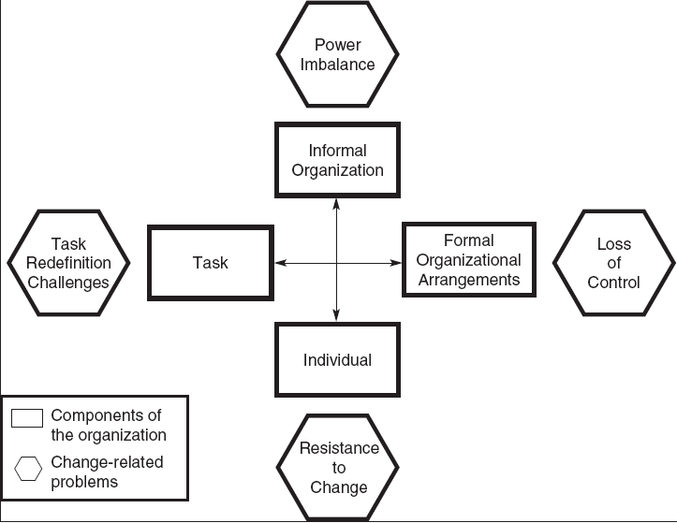
Figure 2.6- A Change Model

Slide 38
Models of Organizing the Training
Department
Resistance to change: Managers’ and employees’
unwillingness to change
Control: Managers’ and employees’ ability to obtain
and distribute valuable resources
Power: Ability to influence others
Task redefinition: Creating changes in managers’
and employees’ roles and job responsibilities

Slide 39
Table 2.10 Steps in a change process
Steps in a change process
Clarify the request for change Make the vision clear
Design the solution
Communicate and market for buy- in
Choose and announce action as soon as possible
Execute and create short term wins Follow up , reevaluate and modify

Slide 40
Marketing the Training and Creating A
Brand
Internal marketing-Making employees and managers excited about training
Internal marketing tactics
Involve the target audience in developing the training program
Demonstrate how a training program can be used to
solve specific business needs
Identify a “champion” who actively supports training
Listen and act on feedback received

Slide 41
Marketing the Training and Creating A
Brand
Advertise on e-mail, on company websites, and in employee break areas
Designate someone to interact between the training
designer and the business unit
Determine the financial gains top- level executives are concerned with
Don’t use jargon

Slide 42
Table 2.11- How to Build Training Brand
Ask current “customers” of training, including managers who purchase or ask for training and employees who participate in training what their perceptions are of the brand. For example, what emotions describe how they feel about the training brand? What words summarize their feelings? What conclusions have they made about doing business with you? Answers to these questions provide information regarding the strength of the training brand and if it is being perceived positively or as intended.
Define how you want to be perceived by current and future customers.
Identify factors that influence your customer’s perceptions of the training function.
Review each of the factors to determine if it is supporting and communicating the brand to your customers in a way that you intended.
Make changes so that each factor is supporting the brand.
Get customers feedback at each step of this process (define the brand, identify
factors, suggest changes, etc.).
When interacting with customers, create an experience that supports and identifies the brand.

Slide 43
Outsourcing Training
Outsourcing: Use of an outside company that takes:
Complete responsibility and control of some or all
training or development activities including
Administration
Design
Delivery
Development
Business process outsourcing
Outsourcing of any business process, such as HRM,
production, or training

Slide 44
Outsourcing Training
Advantages of outsourcing training:
Cost savings
Time savings
Improvements in compliance with training mandates
Access best training practices
Reasons companies do not outsource their training
Inability of outsourcing providers to meet company
needs
Desire to maintain control over all aspects of training and development

Slide 45
Table 2.12- Questions to Ask When
Considering Outsourcing
What are the capabilities of your in-house training function? Does the staff know enough that you can grow the training skills you need, or do you need to hire training skills from the outside?
Can your in-house training function take on additional training responsibilities?
Is training key to your company’s strategy? Is it proprietary?
Does your company value its training organization?
Does the training content change rapidly?
Are outsourced trainers viewed as experts, or are they viewed with cynicism?
Do you understand the strengths and weaknesses of your current training
programs?
Do you want to outsource the entire training function?
Are executive trying to minimize training’s impact on your company? Does
your company accept responsibility for building skills and talent?
Is a combination of internal and external training the best solution?

