Slide 1
Introduction to Employee
Training and Development
Chapter 1
Oeshwik Ahmed, Northern University, Faculty of HRM

Slide 2
Learning Objectives
Discuss the forces influencing the workplace and learning, and explain how training can help companies deal with these forces
Draw a figure or diagram and explain how training, development, informal learning, and knowledge management contribute to business success
Discuss various aspects of the training design
process

Slide 3
Learning Objectives
Describe the amount and types of training occurring in U.S. companies
Discuss the key roles for training professionals
Identify appropriate resources (e.g., journals, websites) for learning about training research and practice

Slide 4
Introduction
Competitiveness: Ability to maintain and gain market share in an industry
Human resource management: Policies, practices, and systems that influence employees’ behaviour, attitudes, and performance
Stakeholders: All parties that have an interest in seeing that the company succeeds

Slide 5
Training and Development: Key
Components of Learning
Learning: Acquiring knowledge, skills, competencies, attitudes, or behaviors
Human capital: Refers to:
Knowledge (know what)
Advanced skills (know how)
System understanding and creativity (know why)
Motivation to deliver high-quality products and services (care why)

Slide 6
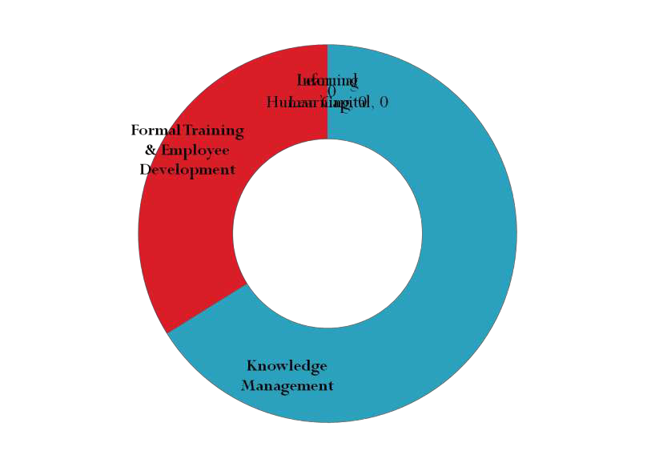
Figure 1.1-The Business Role of Training and Development
Informal
Learning
Learning Human Capital
Performance Improvement Reach Business Goals

Slide 7
Training and Development: Key
Components of Learning
Training: Facilitates learning job-related competencies, knowledge, skills or behavior
Development
Future focused
Includes:
Formal education, job experiences, relationship
Assessments of personality, skills, and abilities
Formal training and development
Programs, courses, and events that are developed
and organized by the company

Slide 8
Training and Development: Key
Components of Learning
Informal learning
Learner initiated
Occurs without a trainer or instructor
Motivated by an intent to develop
Does not occur in a formal learning setting
Breadth, depth, and timing is controlled by the employee
Explicit knowledge
Well documented, easily articulated, and easily
transferred from person-to-person

Slide 9
Training and Development: Key
Components of Learning
Primary focus of formal training and development
Tacit knowledge
Personal knowledge based on individual
experiences that is difficult to codify
Result of informal learning
Knowledge management
Process of enhancing company performance by designing and implementing:
Tools, processes, systems, structures, and cultures to
improve the creation, sharing, and use of knowledge

Slide 10
Designing Effective Training
Training design process
Systematic approach for developing training
programs
Based on the principles of Instructional System Design (ISD)
ADDIE model- Analysis, design, development, implementation, and evaluation
Should be systematic yet flexible to adapt to business needs

Slide 11
Figure 1.2 - Training Design Process
1. Conducting Needs Assessment
3. Creating a Learning Environment
Learning Objectives Meaningful Material
Practice Feedback
Community of Learning Modeling
Program Administration
2. Ensuring Employees’
Readiness for Training
Attitudes and Motivation Basic Skills
Organizational Analysis’
Personal Analysis Task Analysis
5. Developing an Evaluation Plan
Identify Learning Outcomes Choose Evaluation Design Plan Cost-Benefit Analysis
4. Ensuring Transfer of Training
Self-Management
Peer and Manger Support
7. Monitoring and Evaluating the Program
Conduct Evaluation
Make Changes to Improve the Program
6. Selecting Training Method Traditional
E-Learning

Slide 12
Designing Effective Training
Flaws of the ISD model
Step by-step approach is rarely followed in real life
organizations
Necessary requirement of trainers adds time and cost to developing a training program
Implies an end point: evaluation
May lead to assumption that training is the best solution

Slide 13
Table 1.1 - Forces Influencing
Working and Learning
Economic cycles
Globalization
Increased value placed on intangible assets and human capital
Focus on link to business strategy Changing demographics and diversity of the workforce
Talent management
Customer service and quality emphasis New technology
High-performance work systems

Slide 14
Globalization
Offshoring: Process of moving jobs from the United States to other locations in the world
Advantage- Lower labor costs
Disadvantage
Low standards of health and safety
Lack of necessary skills to perform the job

Slide 15
Assets
Human Capital
Tacit knowledge
Education
Work-related know-how
Work-related competence
Customer Capital
Customer relationships
Brands
Customer loyalty
Distribution channels
Social Capital
Corporate culture
Management philosophy
Management practices
Informal networking systems
Coaching/mentoring relationships
Intellectual Capital
Patents
Copyrights
Trade secrets
Intellectual property

Slide 16
Increased Value Placed on
Intangible Assets and Human
Capital
Human capital: Refers to employees’
Attributes
Life experiences
Knowledge
Inventiveness
Energy and enthusiasm
Intellectual capital: Codified knowledge that exists in a company
Social capital: Relationships in the company

Slide 17
Increased Value Placed on Intangible
Assets and Human Capital
Customer capital: Value of relationships with persons or other organizations
Implications of intangible assets and human
capital
Focus on knowledge worker
Employees who contribute to the company not through specialized body of knowledge
Employee engagement
Degree to which employees are fully involved in their work
Strength of employee engagement
Attitude or opinion surveys measure level of engagement

Slide 18
Increased Value Placed on Intangible
Assets and Human Capital
Change and continuous learning
Change: Adoption of a new idea or behavior by a company
Learning organization
Culture of lifelong learning
Enables all employees to continually acquire and share knowledge
Requires financial, time, and content resources

Slide 19
Changing Demographics and
Diversity of the Work Force
Increase in racial and ethnic diversity
Ethnically and racially diverse labor force
Increased participation of minorities in the work
force
Aging labor force
Increased work-force participation of individuals 55 years or greater
Generational differences

Slide 20
Changing Demographics and
Diversity of the Work Force
To manage diversity managers and employees must be trained in:
Communicating effectively
Coaching, training, and developing
Providing performance feedback that is free of stereo types
Recognizing and responding to generational differences
Allowing employees of all backgrounds to be
creative and innovative

Slide 21
Talent Management
Systematic, planned, and strategic effort by a company
To attract, retain, develop, and motivate highly
skilled employees and managers
Involves
acquiring and assessing employees
learning and development
performance management, and compensation

Slide 22
Talent Management
Is important due to:
Changes in demand for certain occupations and
jobs
Skill requirement
Anticipated retirement of baby boomer generation
Requirement to develop managerial talent

Slide 23
Customer Service and Quality
Emphasis
Total Quality Management (TQM)
Companywide effort to continuously improve the ways people, machines, and systems accomplish work
Core values of TQM
Methods and processes designed to meet the needs of internal and external customers
Every employee receives training in quality
Errors are prevented from occurring rather than
being detected and corrected

Slide 24
Customer Service and Quality
Emphasis
Promotes cooperation with vendors, suppliers, and customers
Measures progress with feedback based on data
Quality standards
Malcolm Baldrige National Quality Award
 ISO 9000
Family of standards related to quality
Address what the company does to meet regulatory requirements

Slide 25
Customer Service and Quality
Emphasis
Six Sigma process
Measuring, analyzing, improving, and then
controlling processes once:
They have been brought within the narrow six sigma quality tolerances or standards
Training helps by
Teaching employees statistical process control
Engaging in “lean” processes

Slide 26
Customer Service and Quality
Emphasis
Lean thinking
Doing more with less effort, equipment, space, and
time, but satisfying consumer needs and wants
 ISO 10015
Ensures that training is linked to company needs and performance

Slide 27
New Technology
Influence on training
Makes training more realistic
Allows flexibility of time and any place
Reduces travel costs
Provides greater accessibility and consistency
Increased ability to access experts and share learning with others
Creates a learning environment that provides feedback, self-pacing, and practice exercises
Allows greater use of alternative work
arrangements

Slide 28
High performance models of work
systems
Work teams
Employees with various skills interact to assemble
a product or provide a service
Cross training
Training employees in a wide range of skills to fill any of the roles needed to be performed

Slide 29
High performance models of work
systems
Virtual teams
Separated by time, geographic, cultural, and/or
organizational boundaries
Rely on technology to interact and complete their projects

Slide 30
Snapshot of Training Practices
Key trends in learning initiative investments:
Direct expenditures, has remained stable over the
last several years
Increased demand for specialized learning that
Use of technology-based learning delivery increased from 11%in 2001 to 29 %in 2010
Self-paced online learning is the most popular technology-based learning

Slide 31
Snapshot of Training Practices
Technology-based learning
Has improved learning efficiency
Has resulted in a larger employee–learning staff member ratio
Percentage of services distributed by external providers dropped from 29 % in 2004 to 23 % in 2010.

Slide 32
Table 1.8 - Characteristics of BEST
Award Winners
Alignment of business strategy with training and development
Visible support from senior executives
Efficiency in training and development through internal process improvements, use of technology, and outsourcing
Effective practices by aligning training and development to business needs and providing all employees with access to training and development on an as-needed basis Investment in training and development
Different learning opportunities provided
Measurement of effectiveness and efficiency of training and
development activities
Non-training solutions for performance improvement used, including organization development and process improvement

Slide 33
Snapshot of Training Practices
Who provides training
Trainers, managers, in-house consultants, and employee experts
Outsourcing: Training and development activities provided by individuals outside the company

Slide 34
Snapshot of Training Practices
Who is in charge of training
Professionals in human resources and human resource development
Human resource development
Integrated use of training and development, organizational development, and career development :
To improve individual, group, and organizational effectiveness

